Slide 1
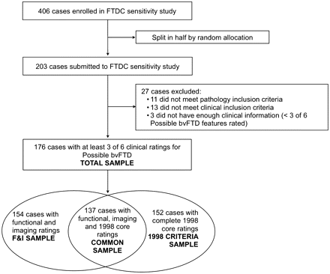
Figure 1 Case selection and description of samples. bvFTD = behavioural variant FTD; F&I = functional disability and ...
Notes:
Figure 1 Case selection and description of samples. bvFTD = behavioural variant FTD; F&I = functional disability and neuroimaging.
Unless provided in the caption above, the following copyright applies to the content of this slide: © The Author (2011). Published by Oxford University Press on behalf of the Guarantors of Brain. All rights reserved. For Permissions, please email: journals.permissions@oup.com

Slide 2
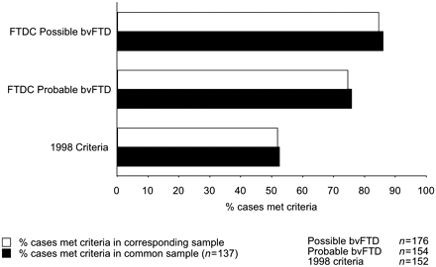
Figure 2 Sensitivity of FTDC and 1998 criteria as per cent of cases that met criteria in the corresponding sample ...
Notes:
Figure 2 Sensitivity of FTDC and 1998 criteria as per cent of cases that met criteria in the corresponding sample (white bars) or the common sample (black bars). bvFTD = behavioural variant FTD.
Unless provided in the caption above, the following copyright applies to the content of this slide: © The Author (2011). Published by Oxford University Press on behalf of the Guarantors of Brain. All rights reserved. For Permissions, please email: journals.permissions@oup.com

Slide 3
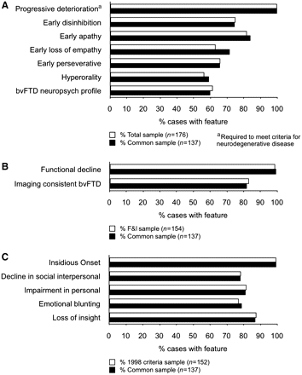
Figure 3 Frequency of individual features for (A) possible bvFTD, (B) probable bvFTD and (C) 1998 core criteria. ...
Notes:
Figure 3 Frequency of individual features for (A) possible bvFTD, (B) probable bvFTD and (C) 1998 core criteria. Frequency is shown as percentage of cases in the corresponding sample (white bars) or the common sample (black bars). bvFTD = behavioural variant FTD; F&I = functional disability and neuroimaging.
Unless provided in the caption above, the following copyright applies to the content of this slide: © The Author (2011). Published by Oxford University Press on behalf of the Guarantors of Brain. All rights reserved. For Permissions, please email: journals.permissions@oup.com

Slide 4
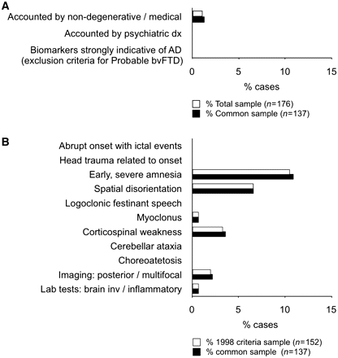
Figure 4 Frequency of exclusionary features for (A) FTDC criteria and (B) 1998 criteria. Frequency is shown as ...
Notes:
Figure 4 Frequency of exclusionary features for (A) FTDC criteria and (B) 1998 criteria. Frequency is shown as percentage of cases in the corresponding sample (clear bars) or the common sample (black bars). Two cases were homozygous for the ApoE e4 allele, but ApoE status was not considered a strong biomarker for Alzheimer’s disease (AD).
Unless provided in the caption above, the following copyright applies to the content of this slide: © The Author (2011). Published by Oxford University Press on behalf of the Guarantors of Brain. All rights reserved. For Permissions, please email: journals.permissions@oup.com

Slide 5
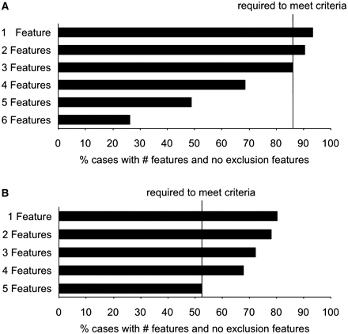
Figure 5 Sensitivity of FTDC and 1998 criteria by number of features for (A) FTDC possible behavioural variant FTD and ...
Notes:
Figure 5 Sensitivity of FTDC and 1998 criteria by number of features for (A) FTDC possible behavioural variant FTD and (B) 1998 criteria (common sample, n = 137). Black bars show percent of cases with specified number of diagnostic features and no exclusion features.
Unless provided in the caption above, the following copyright applies to the content of this slide: © The Author (2011). Published by Oxford University Press on behalf of the Guarantors of Brain. All rights reserved. For Permissions, please email: journals.permissions@oup.com

