Slide 1
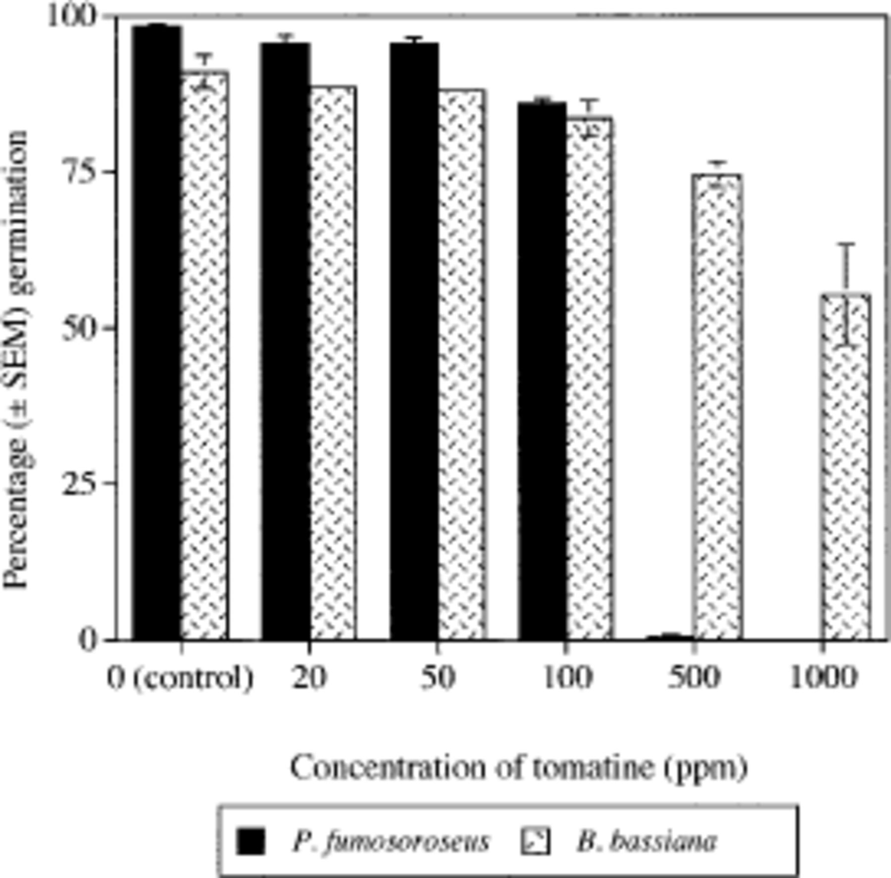
Fig. 1. Effect of a range of concentrations of the glycoalkaloid tomatine on germination of B. bassiana and P. ...
Notes:
Fig. 1. Effect of a range of concentrations of the glycoalkaloid tomatine on germination of B. bassiana and P. fumosoroseus conidia on Noble agar medium at 27°C.
Unless provided in the caption above, the following copyright applies to the content of this slide: © 2000 Entomological Society of America

