Slide 1
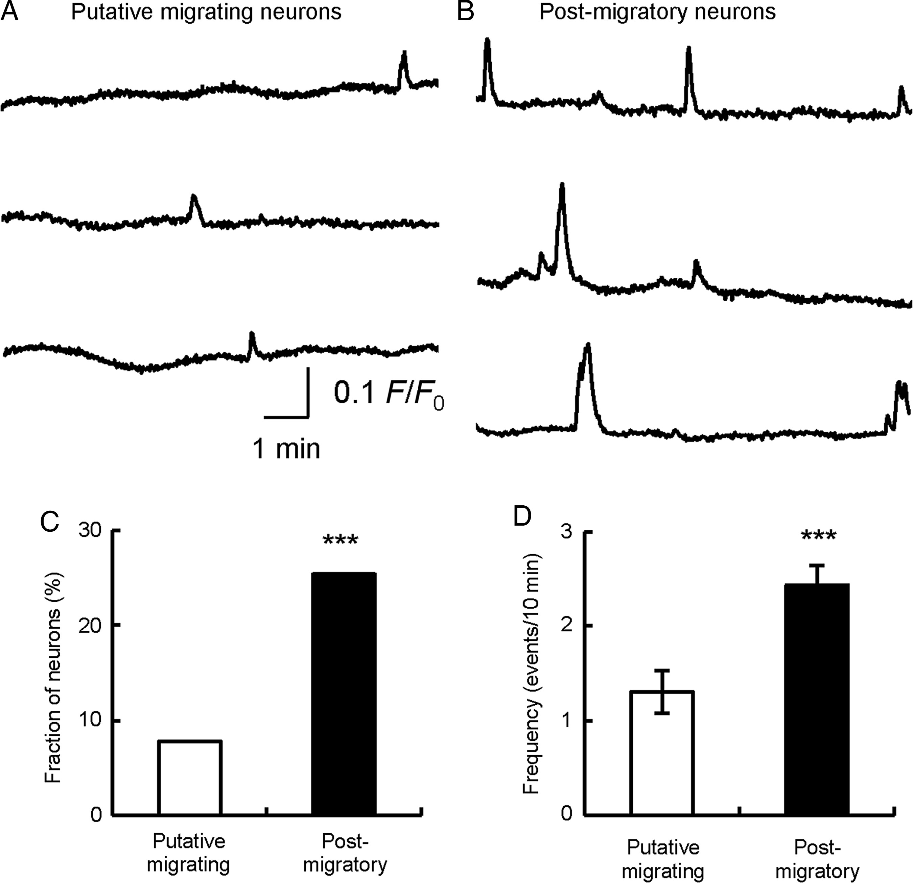
Figure 1. The pattern of spontaneous calcium transients in the developing cortical neurons. (A and B) Representative ...
Notes:
Figure 1. The pattern of spontaneous calcium transients in the developing cortical neurons. (A and B) Representative time courses of spontaneous calcium transients during 10-min recordings. Time courses of calcium transients of GCaMP3-expressing neurons in layers IV–VI, presumably during migration (A), and in layer II/III, presumably after migration (B). (C) Fraction of neurons showing calcium transients. ***P < 0.001, χ2 test. (D) Frequency of calcium transients. Mean ± SEM is presented. ***P < 0.001, Student's t-test.
Unless provided in the caption above, the following copyright applies to the content of this slide: © The Author 2014. Published by Oxford University Press. All rights reserved. For Permissions, please e-mail: journals.permissions@oup.com

Slide 2
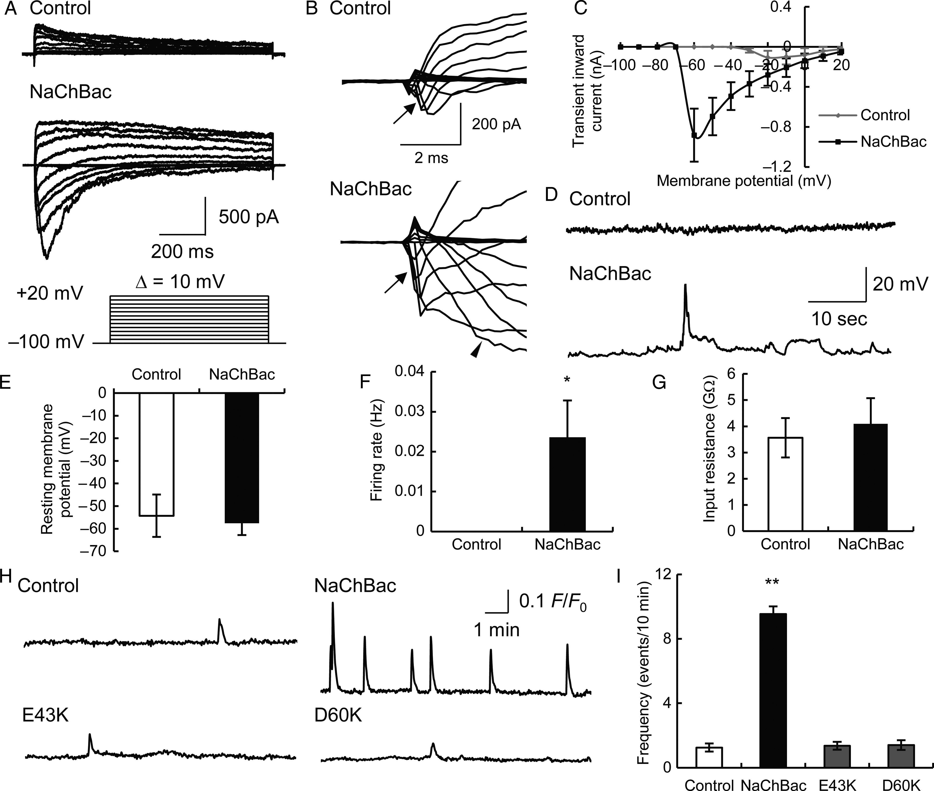
Figure 2. Increase of neural activity in layer II/III neurons induced by expression of a prokaryotic voltage-gated ...
Notes:
Figure 2. Increase of neural activity in layer II/III neurons induced by expression of a prokaryotic voltage-gated sodium channel, NaChBac. (A) Current responses to depolarizing voltage steps, recorded from electroporated neurons in deep CP and IZ at P0 and P1. (B) Initial phases of current responses shown in A are presented. A large, sustained inward current was recorded only from NaChBac-expressing neurons, in response to depolarizing voltage steps from −100 mV (arrowhead). Note small, fast inward current recorded from both control and NaChBac-expressing neurons (arrows), suggesting endogenous expression of voltage-gated sodium channels. (C) Current–voltage relationship of the peak inward current. (D) Representative time courses of membrane potential recorded in a current-clamp mode. (E–G) Resting potential (E), spontaneous firing rate (F), and input resistance (G) of neurons expressing EGFP with or without NaChBac. *P < 0.05, Student's t-test. (H) Spontaneous calcium transients in neurons expressing only GCaMP3 (control), GCaMP3, and wild-type NaChBac (NaChBac), E43K or D60K mutants. (I) The number of calcium transients during 10-min recordings. Mean ± SEM is presented. **P < 0.01, Dunnett's test.
Unless provided in the caption above, the following copyright applies to the content of this slide: © The Author 2014. Published by Oxford University Press. All rights reserved. For Permissions, please e-mail: journals.permissions@oup.com

Slide 3
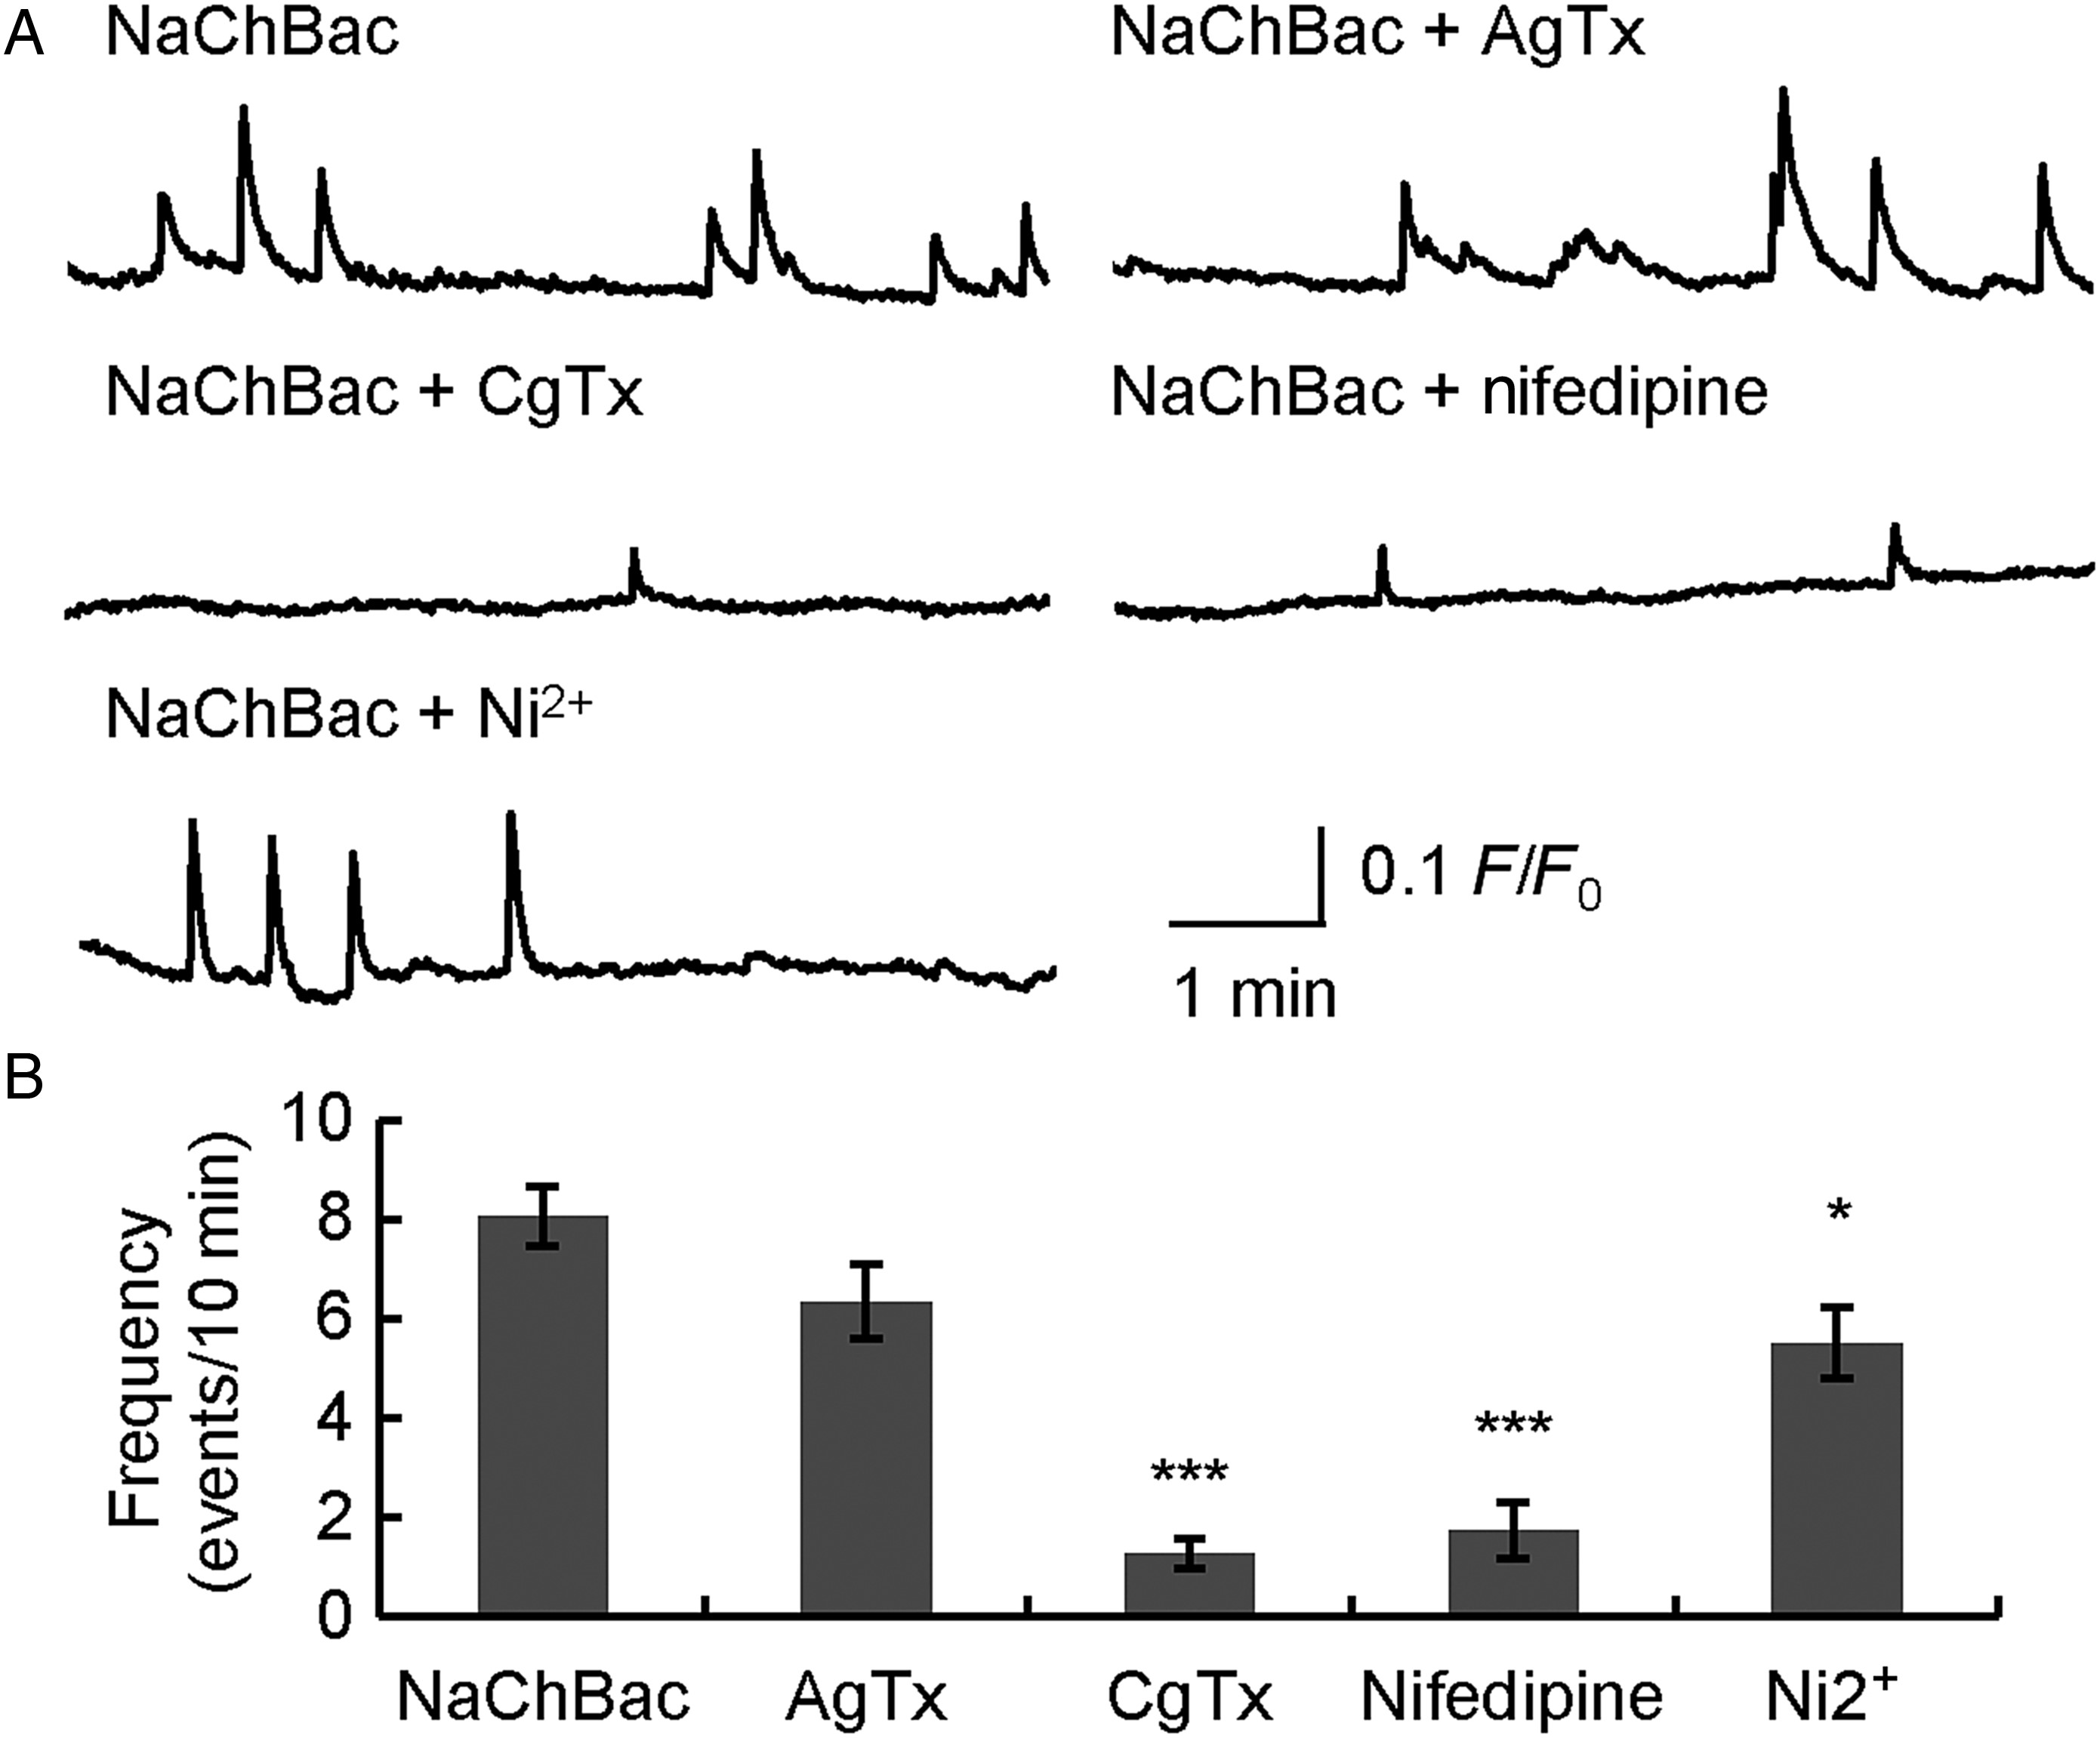
Figure 3. Involvement of voltage-gated calcium channels in spontaneous calcium transients. (A) Representative time ...
Notes:
Figure 3. Involvement of voltage-gated calcium channels in spontaneous calcium transients. (A) Representative time courses of spontaneous calcium transients during 10-min recordings. Recording was performed from neurons in the IZ and CP at P0 and P1. (B) Frequency of calcium transients of NaChBac-expressing neurons with no calcium channel blocker (NaChBac), AgTX (a blocker of P/Q-type calcium channel), CgTx (a blocker of N-type calcium channel), nifedipine (a blocker of L-type calcium channel), or Ni2+ (a blocker of T-type calcium channel). Mean ± SEM is presented. *P < 0.05, ***P < 0.001, Dunnett's test.
Unless provided in the caption above, the following copyright applies to the content of this slide: © The Author 2014. Published by Oxford University Press. All rights reserved. For Permissions, please e-mail: journals.permissions@oup.com

Slide 4
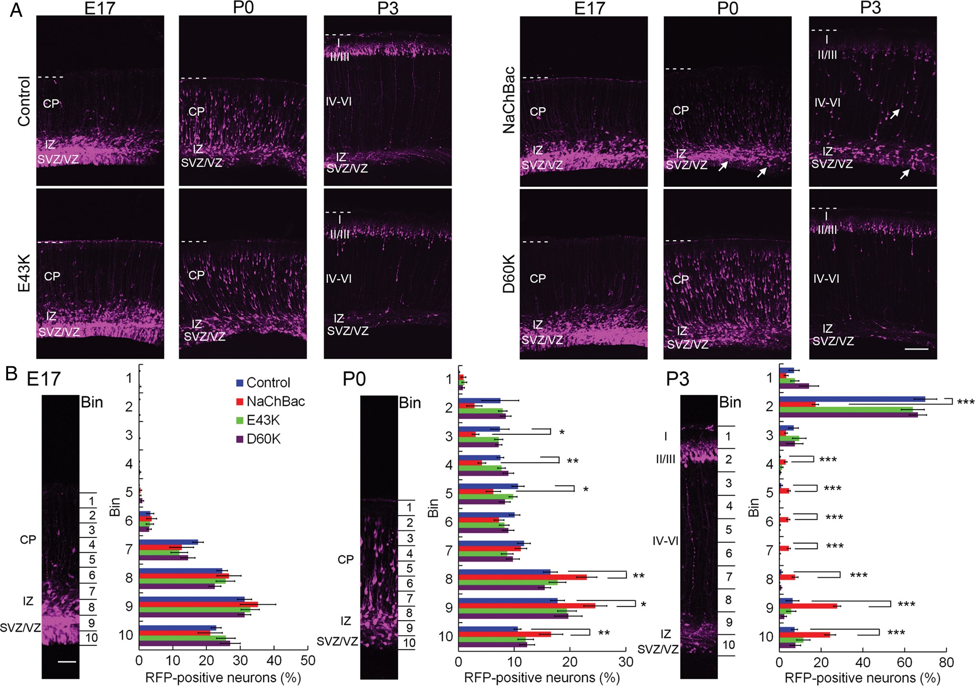
Figure 4. Migration defect caused by expression of NaChBac in the developing cortical neurons. (A) Representative ...
Notes:
Figure 4. Migration defect caused by expression of NaChBac in the developing cortical neurons. (A) Representative images of coronal cortical sections at E17, P0, and P3. TurboRFP (control) or TurboRFP with wild-type (NaChBac), E43K or D60K mutant NaChBac was electroporated at E15. Dashed lines indicate the surface of the cortex. SVZ, subventricular zone. Arrows indicate neurons whose migration is impeded. Scale bar, 100 μm. (B) Distribution of TurboRFP-positive neurons. For bin analysis, the cortex of 100-μm width (representative control images are presented) was divided into 10 bins of equal size. Bin 1 is the most superficial part. Mean ± SEM is presented. *P < 0.05, **P < 0.01, ***P < 0.001, Dunnett's test.
Unless provided in the caption above, the following copyright applies to the content of this slide: © The Author 2014. Published by Oxford University Press. All rights reserved. For Permissions, please e-mail: journals.permissions@oup.com

Slide 5
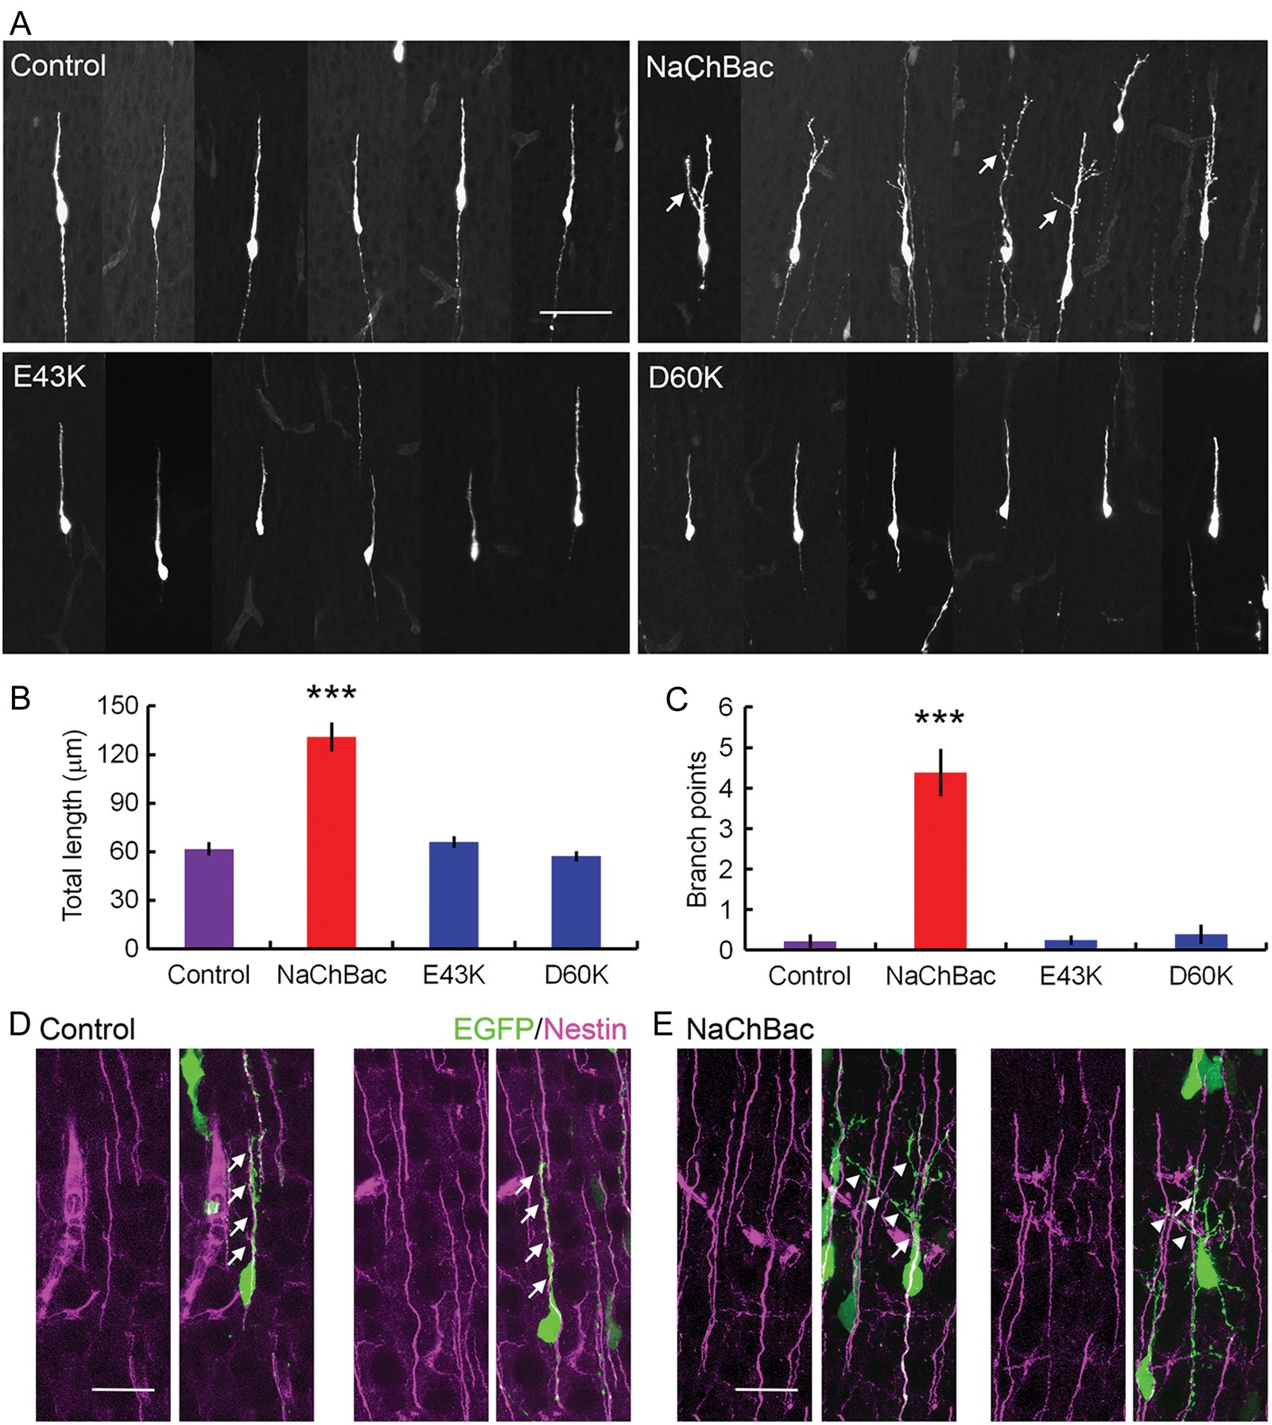
Figure 5. Formation of leading process branches in NaChBac-expressing neurons. (A) Morphology of migrating neurons at ...
Notes:
Figure 5. Formation of leading process branches in NaChBac-expressing neurons. (A) Morphology of migrating neurons at P1. Arrows indicate branches of the leading process. Scale bar, 50 μm. (B and C) Total length of protrusions (B), and number of branch points (C) of control and NaChBac-expressing neurons. Mean ± SEM is presented. ***P < 0.001, Dunnett's test. (D and E) Immunonstaining of Nestin, a marker for radial glial fibers in control (D) and NaChBac-expressing mice (E). Arrows indicate processes attached to radial glia. Arrowheads indicate processes not attached to radial glia. Scale bar, 50 μm.
Unless provided in the caption above, the following copyright applies to the content of this slide: © The Author 2014. Published by Oxford University Press. All rights reserved. For Permissions, please e-mail: journals.permissions@oup.com

Slide 6
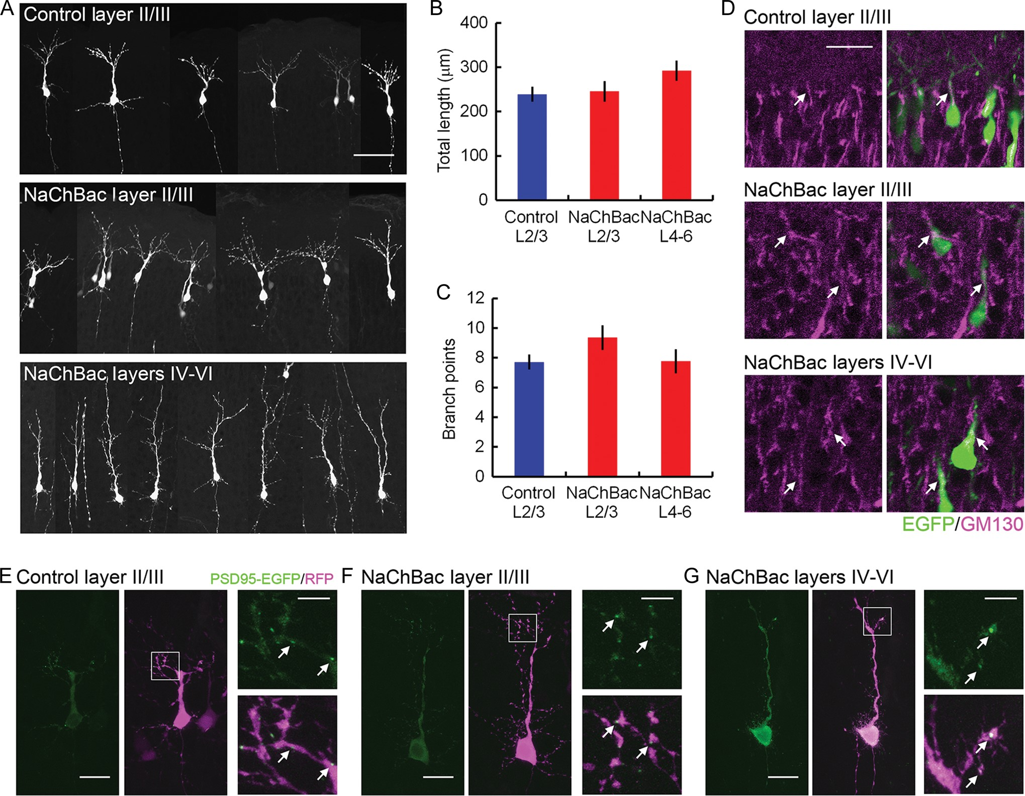
Figure 6. Dendritic differentiation of leading process of NaChBac-expressing neurons. (A) Morphology of migrating ...
Notes:
Figure 6. Dendritic differentiation of leading process of NaChBac-expressing neurons. (A) Morphology of migrating neurons at P3. Scale bar, 50 μm. (B and C) Total length of protrusions (B), and number of branch points (C) of control and NaChBac-expressing neurons. Mean ± SEM is presented. (D) Representative images of control and NaChBac-electroporated cortex stained for GM130, a marker for Golgi apparatus. Arrows indicate GM130-positive apical processes. Scale bar, 20 μm. (E–G) Clustering of PSD95-EGFP in control neurons in layer II/III (E), NaChBac-expressing neurons in layer II/III (F), and layers IV–VI (G) at P5. Left and center panels show representative images of neurons expressing PSD95-EGFP and TurboRFP. Right panels show higher magnification images of the areas indicated by white squares in the center panels. Arrows indicate PSD95-EGFP-positive puncta. Scale bars, 20 μm (left and center panels) and 5 μm (right panels).
Unless provided in the caption above, the following copyright applies to the content of this slide: © The Author 2014. Published by Oxford University Press. All rights reserved. For Permissions, please e-mail: journals.permissions@oup.com

Slide 7
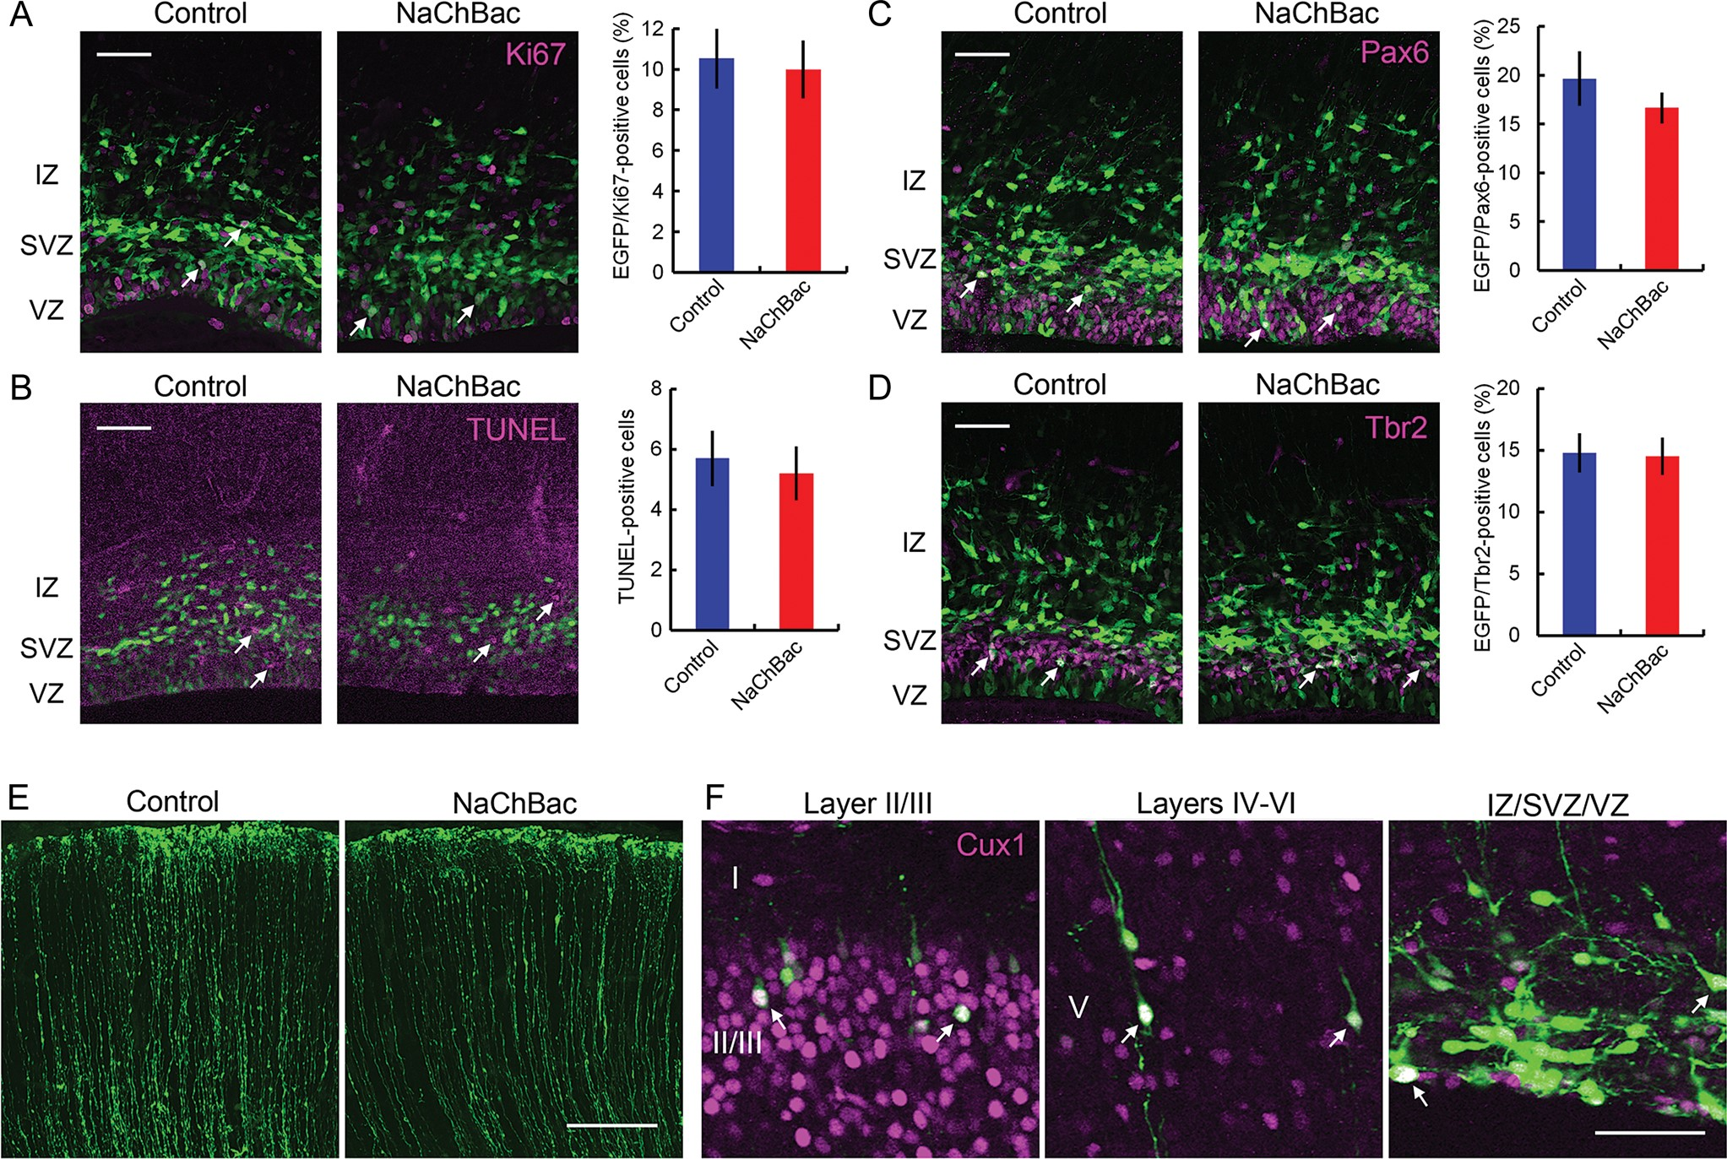
Figure 7. Proliferation, neuronal differentiation, apoptosis, and radial glial scaffold were not affected by NaChBac ...
Notes:
Figure 7. Proliferation, neuronal differentiation, apoptosis, and radial glial scaffold were not affected by NaChBac expression. Immunostaining for marker proteins. EGFP with or without NaChBac was electroporated at E15, and sections were prepared and stained at E17. (A) Representative images of coronal cortical sections immunostained for Ki67, a marker for proliferating cells, and the fraction of EGFP/Ki67-double-positive cells in a 200-μm width of IZ/SVZ/VZ. (B) Staining of apoptotic cells with a TUNEL method, and the number of apoptotic cells in a 200-μm width of IZ/SVZ/VZ. (C) Immunostaining for Pax6, a marker for radial glial cells, and the fraction of EGFP/Pax6-double-positive cells in a 200-μm width of IZ/SVZ/VZ. (D) Immunostaining for Tbr2, a marker for intermediate progenitors, and the fraction of EGFP/Tbr2-double-positive cells in a 200-μm width of IZ/SVZ/VZ. (E) The morphology of radial glial fibers expressing only EGFP (control) or EGFP and NaChBac (NaChBac). (F) Immunostaining for Cux1, a marker for layer II/III and IV neurons. Scale bars (A–D and F) 50 μm and (E) 100 μm. Mean ± SEM is presented.
Unless provided in the caption above, the following copyright applies to the content of this slide: © The Author 2014. Published by Oxford University Press. All rights reserved. For Permissions, please e-mail: journals.permissions@oup.com

Slide 8
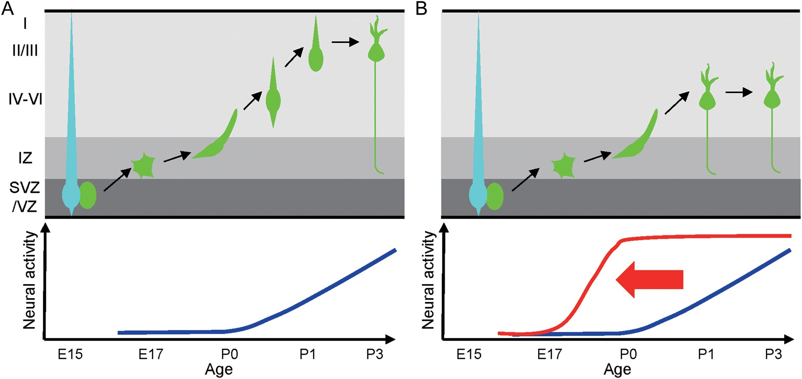
Figure 8. Summary of this study. (A) Relationship between the level of spontaneous neural activity and the development ...
Notes:
Figure 8. Summary of this study. (A) Relationship between the level of spontaneous neural activity and the development of cortical layer II/III neurons. In the control condition, neural activity is low during migration, and it increases after neurons arrive at layer II/III, where postmigratory neurons form dendrites. (B) Effects of NaChBac expression on the development of cortical layer II/III neurons. A premature increase of neural activity (indicated by a red line in the lower panel) stops neuronal migration and promotes dendrite formation before neurons reach layer II/III.
Unless provided in the caption above, the following copyright applies to the content of this slide: © The Author 2014. Published by Oxford University Press. All rights reserved. For Permissions, please e-mail: journals.permissions@oup.com

