Slide 1
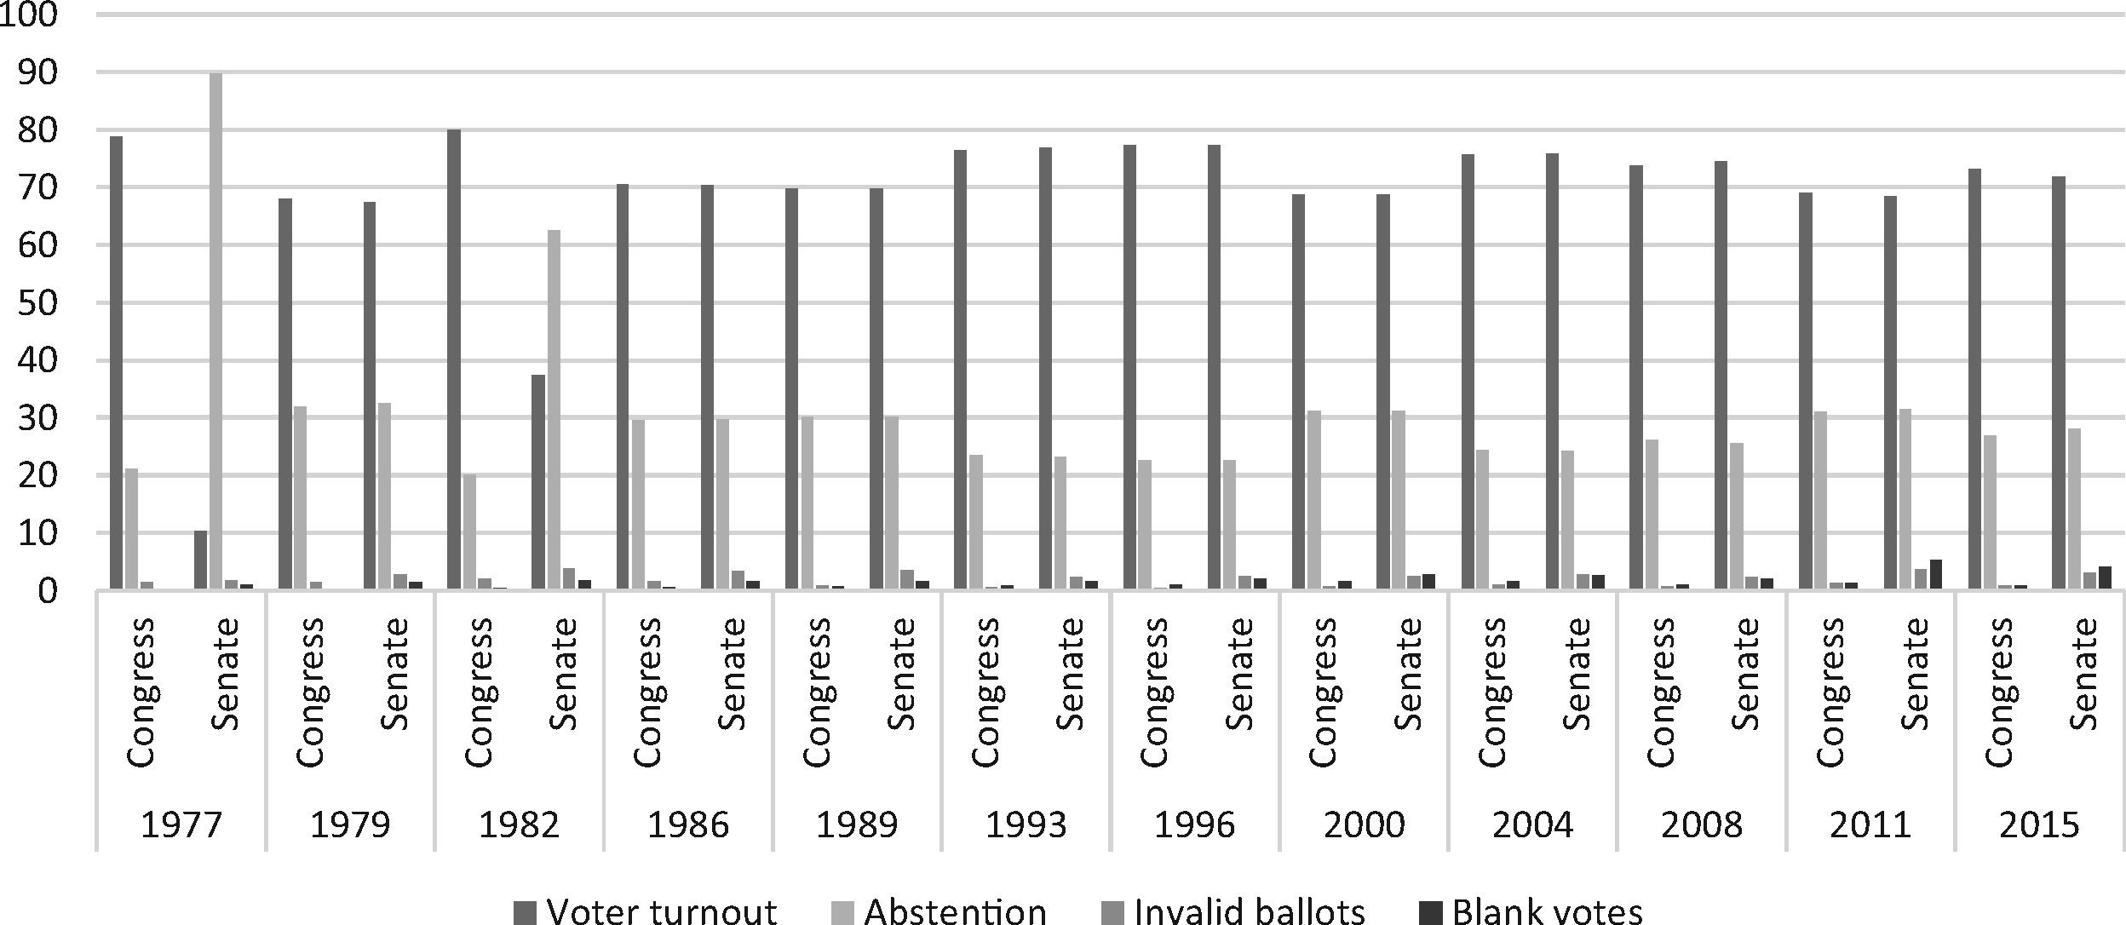
Figure 1 Participation rates in elections to the Congress and the Senate (in %). Source: Authors’ elaboration from ...
Notes:
Figure 1 Participation rates in elections to the Congress and the Senate (in %). Source: Authors’ elaboration from Ministerio de Interior (2016).
Unless provided in the caption above, the following copyright applies to the content of this slide: © The Author 2016. Published by Oxford University Press on behalf of the Hansard Society; all rights reserved. For Permissions, please e-mail: journals.permissions@oup.com

