Slide 1
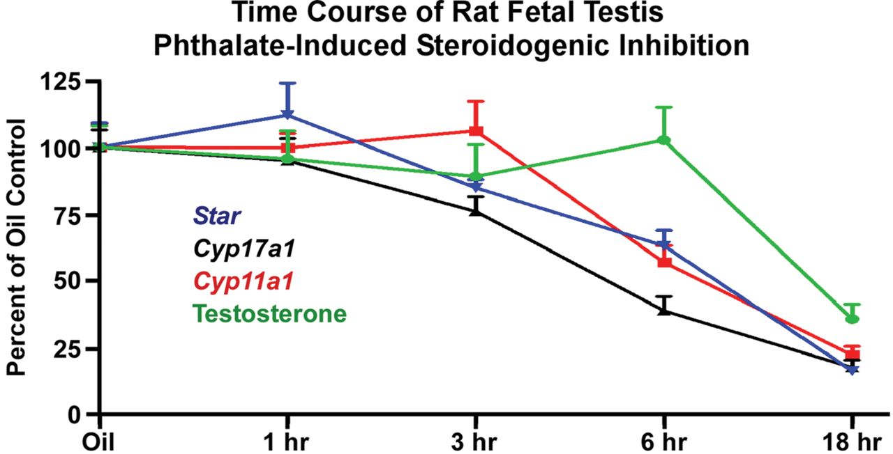
FIG. 1. Time course of acute phthalate-induced disruption of rat fetal testis steroidogenic gene expression and ...
Notes:
FIG. 1. Time course of acute phthalate-induced disruption of rat fetal testis steroidogenic gene expression and intratesticular testosterone levels. Sprague Dawley rat dams at GD19 were gavaged with oil vehicle (n = 10) or a single administration of 500mg/kg DBP followed by euthanasia at 1h (n = 5), 3h (n = 5), 6h (n = 5), or 18h (n = 4). Euthanasia for the oil vehicle dams was spread among the 1-, 3-, 6-, and 18-h time points. From fetal testes, steroidogenic gene mRNA levels were quantified by TaqMan-based reverse transcription-polymerase chain reaction relative to Tata binding protein mRNA levels, and intratesticular testosterone levels were measured by radioimmunoassay (Johnson et al., 2011). Shown are the means ± standard errors about the mean. Statistical significance was determined using a one-way analysis of variance and Dunnett’s post hoc test with p < 0.05 considered significant. In this experiment, steroidogenic gene mRNA levels were reduced significantly by 3 (Cyp17a1) or 6 h (Cyp11a1 and Star) postexposure, but significant intratesticular testosterone reductions were not observed until 18h postexposure. Expression of steroidogenic genes remained significantly lower through the 18-h time point. Thus, inhibition of steroidogenic pathway gene expression preceded reductions in intratesticular testosterone levels.
Unless provided in the caption above, the following copyright applies to the content of this slide: © The Author 2012. Published by Oxford University Press on behalf of the Society of Toxicology. All rights reserved. For permissions, please email: journals.permissions@oup.com

