Slide 1
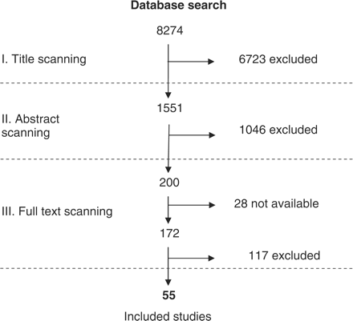
Figure 1 Flow chart representing the selection process for studies included in the review
Notes:
Figure 1 Flow chart representing the selection process for studies included in the review
Unless provided in the caption above, the following copyright applies to the content of this slide: Published by Oxford University Press in association with The London School of Hygiene and Tropical Medicine © The Author 2009; all rights reserved.

Slide 2
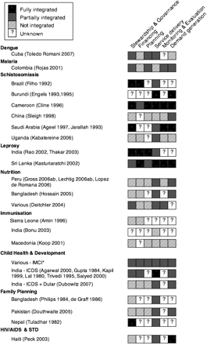
Figure 2 The extent and nature of integration by targeted health intervention and intervention success as reported in ...
Notes:
Figure 2 The extent and nature of integration by targeted health intervention and intervention success as reported in the study
Unless provided in the caption above, the following copyright applies to the content of this slide: Published by Oxford University Press in association with The London School of Hygiene and Tropical Medicine © The Author 2009; all rights reserved.

