Slide 1
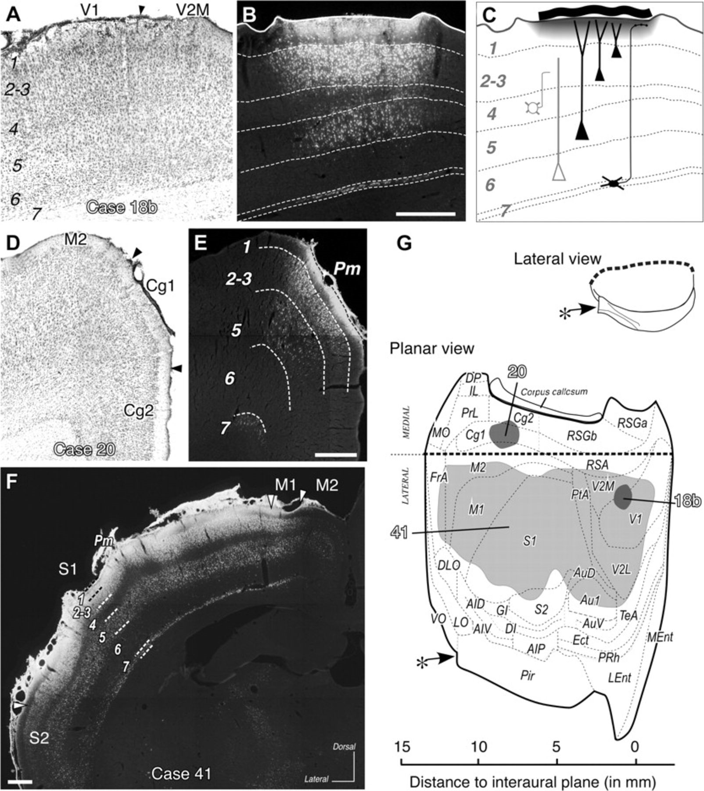
Figure 1. Epipial fluorochrome applications selectively impregnate a patch of layer 1. (A–C) A representative example ...
Notes:
Figure 1. Epipial fluorochrome applications selectively impregnate a patch of layer 1. (A–C) A representative example of a small tracer deposit confined to cerebral cortex layer 1. Adjacent coronal sections taken at the center of a small DY deposit (Case 18b) in the primary visual cortex. Panel (A) shows a Nissl-stained section. Panel (B) shows the epifluorescence image of an adjacent section. Notice the heavily impregnated neuropil in the superficial part of layer 1. At some distance below this zone, numerous cell somata are labeled in layers 2–3, 5, and 7. In contrast, few or no cells are labeled in layers 4 and 6. In panel (C), a line diagram based on panel (B) shows how an epipial deposit works and why the laminar pattern of back labeling observed in deeper layers indicates that tracer uptake occurred only in layer 1. Tracer diffusing from a piece of tracer-soaked filter paper (wavy thick line at the top) applied on the pia mater-impregnated layer 1 (gray shade). Pyramidal neurons whose apical dendrites (layers 2, 3, and 5) or axons (layer 7) arborize selectively in layer 1 are heavily labeled. In contrast, layer 4 or 6 cells, known to not extend axons or dendrites significantly into layer 1, remain unlabeled. (D–E) Adjacent coronal sections taken at the center of an FB deposit (Case 20) involving a region of the Cg1 cingulate and M2 motor areas. The laminar distribution of cells labeled underneath the impregnated part of layer 1 is equivalent to that in panels (A–C); the narrow unlabeled band at the layer 3–5 border represents layer 4 in these agranular areas. (F) Epifluorescence image of a coronal section from a cerebral hemisphere that received an extensive epipial deposit of FB (Case 41). The pattern of cell somata labeling under the deposit again reveals that tracer uptake was limited to layer 1. (G) Representation on a “flat” cortical surface map of the extent of the 3 deposits shown in panels (A–F). For reference, a diagram of a conventional lateral view of the rat cerebral hemisphere is shown. In the flat cortex map, the pial surface of the cerebral hemisphere was “unfolded” by serially aligning the perimeter measurements from all the cortical coronal sections of Paxinos and Watson rat brain atlas (Paxinos and Watson 2005). The perimeters were plotted onto vertical parallel lines aligned along the edge dividing the medial and laterodorsal aspects of the cerebral hemisphere (thick dashed line). Along this axis, perimeter measurements were spaced according to their distance from the interaural coronal plane. The olfactory peduncle is cut (asterisk). Gray shaded areas represent the extent of layer 1 impregnation in each of the 3 experiments illustrated in panels (A–F). See Table 1 for abbreviations. Bar = 500 μm.
Unless provided in the caption above, the following copyright applies to the content of this slide: © The Author 2009. Published by Oxford University Press. All rights reserved. For permissions, please e-mail: journals.permissions@oxfordjournals.org

Slide 2
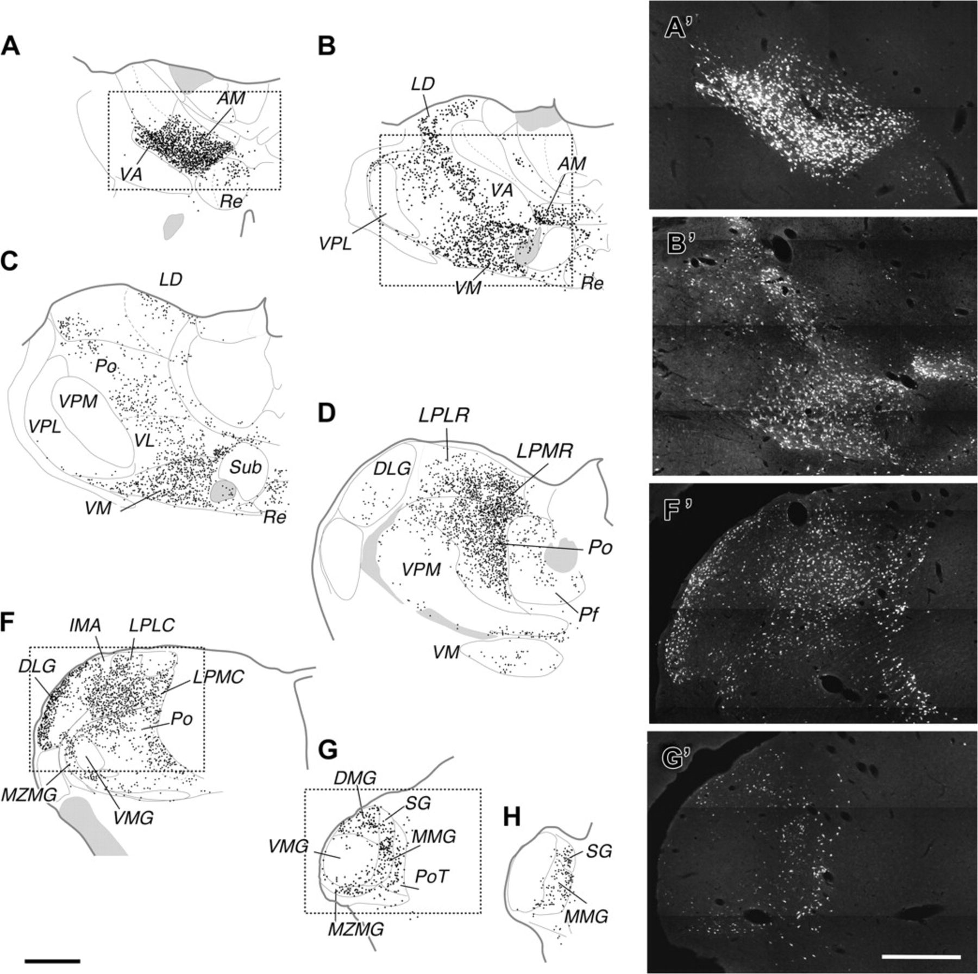
Figure 2. The layer 1–projecting thalamocortical cells are a large population spread throughout the thalamus. (A–H) ...
Notes:
Figure 2. The layer 1–projecting thalamocortical cells are a large population spread throughout the thalamus. (A–H) Line drawings of representative coronal thalamic sections. Each black dot represents one labeled cell soma. Fiber bundles such as the mamillothalamic tract, the stria medularis, the retroflex bundle, or the medial lemniscus are shaded in gray. Note that although the tracer deposit covered most of area S1, the ventroposterior nucleus (VP) is largely unlabeled. (A′, B′, F′, G′) Epifluorescence images of the labeling in the rectangles in, respectively, panels (A, B, F, and G). See Table 1 for abbreviations. Further details of the labeled cells can be appreciated by zooming into the images. A high-magnification epifluorescence image of labeled cells is shown in Supplementary Figure SM3. Bars: (A–H) = 1 mm; (A′–B′), (G′–H′) = 500 μm.
Unless provided in the caption above, the following copyright applies to the content of this slide: © The Author 2009. Published by Oxford University Press. All rights reserved. For permissions, please e-mail: journals.permissions@oxfordjournals.org

Slide 3
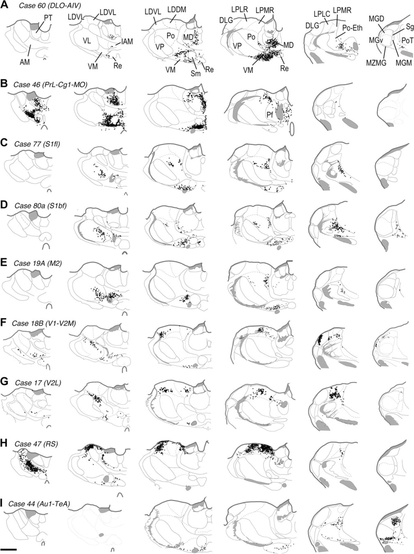
Figure 3. In every cortical area, small tracer deposits in layer 1 back label multiple thalamic nuclei. (A–I) ...
Notes:
Figure 3. In every cortical area, small tracer deposits in layer 1 back label multiple thalamic nuclei. (A–I) Comparison of the thalamic labeling in 9 representative experiments, each of which received a small layer 1 deposit in a different cortical area. Thalamic labeling is shown in 6 coronal sections arranged from rostral (left) to caudal (right). Each black dot represents a single cell. Note that some nuclei, like the ventromedial (VM), anteromedial (AM), or lateral posterior medial rostral part (LPMR), contained labeled cells in most or virtually all cortical regions following the layer 1 deposit. In contrast, nuclei such as the dorsal lateral geniculate (DLG, row F) or the medial geniculate (MGD, row I) were labeled only by layer 1 deposits in a particular area. See Table 1 for other abbreviations. Bar = 1 mm.
Unless provided in the caption above, the following copyright applies to the content of this slide: © The Author 2009. Published by Oxford University Press. All rights reserved. For permissions, please e-mail: journals.permissions@oxfordjournals.org

Slide 4
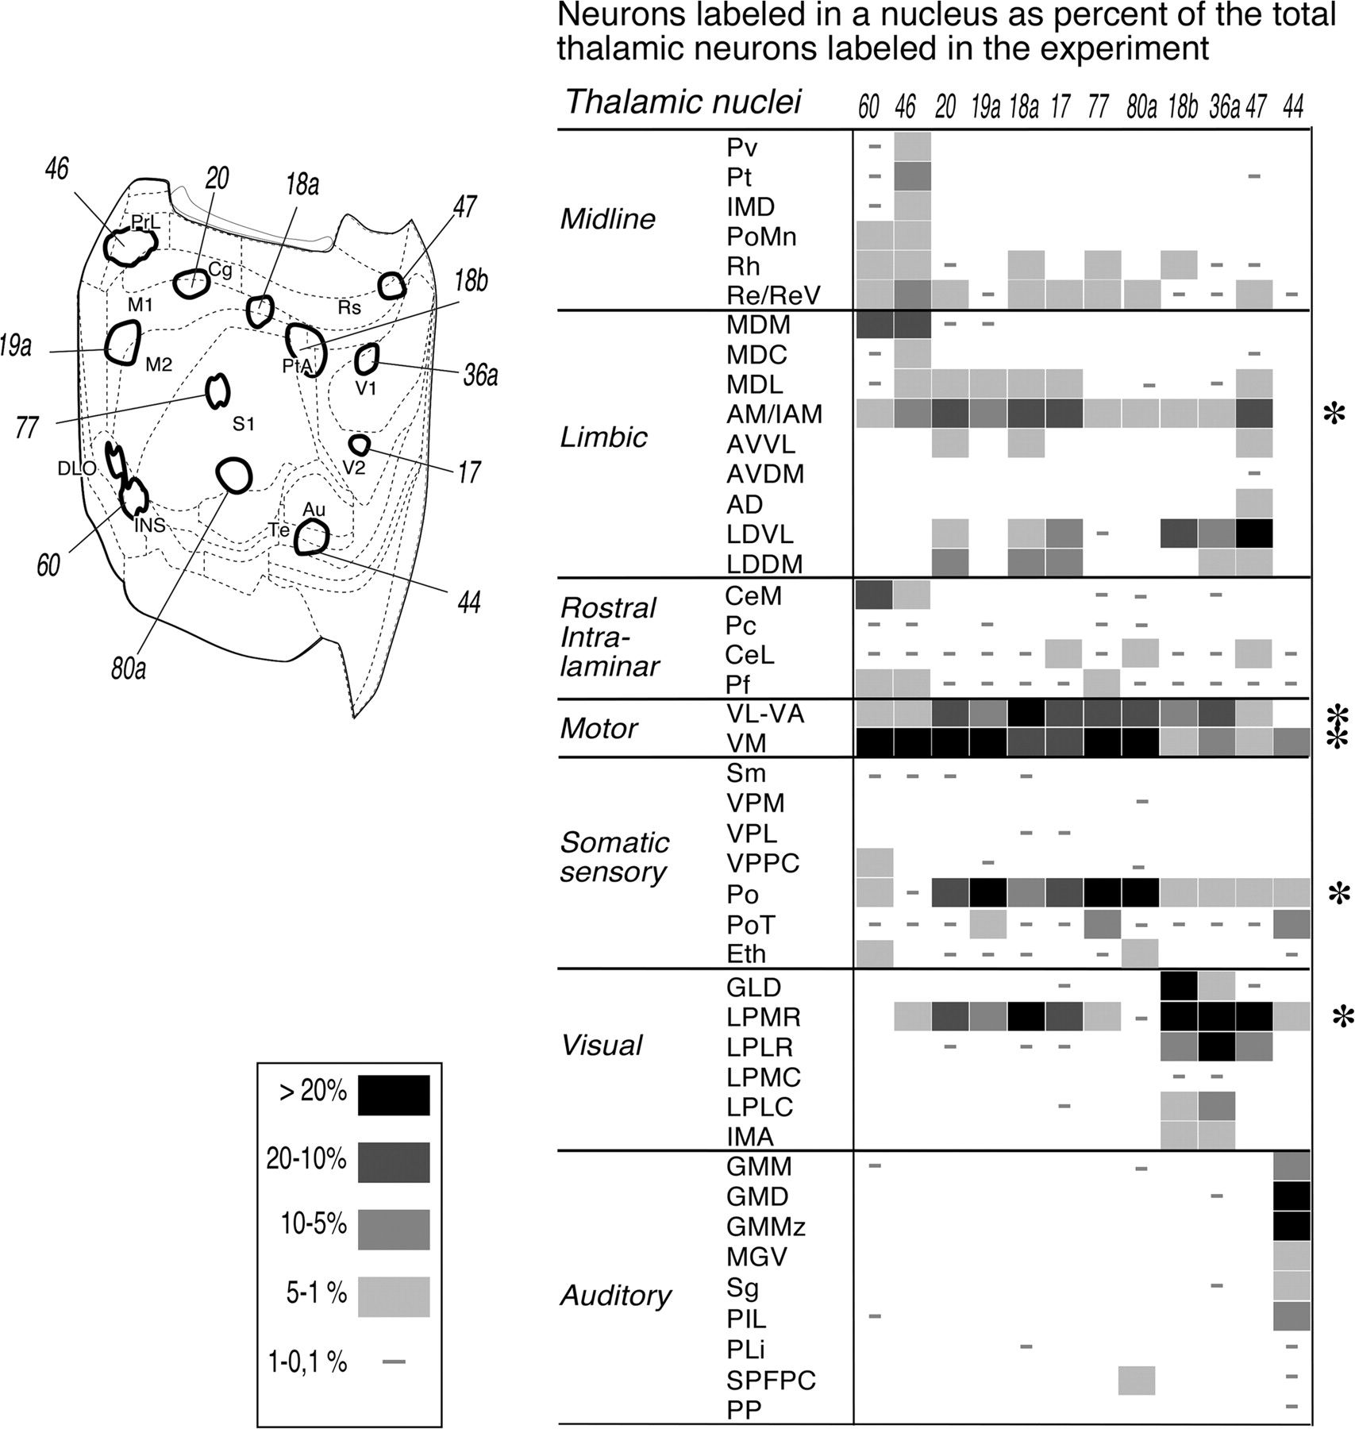
Figure 4. Semiquantitative analysis of the distribution of M-type thalamocortical cells projecting to different ...
Notes:
Figure 4. Semiquantitative analysis of the distribution of M-type thalamocortical cells projecting to different cortical regions. Upper left corner: flat cortex map showing 12 small epipial deposit experiments, each in a different cortical region. To normalize and compare across these experiments, the percentages that the cells labeled in each nuclei represent over the total for the thalamic cells labeled in each experiment are displayed as levels of gray in the table at the left. In the table, nuclei are listed according to broad functional affinities. The experiment number is indicated atop each column. This analysis confirms the impression gained from the observation of individual thalamic sections that some nuclei disperse their axons over vast swaths of layer 1, whereas other nuclei innervate layer 1 in a few or in even only one area. See Table 1 for abbreviations.
Unless provided in the caption above, the following copyright applies to the content of this slide: © The Author 2009. Published by Oxford University Press. All rights reserved. For permissions, please e-mail: journals.permissions@oxfordjournals.org

Slide 5
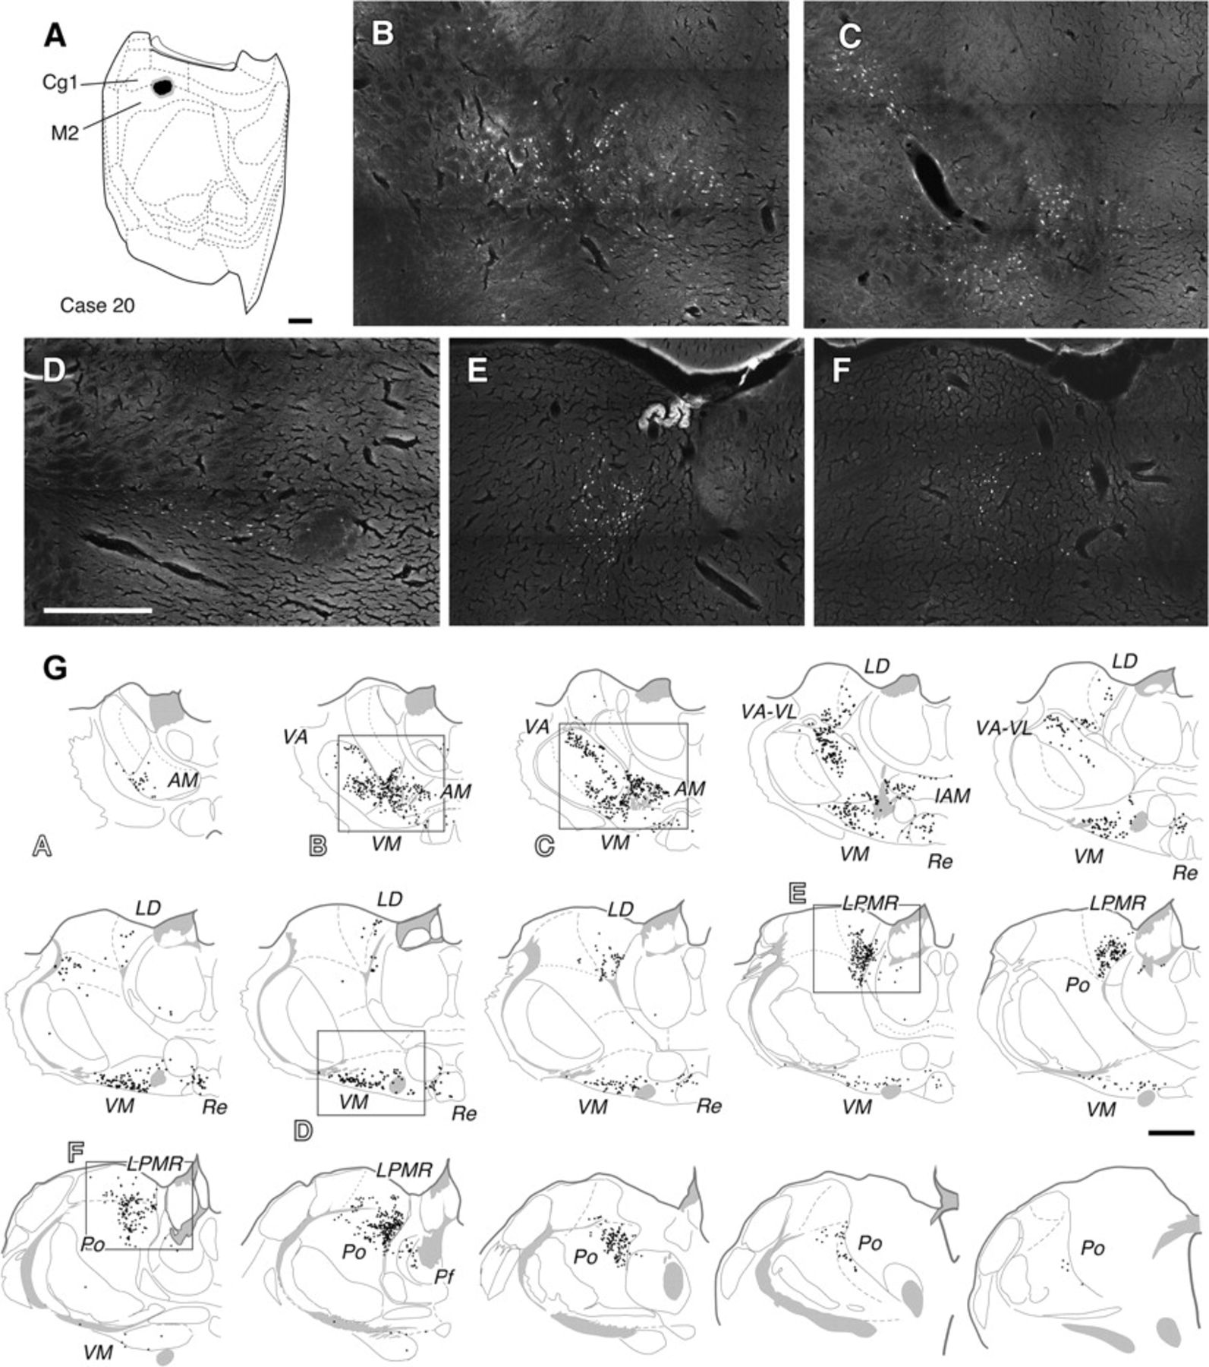
Figure 5. A small tracer deposit in layer 1 labels a large number of neurons in the thalamus. (A) Extent of a typical ...
Notes:
Figure 5. A small tracer deposit in layer 1 labels a large number of neurons in the thalamus. (A) Extent of a typical small deposit reconstructed on a cortical surface map. In this particular experiment (Case 20, see Fig. 1A–B), the FB deposit impregnated 1.8 mm2 of cortical layer 1. (B–F) Panoramic epifluorescence images showing retrogradely labeled neuron somata in the thalamus. The images correspond to the regions indicated by rectangles on the line drawings in panel (G). Further details of the labeled cells can be appreciated by zooming into the images, as well as in Supplementary Figure SM3. (G) Line drawings from an entire series of sections (1 out of 5, 40-μm-thick each, spaced by 200 μm apart). Sections are arranged from rostral (upper left corner) to caudal (lower right corner). Each dot represents a single cell. The total number of neurons labeled in this particular series of thalamic sections was 2211. See Table 1 for abbreviations. Bar: (A) = 2 mm; (B–F) = 500 μm; (G) =1 mm.
Unless provided in the caption above, the following copyright applies to the content of this slide: © The Author 2009. Published by Oxford University Press. All rights reserved. For permissions, please e-mail: journals.permissions@oxfordjournals.org

Slide 6
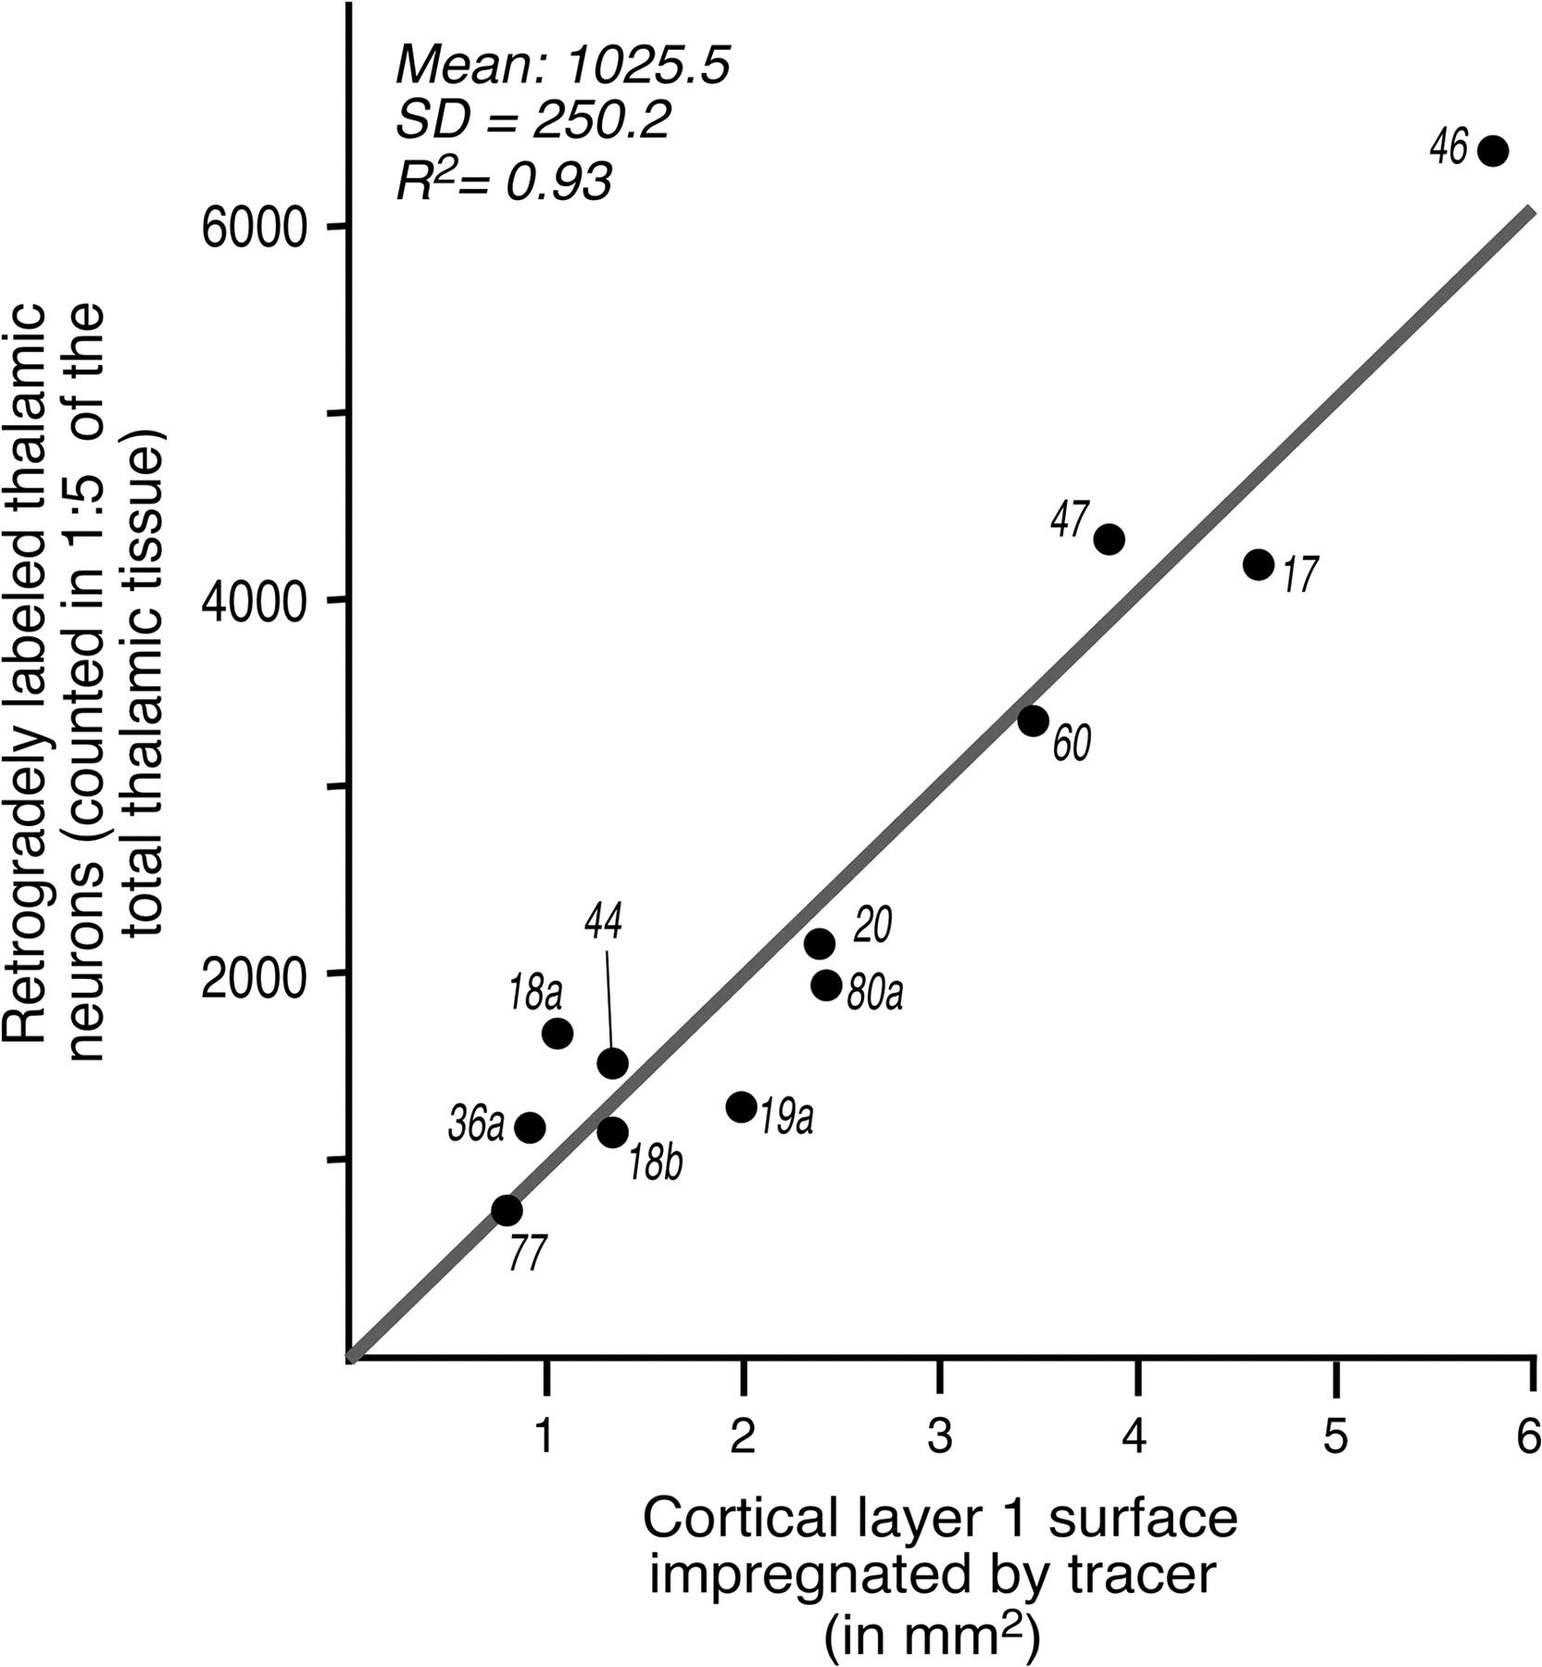
Figure 6. Approximate estimation of the number of cells innervating 1 mm² of cortical layer 1. Surface area ...
Notes:
Figure 6. Approximate estimation of the number of cells innervating 1 mm2 of cortical layer 1. Surface area covered by the tracer deposits in each of the 12 experiments shown in Figure 4A after correction for cortical surface shrinkage (Avendaño C, personal communication) was plotted against the total number of retrogradely labeled thalamic neurons counted in a whole rostrocaudal series of thalamus sections (1:5 sections). This density ratio provides a direct estimate of how many thalamocortical cells extend at least some part of their axon into any given 1 mm2 of layer 1. The mean density ratio is 1025 ± 250 cells per mm2. Note, however, that cells were counted in only a fifth of the total thalamic tissue, so the actual number of thalamic cells innervating 1 mm2 of layer 1 must be on the order of 4000–5000. Regression analysis shows a remarkably similar density in every sensory, association, motor, or limbic cortical area examined (R2 = 0.93).
Unless provided in the caption above, the following copyright applies to the content of this slide: © The Author 2009. Published by Oxford University Press. All rights reserved. For permissions, please e-mail: journals.permissions@oxfordjournals.org

Slide 7
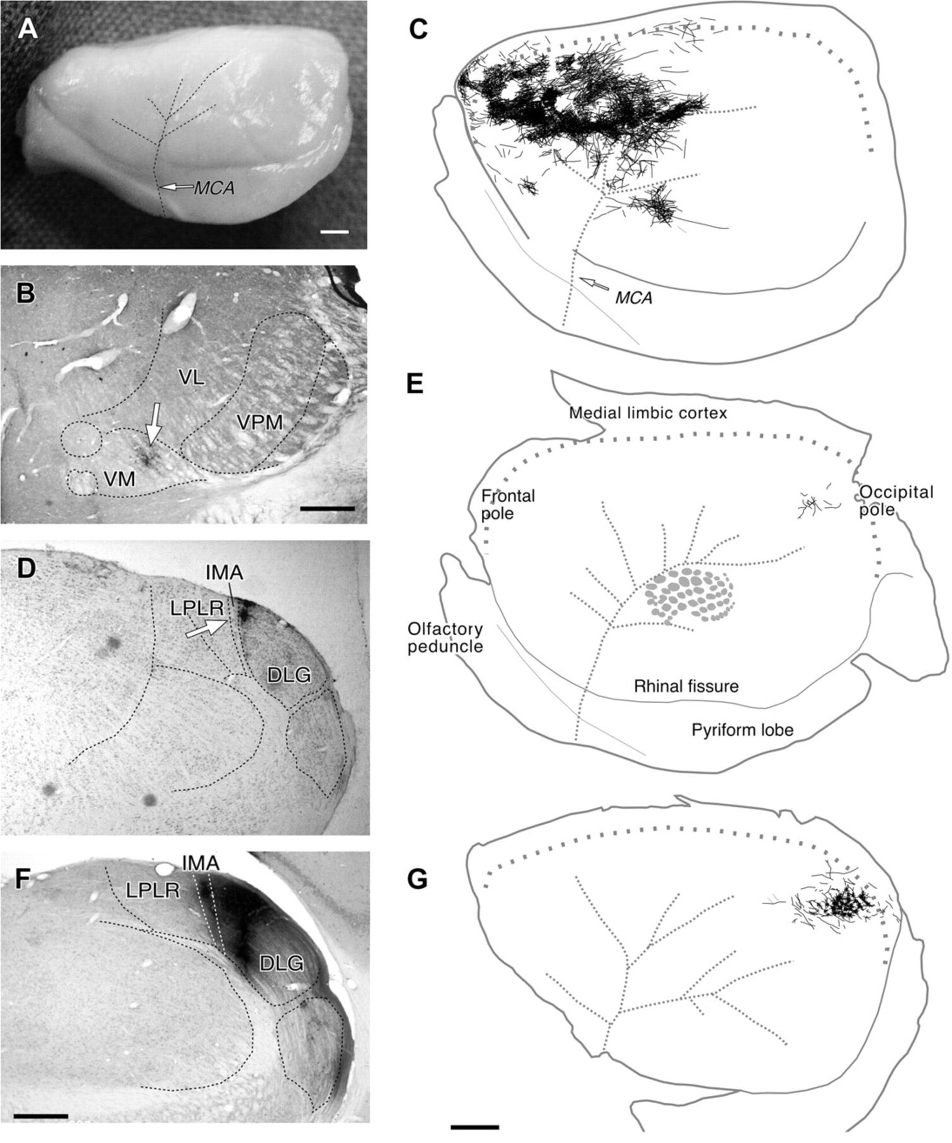
Figure 7. Tangential spread in the cortex varies greatly between M-type axons originated in different thalamic nuclei. ...
Notes:
Figure 7. Tangential spread in the cortex varies greatly between M-type axons originated in different thalamic nuclei. (A) Lateral view of the rat's left cerebral hemisphere. For reference, the position of middle cerebral artery (MCA) and its main branches are indicated by dashed lines. Compare with panels (C) and (E). (B) Coronal section showing the center of a small iontophoretic deposit of BDA (arrow) in the ventromedial (VM) thalamic nucleus. CyO counterstain. This deposit backfilled ∼150 ventromedial neuron somata. (C) Reconstruction of thalamocortical axon arbors labeled in layer 1 after the injection in panel (B) as observed on a flattened whole mount of the cerebral hemisphere. MCA is represented by thick dashed gray lines. Thalamocortical axons in layer 1 are thickened ∼100 times to make them visible at this scale. Note that a large swath of the cerebral surface is reached by the axons arising in the small thalamic zone injected with BDA. For comparison, the “barrel” layer 4 domains in the posteromedial barrel subfield (PMBSF) as revealed by CyO histochemistry are also shown. It is to be remembered that C-type axons arising in the ventroposterior medial nucleus (VPM, panel A) have been shown to arborize essentially within the area of 1 or 2 barrel domains (Jensen and Killackey 1987; Arnold et al. 2001). (D) Small iontophoretic deposit of BDA (arrow) in the most medial part of the dorsal lateral geniculate nucleus. Thionin counterstain. (E) Thalamocortical axon arbors labeled in layer 1 in the experiment shown in panel (D) reconstructed from serial tangential sections of a flattened hemisphere. (F–G) Following a large iontophoretic BDA deposit about the same location as the previous case (panel D), but involving in this case many thousands of thalamic cells, label layer 1 axons only within the primary visual area. Reconstruction from serial tangential sections. Bar: (A, B, D, F) = 2 mm; (C, E, G) = 200 μm.
Unless provided in the caption above, the following copyright applies to the content of this slide: © The Author 2009. Published by Oxford University Press. All rights reserved. For permissions, please e-mail: journals.permissions@oxfordjournals.org

Slide 8
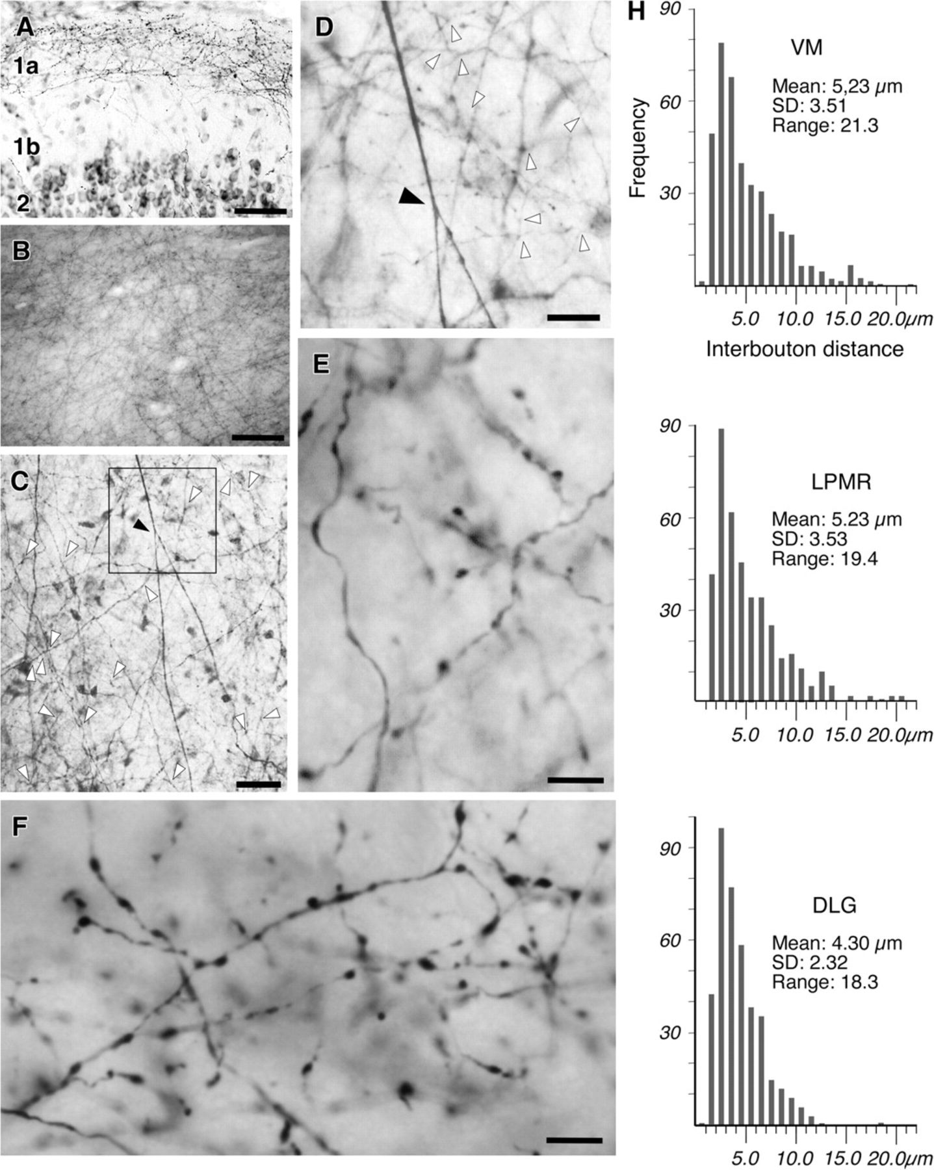
Figure 8. Thalamocortical axons form a dense subpial canopy of crisscrossing terminal branches with numerous ...
Notes:
Figure 8. Thalamocortical axons form a dense subpial canopy of crisscrossing terminal branches with numerous varicosities. (A) Labeled thalamocortical axon branches in layer 1 as seen on coronal section of the frontal cortex (area M2) after a small BDA injection in the ventromedial (VM) nucleus. Pial surface is at the top. Cresyl violet counterstain. The few radially oriented, unbranched, and mostly bouton-free axons ascending through layers 2 and 1b contrast sharply with the mesh of tangential, varicose branches present in sublayer 1a. The same pattern was observed in other areas in this case, as well as BDA injection experiments involving other nuclei (Supplementary Table SM1). (B) Low-magnification view of the pial surface of a flattened, non-defattened, unsectioned cerebral hemisphere in aqueous mounting. Numerous layer 1 BDA-labeled thalamocortical axon arbors are visible through the translucent pia mater even at this low magnification. (C) BDA-labeled thalamocortical axon arbors in layer 1 as seen at in a 60-μm-thick tangential section. Parietal cortex after an injection in the lateral posterior medial nucleus. Numerous branching points are visible at this magnification (arrowheads). (D) One of the numerous axon branching points seen in panel (C) (black arrowhead in both panels) is shown at higher magnification. Note that numerous additional branching points in thinner axons (white arrowheads) become visible at this magnification (G–F) High-magnification detail of bouton-like swellings in M-type axons in layer 1 as seen in tangential sections. Panel (G) axons were labeled by a BDA injection in the lateral posteromedial nucleus (LPMR), whereas panel (F) axons were labeled from the dorsal lateral geniculate nucleus (DLG). (H) Measurements of interbouton distance axons labeled in layer 1 from the VM nucleus, LPMR or DLG; 400 measurements were taken for each. Note that whereas the mean values are similar, the range of interbouton distances is broader in VM and LPMR axons than in DLG axons. Bars (A) = 50 μm; (B) = 200 μm; (C) = 25 μm; (D) = 10 μm; (E–F) = 5 μm.
Unless provided in the caption above, the following copyright applies to the content of this slide: © The Author 2009. Published by Oxford University Press. All rights reserved. For permissions, please e-mail: journals.permissions@oxfordjournals.org

Slide 9
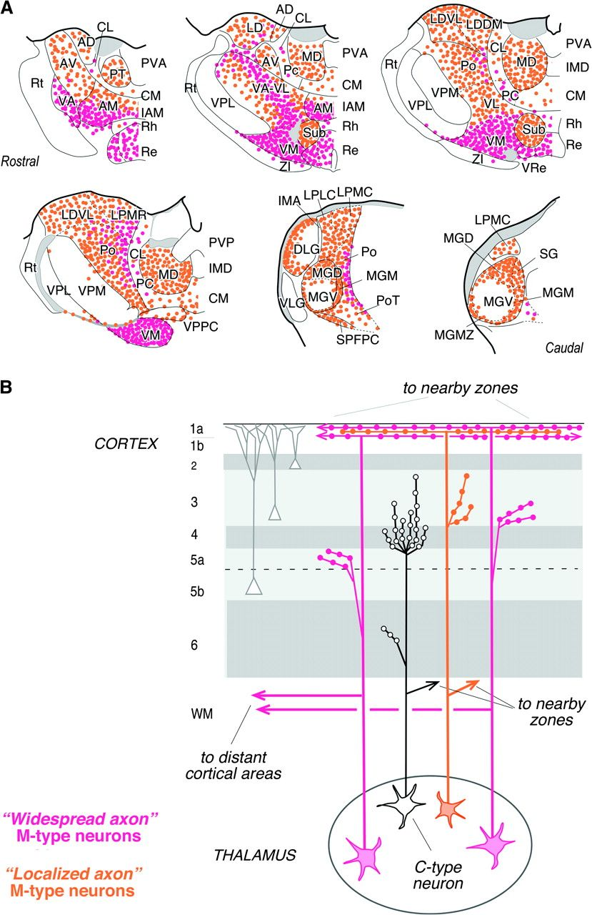
Figure 9. Summary of thalamic location and axon branching diversity of rat M-type neurons. Diagrams based on our data ...
Notes:
Figure 9. Summary of thalamic location and axon branching diversity of rat M-type neurons. Diagrams based on our data as well as from previous studies with anterograde tracer injections in individual nuclei (see text for references). (A) M-type neuron location in the various nuclei is represented by dots on 6 coronal thalamic sections. Orange dots indicate the M-type neurons of “localized axon” subtype (those targeting a single or few adjacent areas), and pink dots represent M-type neurons of the “widespread axon” subtype (targeting multiple, distant cortical fields). Blank regions lack neurons innervating cortical layer 1; these probably contain C-type neurons or neurons projecting diffusely to the infragranular layers (Herkenham 1986). See Table 1 for nuclei abbreviations. (B) Diagram of the wiring pattern of localized axon (orange) or widespread axon (pink) thalamocortical M-type neuron in rodents. These 2 axon forms are intended to represent the extremes of a continuum of variance among M-type neurons. Note that the overlap in sublayer 1a of a great many M-type axon arbors creates a dense axonal canopy. Moreover, as these arbors give off some branches in this layer and have a high spatial frequency of boutons (Fig. 8), the resulting local density of thalamocortical boutons in sublayer 1a may be very high, consistent with the VGluT2 immunolabeling (compare with Supplementary Fig. SM6). M-type axons frequently leave collateral braches to layers 5a or 3 that may contribute to the observed VGluT2 immunolabeling in the middle cortical layers (Fujiyama et al. 2001; see also Supplementary Fig. SM6). In widespread axons, branching in the subcortical white matter allows the simultaneous targeting of multiple and distant cortical zones (Deschênes et al. 1998). Subcortical axon branching is more limited in localized M-type axons. For comparison, a generalized C-type neuron (black line) is included in the diagram, based on published single-axon reconstruction studies in rodents (Jensen and Killackey 1987; Deschênes et al. 1998; Arnold et al. 2001; Gheorghita et al. 2006). Note that, in contrast to M-type axons, C-type axons give rise to a high local bouton density of in layers 4–3 as a result of the profuse branching of individual axons in largely nonoverlapping domains.
Unless provided in the caption above, the following copyright applies to the content of this slide: © The Author 2009. Published by Oxford University Press. All rights reserved. For permissions, please e-mail: journals.permissions@oxfordjournals.org

