Slide 1
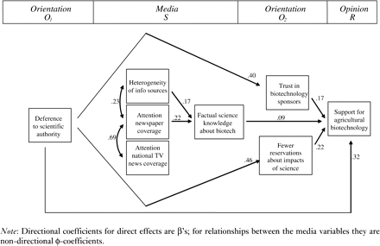
Figure 1 Relationships among endogenous variables
Notes:
Figure 1 Relationships among endogenous variables
Unless provided in the caption above, the following copyright applies to the content of this slide: © The Author 2006. Published by Oxford University Press on behalf of The World Association for Public Opinion Research. All rights reserved.

