Slide 1
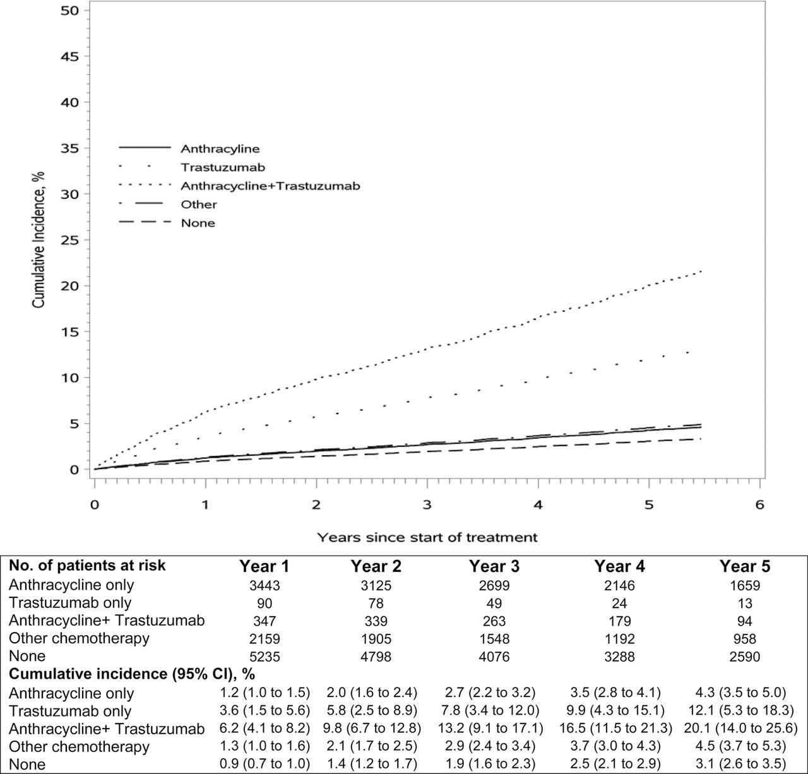
Figure 1. Cumulative incidence of heart failure and/or cardiomyopathy (HF/CM) in women with invasive breast cancer over ...
Notes:
Figure 1. Cumulative incidence of heart failure and/or cardiomyopathy (HF/CM) in women with invasive breast cancer over 5 years by adjuvant chemotherapy group. Adjusted cumulative incidence of HF/CM and number of patients at risk by exposure group (anthracycline only, trastuzumab only, anthracycline &#x002B; trastuzumab, other chemotherapy, or none) for the first 5 years of follow-up. Cumulative incidence was adjusted for Cancer Research Network (CRN) site (eight sites), age at diagnosis (<55, 55–64, 65–74, ≥75 years), Charlson comorbidity index (0, 1, 2, ≥3), summary stage at diagnosis (local vs regional), year of diagnosis (categorical for each year), and radiation treatment (yes vs no).
Unless provided in the caption above, the following copyright applies to the content of this slide: © The Author 2012. Published by Oxford University Press. All rights reserved.This is an Open Access article distributed under the terms of the Creative Commons Attribution Non-Commercial License (http://creativecommons.org/licenses/bync/3.0/uk/) which permits unrestricted noncommercial use, distribution, and reproduction in any medium, provided the original work is properly cited.

Slide 2
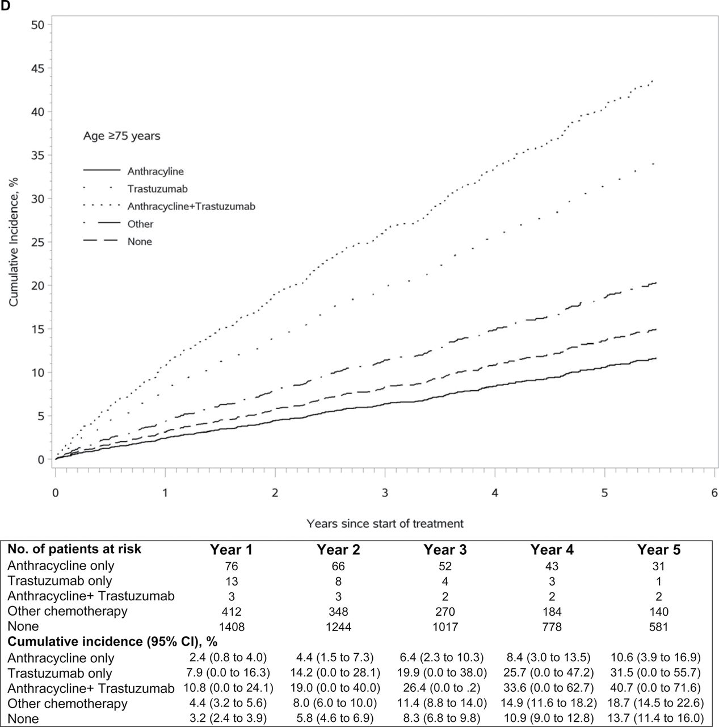
Figure 2. Cumulative incidence of heart failure and/or cardiomyopathy (HF/CM) in women with invasive breast cancer ...
Notes:
Figure 2. Cumulative incidence of heart failure and/or cardiomyopathy (HF/CM) in women with invasive breast cancer over 5 years by adjuvant chemotherapy and age groups. Adjusted cumulative incidence of HF/CM and number of patients at risk by exposure group (anthracycline only, trastuzumab only, anthracycline &#x002B; trastuzumab, other chemotherapy, or none) for the first 5 years of follow-up, by age at diagnosis. Cumulative incidence was adjusted for Cancer Research Network (CRN) site (eight sites), age at diagnosis (<55, 55–64, 65–74, ≥75 years), Charlson comorbidity index (0, 1, 2, ≥3), summary stage at diagnosis (local vs regional), year of diagnosis (categorical for each year), and radiation treatment (yes vs no). A ) Age <55 years. B ) Age 55–64 years. C ) Age 65–74 years. D ) Age ≥75 years.
Unless provided in the caption above, the following copyright applies to the content of this slide: © The Author 2012. Published by Oxford University Press. All rights reserved.This is an Open Access article distributed under the terms of the Creative Commons Attribution Non-Commercial License (http://creativecommons.org/licenses/bync/3.0/uk/) which permits unrestricted noncommercial use, distribution, and reproduction in any medium, provided the original work is properly cited.

Slide 3
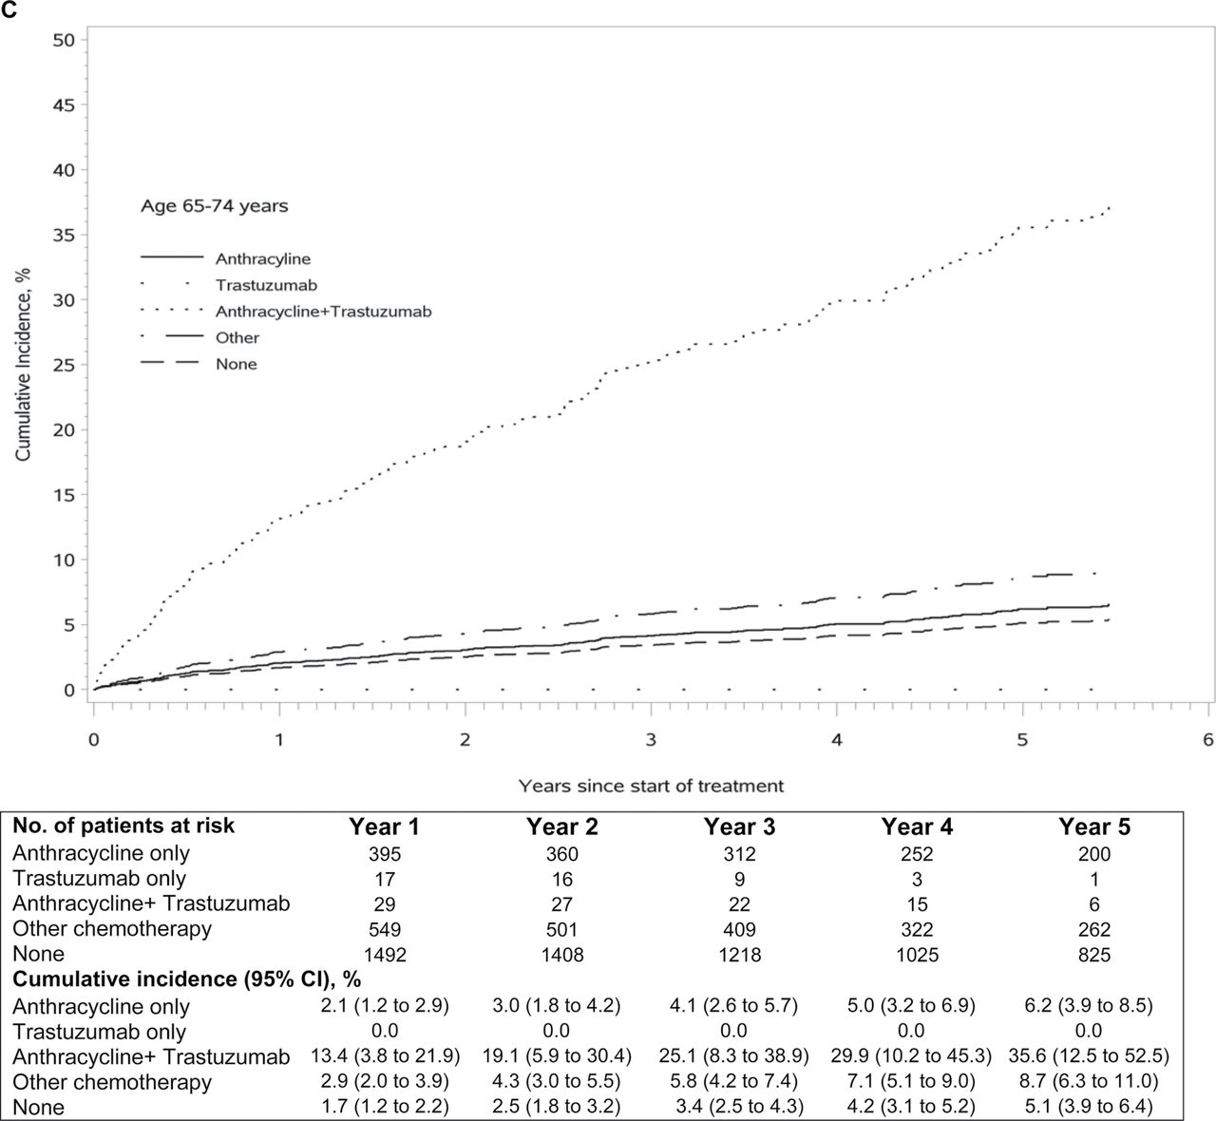
Figure 2. Cumulative incidence of heart failure and/or cardiomyopathy (HF/CM) in women with invasive breast cancer ...
Notes:
Figure 2. Cumulative incidence of heart failure and/or cardiomyopathy (HF/CM) in women with invasive breast cancer over 5 years by adjuvant chemotherapy and age groups. Adjusted cumulative incidence of HF/CM and number of patients at risk by exposure group (anthracycline only, trastuzumab only, anthracycline &#x002B; trastuzumab, other chemotherapy, or none) for the first 5 years of follow-up, by age at diagnosis. Cumulative incidence was adjusted for Cancer Research Network (CRN) site (eight sites), age at diagnosis (<55, 55–64, 65–74, ≥75 years), Charlson comorbidity index (0, 1, 2, ≥3), summary stage at diagnosis (local vs regional), year of diagnosis (categorical for each year), and radiation treatment (yes vs no). A ) Age <55 years. B ) Age 55–64 years. C ) Age 65–74 years. D ) Age ≥75 years.
Unless provided in the caption above, the following copyright applies to the content of this slide: © The Author 2012. Published by Oxford University Press. All rights reserved.This is an Open Access article distributed under the terms of the Creative Commons Attribution Non-Commercial License (http://creativecommons.org/licenses/bync/3.0/uk/) which permits unrestricted noncommercial use, distribution, and reproduction in any medium, provided the original work is properly cited.

Slide 4
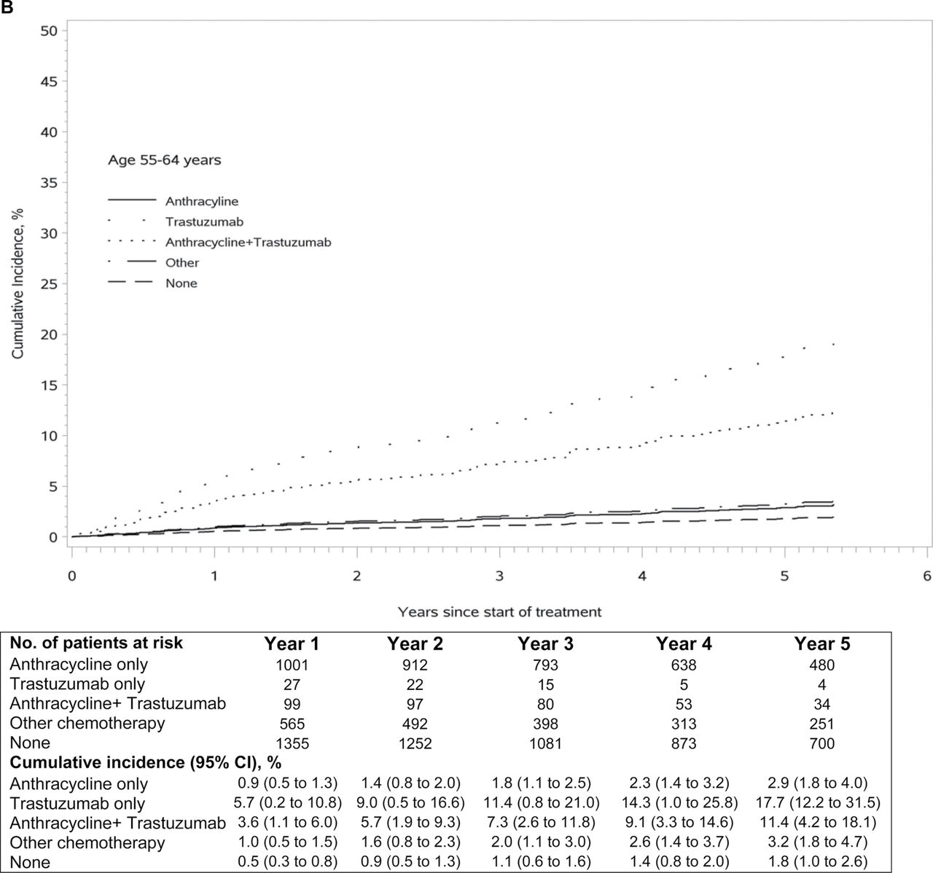
Figure 2. Cumulative incidence of heart failure and/or cardiomyopathy (HF/CM) in women with invasive breast cancer ...
Notes:
Figure 2. Cumulative incidence of heart failure and/or cardiomyopathy (HF/CM) in women with invasive breast cancer over 5 years by adjuvant chemotherapy and age groups. Adjusted cumulative incidence of HF/CM and number of patients at risk by exposure group (anthracycline only, trastuzumab only, anthracycline &#x002B; trastuzumab, other chemotherapy, or none) for the first 5 years of follow-up, by age at diagnosis. Cumulative incidence was adjusted for Cancer Research Network (CRN) site (eight sites), age at diagnosis (<55, 55–64, 65–74, ≥75 years), Charlson comorbidity index (0, 1, 2, ≥3), summary stage at diagnosis (local vs regional), year of diagnosis (categorical for each year), and radiation treatment (yes vs no). A ) Age <55 years. B ) Age 55–64 years. C ) Age 65–74 years. D ) Age ≥75 years.
Unless provided in the caption above, the following copyright applies to the content of this slide: © The Author 2012. Published by Oxford University Press. All rights reserved.This is an Open Access article distributed under the terms of the Creative Commons Attribution Non-Commercial License (http://creativecommons.org/licenses/bync/3.0/uk/) which permits unrestricted noncommercial use, distribution, and reproduction in any medium, provided the original work is properly cited.

Slide 5
Figure 2. Cumulative incidence of heart failure and/or cardiomyopathy (HF/CM) in women with invasive breast cancer ...
Notes:
Figure 2. Cumulative incidence of heart failure and/or cardiomyopathy (HF/CM) in women with invasive breast cancer over 5 years by adjuvant chemotherapy and age groups. Adjusted cumulative incidence of HF/CM and number of patients at risk by exposure group (anthracycline only, trastuzumab only, anthracycline &#x002B; trastuzumab, other chemotherapy, or none) for the first 5 years of follow-up, by age at diagnosis. Cumulative incidence was adjusted for Cancer Research Network (CRN) site (eight sites), age at diagnosis (<55, 55–64, 65–74, ≥75 years), Charlson comorbidity index (0, 1, 2, ≥3), summary stage at diagnosis (local vs regional), year of diagnosis (categorical for each year), and radiation treatment (yes vs no). A ) Age <55 years. B ) Age 55–64 years. C ) Age 65–74 years. D ) Age ≥75 years.
Unless provided in the caption above, the following copyright applies to the content of this slide: © The Author 2012. Published by Oxford University Press. All rights reserved.This is an Open Access article distributed under the terms of the Creative Commons Attribution Non-Commercial License (http://creativecommons.org/licenses/bync/3.0/uk/) which permits unrestricted noncommercial use, distribution, and reproduction in any medium, provided the original work is properly cited.

