Slide 1
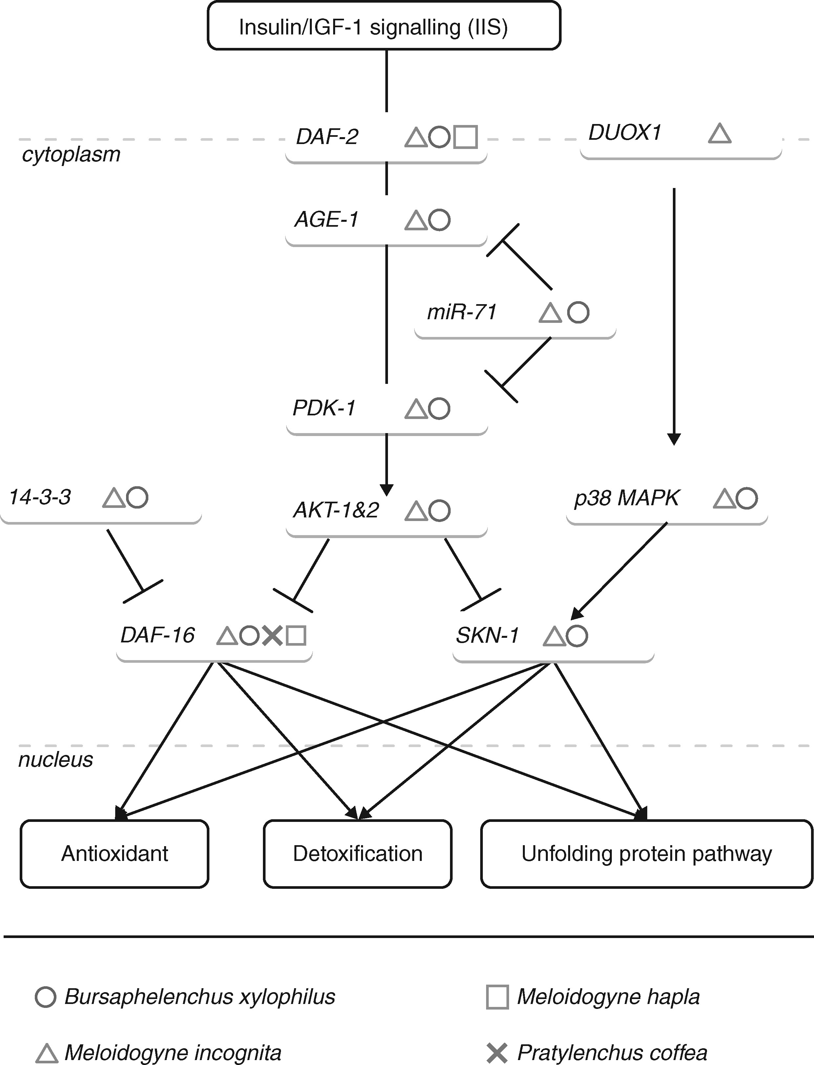
Fig. 1. Regulatory components of DAF-16 and SKN-1 identified in plant-parasitic nematodes. DAF-2 is the insulin ...
Notes:
Fig. 1. Regulatory components of DAF-16 and SKN-1 identified in plant-parasitic nematodes. DAF-2 is the insulin receptor during IIS signaling. In C. elegans, IIS signalling activates the phosphorylation cascade of PDK-1/AKT, leading to the sequestration of DAF-16 and SKN-1 in the cytoplasm. miR-71 expression inhibits the phosphorylation cascade, allowing the translocation of DAF-16 and SKN-1 to the nucleus. The genes identified for B. xylophilus, M. incognita, M. hapla or P. coffea are tagged with a dedicated symbol (see key). The most relevant regulatory components of DAF-16 and SKN-1 are highlighted here according to the identification of the orthologous genes between plant-parasitic nematodes and C. elegans.
Unless provided in the caption above, the following copyright applies to the content of this slide: © The Author 2017. Published by Oxford University Press on behalf of the Annals of Botany Company.This is an Open Access article distributed under the terms of the Creative Commons Attribution License (http://creativecommons.org/licenses/by/4.0/), which permits unrestricted reuse, distribution, and reproduction in any medium, provided the original work is properly cited.

Slide 2
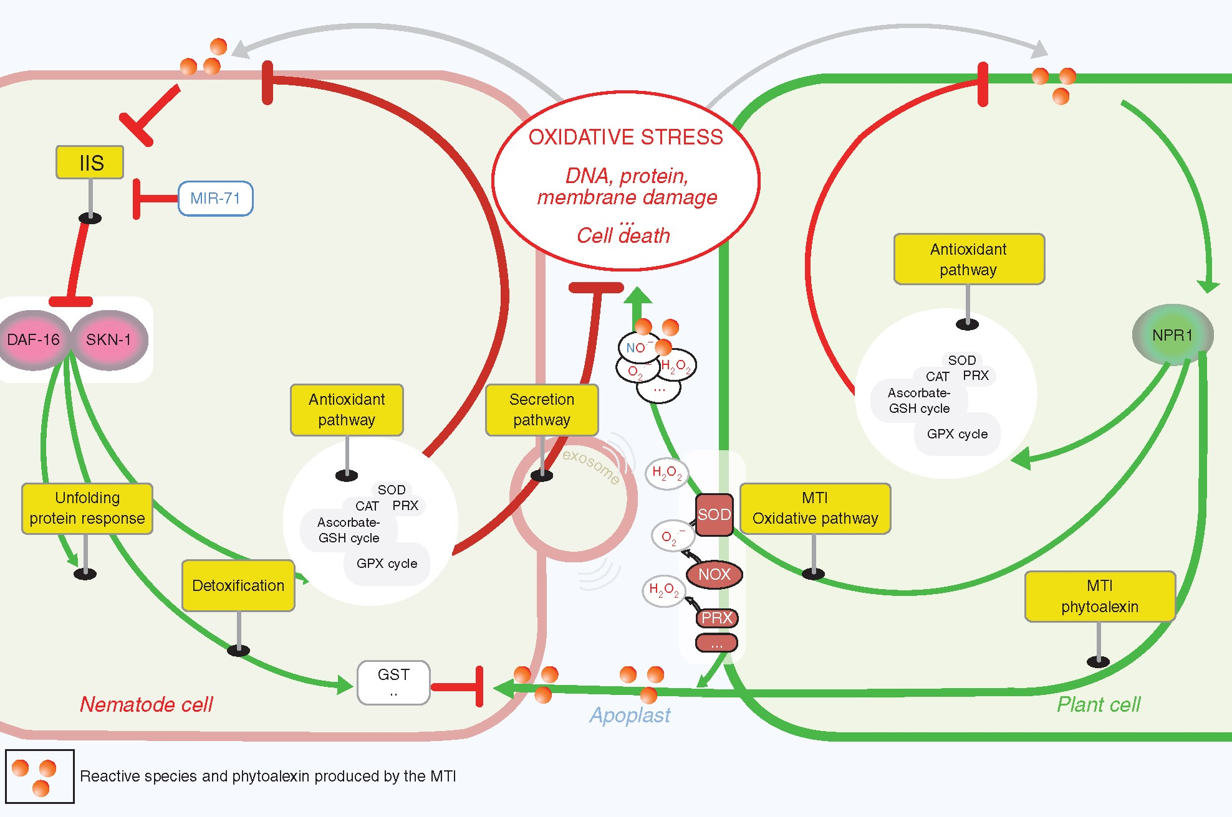
Fig. 2. How do plant-parasitic nematodes alleviate the stress of an apoplast ‘on fire’? A model is proposed to ...
Notes:
Fig. 2. How do plant-parasitic nematodes alleviate the stress of an apoplast ‘on fire’? A model is proposed to explain the DAF-16 and SKN-1 functions that were orchestrated within different cellular pathways to resist the release of toxic compounds (reactive species and phytoalexins) by the plant cell early in infection. In this model, the nematodes sense the physiological state of the plant cell by detecting reactive species, and they generate an adapted response. The findings illustrated in this figure are based primarily on multi-omic resources from plant-parasitic nematodes and functional genomics data from the nematode model system C. elegans. The plant defence response activates the oxidative pathway, leading to the release of reactive species in the apoplast. At the same time, the plant activates its antioxidant pathway to protect the plant cell from oxidative damage. Secondary metabolism is modulated to produce phytoalexins, which represent xenobiotics to the nematode cell. Additionally, the perception of reactive species leads the nematode cell to activate its oxidative stress response. In C. elegans, this pathway is orchestrated by DAF-16 and SKN-1, two transcription factors that are conserved in the animal kingdom. DAF-16 and SKN-1 are negatively regulated by the insulin/IGF-1 signalling (IIS) pathway and positively regulated by miR-71. As in the plant cell, the activation of the antioxidant pathways has a cytoprotective function. In parallel, ROS-scavenging enzymes can be secreted in the apoplast to mitigate the plant’s oxidative burst. The unfolding protein response (UPR) adapts cellular homeostasis and protects proteins directly from oxidative damage induced by oxidative stress. The detoxification pathway covers the phytoalexins produced by the plant cell to suppress their toxicity. GSH, glutathione; CAT, catalase; PER, peroxidase; PRX, peroxiredoxin; SOD, superoxide dismutase; GPX, glutathione peroxidase; SKN-1, skinhead transcription factor-1; DAF-16, dauer formation 16; DAF-12, dauer formation-12; NPR1, non-pathogenic related protein-1; NOX, NADPH oxidase; MTI, MAMP-triggered immunity; MIR-71, micro RNA-71; IIS, insulin IGF1 signalling.
Unless provided in the caption above, the following copyright applies to the content of this slide: © The Author 2017. Published by Oxford University Press on behalf of the Annals of Botany Company.This is an Open Access article distributed under the terms of the Creative Commons Attribution License (http://creativecommons.org/licenses/by/4.0/), which permits unrestricted reuse, distribution, and reproduction in any medium, provided the original work is properly cited.

