Slide 1
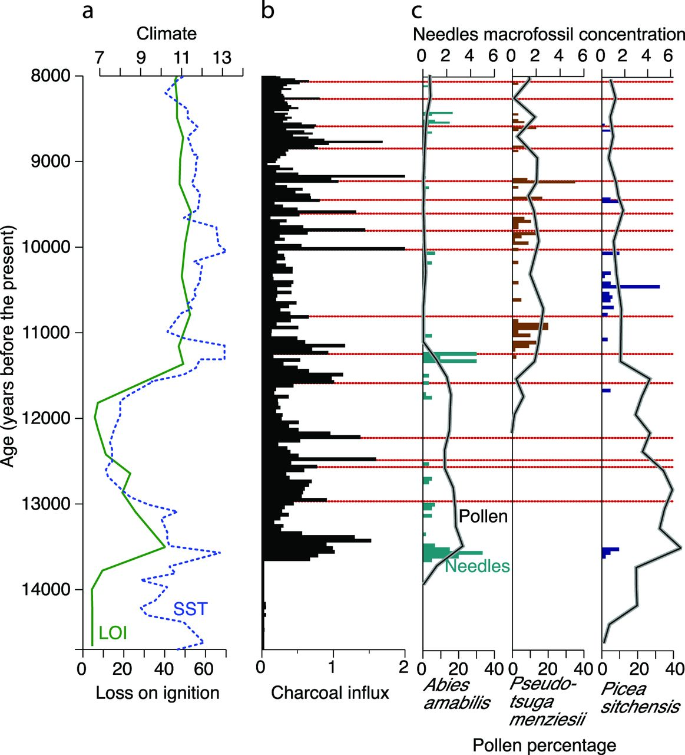
Figure 1. Paleoecological studies capture long-term disturbance histories, state changes in vegetation, and coarse ...
Notes:
Figure 1. Paleoecological studies capture long-term disturbance histories, state changes in vegetation, and coarse measures of carbon stores. Multiproxy sedimentary data from Yahoo Lake, Washington, show how climate affects biomass and how fire mediates tree species composition during periods of rapid climate change (Gavin et al. 2013). (a) Organic content (loss on ignition [LOI], expressed as a percentage) and climate estimated by sea surface temperature (SST, in degrees Celsius) in the northeast Pacific Ocean. (b) Macroscopic charcoal stratigraphy quantified at 1-centimeter intervals. The red lines indicate inferred fire events near the lake. (c) The percentage of pollen (the black lines) and needle macrofossil concentration (the number of needles per 5 cubic meters of sediment; the colored bars) for three coniferous tree species.
Unless provided in the caption above, the following copyright applies to the content of this slide: © The Author(s) 2014. Published by Oxford University Press on behalf of the American Institute of Biological Sciences. All rights reserved. For Permissions, please e-mail: journals.permissions@oup.com.

Slide 2
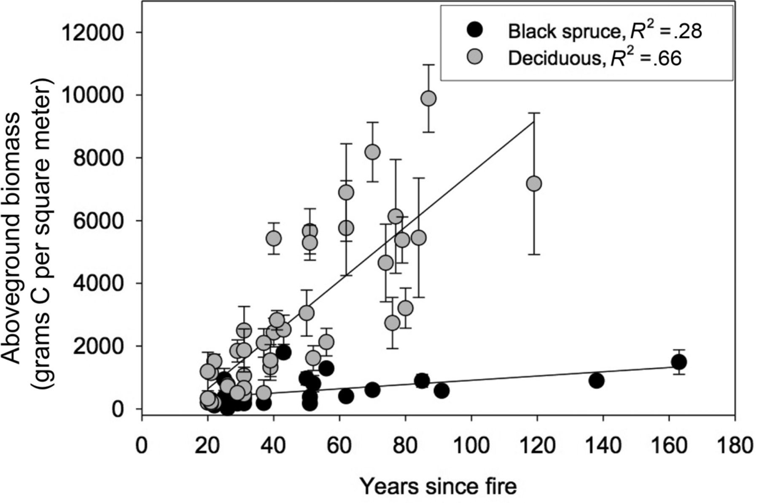
Figure 2. Postfire aboveground carbon (C) accumulation in forests in Alaska. The postfire vegetation type determines ...
Notes:
Figure 2. Postfire aboveground carbon (C) accumulation in forests in Alaska. The postfire vegetation type determines the rate of C accumulation in living aboveground biomass. The error bars represent the standard error.
Unless provided in the caption above, the following copyright applies to the content of this slide: © The Author(s) 2014. Published by Oxford University Press on behalf of the American Institute of Biological Sciences. All rights reserved. For Permissions, please e-mail: journals.permissions@oup.com.

Slide 3
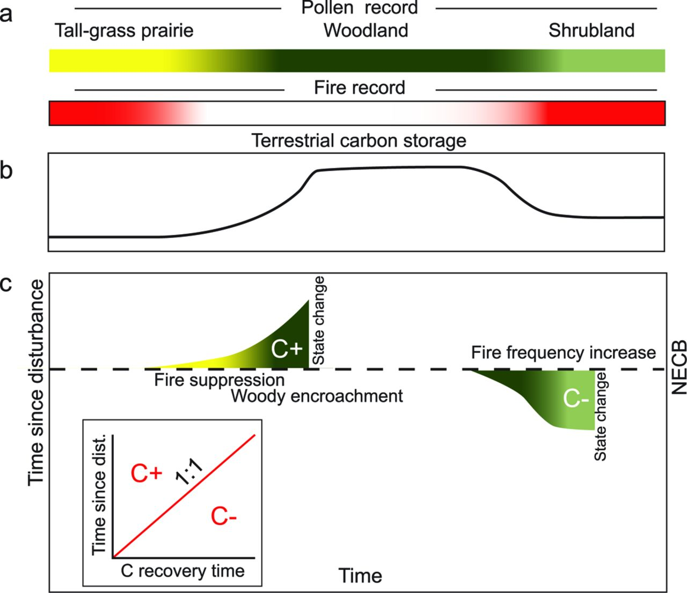
Figure 3. Long-term ecosystem carbon (C) state in the context of disturbance regimes. (a) How this would be recorded in ...
Notes:
Figure 3. Long-term ecosystem carbon (C) state in the context of disturbance regimes. (a) How this would be recorded in the charcoal and pollen paleorecords of a sediment core. (b) Carbon storage in the ecosystem. (c) The underlying processes of a shift in net ecosystem C balance (NECB), including state changes in vegetation and disturbance regime.
Unless provided in the caption above, the following copyright applies to the content of this slide: © The Author(s) 2014. Published by Oxford University Press on behalf of the American Institute of Biological Sciences. All rights reserved. For Permissions, please e-mail: journals.permissions@oup.com.

Slide 4
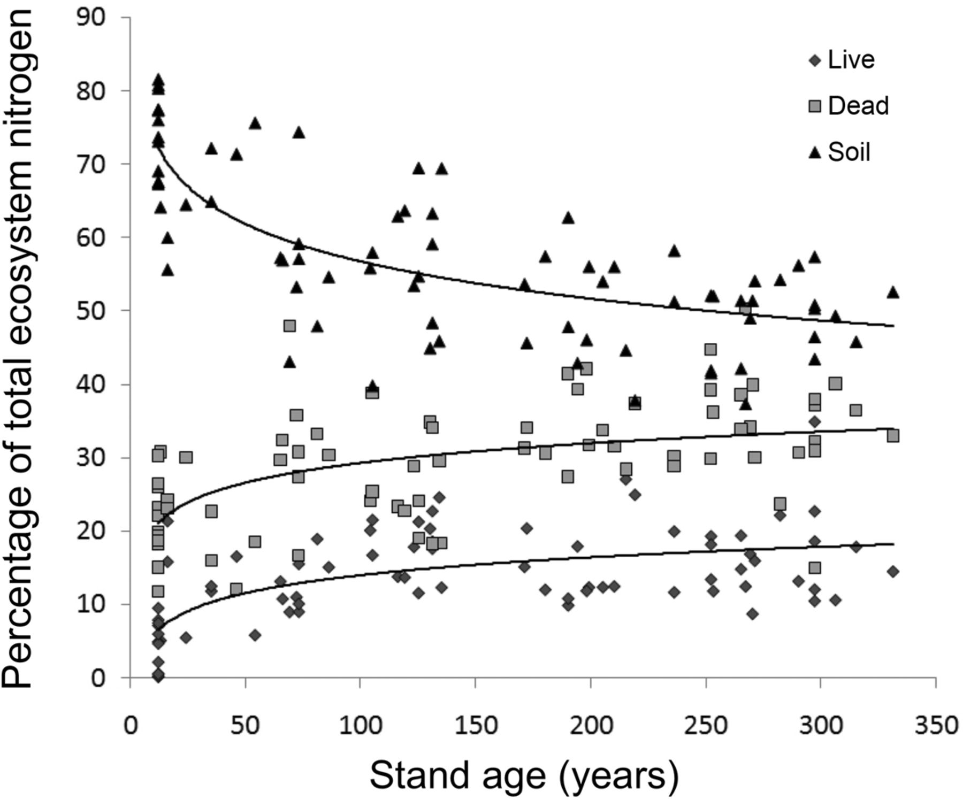
Figure 4. A well-replicated postdisturbance chronosequence of lodgepole pine (Pinus contorta var. latifolia) forests in ...
Notes:
Figure 4. A well-replicated postdisturbance chronosequence of lodgepole pine (Pinus contorta var. latifolia) forests in the western United States shows an equilibration of ecosystem nitrogen pools but a redistribution of ecosystem nitrogen among the pools after a disturbance. Source: Reprinted with permission from Smithwick and colleagues (2009)).
Unless provided in the caption above, the following copyright applies to the content of this slide: © The Author(s) 2014. Published by Oxford University Press on behalf of the American Institute of Biological Sciences. All rights reserved. For Permissions, please e-mail: journals.permissions@oup.com.

Slide 5
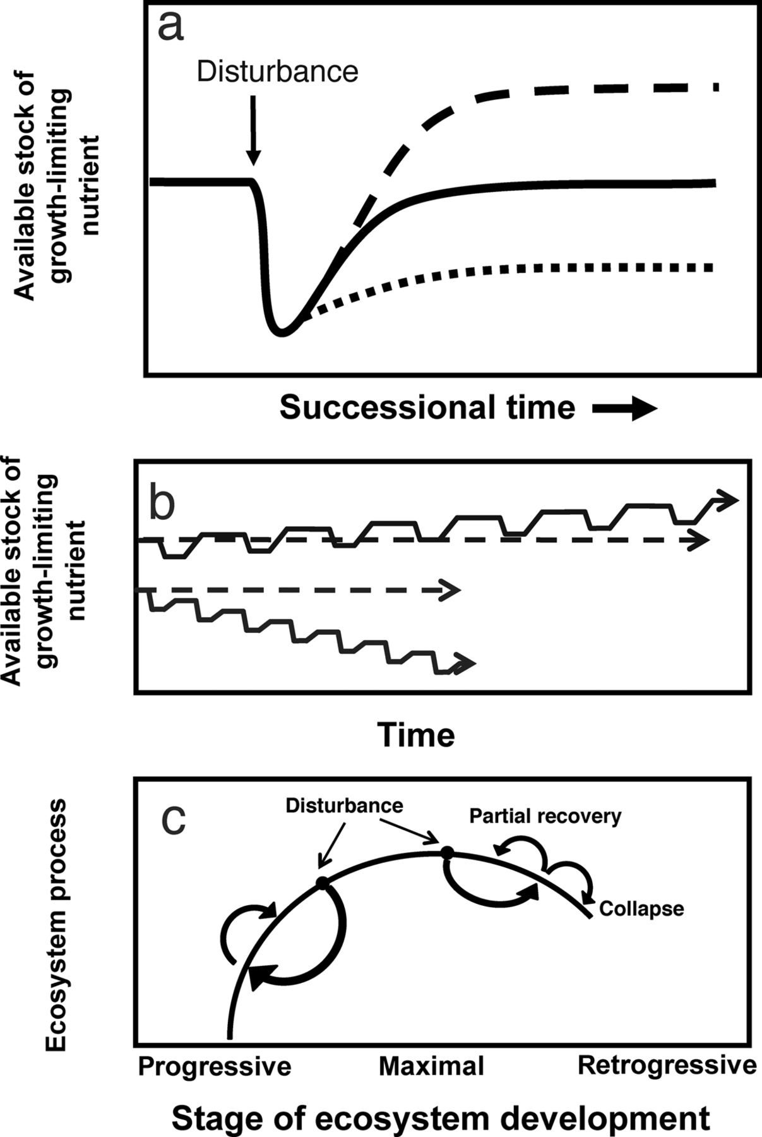
Figure 5. The response of available stocks of growth-limiting nutrients to disturbance. (a) A single disturbance event ...
Notes:
Figure 5. The response of available stocks of growth-limiting nutrients to disturbance. (a) A single disturbance event may serve to increase or decrease or may not affect net stocks of a nutrient, depending on postdisturbance accumulation and loss rates. (b) Over time, a disturbance regime may gradually increase or decrease nutrient availability, a phenomenon that we term the biogeochemical staircase. (c) Over longer timescales, ecosystems often experience the onset of phosphorus limitation and reduced net primary productivity, known as retrogression. In the oldest stages of ecosystems, disturbances can serve to replenish nutrients. Source: Panel (c) was adapted from Peltzer and colleagues (2010)).
Unless provided in the caption above, the following copyright applies to the content of this slide: © The Author(s) 2014. Published by Oxford University Press on behalf of the American Institute of Biological Sciences. All rights reserved. For Permissions, please e-mail: journals.permissions@oup.com.

Slide 6
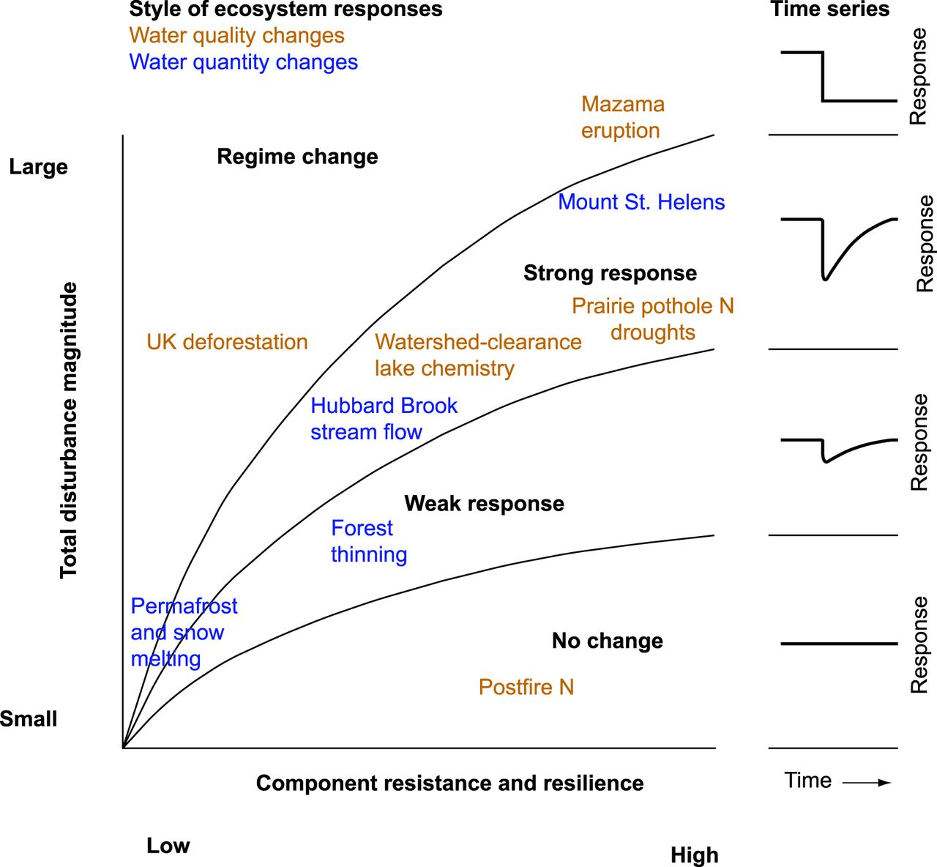
Figure 6. Four types of hydrologic responses to disturbances, encapsulating the range of responses demonstrated in ...
Notes:
Figure 6. Four types of hydrologic responses to disturbances, encapsulating the range of responses demonstrated in various paleorecords, observations, and modern experiments. Red indicates a response of water quality, and blue indicates a response of water quantity. Abbreviation: N, nitrogen.
Unless provided in the caption above, the following copyright applies to the content of this slide: © The Author(s) 2014. Published by Oxford University Press on behalf of the American Institute of Biological Sciences. All rights reserved. For Permissions, please e-mail: journals.permissions@oup.com.

