Slide 1
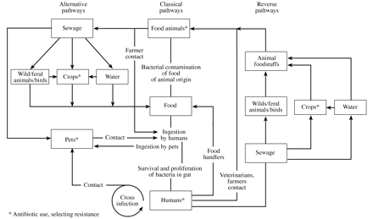
Figure 1. Some routes of transmission of antibiotic-susceptible or -resistant gastrointestinal pathogens or ...
Notes:
Figure 1. Some routes of transmission of antibiotic-susceptible or -resistant gastrointestinal pathogens or normal intestinal flora between animals and humans.
Unless provided in the caption above, the following copyright applies to the content of this slide: The British Society for Antimicrobial Chemotherapy

Slide 2
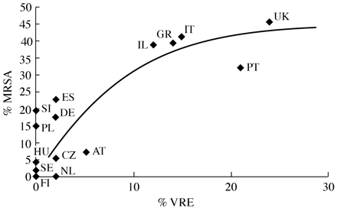
Figure 2. Prevalence of MRSA and VRE (E. faecium) in Europe based on EARSS report 2001.85 Those countries ...
Notes:
Figure 2. Prevalence of MRSA and VRE (E. faecium) in Europe based on EARSS report 2001.85 Those countries that reported on the susceptibility of <10 isolates of E. faecium have been excluded. The UK figure for VRE is based on information from the UK ARMRL Newsletter (June 1999). AT, Austria; CZ, Czech Republic; DE, Germany; ES, Spain; FI, Finland; GR, Greece; HU, Hungary; IL, Israel; IT, Italy; NL, the Netherlands; PL, Poland; PT, Portugal; SE, Sweden; SI, Slovenia; UK, United Kingdom.
Unless provided in the caption above, the following copyright applies to the content of this slide: The British Society for Antimicrobial Chemotherapy

