Slide 1
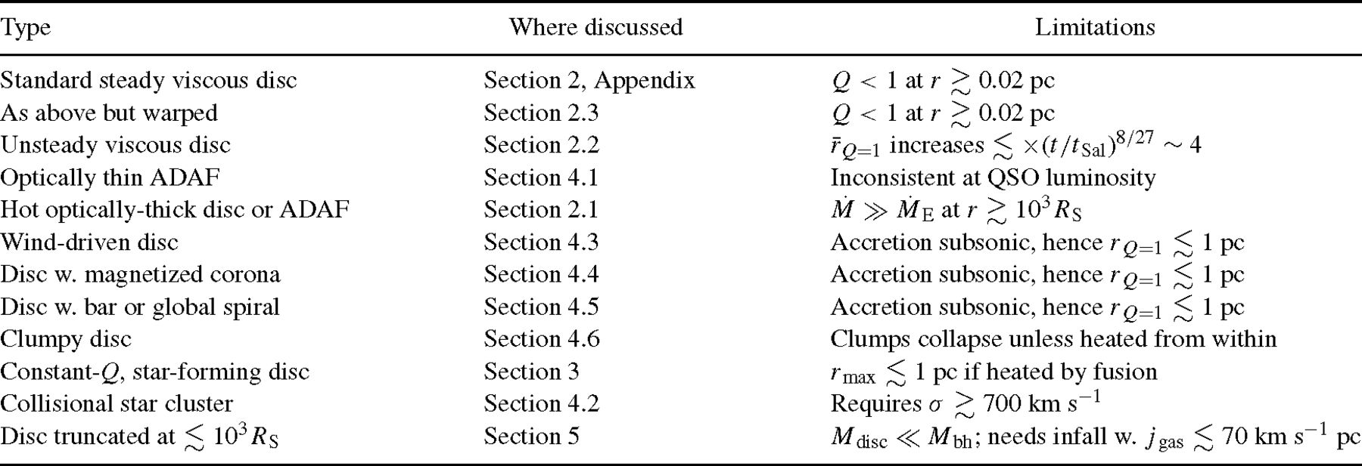
Table 1 Accretion solutions and their limitations.
Notes:
Table 1 Accretion solutions and their limitations.
Unless provided in the caption above, the following copyright applies to the content of this slide: © © 2003 RAS 2003

Slide 2
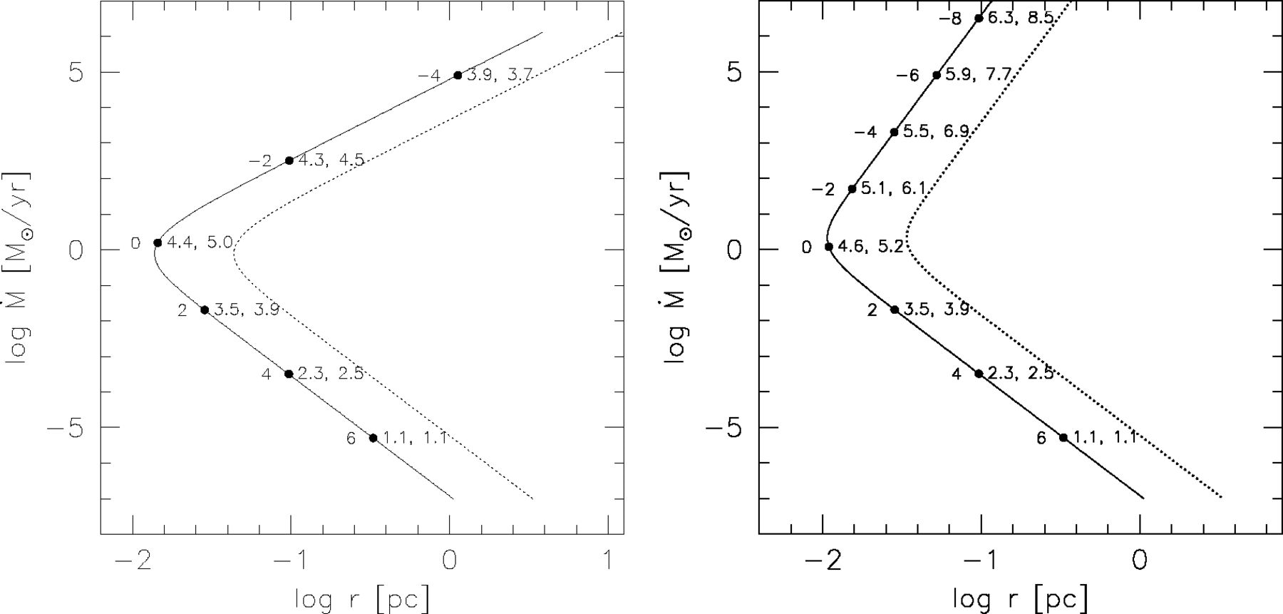
Figure 1 Loci of constant Q for black-hole masses M = 10⁸ M⊙ (solid) and M = 10^{9.5} ...
Notes:
Figure 1 Loci of constant Q for black-hole masses M = 108 M⊙ (solid) and M = 109.5 M⊙ (dashed), α = 0.3, and κ = 0.4 cm2 g−1. Left panel: b = 0, i.e. viscosity proportional to total pressure. Right panel: b = 1, ν∝pgas. Filled circles are labelled (left to right) with log (pgas/prad), log T (K), log Σ (g cm−2).
Unless provided in the caption above, the following copyright applies to the content of this slide: © © 2003 RAS 2003

