Slide 1
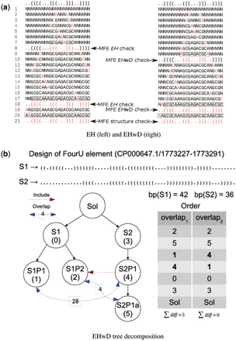
Fig. 1. Examples of CP search for helixes versus EHwDs and EHwDs decomposition heuristic. ( a ) MFE structure check ...
Notes:
Fig. 1. Examples of CP search for helixes versus EHwDs and EHwDs decomposition heuristic. ( a ) MFE structure check made for EH on the left, and EHwD on the right. In each line, either a new base pair (2 positions) or a new nucleotide (1 position) is instantiated, following the variable order heuristic . For simplification, this example assumes that correct value assignments are made in each instantiation step. ( b ) Tree decomposition for target structure S1 (resp. S2 ) at temperature T1 (resp. T2 ), using target structures for the FourU element CP000647.1/1773227-1773291. The table on the right presents the order of helix exploration using overlap1 and overlap2 heuristics
Unless provided in the caption above, the following copyright applies to the content of this slide: © The Author 2016. Published by Oxford University Press. This is an Open Access article distributed under the terms of the Creative Commons Attribution Non-Commercial License ( http://creativecommons.org/licenses/by-nc/4.0/ ), which permits non-commercial re-use, distribution, and reproduction in any medium, provided the original work is properly cited. For commercial re-use, please contact journals.permissions@oup.com

Slide 2
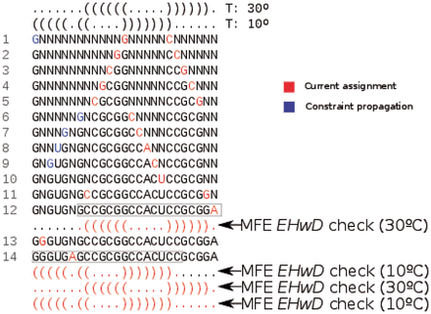
Fig. 2. Example of CP search for target structures S₁ (top) at temperature 30 °C, and S₂ ...
Notes:
Fig. 2. Example of CP search for target structures S1 (top) at temperature 30 °C, and S2 (bottom) at temperature 10 °C. Undetermined positions are assigned (red) in the following order: base pairs are instantiated in lines 1,2,3,4,5,13; unpaired positions in lines 6,7,8,9,10,14; a closing base pair in line 11; a dangling position in line 12. When the left nucleotide of a base pair is instantiated to C (resp. A), then propagation of the base pairing constraint reduces the domain of possible values of the right nucleotide of the base pair from {A,C,G,U} to the set {G} [resp. {U} ]—this happens in lines 1, 6–9. For simplification, this example assumes that correct value assignments always occur at each search step
Unless provided in the caption above, the following copyright applies to the content of this slide: © The Author 2016. Published by Oxford University Press. This is an Open Access article distributed under the terms of the Creative Commons Attribution Non-Commercial License ( http://creativecommons.org/licenses/by-nc/4.0/ ), which permits non-commercial re-use, distribution, and reproduction in any medium, provided the original work is properly cited. For commercial re-use, please contact journals.permissions@oup.com

Slide 3
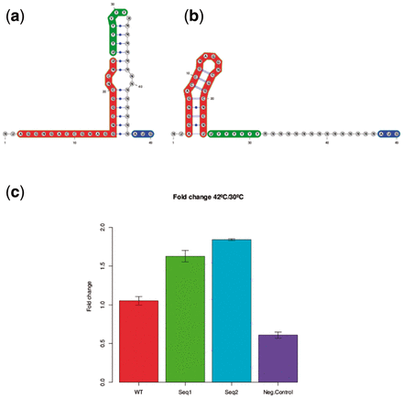
Fig. 3. ( a and b ) Target structures S₁ at temperature 30 °C (a) and S₂ at temperature 42 °C ...
Notes:
Fig. 3. ( a and b ) Target structures S1 at temperature 30 °C (a) and S2 at temperature 42 °C (b) for domain 5 thermo-IRES element with added AUG codon (blue). IUPAC sequence constraints are determined from an alignment of 183 IRES sequences as shown in Figure 1 of Fernandez et al. (2011) . Domain 5 stem-loop (positions 3-24 in red) and unpaired polypyrimidine tract (PPT positions 25–32 in green) are known to be essential for IRES activity ( Kuhn et al. , 1990 ). Target structure S1 was designed to sequester the PPT at low temperature, thus creating a thermo-IRES which should be functional only at high temperature. ( c ) Ratio of normalized IRES activity at 42 °C over that at 30 °C for wild-type FMDV IRES, a negative control, and two thermosensors designed using RNAiFold2T
Unless provided in the caption above, the following copyright applies to the content of this slide: © The Author 2016. Published by Oxford University Press. This is an Open Access article distributed under the terms of the Creative Commons Attribution Non-Commercial License ( http://creativecommons.org/licenses/by-nc/4.0/ ), which permits non-commercial re-use, distribution, and reproduction in any medium, provided the original work is properly cited. For commercial re-use, please contact journals.permissions@oup.com

Slide 4
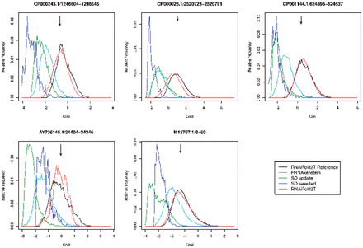
Fig. 4. Relative frequency of the cost function optimized by SwitchDesign, for solutions returned by RNAiFold2T, ...
Notes:
Fig. 4. Relative frequency of the cost function optimized by SwitchDesign, for solutions returned by RNAiFold2T, SwitchDesign and Frnakenstein, given target structure S1 (resp. S2 ) at temperature T1 (resp. T2 ) for λ phage CIII thermoregulators from Rfam family RF01804. This figure is a more generous representation of the data from SwitchDesign and Frnakenstein, since all single point mutant solutions have been added to the raw output. ( Supplementary Figure S1 presents histograms for the raw output of these programs.) The reference distribution for RNAiFold2T Reference (black curve), was produced by running RNAiFold2T for several days. Remaining curves are for Frnakenstein (light green), SwitchDesign (dark green and purple) and RNAiFold2T (red). Arrows indicate cost values for the real λ phage CIII thermoregulators from Rfam RF01804. Distribution for SD and FRNA without additional single point mutants shown in Supplementary Material . Supplementary Figures S1 and S3 show clearly that cost function values for Rfam sequences approximately equal the reference distribution mean
Unless provided in the caption above, the following copyright applies to the content of this slide: © The Author 2016. Published by Oxford University Press. This is an Open Access article distributed under the terms of the Creative Commons Attribution Non-Commercial License ( http://creativecommons.org/licenses/by-nc/4.0/ ), which permits non-commercial re-use, distribution, and reproduction in any medium, provided the original work is properly cited. For commercial re-use, please contact journals.permissions@oup.com

Slide 5
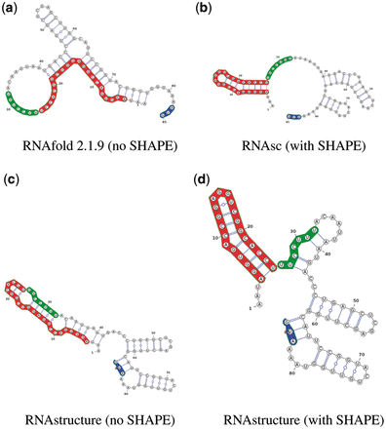
Fig. 5. Secondary structure predictions of domain 5 of wild-type FMDV IRES, including the first functional AUG start ...
Notes:
Fig. 5. Secondary structure predictions of domain 5 of wild-type FMDV IRES, including the first functional AUG start codon, both with and without integration of probing data using selective 2′ -hydroxyl acylation analyzed by primer extension (SHAPE). ( a ) RNAfold 2.1.9, which does not incorporate SHAPE data. ( b ) RNAsc ( Zarringhalam et al. , 2012 ), which penalizes deviations from SHAPE data for both base paired and loop regions. ( c ) RNAstructure ( Reuter and Mathews, 2010 ) without SHAPE data. ( d ) RNAstructure ( Deigan et al. , 2009 ), which penalizes deviations from SHAPE data only for base paired regions. The polypyrimidine tract (PPT) is unbound in only structures (a) from RNAfold 2.1.9 and (b) from RNAsc, compatible with the full IRES structure appearing in Figure 1 of Fernandez et al. (2011)
Unless provided in the caption above, the following copyright applies to the content of this slide: © The Author 2016. Published by Oxford University Press. This is an Open Access article distributed under the terms of the Creative Commons Attribution Non-Commercial License ( http://creativecommons.org/licenses/by-nc/4.0/ ), which permits non-commercial re-use, distribution, and reproduction in any medium, provided the original work is properly cited. For commercial re-use, please contact journals.permissions@oup.com

