Slide 1
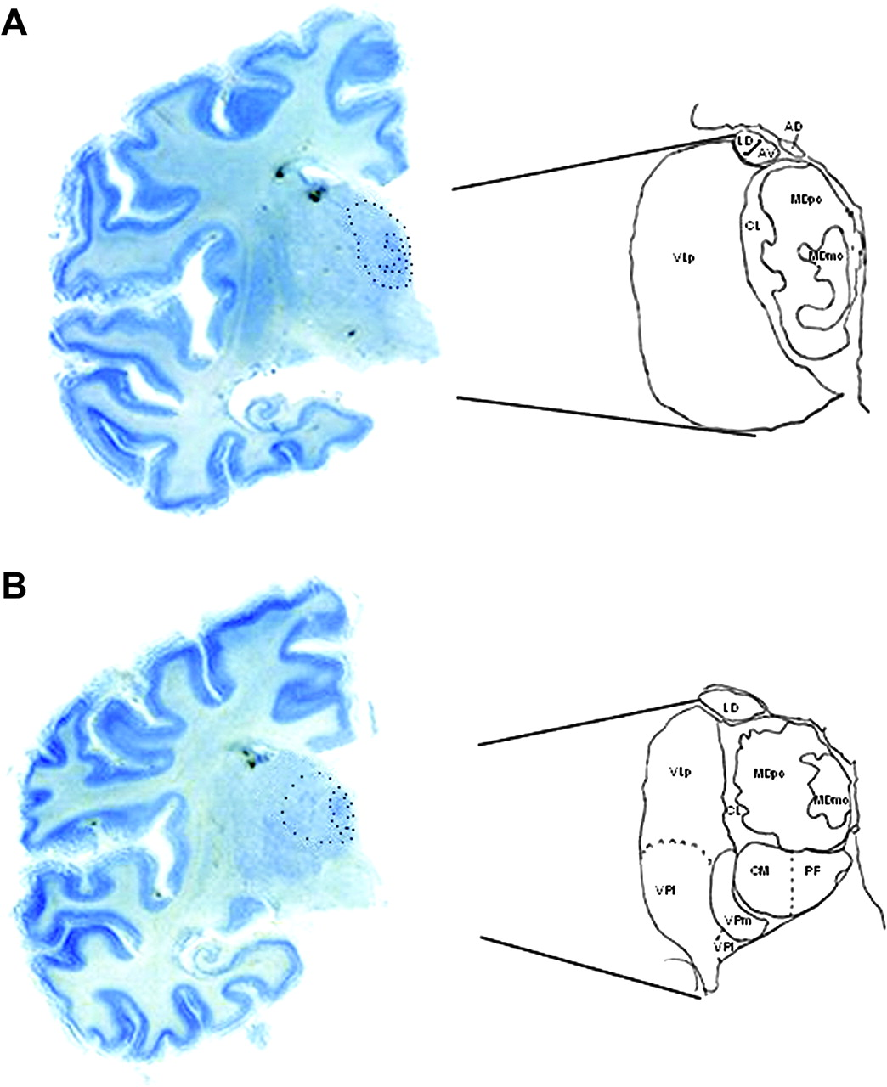
Figure 1. Photomicrographs showing the delineation of the subregions in the newborn MD at 2 different coronal ...
Notes:
Figure 1. Photomicrographs showing the delineation of the subregions in the newborn MD at 2 different coronal positions, 3 mm apart, (A) anterior and (B) posterior. AV, anteroventral nucleus; AD, anterodorsal nucleus; LD, laterodorsal nucleus; CM, center median nucleus: PF, parafascicular nucleus; VLp, ventral lateral posterior nucleus; VPL, ventral posterior lateral nucleus; VPM, ventral posterior medial nucleus; VPI, ventral posterior inferior nucleus.
Unless provided in the caption above, the following copyright applies to the content of this slide: © 2007 The AuthorsThis is an Open Access article distributed under the terms of the Creative Commons Attribution Non-Commercial License (http://creativecommons.org/licenses/by-nc/2.0/uk/) which permits unrestricted non-commercial use, distribution, and reproduction in any medium, provided the original work is properly cited.

Slide 2
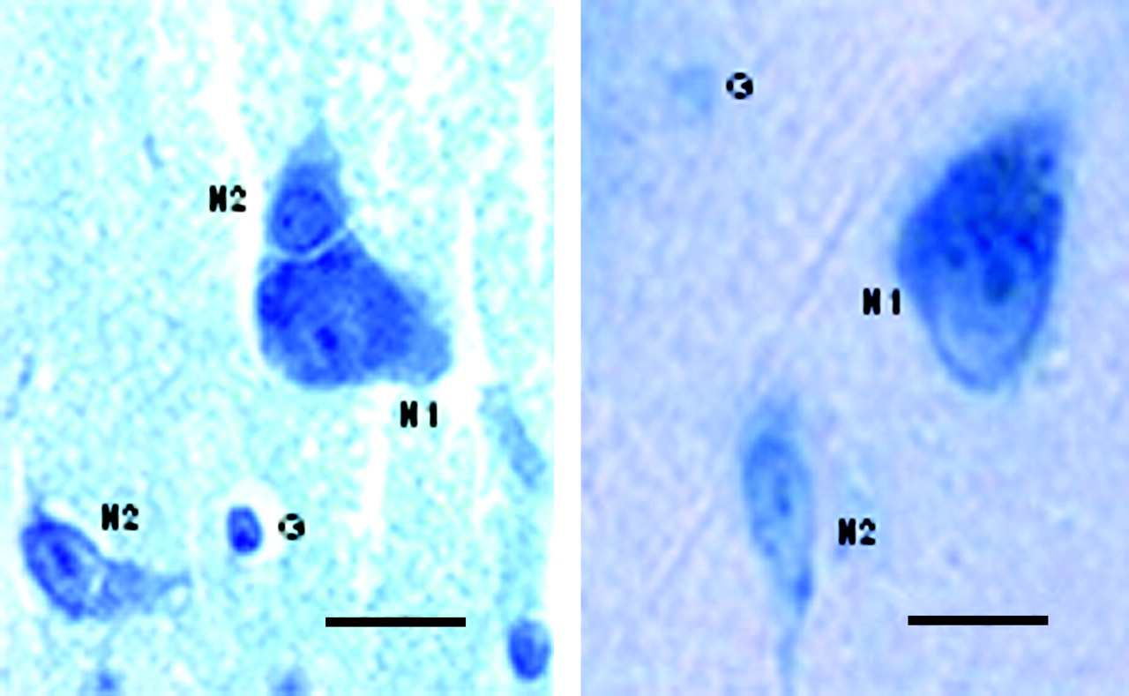
Figure 2. Photomicrographs of Giemsa-stained sections showing examples of large (N1) and small (N2) neurons and glial ...
Notes:
Figure 2. Photomicrographs of Giemsa-stained sections showing examples of large (N1) and small (N2) neurons and glial cells (G) in the MD thalamus. Left panel is from a newborn brain and right panel is from a 65-year-old male subject. Scale bar = 10 μm.
Unless provided in the caption above, the following copyright applies to the content of this slide: © 2007 The AuthorsThis is an Open Access article distributed under the terms of the Creative Commons Attribution Non-Commercial License (http://creativecommons.org/licenses/by-nc/2.0/uk/) which permits unrestricted non-commercial use, distribution, and reproduction in any medium, provided the original work is properly cited.

Slide 3
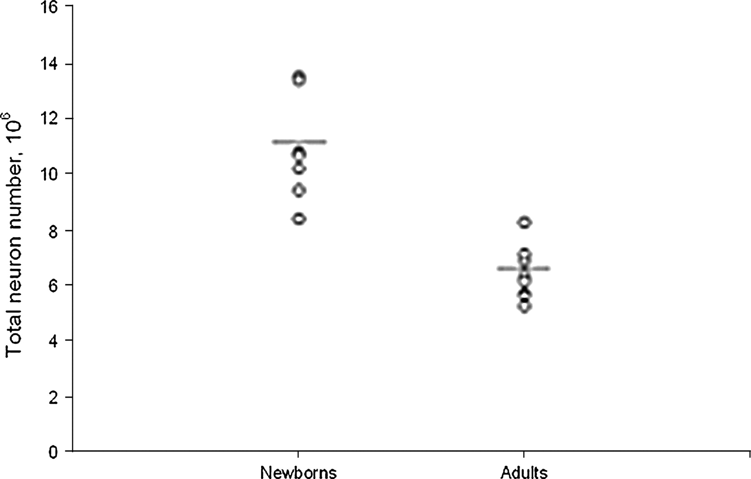
Figure 3. Scatter plot showing the estimates of the total number of neurons in the entire MD thalamus for the newborn ...
Notes:
Figure 3. Scatter plot showing the estimates of the total number of neurons in the entire MD thalamus for the newborn and adult subjects.
Unless provided in the caption above, the following copyright applies to the content of this slide: © 2007 The AuthorsThis is an Open Access article distributed under the terms of the Creative Commons Attribution Non-Commercial License (http://creativecommons.org/licenses/by-nc/2.0/uk/) which permits unrestricted non-commercial use, distribution, and reproduction in any medium, provided the original work is properly cited.

