Slide 1
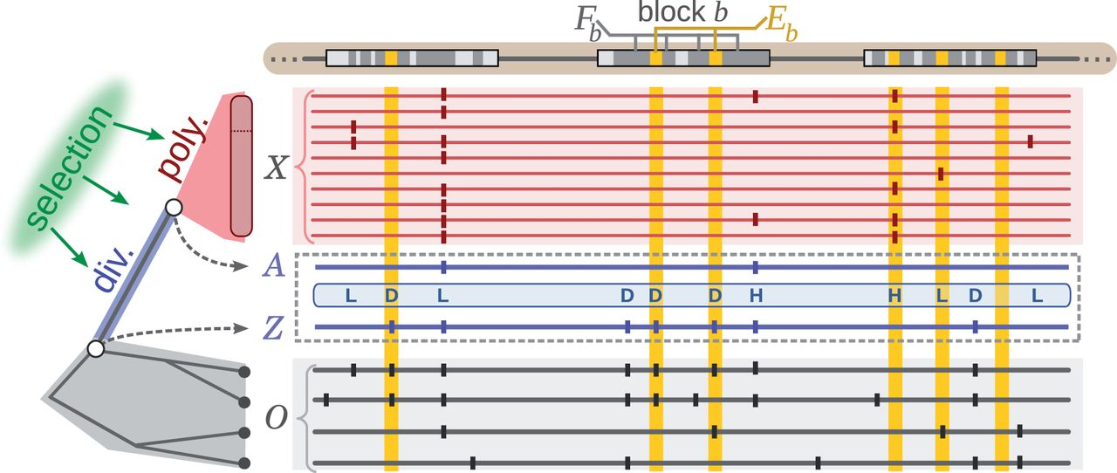
Fig. 1. Schematic description of INSIGHT. The method measures the influence of natural selection by contrasting ...
Notes:
Fig. 1. Schematic description of INSIGHT. The method measures the influence of natural selection by contrasting patterns of polymorphism and divergence in a collection of genomic elements of interest (gold) with those in flanking neutral sites (dark gray). Nucleotide sites in both elements (Eb) and flanks (Fb) are grouped into genomic blocks of a few kilobases in length (b) to accommodate variation along the genome in mutation rate and coalescence time. The model consists of phylogenetic (gray), recent divergence (blue), and intraspecies polymorphism (red) components, which are applied to genome sequences for the target population (X, red) and outgroup species (O, gray). At each nucleotide position, the alleles at the MRCA of the samples from the target population (A) and of the target population and closest outgroup (Z) are represented as hidden variables and treated probabilistically during inference. The allele Z determines whether monomorphic sites are considered to be divergent (D). Polymorphic sites are classified as having low- (L) or high- (H) frequency–derived alleles based on A and a frequency threshold f. The labels shown here are based on a likely setting of Z and A. Vertical ticks represent single nucleotide variants relative to an arbitrary reference. Inference is based on differences in the patterns of polymorphism and divergence expected at neutral and selected sites.
Unless provided in the caption above, the following copyright applies to the content of this slide: © The Author 2013. Published by Oxford University Press on behalf of the Society for Molecular Biology and Evolution. All rights reserved. For permissions, please e-mail: journals.permissions@oup.com

Slide 2
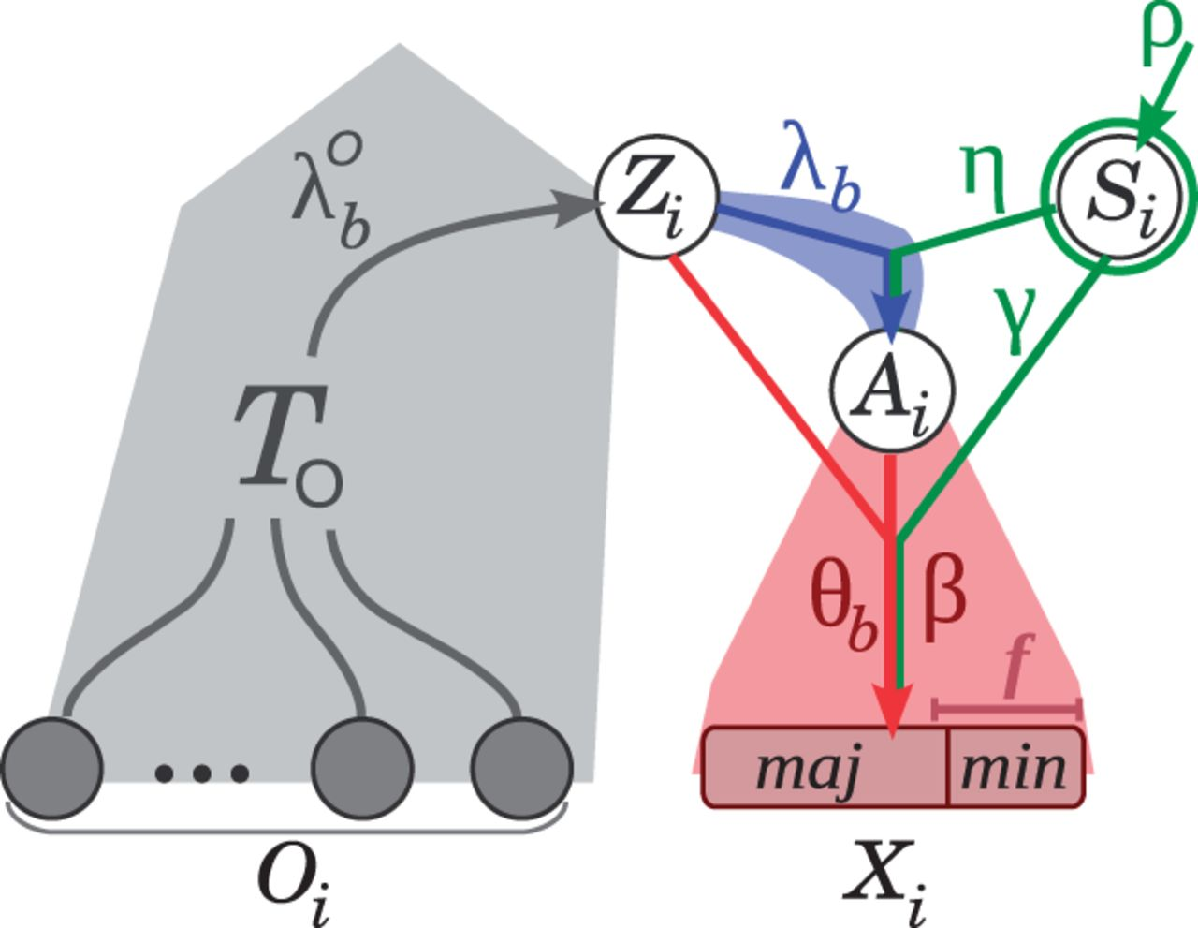
Fig. 2. Graphical model for an individual nucleotide site i. As in figure 1, the phylogenetic portion of the model is ...
Notes:
Fig. 2. Graphical model for an individual nucleotide site i. As in figure 1, the phylogenetic portion of the model is shown in gray, the divergence component in blue, and the polymorphism component in red. Observed variables are represented by solid circles and hidden variables by empty circles. The observed alleles in the target population and outgroups are represented by Xi and Oi, respectively. Xi consists of a major () and minor () allele, as well as the minor allele frequency class (Yi; not shown). The selection class is denoted Si, and the ancestral alleles are denoted Zi and Ai, as described in figure 1. Conditional dependence between the variables is indicated by directed edges, in the standard manner for probabilistic graphical models. Model parameters are shown alongside the associated conditional dependency edges. The selection parameters are highlighted in green.
Unless provided in the caption above, the following copyright applies to the content of this slide: © The Author 2013. Published by Oxford University Press on behalf of the Society for Molecular Biology and Evolution. All rights reserved. For permissions, please e-mail: journals.permissions@oup.com

Slide 3
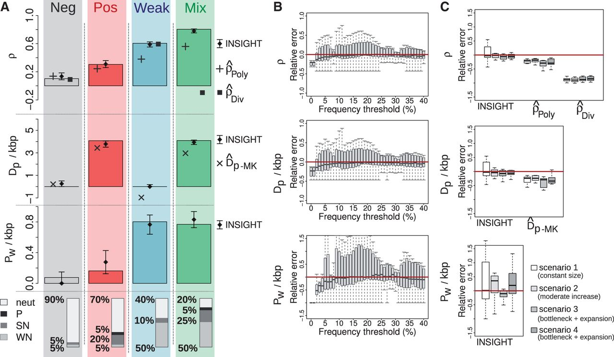
Fig. 3. Simulation results. (A) Parameter estimates for four collections of 20,000 simulated elements based on ...
Notes:
Fig. 3. Simulation results. (A) Parameter estimates for four collections of 20,000 simulated elements based on different mixtures of neutral (neut), positive (P), strong negative (SN), and weak negative (WN) selection (as indicated at bottom). The true values of ρ, , and are indicated by solid bars, and estimates from INSIGHT are indicated by diamonds, with error bars representing one standard error. For comparison, estimates from several simpler count-based methods are also shown, including estimates of ρ based on polymorphism (; “+”) and divergence (; solid squares) rates, and estimates of based on the MK framework (; “×”). Adaptive divergences () and deleterious polymorphisms () are shown as rates per 1,000 base pairs (kbp). See Materials and Methods for details. (B) INSIGHT was applied to 11 collections of 10,000 elements with various fractions of sites under selection (see text), assuming a range of values for the low-frequency derived allele threshold f. Relative estimation errors for ρ, , and , measured as differences between the estimates and true values normalized by the true value, are shown as a function of the frequency threshold f. Each box plot describes the distribution of values for the 11 collections considered. Curvature-based standard errors for these experiments are summarize in supplementary figure S2, Supplementary Material online. (C) Simulated data sets were generated for the same 11 mixtures of selective modes × four different demographic scenarios (supplementary table S2, Supplementary Material online), and INSIGHT parameter estimates were compared with true values. Box plots represent the distribution of relative error per demographic scenario. The relative estimation error for the simple count-based estimators, , , and , is shown for comparison.
Unless provided in the caption above, the following copyright applies to the content of this slide: © The Author 2013. Published by Oxford University Press on behalf of the Society for Molecular Biology and Evolution. All rights reserved. For permissions, please e-mail: journals.permissions@oup.com

Slide 4
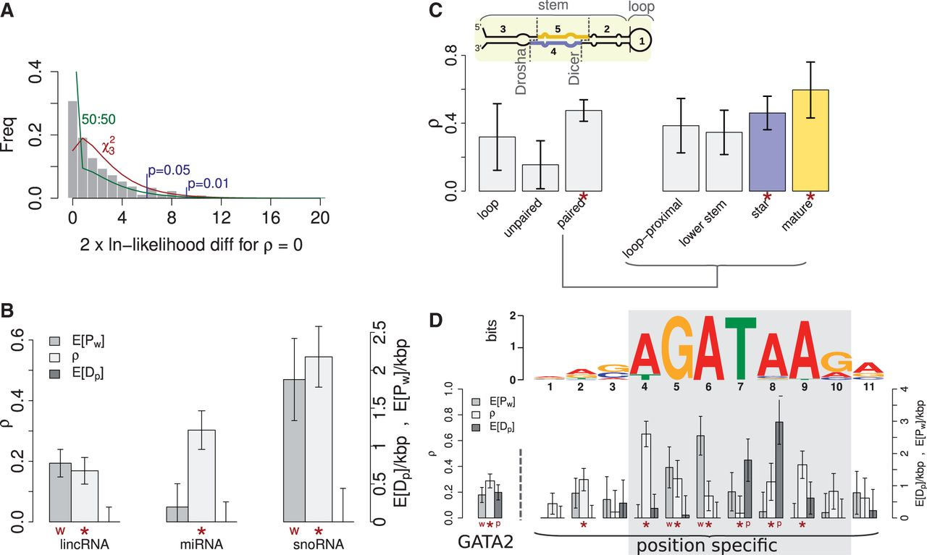
Fig. 4. Analysis of human genomic elements. (A) Distribution of LRT statistics for 500 sampled sets of “neutral” ...
Notes:
Fig. 4. Analysis of human genomic elements. (A) Distribution of LRT statistics for 500 sampled sets of “neutral” genomic elements, with approximately 30,000 elements per set. Test statistics reflect a null hypothesis that and an alternative hypothesis that . For comparison, a distribution (with three degrees of freedom; red) and a 50:50 mixture of a distribution and a point mass at 0 (green) are also shown. Blue lines indicate significance thresholds for and based on the distribution. Four of the 500 data sets (0.8%) had test statistics exceeding the cutoff, and 24 (4.8%) exceeded the cutoff, indicating a reasonably good fit to the tail of the distribution. The distribution of estimated values of ρ is shown in supplementary figure S3, Supplementary Material online. (B) Model-based estimates of ρ, , and for three classes of noncoding RNAs (lincRNAs, miRNAs, and snoRNAs; see Materials and Methods). Error bars indicate one standard error. Symbols in red indicate statistical significance in LRTs for overall selection (; “*” ) and WN selection (; “w” ), based on a distribution for and a distribution for . (C) Estimates of ρ for several structural regions of miRNAs (inset). (Left) Results for a coarse-grained partitioning into loop bases, unpaired stem bases, and paired stem bases. (Right) Results for a fine-grained partitioning of paired bases in the stem into loop-proximal, lower-stem, star, and mature regions, corresponding to the regions that undergo cropping and dicing by Drosha and Dicer (dashed lines). Estimates found to be significantly greater than 0 () are highlighted (“*”). (D) The motif inferred for GATA2 together with position-specific estimates of ρ (left axis), , and (right axis). Statistical significance is assessed and indicated as in (B), with significant positive selection (; “P” ) estimated using a distribution. The “core” seven positions of the motif, having IC, are highlighted in gray. Estimates obtained for the joint analysis of all seven positions of the core motif are shown as well (left).
Unless provided in the caption above, the following copyright applies to the content of this slide: © The Author 2013. Published by Oxford University Press on behalf of the Society for Molecular Biology and Evolution. All rights reserved. For permissions, please e-mail: journals.permissions@oup.com

