Slide 1
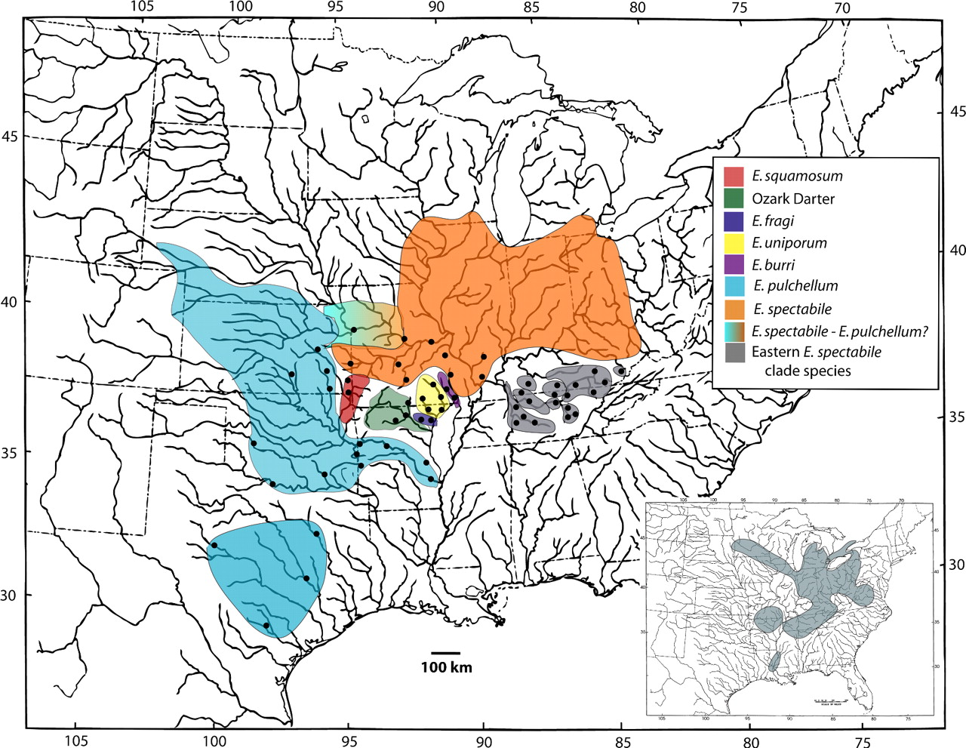
FIGURE 1. Geographic distribution of Etheostoma spectabile clade species. The geographic distributions of species in ...
Notes:
FIGURE 1. Geographic distribution of Etheostoma spectabile clade species. The geographic distributions of species in the Eastern Highlands are colored grey and include Etheostoma bison, Etheostoma tecumsehi, Etheostoma lawrencei, Etheostoma kantuckeense, Mamequit darter, Sheltowee darter, and Ihiyo darter. Region of ambiguous species designation between E. spectabile and Etheostoma pulchellum is indicated. Approximate sampling localities are shown with solid circles. Inset map shows the geographic distribution of Etheostoma caeruleum.
Unless provided in the caption above, the following copyright applies to the content of this slide: © Society of Systematic Biologists

Slide 2
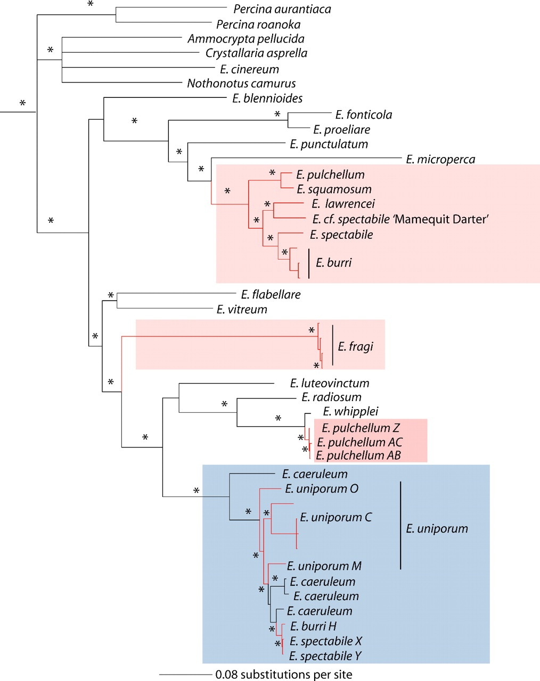
FIGURE 3. A phylogeny of 44 individuals focusing on putative introgressed mitochondrial genomes resulting from the ...
Notes:
FIGURE 3. A phylogeny of 44 individuals focusing on putative introgressed mitochondrial genomes resulting from the partitioned Bayesian analysis of 2 mitochondrial genes, cytband ND2. The red and blue boxes highlight the Etheostoma spectabileand Etheostoma caeruleumclades, respectively. Red branches indicate E. spectabileclade species. Asterisks identify nodes supported by Bayesian posterior probabilities ≥ 95%.
Unless provided in the caption above, the following copyright applies to the content of this slide: © Society of Systematic Biologists

Slide 3
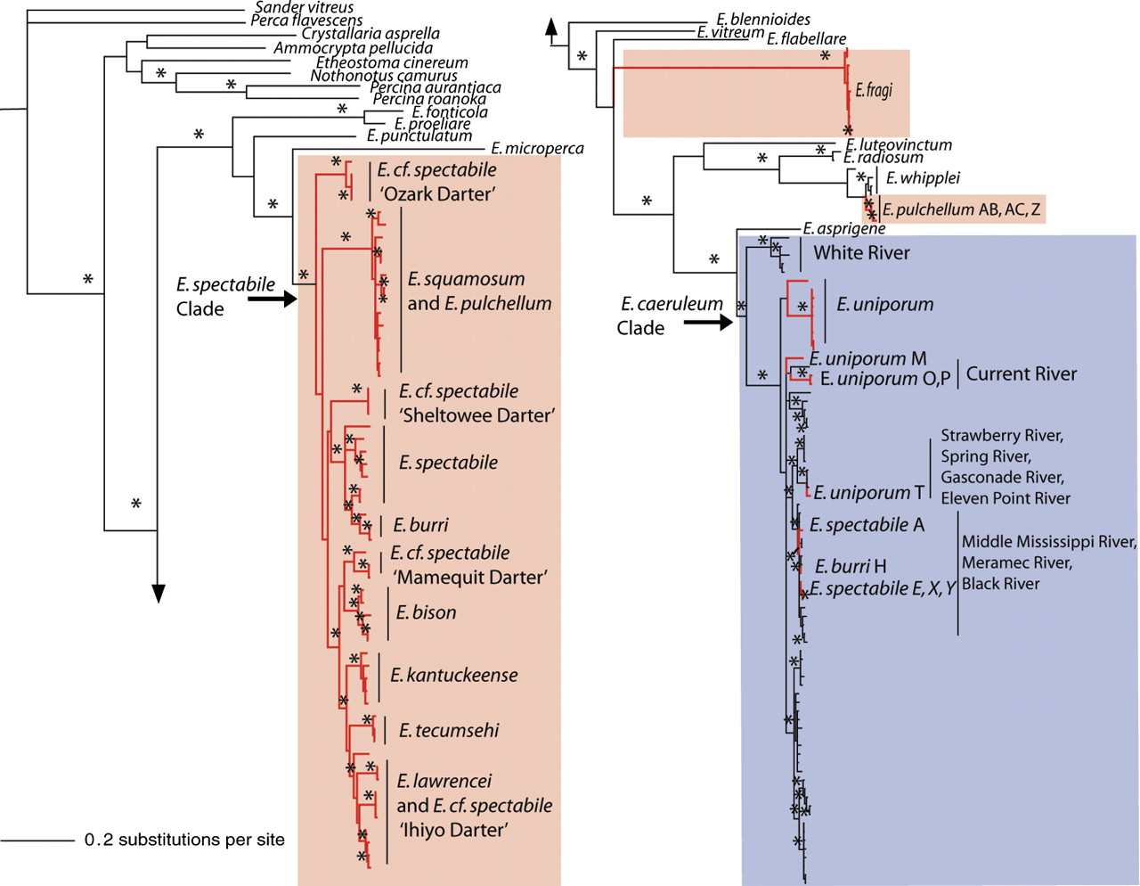
FIGURE 2. Phylogeny resulting from a partitioned Bayesian analysis of mitochondrial cytbgene sequences; the ...
Notes:
FIGURE 2. Phylogeny resulting from a partitioned Bayesian analysis of mitochondrial cytbgene sequences; the phylogenetic tree is connected at the arrowheads. The red block and red branches highlight the Etheostoma spectabileclade species, and the blue box highlights the Etheostoma caeruleumclade. Asterisks identify nodes supported by Bayesian posterior probabilities ≥ 95%.
Unless provided in the caption above, the following copyright applies to the content of this slide: © Society of Systematic Biologists

Slide 4
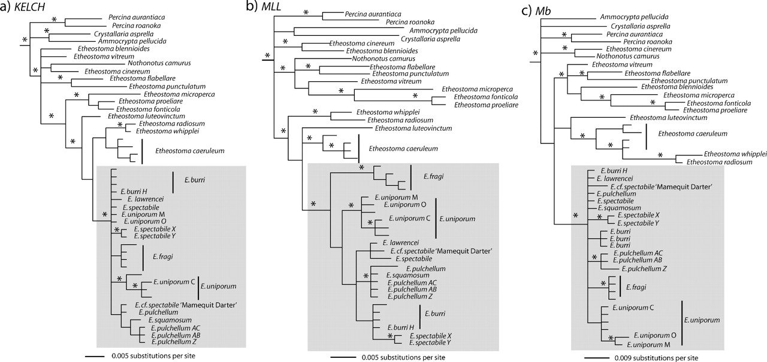
FIGURE 4. Phylogenies resultingfrom partitioned Bayesian analyses of the nuclear genes (a) KELCH, (b) MLL, and (c) Mb. ...
Notes:
FIGURE 4. Phylogenies resultingfrom partitioned Bayesian analyses of the nuclear genes (a) KELCH, (b) MLL, and (c) Mb. The gray box highlights the Etheostoma spectabileclade species. Asterisks identify nodes supported by Bayesian posterior probabilities ≥ 95%.
Unless provided in the caption above, the following copyright applies to the content of this slide: © Society of Systematic Biologists

Slide 5
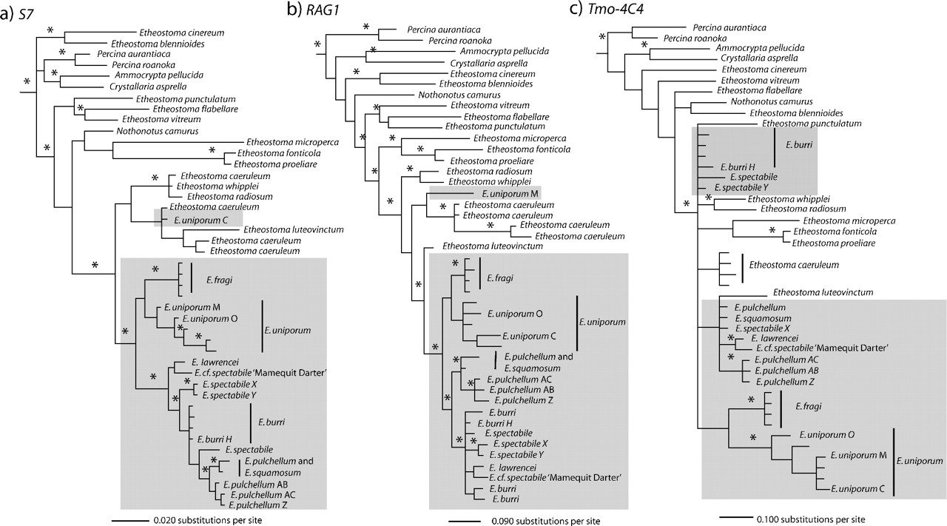
FIGURE 5. Partitioned Bayesian analyses of the nuclear genes (a) ribosomal protein S7 intron 1 (S7), (b) RAG1 exon 3 ...
Notes:
FIGURE 5. Partitioned Bayesian analyses of the nuclear genes (a) ribosomal protein S7 intron 1 (S7), (b) RAG1 exon 3 (RAG1), and (c) Tmo-4C4 (Tmo). The gray box highlights the Etheostoma spectabile clade species. Asterisks identify nodes supported by Bayesian posterior probabilities ≥ 95%.
Unless provided in the caption above, the following copyright applies to the content of this slide: © Society of Systematic Biologists

Slide 6
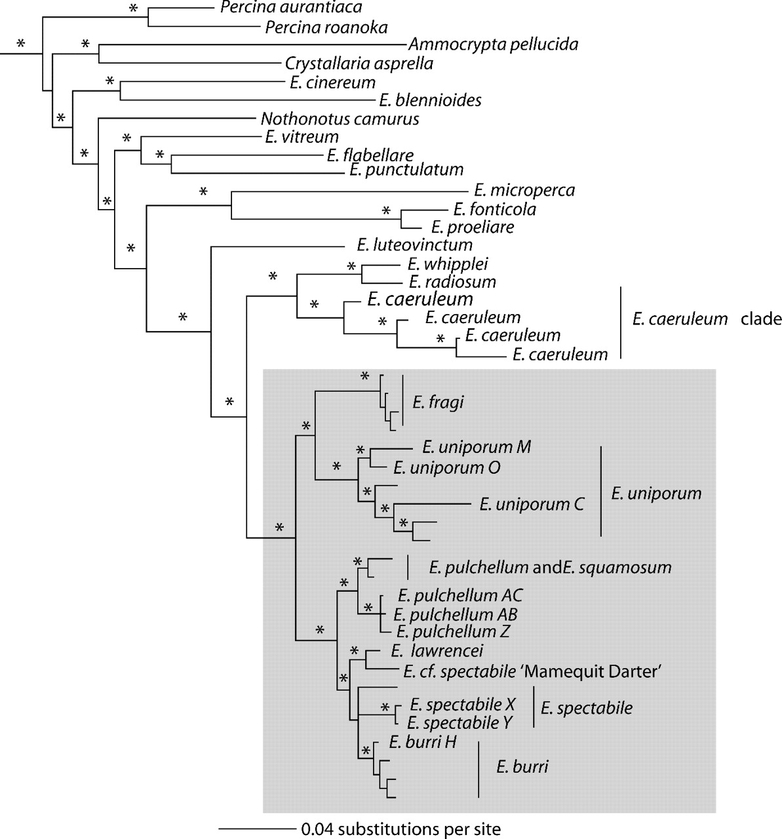
FIGURE 6. Phylogeny resulting from a partitioned Bayesian analysis of the concatenated 6 nuclear genes. The gray box ...
Notes:
FIGURE 6. Phylogeny resulting from a partitioned Bayesian analysis of the concatenated 6 nuclear genes. The gray box encloses the Etheostoma spectabile clade species. Asterisks identify nodes supported by Bayesian posterior probabilities ≥ 95%.
Unless provided in the caption above, the following copyright applies to the content of this slide: © Society of Systematic Biologists

Slide 7
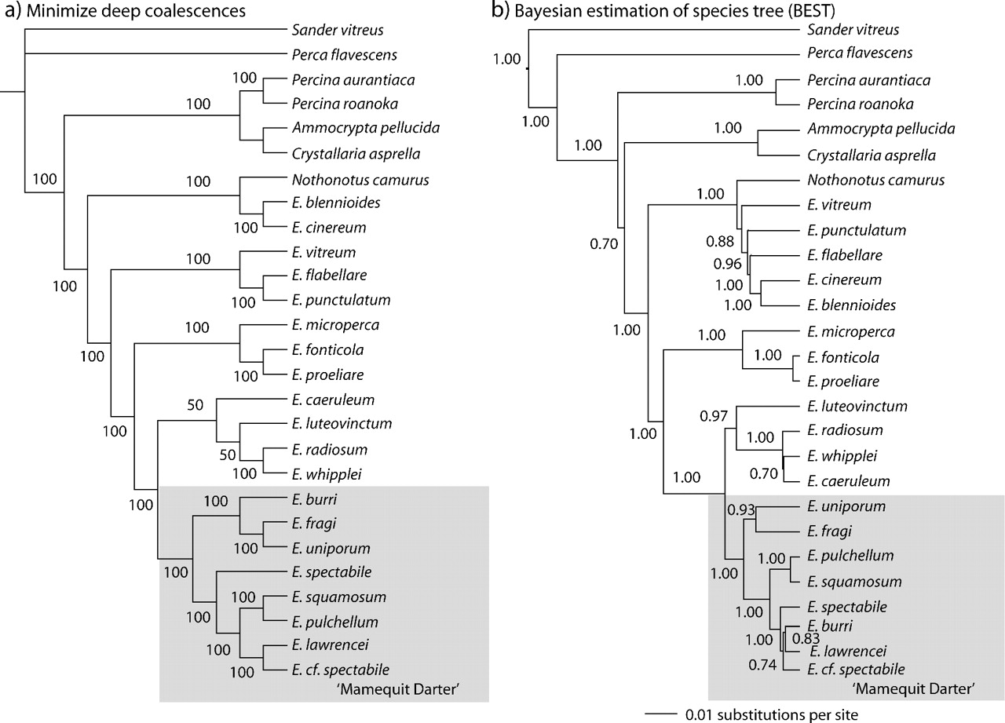
FIGURE 7. Results from species tree analyses. (a) A 50% majority rule consensus tree resulting from a minimizing deep ...
Notes:
FIGURE 7. Results from species tree analyses. (a) A 50% majority rule consensus tree resulting from a minimizing deep coalescences analysis. A gray box encloses Etheostoma spectabile clade species. Values at nodes represent consensus support. (b) A 50% majority rule consensus tree resulting from a BEST analysis. A gray box encloses E. spectabile clade species. Values at nodes represent posterior probability support.
Unless provided in the caption above, the following copyright applies to the content of this slide: © Society of Systematic Biologists

Slide 8
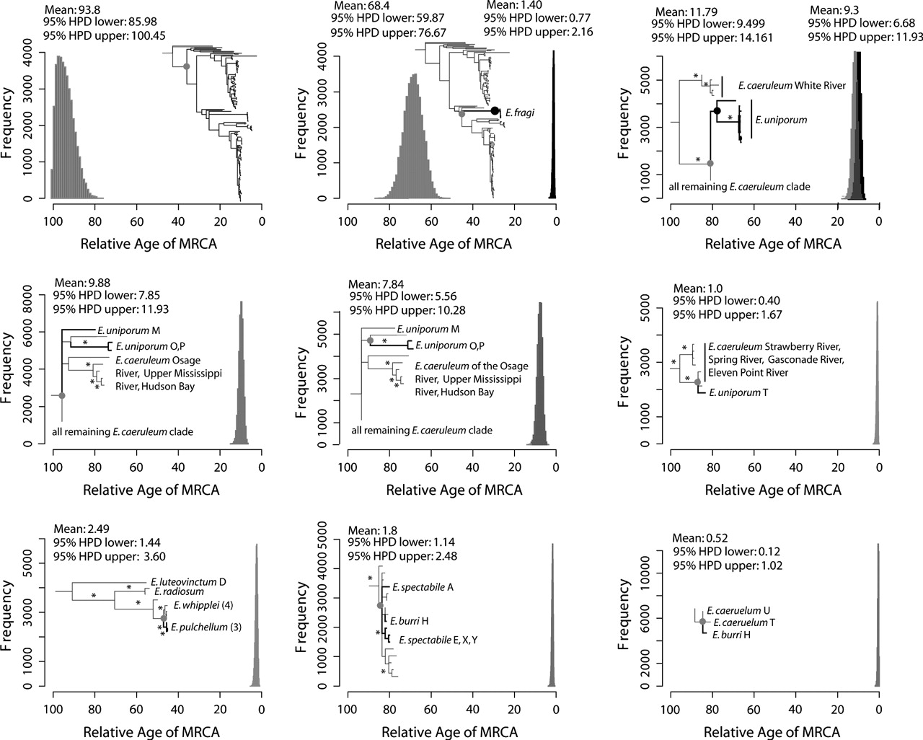
FIGURE 8. Histograms of the posterior density of relative ages for the MRCA of each identified mtDNA introgression ...
Notes:
FIGURE 8. Histograms of the posterior density of relative ages for the MRCA of each identified mtDNA introgression event, as estimated using BEAST, with the same taxon sampling as the mitochondrial gene tree presented in Figure 2. Circles identify the node age presented in the histogram, and the color of the marked node (gray or black) matches that of the histogram when multiple nodes are dated in a single graph. Thick branches in the phylogenies mark heterospecific haplotype lineages found in Etheostoma spectabile clade species. The mean age is reported as well as the 95% upper and lower HPD. The first histogram estimates the relative age of the MRCA of the entire darter clade.
Unless provided in the caption above, the following copyright applies to the content of this slide: © Society of Systematic Biologists

