Slide 1
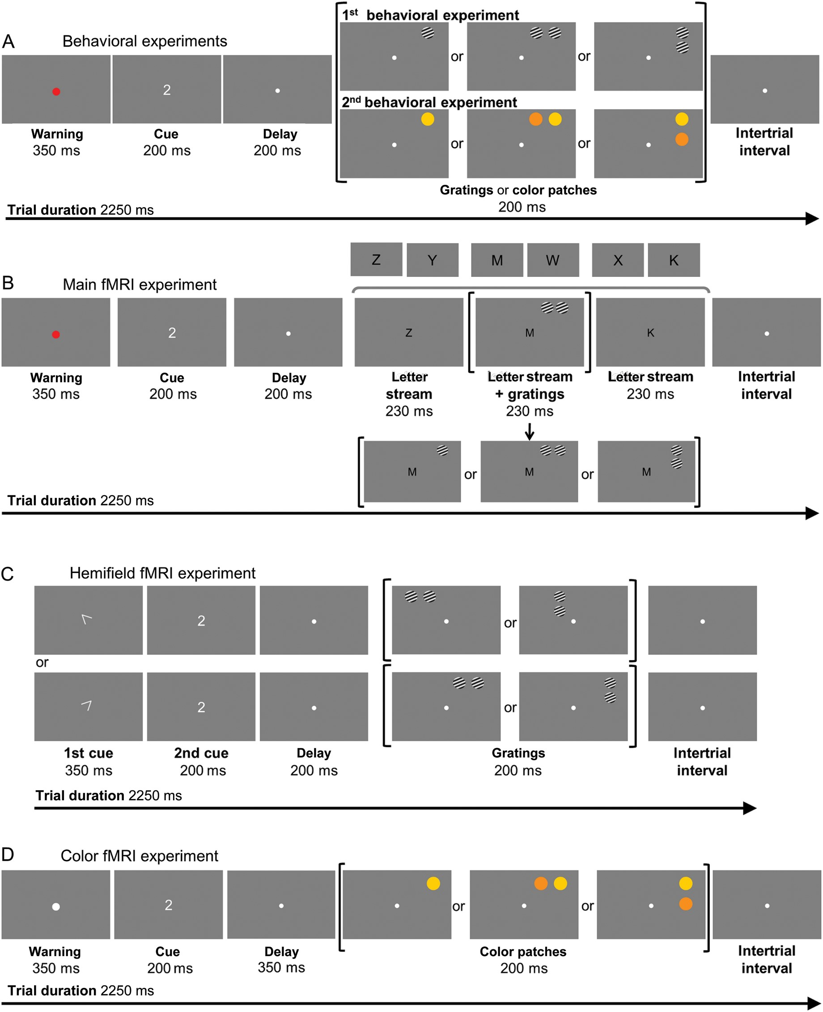
Figure 1. Experimental paradigm. (A) In the behavioral experiments, a digit cued attention to a location in the upper ...
Notes:
Figure 1. Experimental paradigm. (A) In the behavioral experiments, a digit cued attention to a location in the upper right visual field. The target at the cued location was presented either on its own or simultaneously with a competing distracter. In that case, target and distracter were configured along the horizontal or the vertical axis. (B) In the main fMRI experiment, we simultaneously presented a central letter stream and peripheral gratings. Subjects were instructed to determine whether or not the letter stream contained the letter X, or to discriminate the orientation of the grating presented at the target location. In each trial, 1 or 2 gratings were presented in the upper right visual field. In case of 2 gratings, they were configured along the horizontal or the vertical axis. (C) In the hemifield fMRI experiment, oriented gratings appeared in the right upper visual field or in the left upper visual field. The target at the cued location was always presented simultaneously with a competing distracter. Target and distracter were configured along the horizontal or the vertical axis. (D) In the color fMRI experiment, the target at the cued location was presented either on its own or simultaneously with a competing distracter. In that case, target and distracter were configured along the horizontal or the vertical axis.
Unless provided in the caption above, the following copyright applies to the content of this slide: © The Author 2012. Published by Oxford University Press. All rights reserved. For Permissions, please e-mail: journals.permissions@oup.com

Slide 2
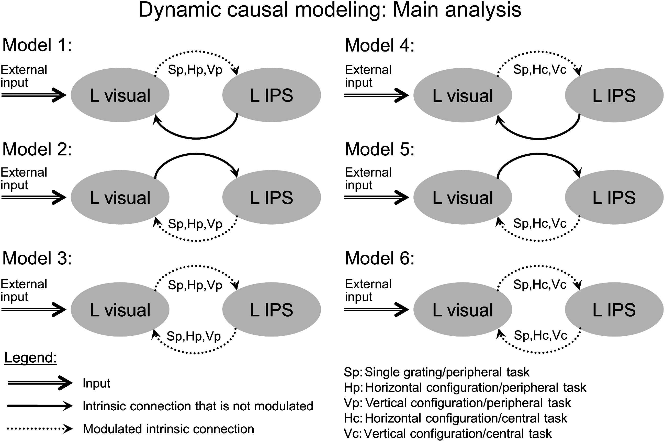
Figure 2. DCM: Main analysis. Six models for the DCM model comparison. Black arrows represent intrinsic connections. ...
Notes:
Figure 2. DCM: Main analysis. Six models for the DCM model comparison. Black arrows represent intrinsic connections. Thick and solid black arrows are intrinsic connections for which the model does not contain modulating factors, dotted black arrow connections for which the model contains modulating factors. The GLM used to extract the relevant time series for the 6 DCMs consisted of the external input term and 5 regressors: Single grating/peripheral task (Sp), horizontal configuration/peripheral task (Hp), vertical configuration/peripheral task (Vp), horizontal configuration/central task (Hc), and vertical configuration/central task (Vc). The external input reflect the trial onsets across all trial types and was identical between models.
Unless provided in the caption above, the following copyright applies to the content of this slide: © The Author 2012. Published by Oxford University Press. All rights reserved. For Permissions, please e-mail: journals.permissions@oup.com

Slide 3
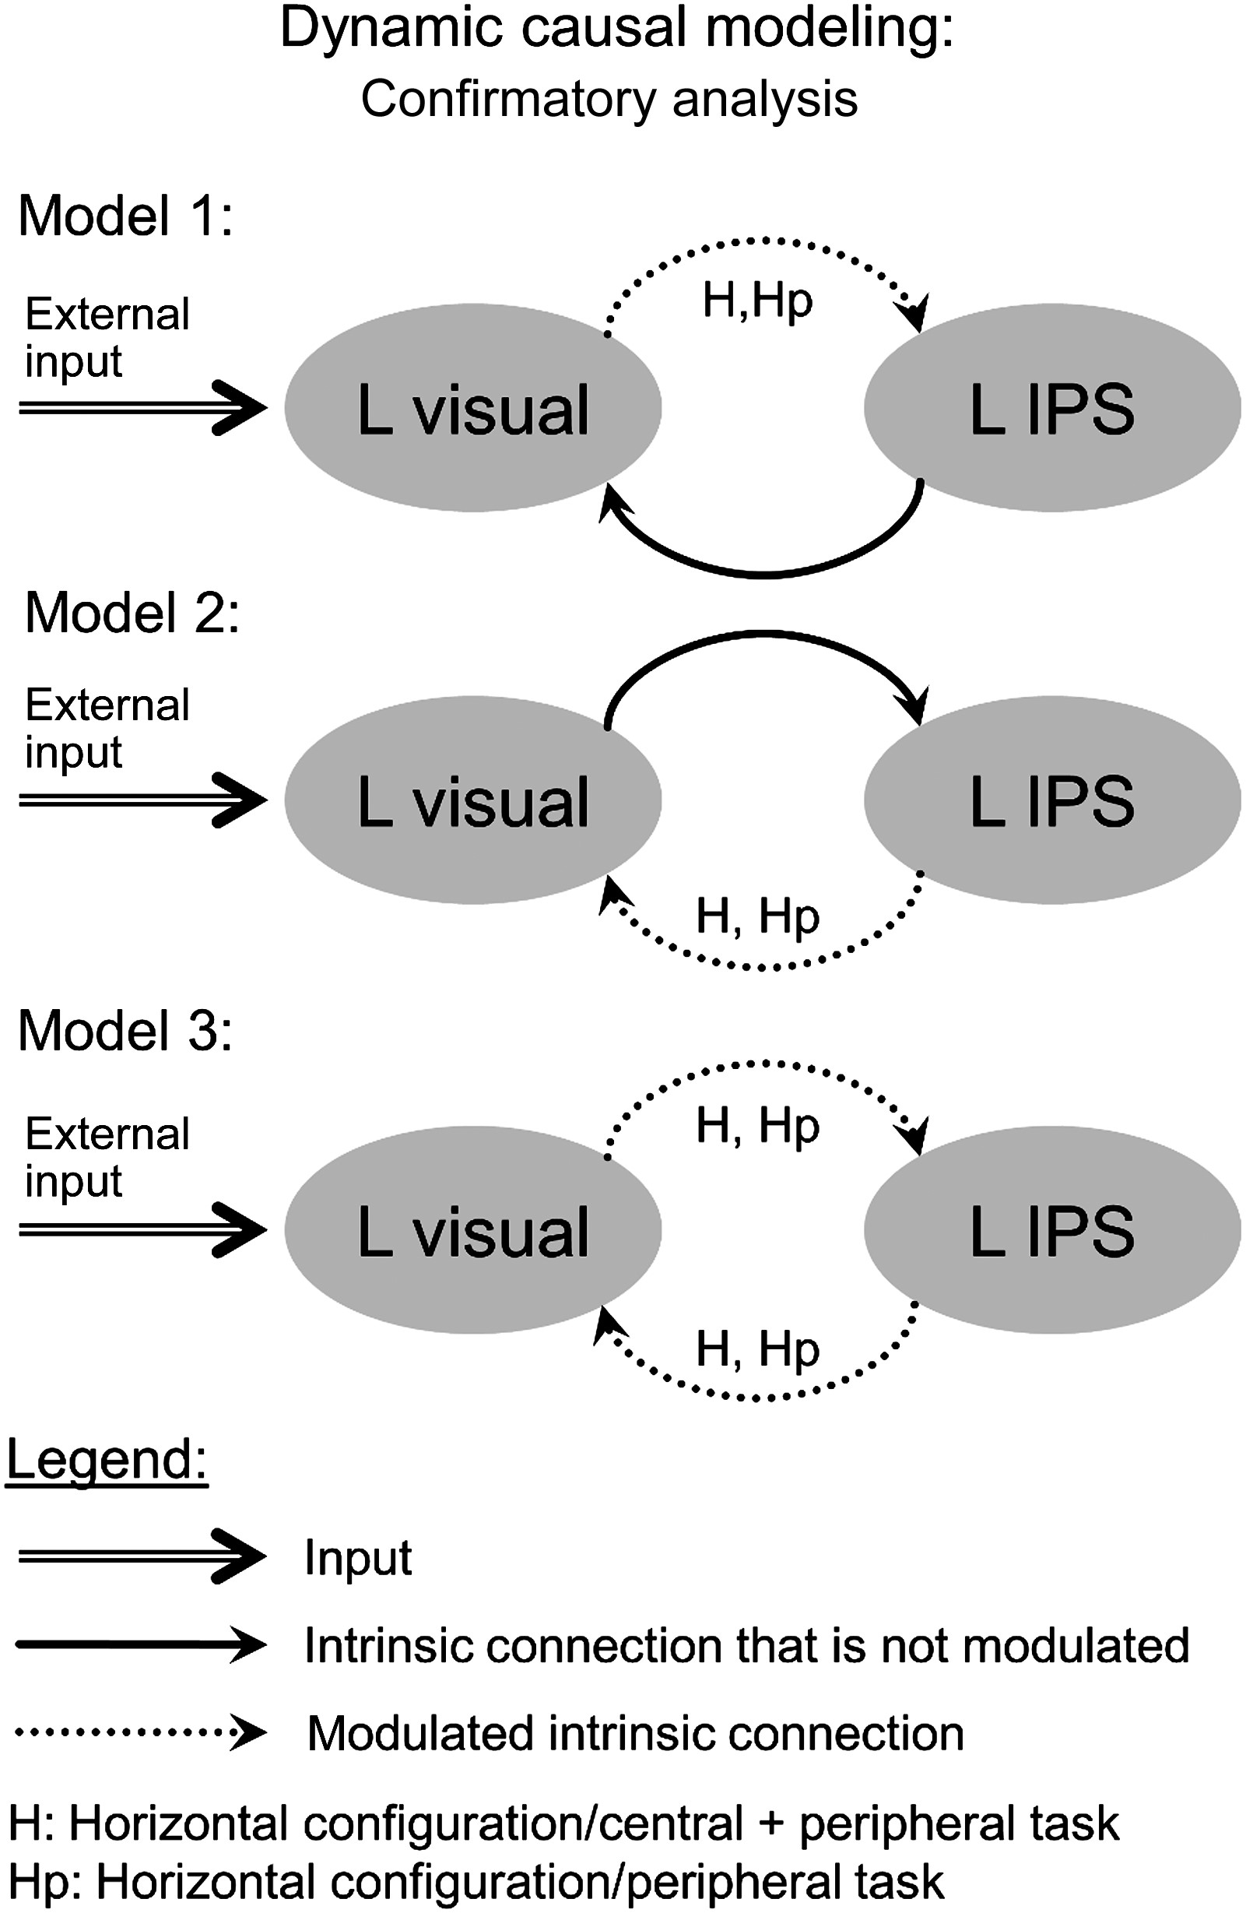
Figure 3. DCM: Confirmatory analysis. Three models for the DCM model comparison. The GLM used to extract the relevant ...
Notes:
Figure 3. DCM: Confirmatory analysis. Three models for the DCM model comparison. The GLM used to extract the relevant time series for the 3 DCMs consisted of the external input term and 2 regressors: Horizontal configuration (H) and horizontal configuration/peripheral task (Hp). Same conventions as in Figure 2.
Unless provided in the caption above, the following copyright applies to the content of this slide: © The Author 2012. Published by Oxford University Press. All rights reserved. For Permissions, please e-mail: journals.permissions@oup.com

Slide 4
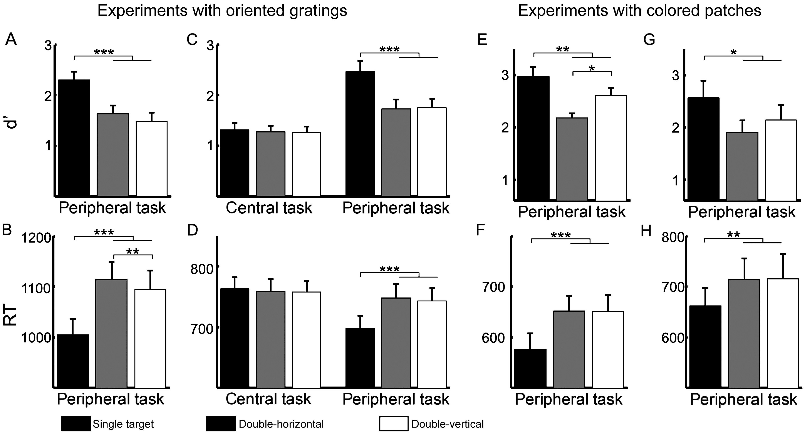
Figure 4. Behavioral performance. Mean d′ score (A,C,E,G) and mean RT (B,D,F,H) as a function of the stimulus display. ...
Notes:
Figure 4. Behavioral performance. Mean d′ score (A,C,E,G) and mean RT (B,D,F,H) as a function of the stimulus display. Performance is given for the first behavioral experiment with oriented gratings (A and B), the main fMRI experiment (C and D), and for the experiments with colored patches (second behavioral experiment [E and F] and color fMRI experiment [G and H]). Error bars indicate 1 standard error of the mean across subjects.
Unless provided in the caption above, the following copyright applies to the content of this slide: © The Author 2012. Published by Oxford University Press. All rights reserved. For Permissions, please e-mail: journals.permissions@oup.com

Slide 5
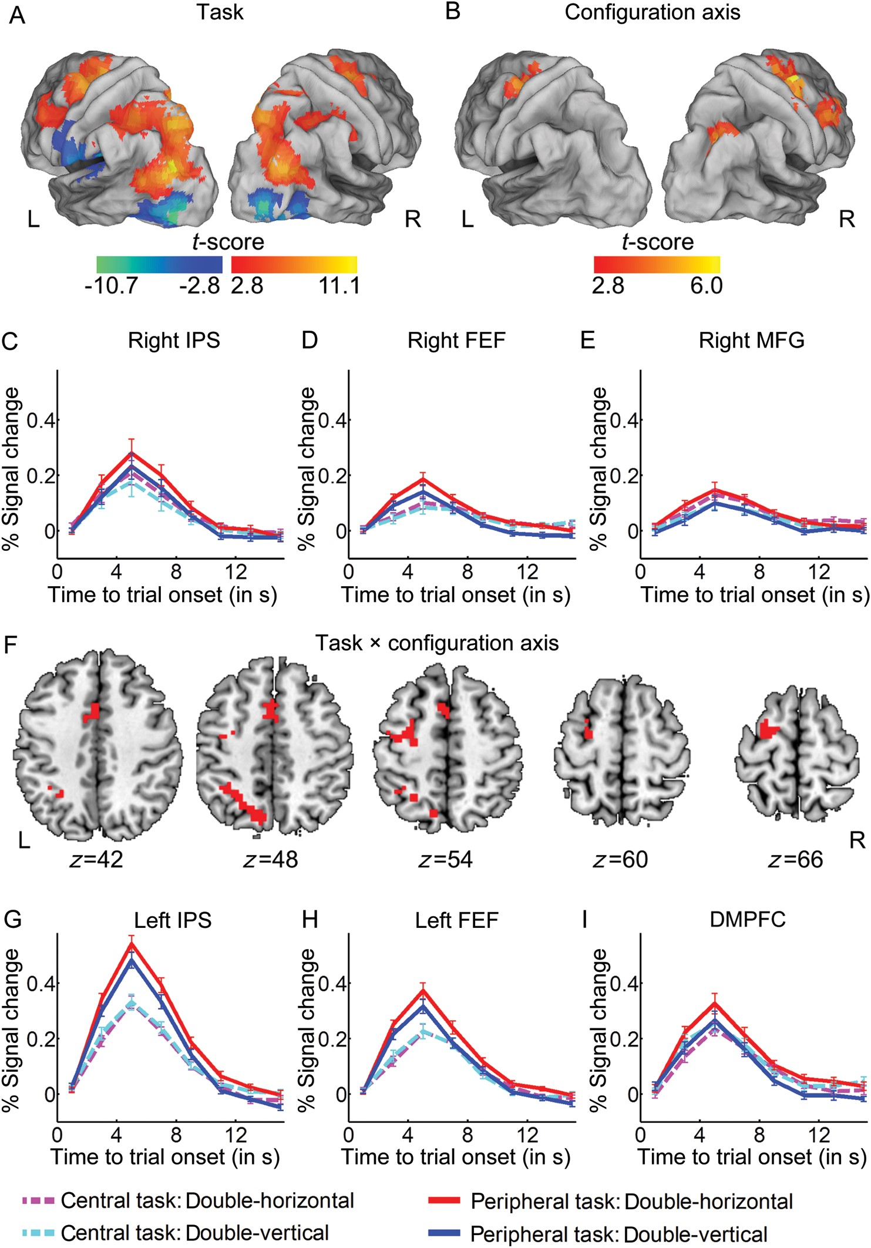
Figure 5. Main fMRI experiment. (A) T-map for the effect of task in case of double stimulation (contrast 1: Peripheral ...
Notes:
Figure 5. Main fMRI experiment. (A) T-map for the effect of task in case of double stimulation (contrast 1: Peripheral task minus central task; red to yellow) and the reverse (blue to cyan). The T-map is projected onto a surface rendering of the brain (population averaged, landmark- and surface-based [PALS] atlas, Caret 5.612 [Van Essen, 2005]). Threshold: Voxel-level uncorrected P < 0.005, cluster-level FWE-corrected P < 0.05. (B) T-map for the effect of configuration axis (contrast 2: Double horizontal minus double vertical). (C–E) Time-activity curves averaged over all subjects and all significant voxels in right IPS (C), right FEF (D), and right MFG (E), defined based on contrast 2. Error bars indicate 1 standard error of the mean across subjects. (F) T-map for the interaction between task and configuration axis (contrast 3), projected onto axial slices of the brain. (G–I) Time-activity curves averaged over all subjects and all significant voxels in left IPS (G), left FEF (H), and DMPFC (I), defined based on contrast 3. IPS, intraparietal sulcus; FEF, frontal eye fields; DMPFC, dorsomedial prefrontal cortex; MFG, middle frontal gyrus.
Unless provided in the caption above, the following copyright applies to the content of this slide: © The Author 2012. Published by Oxford University Press. All rights reserved. For Permissions, please e-mail: journals.permissions@oup.com

Slide 6
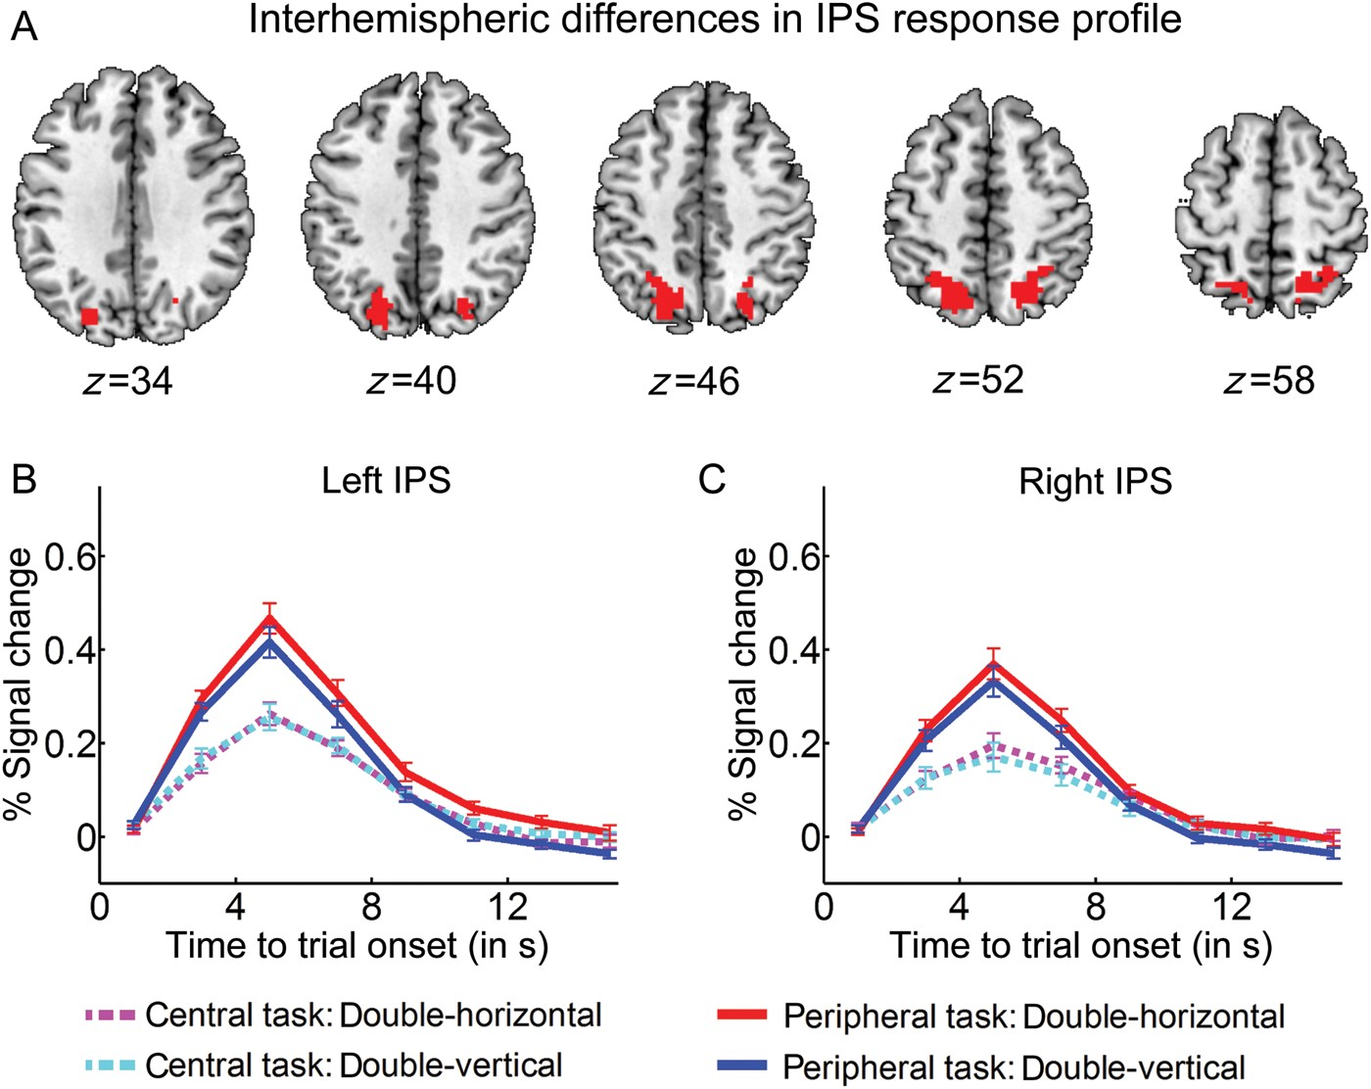
Figure 6. Interhemispheric differences in IPS response profile. (A) T-map for the contrast of all double versus all ...
Notes:
Figure 6. Interhemispheric differences in IPS response profile. (A) T-map for the contrast of all double versus all single-stimulation conditions (contrast 6, threshold: Voxel-level uncorrected P < 0.005, FWE-corrected P < 0.05), projected onto axial slices of the brain. (B and C) Time-activity curves averaged over all subjects and all significant voxels in left IPS (B) and right IPS (C), defined based on contrast 6. Error bars indicate 1 standard error of the mean across 22 subjects.
Unless provided in the caption above, the following copyright applies to the content of this slide: © The Author 2012. Published by Oxford University Press. All rights reserved. For Permissions, please e-mail: journals.permissions@oup.com

Slide 7
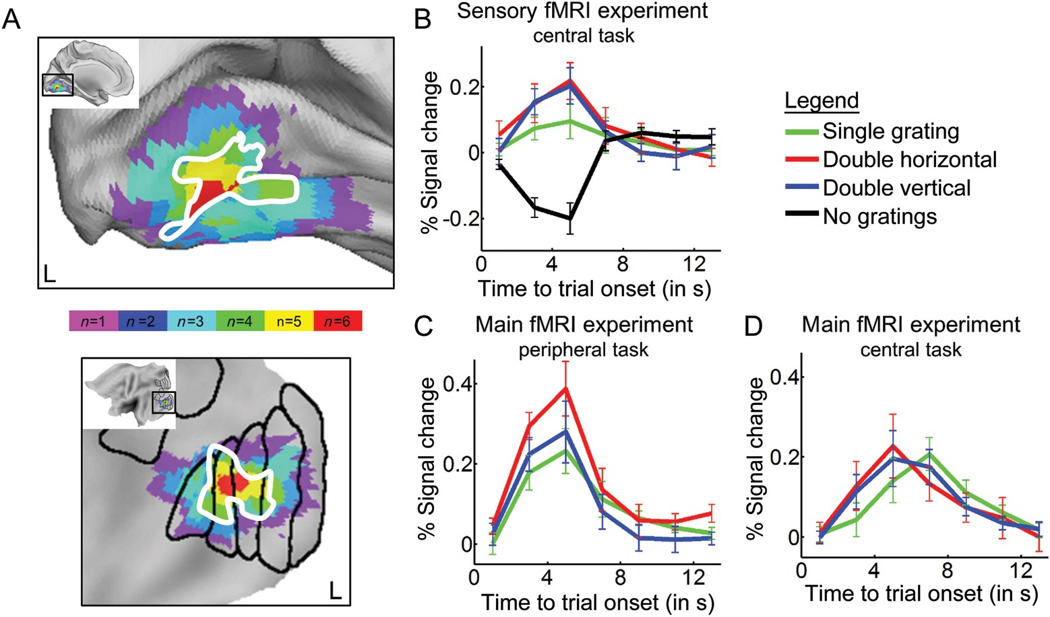
Figure 7. Sensory fMRI experiment. (A) T-maps for the effect of adding gratings to the display in the central letter ...
Notes:
Figure 7. Sensory fMRI experiment. (A) T-maps for the effect of adding gratings to the display in the central letter detection task (contrast 8). Threshold: Single-subject, FWE-corrected P < 0.05. The color-scale indicates the number of subjects for which the t-map survived the threshold. The black borders outline the visuotopic cortical partitioning scheme available in Caret (PALS atlas, Caret 5.612 [Van Essen 2005]). The white border reflects the area significant in a random effects analysis across 6 subjects (voxel-level uncorrected P < 0.001, cluster-level corrected P < 0.05). (B) Time-activity curves averaged over all 6 subjects and voxels in the subject-specific VOIs, using the data from the sensory fMRI experiment. (C and D) Time-activity curves averaged over all subjects and voxels in the subject-specific VOIs, using the data from the main fMRI experiment (C: Peripheral orientation discrimination task; D: Central letter detection task). Error bars indicate 1 standard error of the mean across subjects.
Unless provided in the caption above, the following copyright applies to the content of this slide: © The Author 2012. Published by Oxford University Press. All rights reserved. For Permissions, please e-mail: journals.permissions@oup.com

