Slide 1
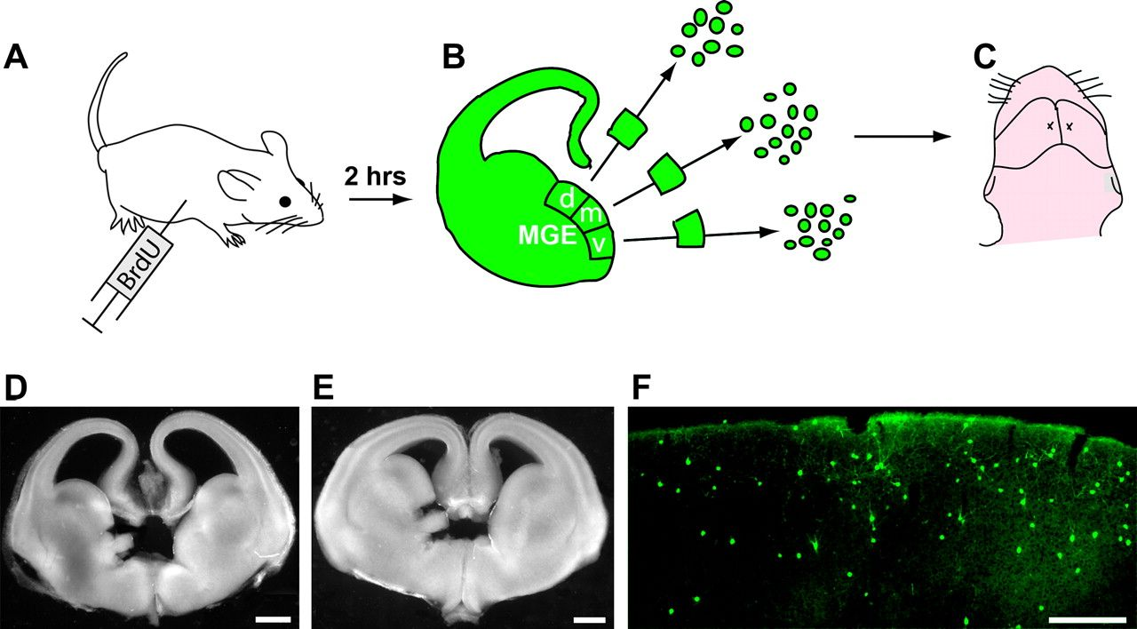
Figure 1. Experimental design. (A) Two hours before euthanization, BrdU (100 mg/kg; intraperitoneally) was injected ...
Notes:
Figure 1. Experimental design. (A) Two hours before euthanization, BrdU (100 mg/kg; intraperitoneally) was injected into the dam carrying pan-GFP expressing pups at E13.5 or E15.5. (B, C) Brains were sectioned on a vibrating microtome, and the dorsal (d), middle (m), or ventral (v) subregions of the MGE were dissociated and transplanted into the cortex of neonatal hosts (C). (D, E) Examples of coronal slices from which d- and vMGE were dissected at E13.5 (D) and E15.5 (E). (F) Immunofluorescence labeling of GFP-expressing cells at postnatal day 30 neocortex. Scale bars: 200 μm.
Unless provided in the caption above, the following copyright applies to the content of this slide: © The Author 2011. Published by Oxford University Press. All rights reserved. For permissions, please e-mail: journals.permissions@oup.com

Slide 2
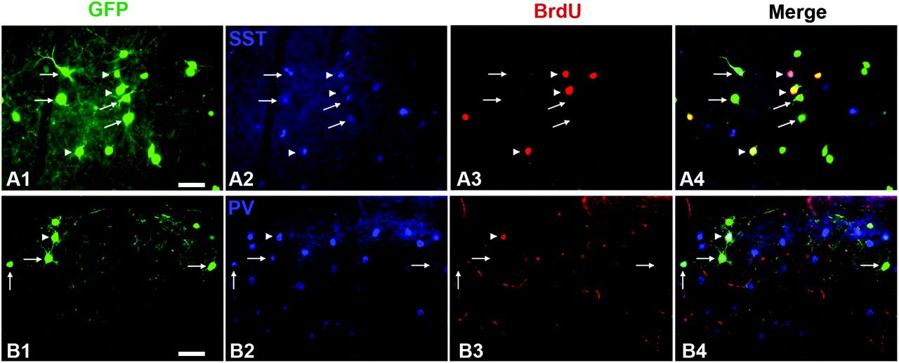
Figure 2. BrdU and GFP colabeling with PV or SST in MGE transplants. MGE-derived GFP⁺ cells transplanted ...
Notes:
Figure 2. BrdU and GFP colabeling with PV or SST in MGE transplants. MGE-derived GFP+ cells transplanted into the neocortex (A1, B1) give rise to SST-expressing (A2, A4) and PV-expressing (B2, B4) interneurons. GFP+ cells that originate from progenitors in S-phase (arrowheads) at the time of transplant colabel with BrdU (A1, 3, 4, B1, 3, 4). BrdU staining is absent in GFP+ cells that were not in S-phase at the time of transplant (arrows). Scale bars: 50 μm.
Unless provided in the caption above, the following copyright applies to the content of this slide: © The Author 2011. Published by Oxford University Press. All rights reserved. For permissions, please e-mail: journals.permissions@oup.com

Slide 3
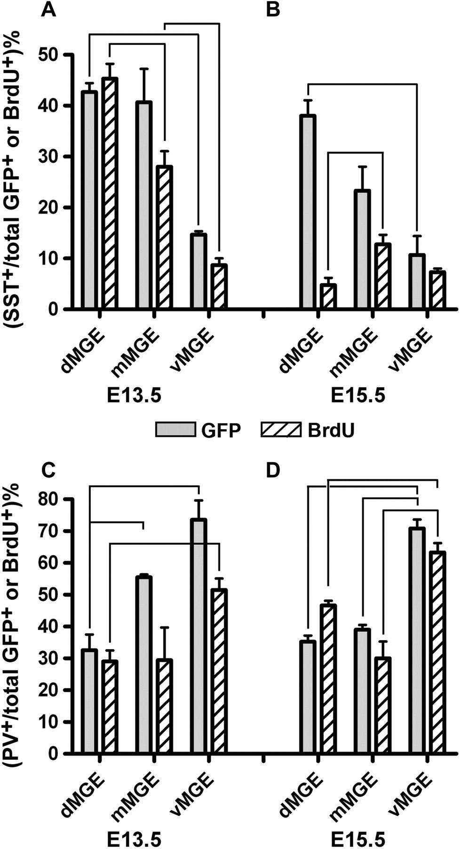
Figure 3. Quantification of regional and temporal differences in transplanted MGE cells expressing SST or PV. Bars ...
Notes:
Figure 3. Quantification of regional and temporal differences in transplanted MGE cells expressing SST or PV. Bars represent percentages of either GFP+ cells (solid pattern) or BrdU+ cells (striped pattern) that colabel for SST (A, B) or PV (C, D) at E13.5 (A, C) and E15.5 (B, D). Lines connecting bars indicate significant differences with P < 0.05 (generally unpaired one-way ANOVA, post hoc Tukey; see Materials and Methods for details on statistical analysis).
Unless provided in the caption above, the following copyright applies to the content of this slide: © The Author 2011. Published by Oxford University Press. All rights reserved. For permissions, please e-mail: journals.permissions@oup.com

Slide 4
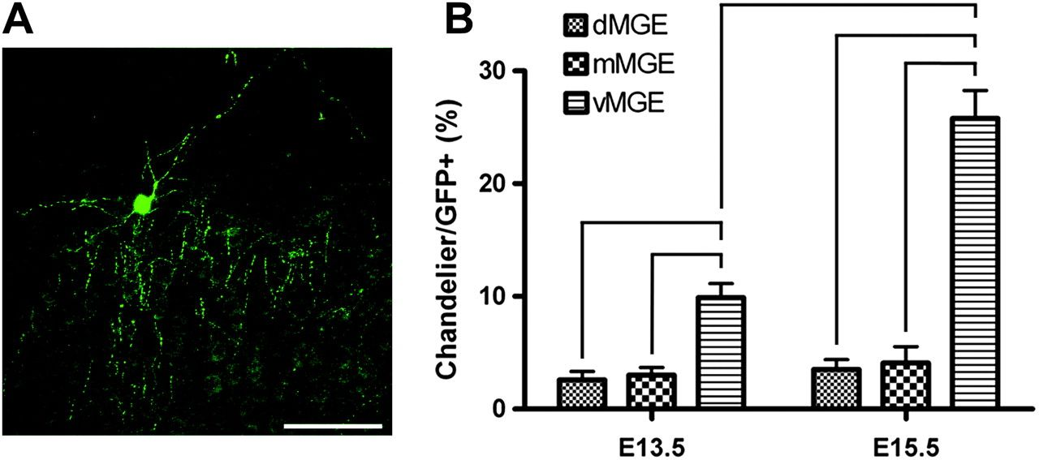
Figure 4. E15.5 vMGE transplants are highly enriched for chandelier interneurons. (A) Example of a transplanted cell ...
Notes:
Figure 4. E15.5 vMGE transplants are highly enriched for chandelier interneurons. (A) Example of a transplanted cell with chandelier interneuron morphology. Note the prominent vertically oriented “cartridges” of axon terminals. (B) Quantification of transplanted cells with chandelier morphology. There was an enrichment of chandelier interneurons in the vMGE at both ages. At E15.5, this enrichment significantly increased relative to both dMGE and mMGE at E15.5 and relative to the vMGE in the E13.5 transplants. Bars above the graphs indicate significant differences using an unpaired one-way ANOVA, P < 0.05, post hoc Tukey. Scale bar: 100 μm.
Unless provided in the caption above, the following copyright applies to the content of this slide: © The Author 2011. Published by Oxford University Press. All rights reserved. For permissions, please e-mail: journals.permissions@oup.com

Slide 5
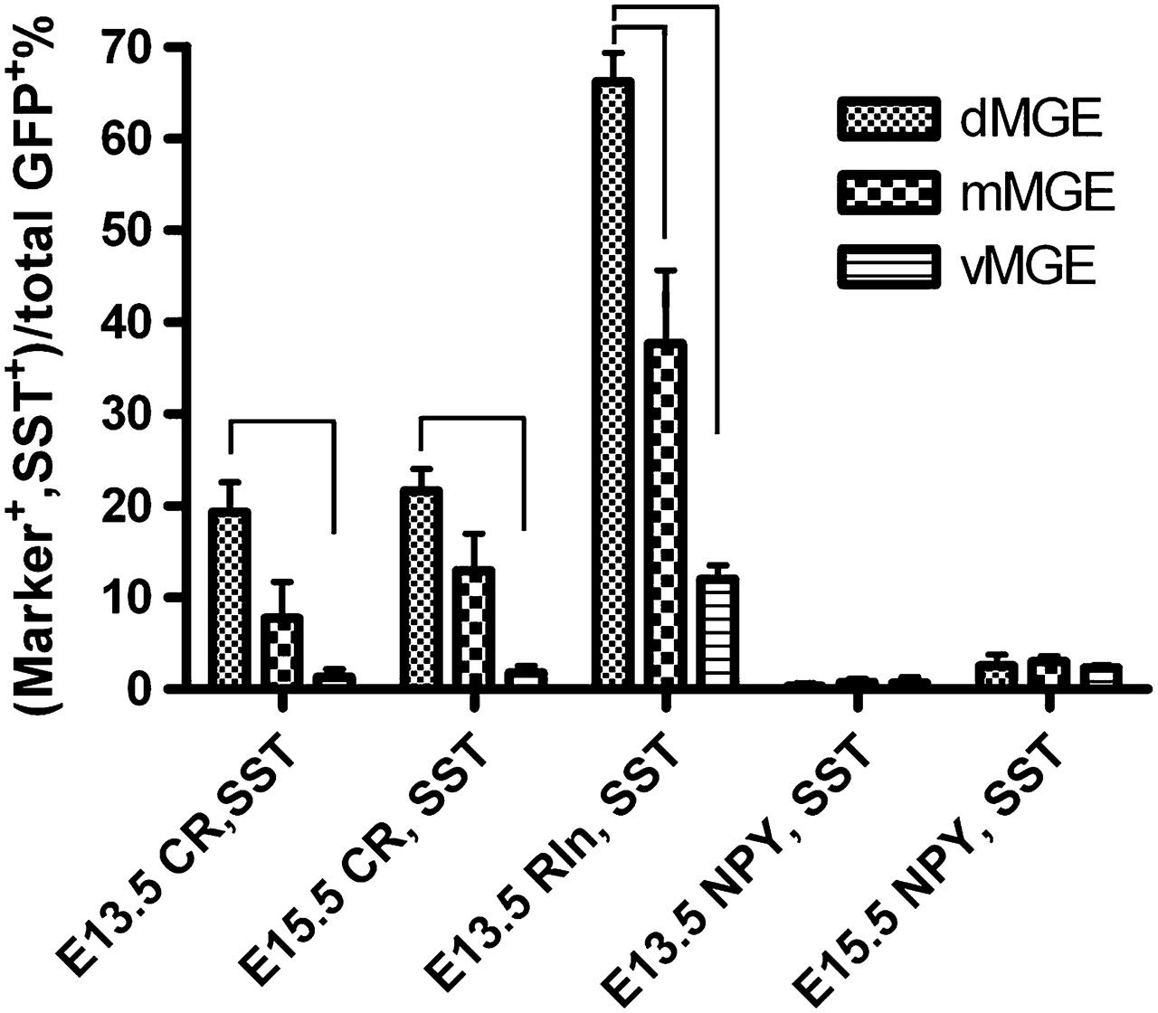
Figure 5. Quantification of regional and temporal differences in transplanted MGE cells coexpressing SST and either one ...
Notes:
Figure 5. Quantification of regional and temporal differences in transplanted MGE cells coexpressing SST and either one of the SST subgroup markers calretinin (CR), reelin (Rln), or Neuropeptide Y (NPY). Bars represent percentages of GFP+ cells derived from spatially and temporally distinct MGE regions. Lines connecting bars indicate significant differences with P < 0.05 (unpaired one-way ANOVA, post hoc Tukey; see Materials and Methods for details on statistical analysis).
Unless provided in the caption above, the following copyright applies to the content of this slide: © The Author 2011. Published by Oxford University Press. All rights reserved. For permissions, please e-mail: journals.permissions@oup.com

Slide 6
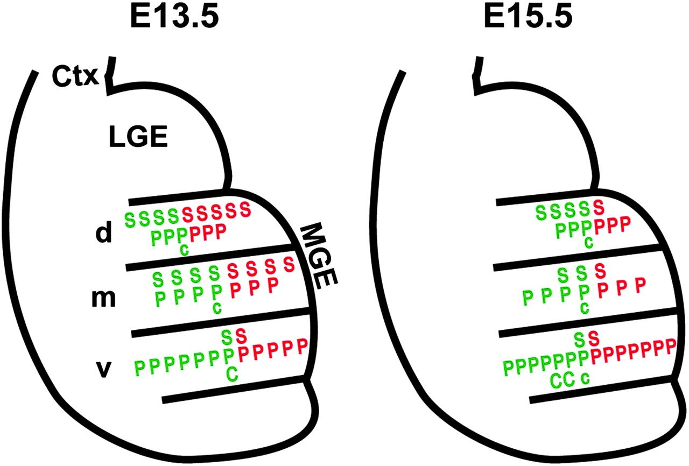
Figure 6. Summary of the spatial and temporal differences in the origins of SST⁺, PV⁺, and ...
Notes:
Figure 6. Summary of the spatial and temporal differences in the origins of SST+, PV+, and chandelier interneurons. Green indicates counts of GFP+ neurons in the transplants, whereas red indicates counts of BrdU+ cells. Capital letters indicate, approximately, each 10% of cells in the transplant expressing SST (S), parvalbumin (P), or having a chandelier interneuron morphology (C). The lower-case (c) indicates roughly 5%. Note that in general, the results from counts of GFP or BrdU-labeled cells are similar, whereas these counts are highly discordant in the case of SST+ cells in the dMGE at E15.5. In addition, there is a remarkable enrichment for chandelier interneurons in the vMGE transplants at E15.5. (Ctx: Cortex, d: dorsal, m: middle, v: ventral).
Unless provided in the caption above, the following copyright applies to the content of this slide: © The Author 2011. Published by Oxford University Press. All rights reserved. For permissions, please e-mail: journals.permissions@oup.com

