Slide 1
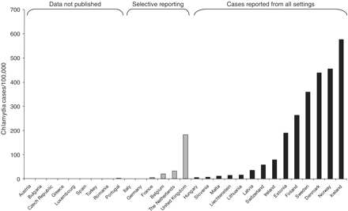
Figure 1 Rate of diagnosed chlamydia cases per 100 000 population in Europe, 2005 or 2006. Figure includes data from ...
Notes:
Figure 1 Rate of diagnosed chlamydia cases per 100 000 population in Europe, 2005 or 2006. Figure includes data from all countries that provided data about reported chlamydia cases in 2005 or 2006. Numerator is the number of diagnosed chlamydia cases reported; denominator is the total mid-year population of the country in the year of data collection. Countries with selective reporting include those that publish data about all cases reported from sentinel sites, including countries that report all cases diagnosed in specialist clinics. Countries with no apparent cases either did not provide data, or did not have data available. Reproduced from Figure 4, Ref. 15
Unless provided in the caption above, the following copyright applies to the content of this slide: © The Author 2011. Published by Oxford University Press on behalf of the European Public Health Association. All rights reserved.

