Slide 1
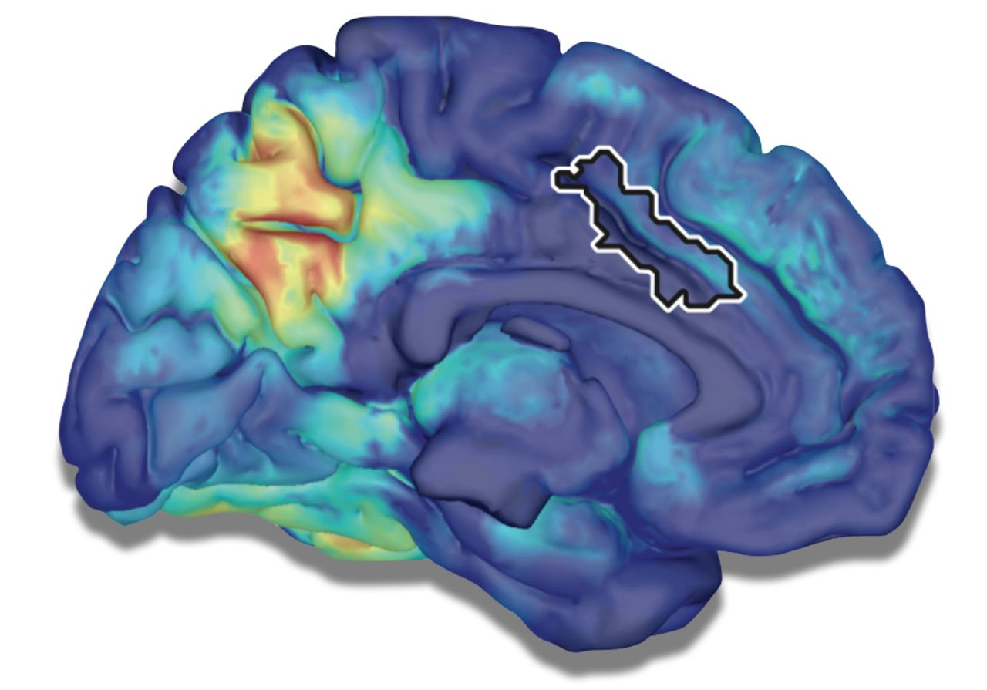
See Clark and Warren (doi:10.1093/brain/awv148) for a scientific commentary on this article. Musical memory ...
Notes:
See Clark and Warren (doi:10.1093/brain/awv148) for a scientific commentary on this article. Musical memory is relatively preserved in Alzheimer’s disease and other dementias. In a 7 Tesla functional MRI study employing multi-voxel pattern analysis, Jacobsen et al. identify brain regions encoding long-term musical memory in young healthy controls, and show that these same regions display relatively little atrophy and hypometabolism in patients with Alzheimer’s disease.
Unless provided in the caption above, the following copyright applies to the content of this slide: © The Author (2015). Published by Oxford University Press on behalf of the Guarantors of Brain. All rights reserved. For Permissions, please email: journals.permissions@oup.com

Slide 2
Figure 1 Stimuli validation experiment. Behavioural pilot experiment to select musical stimuli. (1) Basic idea: ...
Notes:
Figure 1 Stimuli validation experiment. Behavioural pilot experiment to select musical stimuli. (1) Basic idea: matched triplets of music excerpts. Highly similar mood, instrumentation, genre, etc. within each triplet. (2) Each triplet consists of three song excerpts, one well known and two unknown. In total we used 40 triplets (i.e. 120 song excerpts). (3) One hundred subjects rated these 120 excerpts regarding whether they were ‘known’, ‘unknown’ and the time until recognition. (4) For the functional MRI (fMRI) experiment, we selected the 20 highest ranked triplets, which were rated 95% in accordance to the presumed categories (‘known’, ‘unknown’).
Unless provided in the caption above, the following copyright applies to the content of this slide: © The Author (2015). Published by Oxford University Press on behalf of the Guarantors of Brain. All rights reserved. For Permissions, please email: journals.permissions@oup.com

Slide 3
Figure 2 Constructing third experimental class. Familiarization task and constructing experimental class ‘recently ...
Notes:
Figure 2 Constructing third experimental class. Familiarization task and constructing experimental class ‘recently known’. (1) One unknown song per triplet was randomly selected and played twice to the subject before scanning. (2) The randomly selected song had now become ‘recently known’ for the subject. (3) Hence each subject had his own set of long-known, recently known and unknown songs. (4) Each subject in the functional MRI (fMRI) experiment had their own unique set of stimuli; classes are balanced and labels validated. rand. = random.
Unless provided in the caption above, the following copyright applies to the content of this slide: © The Author (2015). Published by Oxford University Press on behalf of the Guarantors of Brain. All rights reserved. For Permissions, please email: journals.permissions@oup.com

Slide 4
Figure 3 Functional MRI experiment design. (1) Five functional runs, each containing 12 trials/musical pieces, which ...
Notes:
Figure 3 Functional MRI experiment design. (1) Five functional runs, each containing 12 trials/musical pieces, which resulted in 60 musical excerpts presented to each subject. (2) Each run contained four long-known, four recently known and four unknown songs. Numbers represent indices of triplets. For example: ‘7 red’ denotes the well-known song out of the seventh triplet. Five runs contain all 20 triplets mentioned above. (3) Trial design: 20-s music listening, 8-s familiarity and liking rating via button press. fMRI = functional MRI; rand. = random.
Unless provided in the caption above, the following copyright applies to the content of this slide: © The Author (2015). Published by Oxford University Press on behalf of the Guarantors of Brain. All rights reserved. For Permissions, please email: journals.permissions@oup.com

Slide 5
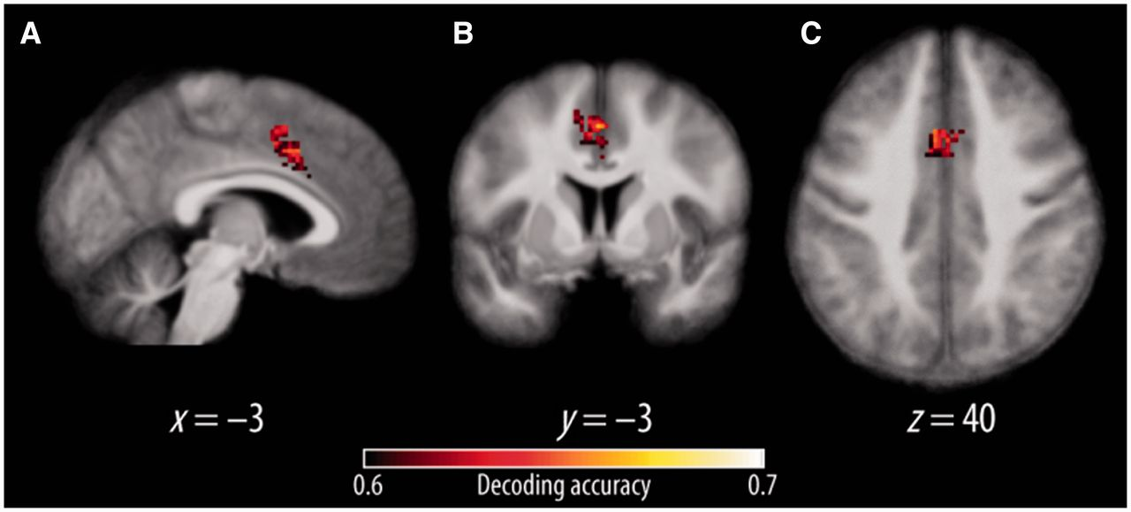
Figure 4 Multivariate pattern analysis results: long-known versus recently known music. We show cluster size corrected ...
Notes:
Figure 4 Multivariate pattern analysis results: long-known versus recently known music. We show cluster size corrected accuracy maps (permutation statistics, corrected for multiple comparison, voxel-wise threshold P = 0.001). x, y and z denote the MNI coordinates of the selected sagittal (A), coronal (B) and axial (C) slice. The colour bar indicates the significance of the decoding accuracies (e.g. 0.6 indicates 10% over chance and 0.7 indicates 20% over chance).
Unless provided in the caption above, the following copyright applies to the content of this slide: © The Author (2015). Published by Oxford University Press on behalf of the Guarantors of Brain. All rights reserved. For Permissions, please email: journals.permissions@oup.com

Slide 6
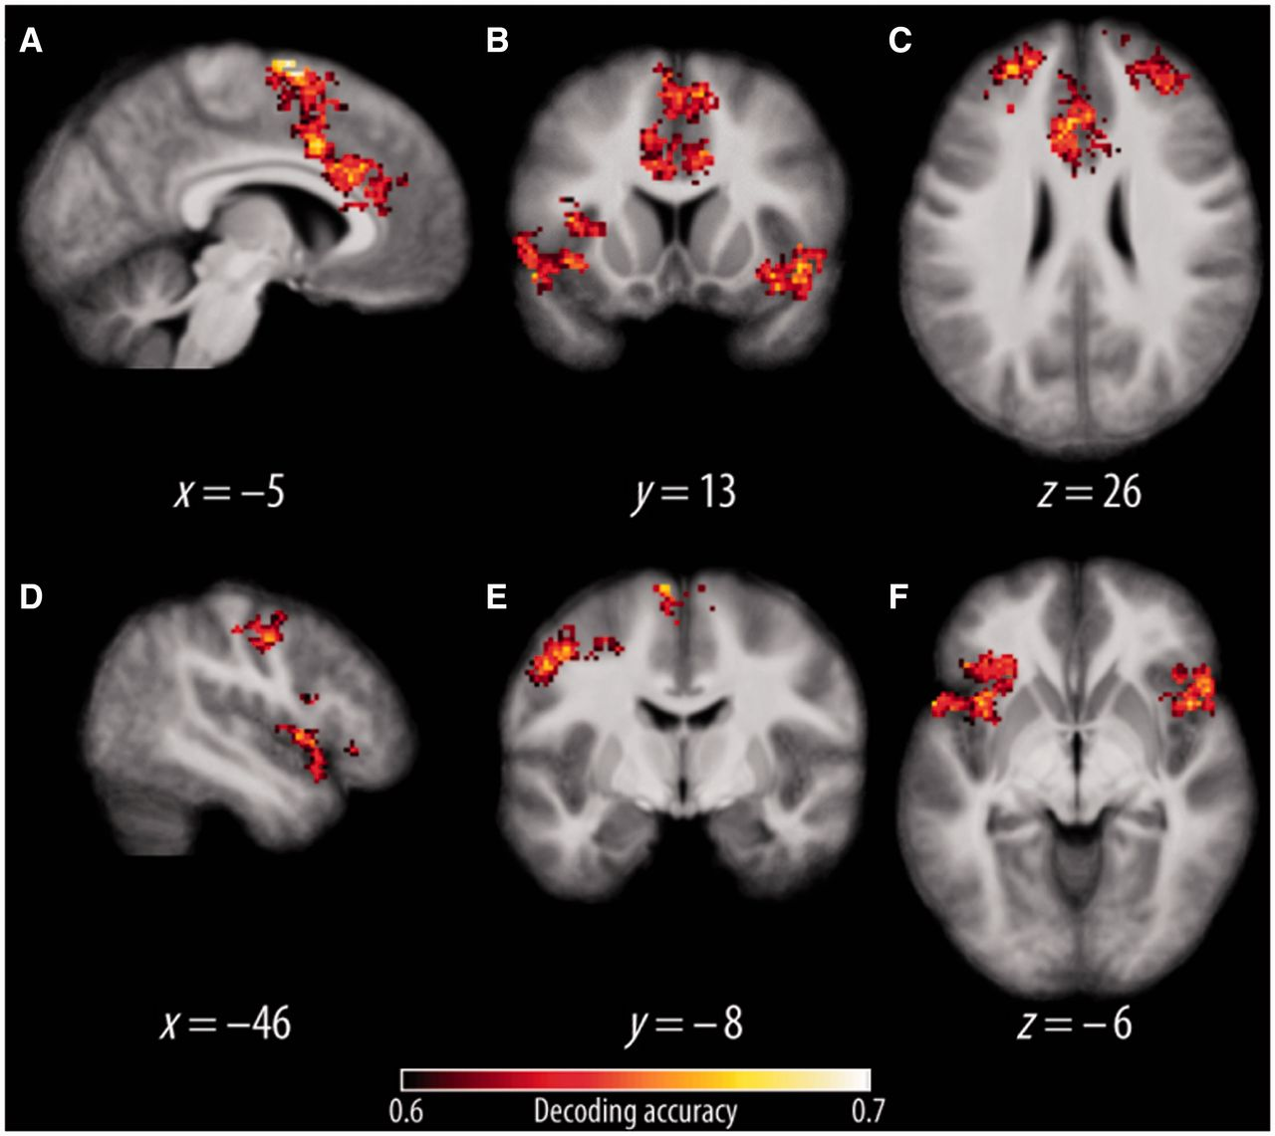
Figure 5 Multivariate pattern analysis results: long-known versus unknown music. Shown are cluster size corrected ...
Notes:
Figure 5 Multivariate pattern analysis results: long-known versus unknown music. Shown are cluster size corrected accuracy maps (permutation statistics, corrected for multiple comparison, voxel-wise threshold P = 0.001). x, y and z denote the MNI coordinates of the selected sagittal (A and D), coronal (B and E) and axial (C and F) slices. The colour bar indicates the significance of the decoding accuracies according to Table 1.
Unless provided in the caption above, the following copyright applies to the content of this slide: © The Author (2015). Published by Oxford University Press on behalf of the Guarantors of Brain. All rights reserved. For Permissions, please email: journals.permissions@oup.com

Slide 7
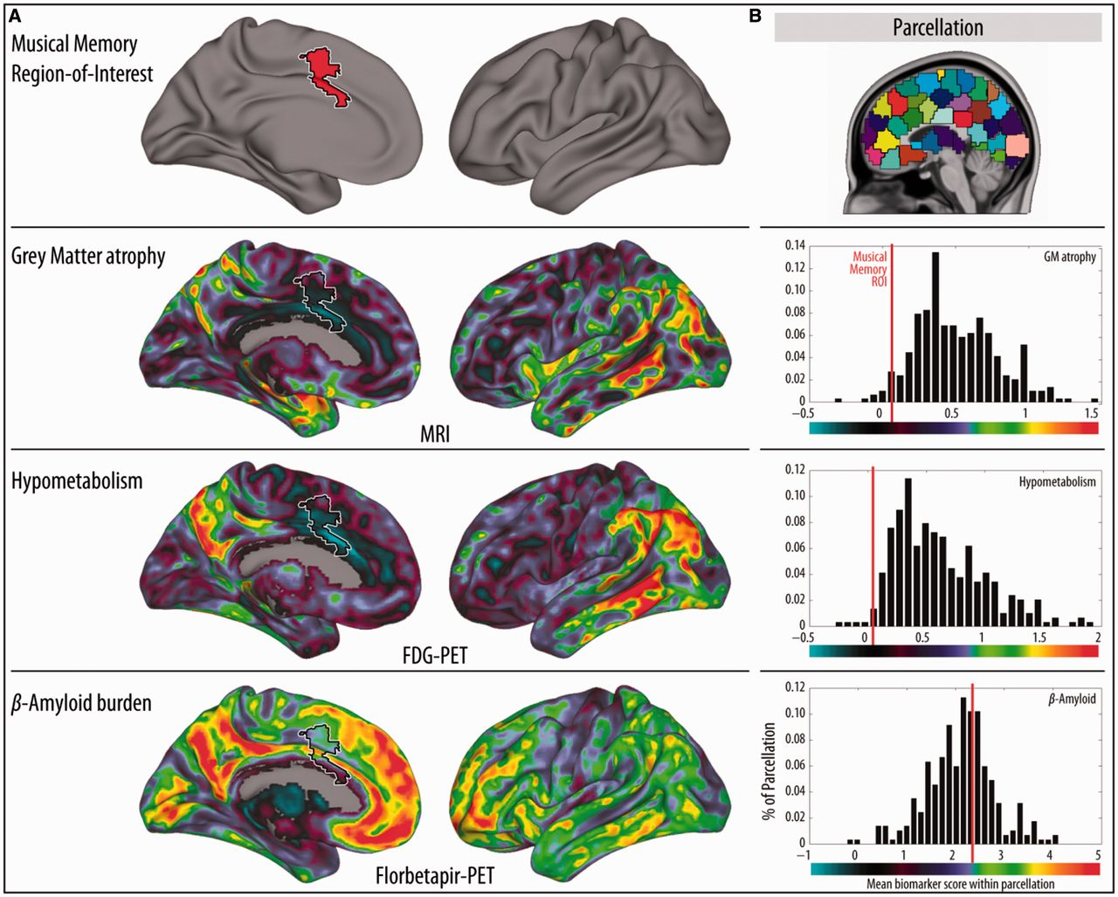
Figure 6 Musical memory region of interest and Alzheimer’s disease biomarkers. (A) Qualitative comparison between ...
Notes:
Figure 6 Musical memory region of interest and Alzheimer’s disease biomarkers. (A) Qualitative comparison between Alzheimer’s disease biomarker maps and the musical memory region. The top row shows the musical memory region of interest (red) on a 3D brain render. The musical memory region of interest is shown as a white coloured contour in rows two to four, overlaid on the W-score biomarker maps. For the sake of clarity, and because all W-score maps and the musical memory region of interest were highly symmetrical, only the left hemisphere is displayed. The second row shows rendered surfaces and overlaid W-score maps of cortical atrophy. The third row displays the hypometabolism W-score map analogous to the second row. The bottom row shows amyloid-β deposition as W-score maps accordingly. Colour scales were adapted to each biomarker map and are presented under each corresponding histogram. (B) For a quantitative comparison, we computed the mean biomarker values inside of the musical memory region of interest and the mean biomarker value within other regions of interest of similar size accordingly (see ‘Materials and methods’ section). A view of the parcellation mask is shown in the top row on the right side. In the three histograms below, each black bar represents the frequency of parcels (y-axis) with a certain mean biomarker value (x-axis). The red line depicts the mean biomarker value within the musical memory region of interest. Each histogram shows the corresponding biomarker (e.g. the top one depicts the grey matter atrophy). GM = grey matter.
Unless provided in the caption above, the following copyright applies to the content of this slide: © The Author (2015). Published by Oxford University Press on behalf of the Guarantors of Brain. All rights reserved. For Permissions, please email: journals.permissions@oup.com

