Slide 1
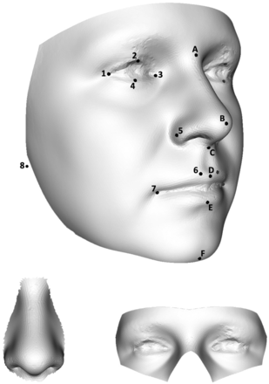
Figure 1 Dense surface models of the face. Three regions of the face were used as base meshes to restrict the extent ...
Notes:
Figure 1 Dense surface models of the face. Three regions of the face were used as base meshes to restrict the extent of the models. The upper image is also annotated with the landmarks used in model construction. The perinasal and periorbital regions are shown on the bottom left and bottom right, respectively. Landmarks A–F are in the midline. Landmarks 1–8 are paired and only shown for the right side of the face. They are as follows: A = nasion; B = pronasale; C = subnasale; D = labiale superius; E = labiale inferius; F = gnathion; 1 = exocanthion; 2 = palpebrale superius; 3 = endocanthion; 4 = palpebrale inferius; 5 = ala nasi; 6 = christa philtri; 7 = cheilion; 8 = lower auricular attachment. Landmark 8 is applied to all unprocessed face surface images, but the ears are omitted from the base mesh because of variable loss of surface at the image periphery because of occluding hair.
Unless provided in the caption above, the following copyright applies to the content of this slide: © The Author (2012). Published by Oxford University Press.This is an Open Access article distributed under the terms of the Creative Commons Attribution Non-Commercial License (http://creativecommons.org/licenses/by-nc/3.0), which permits unrestricted non-commercial use, distribution, and reproduction in any medium, provided the original work is properly cited.

Slide 2
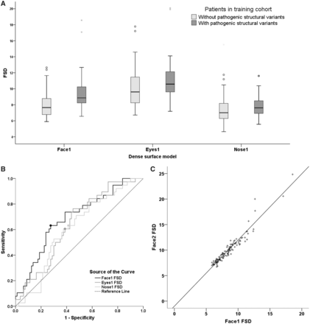
Figure 2 FSD in the training cohort. (A) Box plots of the median, interquartile range and range of FSD for the three ...
Notes:
Figure 2 FSD in the training cohort. (A) Box plots of the median, interquartile range and range of FSD for the three different models using the training cohort (n = 118). FSD is significantly greater for the whole face model (Face1: 8.86 versus 7.65; P = 0.001), the periorbital model (Eyes1: 10.6 versus 9.60; P = 0.013) and the perinasal model (Nose1: 7.62 versus 7.01; P = 0.031) in patients with pathogenic structural variants. Outliers >1.5 or 3 times the interquartile range from the upper quartile are shown in circles or asterisks, respectively. Excluding all outliers does not alter significance. (B) Receiver operating characteristic curves of face FSD, periorbital FSD and perinasal FSD used for detecting pathogenic structural variants in the training cohort. The areas under the curve are 0.69, 0.64 and 0.61, respectively. The filled circles mark the optimal FSD threshold for equal sensitivity and specificity, used for prediction in the validation cohort in the second set of models (Face2, Eyes2, Nose2). (C) For the training cohort, there was very strongly positive correlation for FSD between the Face1 and Face2 models (ρ = 0.96; P < 0.001). This was also true for the periorbital and perinasal region (not shown; Eyes1 versus Eyes2: ρ = 0.96; P < 0.001, Nose1 versus Nose2: ρ = 0.93; P < 0.001). Best-fit linear regression lines were used to convert the optimal FSD threshold values from the original model to the corresponding second model so that it could be used to predict the presence of pathogenic structural variants in the validation cohort. The formula for the line above is: Face2 FSD = (1.30 × Face1 FSD) − 0.99.
Unless provided in the caption above, the following copyright applies to the content of this slide: © The Author (2012). Published by Oxford University Press.This is an Open Access article distributed under the terms of the Creative Commons Attribution Non-Commercial License (http://creativecommons.org/licenses/by-nc/3.0), which permits unrestricted non-commercial use, distribution, and reproduction in any medium, provided the original work is properly cited.

Slide 3
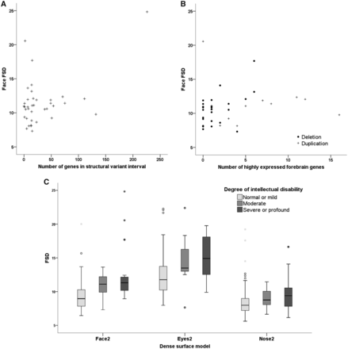
Figure 3 Analysis of face FSD with structural variant interval, intellectual disability and age in all patients. (A) ...
Notes:
Figure 3 Analysis of face FSD with structural variant interval, intellectual disability and age in all patients. (A) There was no significant correlation between whole face FSD and the number of genes in the pathogenic structural variant interval (ρ = 0.19; P = 0.25), within all patients with available data (n = 39). (B) Within the same group of patients, we identified genes in the structural variant interval that were highly expressed in the foetal forebrain. The number of such genes was correlated to whole face FSD (ρ = 0.34; P = 0.036; n = 39), but when looking at those with deletions and those with duplications separately, there was no significant difference. (C) FSDs for the whole face, periorbital region or perinasal region were all significantly greater with increasing intellectual disability (P < 0.001, P < 0.001, P = 0.026, respectively; n = 179). (D) We also assessed patients only undergoing array comparative genomic hybridization to exclude bias from different techniques to detect pathogenic structural variants, and found the median face FSD was still significantly different (11.1 versus 9.26; P = 0.005; n = 52). (E) Although patients with pathogenic structural variants were younger than those without pathogenic structural variants, no correlation was seen with age and whole face FSD.
Unless provided in the caption above, the following copyright applies to the content of this slide: © The Author (2012). Published by Oxford University Press.This is an Open Access article distributed under the terms of the Creative Commons Attribution Non-Commercial License (http://creativecommons.org/licenses/by-nc/3.0), which permits unrestricted non-commercial use, distribution, and reproduction in any medium, provided the original work is properly cited.

Slide 4
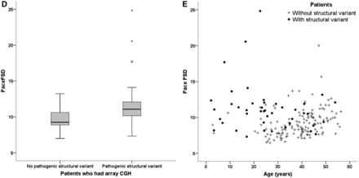
Figure 3 Analysis of face FSD with structural variant interval, intellectual disability and age in all patients. (A) ...
Notes:
Figure 3 Analysis of face FSD with structural variant interval, intellectual disability and age in all patients. (A) There was no significant correlation between whole face FSD and the number of genes in the pathogenic structural variant interval (ρ = 0.19; P = 0.25), within all patients with available data (n = 39). (B) Within the same group of patients, we identified genes in the structural variant interval that were highly expressed in the foetal forebrain. The number of such genes was correlated to whole face FSD (ρ = 0.34; P = 0.036; n = 39), but when looking at those with deletions and those with duplications separately, there was no significant difference. (C) FSDs for the whole face, periorbital region or perinasal region were all significantly greater with increasing intellectual disability (P < 0.001, P < 0.001, P = 0.026, respectively; n = 179). (D) We also assessed patients only undergoing array comparative genomic hybridization to exclude bias from different techniques to detect pathogenic structural variants, and found the median face FSD was still significantly different (11.1 versus 9.26; P = 0.005; n = 52). (E) Although patients with pathogenic structural variants were younger than those without pathogenic structural variants, no correlation was seen with age and whole face FSD.
Unless provided in the caption above, the following copyright applies to the content of this slide: © The Author (2012). Published by Oxford University Press.This is an Open Access article distributed under the terms of the Creative Commons Attribution Non-Commercial License (http://creativecommons.org/licenses/by-nc/3.0), which permits unrestricted non-commercial use, distribution, and reproduction in any medium, provided the original work is properly cited.

