Slide 1
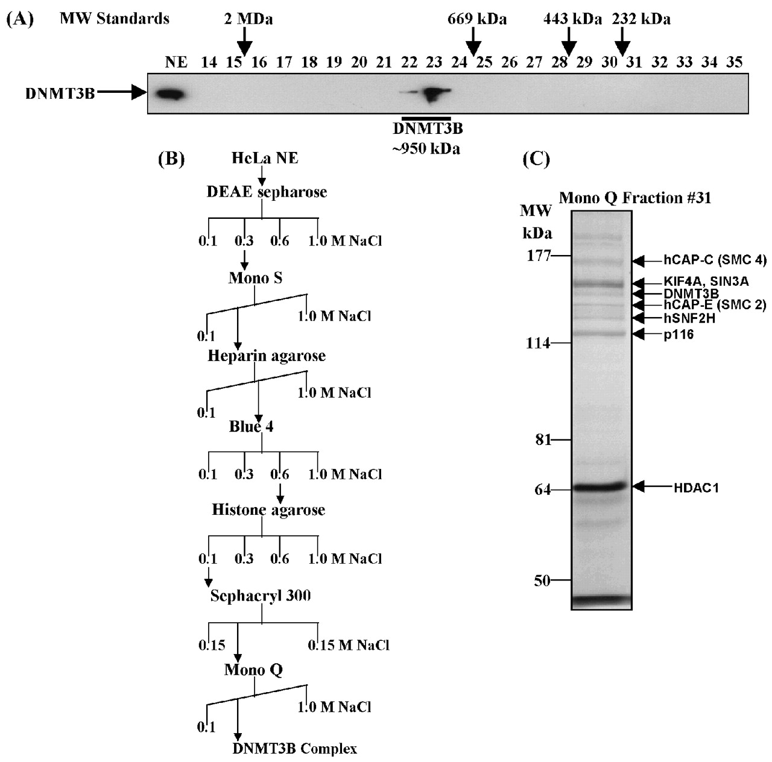
Figure 1. Purification of a novel DNMT3B complex from HeLa cells. (A) Endogenous DNMT3B in HeLa nuclear ...
Notes:
Figure 1. Purification of a novel DNMT3B complex from HeLa cells. (A) Endogenous DNMT3B in HeLa nuclear extract (NE) migrates at a molecular weight of ∼950 kDa on a Superose 6 gel filtration column. The position of the size standards and column fraction numbers are shown along the top. Western blotting was performed with an epitope affinity‐purified rabbit polyclonal anti‐DNMT3B antibody. (B) Purification scheme for the DNMT3B complex. (C) Silver staining of the peak fraction of DNMT3B (detected by western blotting) from the final Mono Q purification step. Protein bands were excised from the gel and identified by mass spectrometry and/or western blotting, as described in Materials and methods. (D) Western blot analysis of the Mono Q column fractions across the peak of DNMT3B. Antibodies used in the western analysis are shown at the right of the figure. Fraction 31 was used for the mass spectrometry identification of DNMT3B co‐purifying proteins. (E) Enzymatic activities co‐purifying with the HeLa DNMT3B complex. Column fractions across the DNMT3B peak were screened for HDAC activity, ATPase activity (ATP hydrolysis stimulated by the addition of purified core histones) and DNA methyltransferase activity [with poly d(I‐C) as the DNA substrate]. The inset shows the DNA methyltransferase activity from an immunoprecipitation with anti‐DNMT3B antibody (‘3B’) demonstrating that the DNMT3B complex possesses DNA methyltransferase activity. ‘IR’ is an irrelevant antibody control (normal rabbit IgG). In the bottom panel, column fractions were probed for DNMT1 by western blotting.
Unless provided in the caption above, the following copyright applies to the content of this slide: Oxford University Press

Slide 2
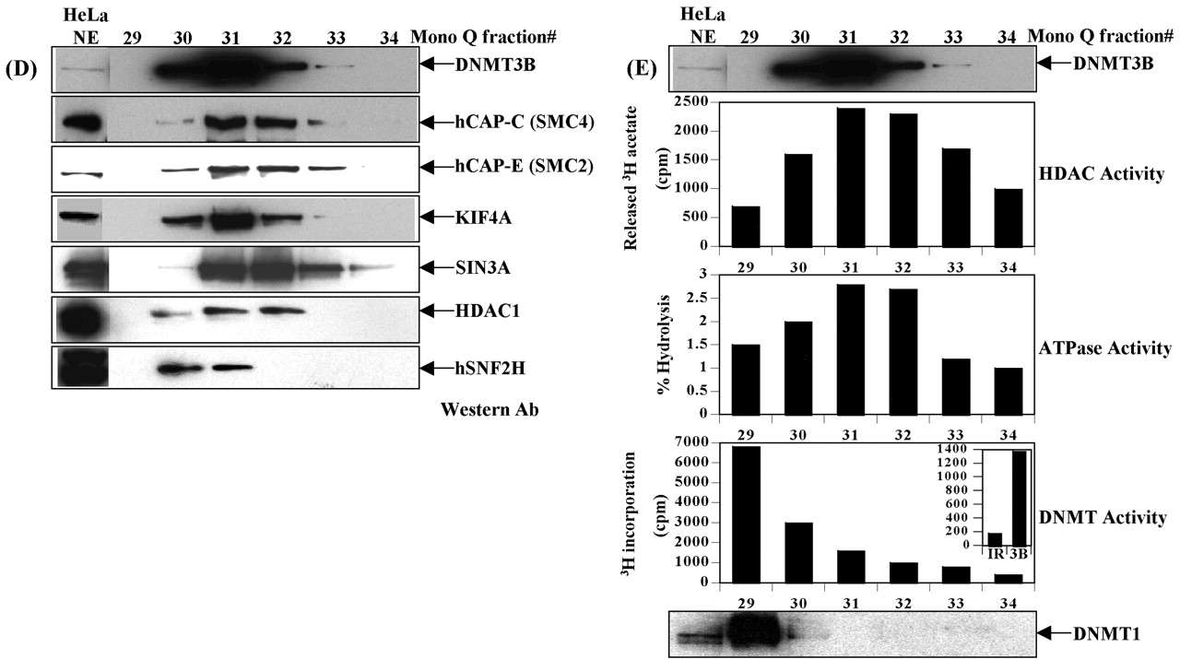
Figure 1. Purification of a novel DNMT3B complex from HeLa cells. (A) Endogenous DNMT3B in HeLa nuclear ...
Notes:
Figure 1. Purification of a novel DNMT3B complex from HeLa cells. (A) Endogenous DNMT3B in HeLa nuclear extract (NE) migrates at a molecular weight of ∼950 kDa on a Superose 6 gel filtration column. The position of the size standards and column fraction numbers are shown along the top. Western blotting was performed with an epitope affinity‐purified rabbit polyclonal anti‐DNMT3B antibody. (B) Purification scheme for the DNMT3B complex. (C) Silver staining of the peak fraction of DNMT3B (detected by western blotting) from the final Mono Q purification step. Protein bands were excised from the gel and identified by mass spectrometry and/or western blotting, as described in Materials and methods. (D) Western blot analysis of the Mono Q column fractions across the peak of DNMT3B. Antibodies used in the western analysis are shown at the right of the figure. Fraction 31 was used for the mass spectrometry identification of DNMT3B co‐purifying proteins. (E) Enzymatic activities co‐purifying with the HeLa DNMT3B complex. Column fractions across the DNMT3B peak were screened for HDAC activity, ATPase activity (ATP hydrolysis stimulated by the addition of purified core histones) and DNA methyltransferase activity [with poly d(I‐C) as the DNA substrate]. The inset shows the DNA methyltransferase activity from an immunoprecipitation with anti‐DNMT3B antibody (‘3B’) demonstrating that the DNMT3B complex possesses DNA methyltransferase activity. ‘IR’ is an irrelevant antibody control (normal rabbit IgG). In the bottom panel, column fractions were probed for DNMT1 by western blotting.
Unless provided in the caption above, the following copyright applies to the content of this slide: Oxford University Press

Slide 3
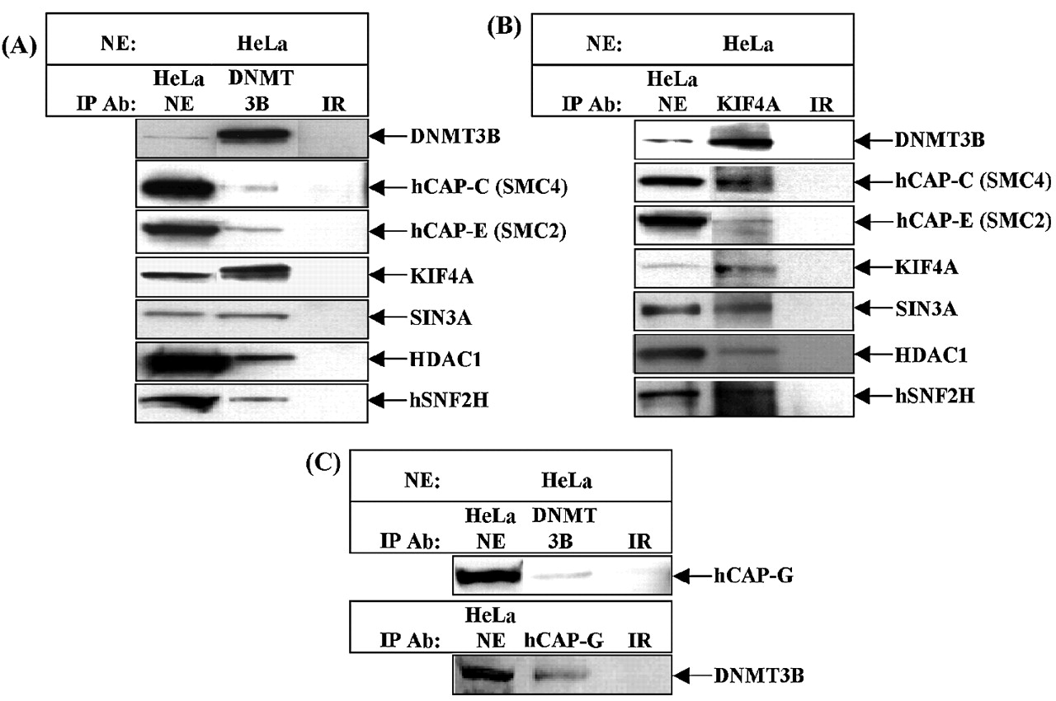
Figure 2. Confirmation of the DNMT3B protein interactions identified in the biochemical purification by ...
Notes:
Figure 2. Confirmation of the DNMT3B protein interactions identified in the biochemical purification by co‐immunoprecipitation. (A) Anti‐DNMT3B antibody was used as the immunoprecipitating antibody to identify DNMT3B‐interacting proteins from HeLa nuclear extract. Immunoprecipitation reactions were then probed with the antibodies shown at the right of the panel by western blotting. (B) Use of a rabbit polyclonal antibody to KIF4A in an immunoprecipitation from HeLa nuclear extract confirms all interactions in (A). (C) The hCAP‐C/hCAP‐E heterodimer can exist free or in the condensin complex. The condensin complex also contains hCAP‐D2/CNAP1, hCAP‐H and hCAP‐G. hCAP‐G can be reciprocally co‐immunoprecipitated with DNMT3B, indicating that DNMT3B also interacts with the condensin complex in HeLa cells. In each case, the input (HeLa NE) and an irrelevant antibody control (species‐matched normal IgG) were run on the same gels.
Unless provided in the caption above, the following copyright applies to the content of this slide: Oxford University Press

Slide 4
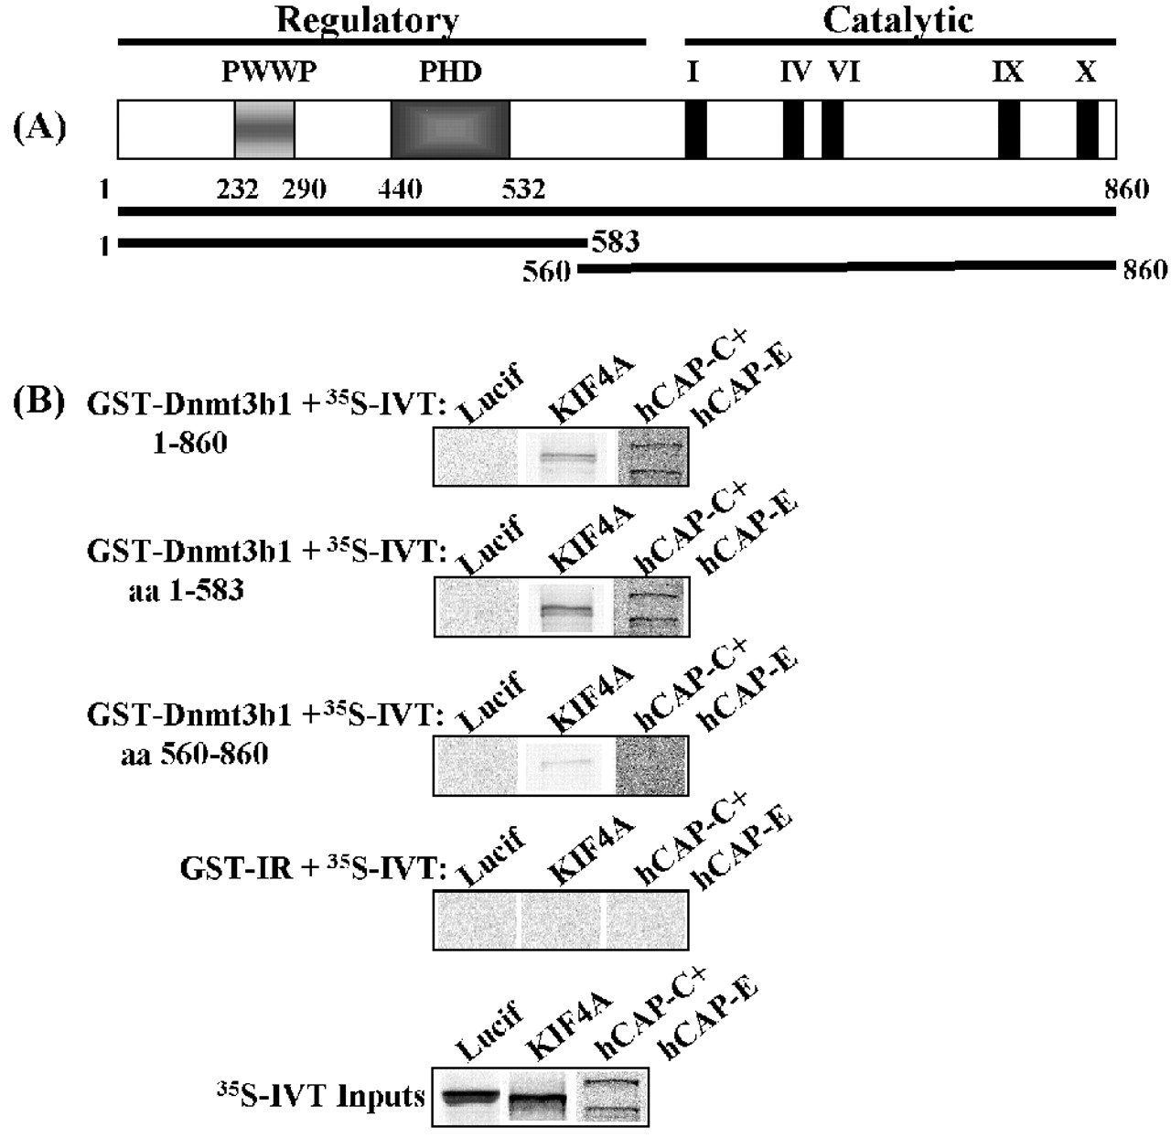
Figure 3. DNMT3B binds to the hCAP‐C/hCAP‐E heterodimer and KIF4A in vitro in a GST pull‐down assay. (A) ...
Notes:
Figure 3. DNMT3B binds to the hCAP‐C/hCAP‐E heterodimer and KIF4A in vitro in a GST pull‐down assay. (A) Schematic structure of DNMT3B showing the extent of the two deletion mutants used in the interaction domain mapping study. (B) The GST fusion proteins indicated at the upper left of each panel were incubated with in vitro‐transcribed and ‐translated 35S‐labeled proteins (IVT), then washed extensively. An irrelevant GST fusion (‘GST‐IR’) served as a control for non‐specific binding to the IVT proteins, while IVT–luciferase served as a control for non‐specific binding to GST–DNMT3B proteins. The IVT inputs used in the GST pull‐down are shown in the bottom panel.
Unless provided in the caption above, the following copyright applies to the content of this slide: Oxford University Press

Slide 5
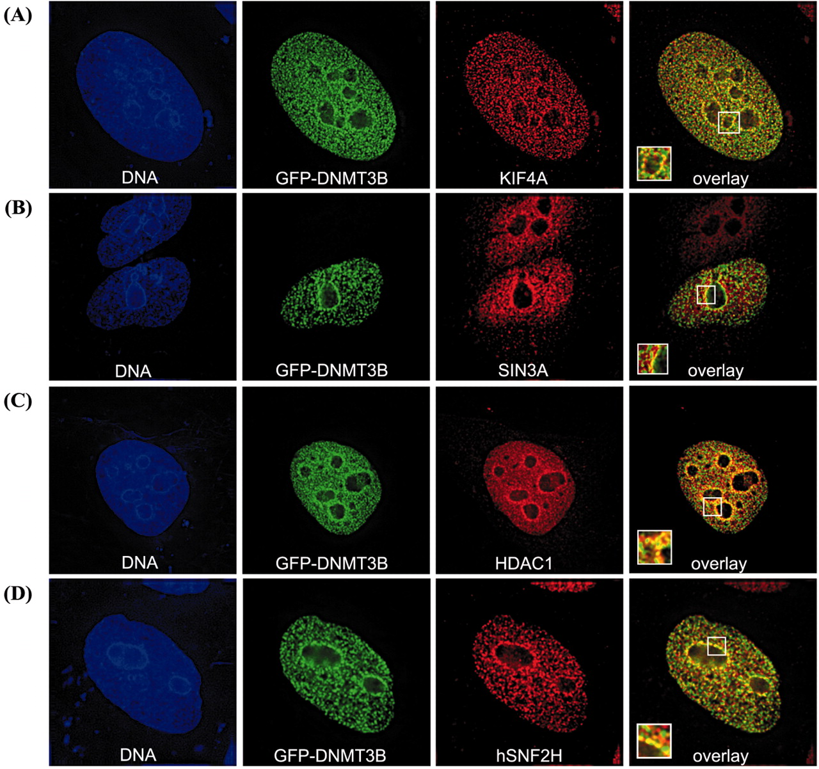
Figure 4. Immunofluorescence localization of DNMT3B‐associated proteins in interphase HeLa cells. DNMT3B (as ...
Notes:
Figure 4. Immunofluorescence localization of DNMT3B‐associated proteins in interphase HeLa cells. DNMT3B (as a GFP fusion) co‐localizes extensively with KIF4A (A). GFP–DNMT3B co‐localization with SIN3A (B), HDAC1 (C), hSNF2H (D), hCAP‐C (E) and hCAP‐G (F) in interphase cells. Note that much of the hCAP‐C and hCAP‐G localizes to the cytoplasm during interphase, but a fraction of the nuclear hCAP‐C/hCAP‐G clearly co‐localizes with DNMT3B. In order to enhance the nuclear condensin immunofluorescence signal (monitored by hCAP‐G staining), HeLa cells were treated with digitonin to remove cytoplasmic proteins. This treatment allowed for better visualization of nuclear hCAP‐G, and revealed that hCAP‐G and DNMT3B co‐localize extensively (G). Co‐localization of endogenous hCAP‐G (green) and KIF4A (red) in interphase nuclei (H). The left panel of each row is the Hoechst 33342 DNA stain (blue), and the middle two panels show the localization of GFP–DNMT3B (green) and the indicated proteins (red). In (H), hCAP‐G is shown in green and KIF4A is in red. The two images are merged in the right‐most panel, where yellow color represents co‐localization. Boxed areas are enlarged and shown in the lower‐left corner of each overlay panel. The scale bar corresponds to 5 µm.
Unless provided in the caption above, the following copyright applies to the content of this slide: Oxford University Press

Slide 6
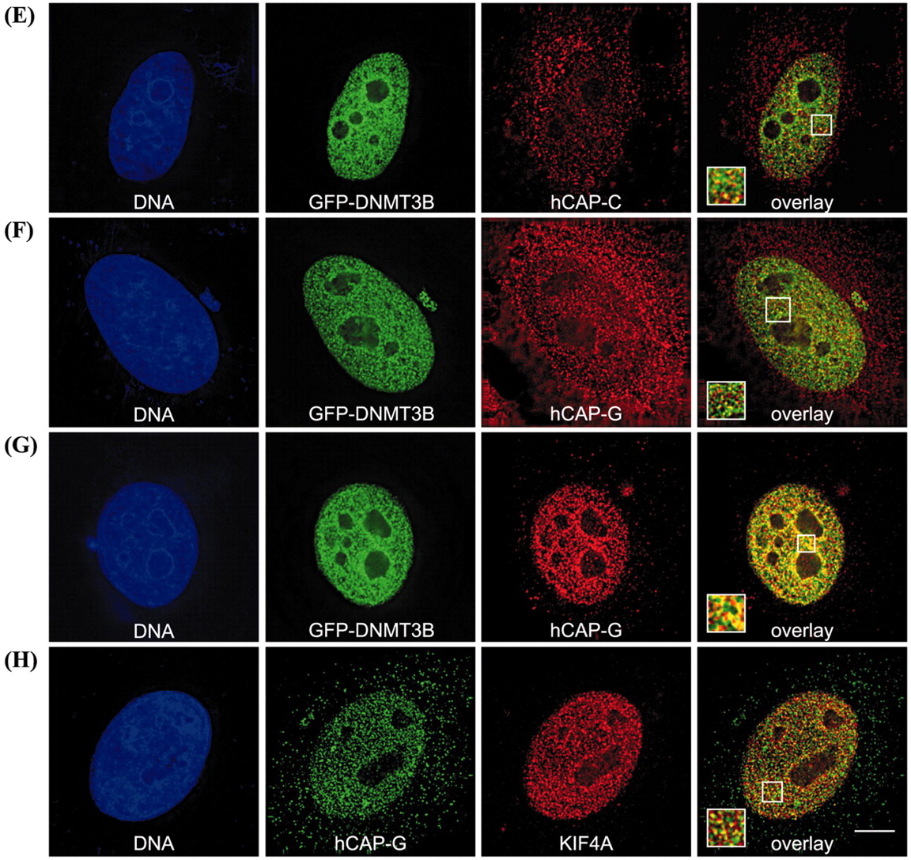
Figure 4. Immunofluorescence localization of DNMT3B‐associated proteins in interphase HeLa cells. DNMT3B (as ...
Notes:
Figure 4. Immunofluorescence localization of DNMT3B‐associated proteins in interphase HeLa cells. DNMT3B (as a GFP fusion) co‐localizes extensively with KIF4A (A). GFP–DNMT3B co‐localization with SIN3A (B), HDAC1 (C), hSNF2H (D), hCAP‐C (E) and hCAP‐G (F) in interphase cells. Note that much of the hCAP‐C and hCAP‐G localizes to the cytoplasm during interphase, but a fraction of the nuclear hCAP‐C/hCAP‐G clearly co‐localizes with DNMT3B. In order to enhance the nuclear condensin immunofluorescence signal (monitored by hCAP‐G staining), HeLa cells were treated with digitonin to remove cytoplasmic proteins. This treatment allowed for better visualization of nuclear hCAP‐G, and revealed that hCAP‐G and DNMT3B co‐localize extensively (G). Co‐localization of endogenous hCAP‐G (green) and KIF4A (red) in interphase nuclei (H). The left panel of each row is the Hoechst 33342 DNA stain (blue), and the middle two panels show the localization of GFP–DNMT3B (green) and the indicated proteins (red). In (H), hCAP‐G is shown in green and KIF4A is in red. The two images are merged in the right‐most panel, where yellow color represents co‐localization. Boxed areas are enlarged and shown in the lower‐left corner of each overlay panel. The scale bar corresponds to 5 µm.
Unless provided in the caption above, the following copyright applies to the content of this slide: Oxford University Press

Slide 7
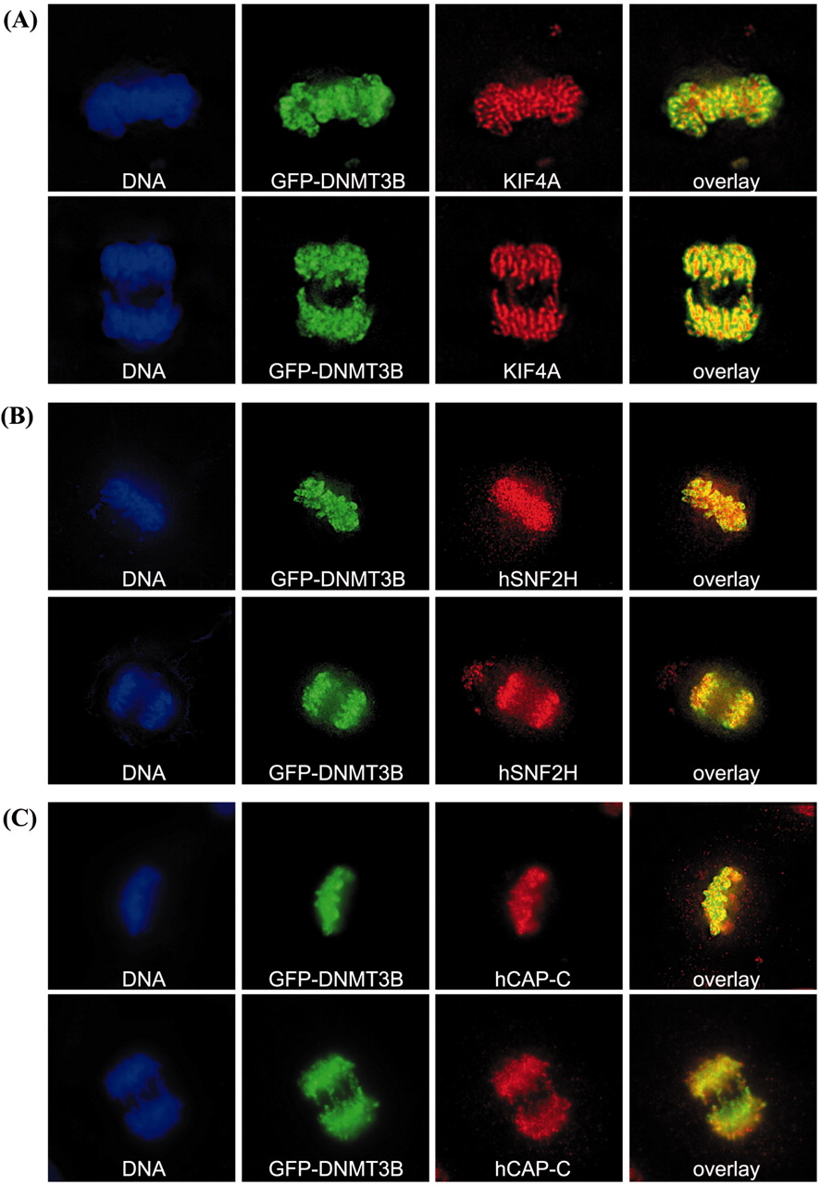
Figure 5. DNMT3B localizes to condensed chromosomes throughout mitosis, and co‐localizes with condensin, ...
Notes:
Figure 5. DNMT3B localizes to condensed chromosomes throughout mitosis, and co‐localizes with condensin, KIF4A and hSNF2H. HeLa cells were transfected with GFP–DNMT3B, synchronized using a thymidine block, then released. When cells were entering mitosis, they were fixed and stained for endogenous KIF4A (A), hSNF2H (B), hCAP‐C (C), hCAP‐G (D), and KIF4A and hCAP‐G (E). Representative cells from metaphase (upper panels) and anaphase (lower panels) are shown. The left panel is the DNA stain (blue), the middle two panels show the localization of GFP–DNMT3B (green) and the indicated protein (red), and the right panel is an overlay of the green and red channels. In (E), hCAP‐G staining is in green and KIF4A staining is in red.
Unless provided in the caption above, the following copyright applies to the content of this slide: Oxford University Press

Slide 8
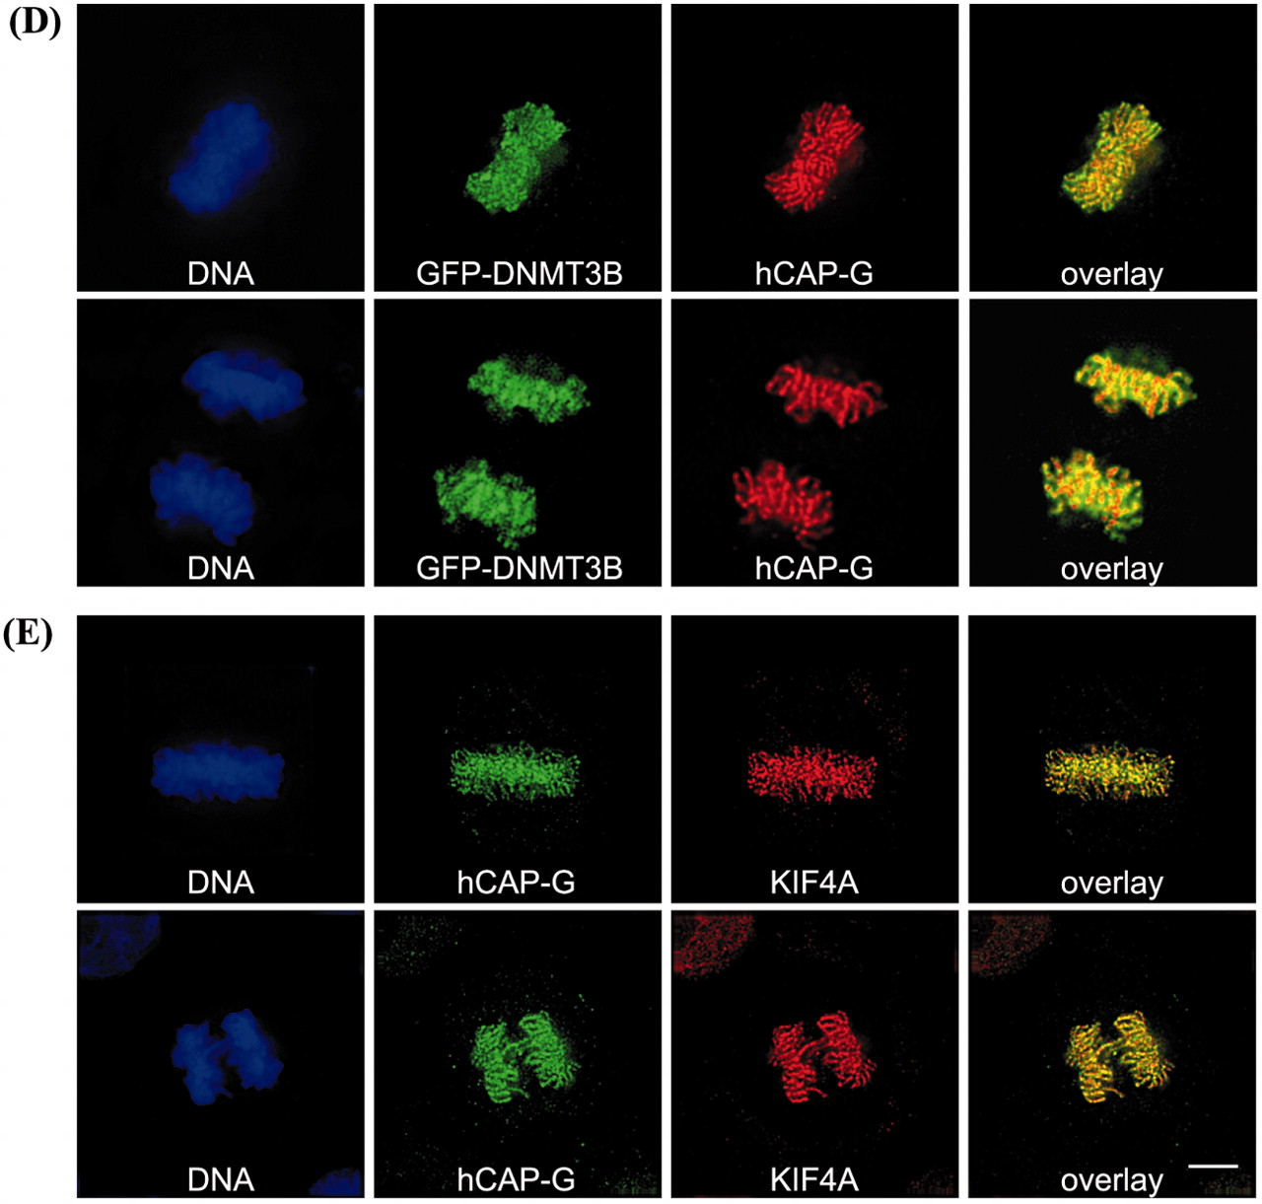
Figure 5. DNMT3B localizes to condensed chromosomes throughout mitosis, and co‐localizes with condensin, ...
Notes:
Figure 5. DNMT3B localizes to condensed chromosomes throughout mitosis, and co‐localizes with condensin, KIF4A and hSNF2H. HeLa cells were transfected with GFP–DNMT3B, synchronized using a thymidine block, then released. When cells were entering mitosis, they were fixed and stained for endogenous KIF4A (A), hSNF2H (B), hCAP‐C (C), hCAP‐G (D), and KIF4A and hCAP‐G (E). Representative cells from metaphase (upper panels) and anaphase (lower panels) are shown. The left panel is the DNA stain (blue), the middle two panels show the localization of GFP–DNMT3B (green) and the indicated protein (red), and the right panel is an overlay of the green and red channels. In (E), hCAP‐G staining is in green and KIF4A staining is in red.
Unless provided in the caption above, the following copyright applies to the content of this slide: Oxford University Press

Slide 9
Figure 6. DNMT3B and its associated proteins bind to similar repetitive sequences in vivo. ChIP assays were ...
Notes:
Figure 6. DNMT3B and its associated proteins bind to similar repetitive sequences in vivo. ChIP assays were carried out on formaldehyde‐fixed chromatin isolated from the CCL256.1 lymphoblastoid cell line. Following the washes, cross‐links were reversed and the purified DNA was analyzed by PCR with primers specific for (A) satellite 2 repeat, (B) rDNA repeat, (C) alu repeat and (D) the GAPDH housekeeping gene. For each antibody, PCRs were set up for the input, unbound ‘U’ and specifically bound ‘B’ fractions. Antibodies used in the ChIP are shown along the top of the panel. Control ChIP reactions were performed with species‐matched normal IgG. Aliquots of PCRs were run on a 3% agarose gel and visualized with ethidium bromide.
Unless provided in the caption above, the following copyright applies to the content of this slide: Oxford University Press

