Slide 1
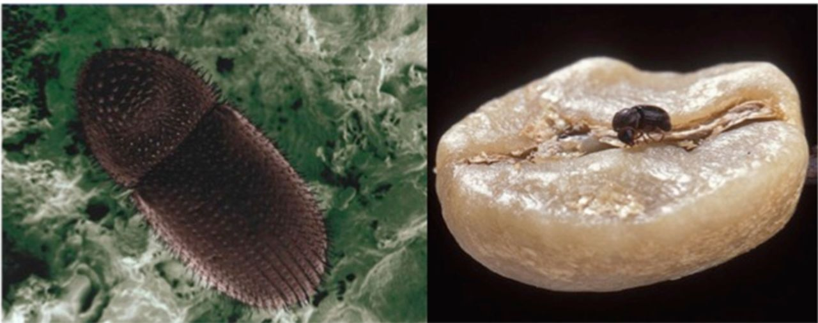
Figure 1. Dorsal view of an adult coffee berry borer, Hypothenemus hampei (left) and adult female (~ 2 mm long) walking ...
Notes:
Figure 1. Dorsal view of an adult coffee berry borer, Hypothenemus hampei (left) and adult female (~ 2 mm long) walking over a coffee seed (right). Photos by Eric Erbe, USDA, ARS (left) and Peggy Greb, USDA, ARS (right). High quality figures are available online.
Unless provided in the caption above, the following copyright applies to the content of this slide: This is an open access paper. We use the Creative Commons Attribution 3.0 license that permits unrestricted use, provided that the paper is properly attributed.This is an Open Access article distributed under the terms of the Creative Commons Attribution License (http://creativecommons.org/licenses/by/3.0/), which permits unrestricted reuse, distribution, and reproduction in any medium, providedthe original work is properly cited.

Slide 2
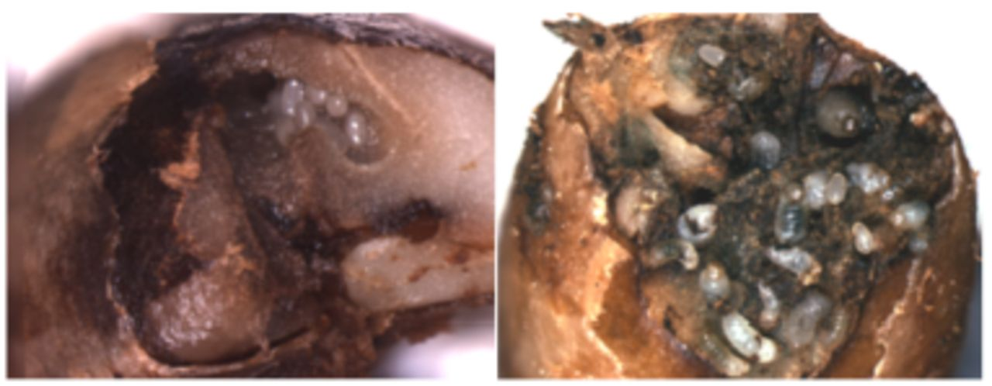
Figure 2. Hypothenemus hampei galleries containing eggs (left), and eggs and larvae (right). Photos by Elsie Burbano. ...
Notes:
Figure 2. Hypothenemus hampei galleries containing eggs (left), and eggs and larvae (right). Photos by Elsie Burbano. High quality figures are available online.
Unless provided in the caption above, the following copyright applies to the content of this slide: This is an open access paper. We use the Creative Commons Attribution 3.0 license that permits unrestricted use, provided that the paper is properly attributed.This is an Open Access article distributed under the terms of the Creative Commons Attribution License (http://creativecommons.org/licenses/by/3.0/), which permits unrestricted reuse, distribution, and reproduction in any medium, providedthe original work is properly cited.

Slide 3
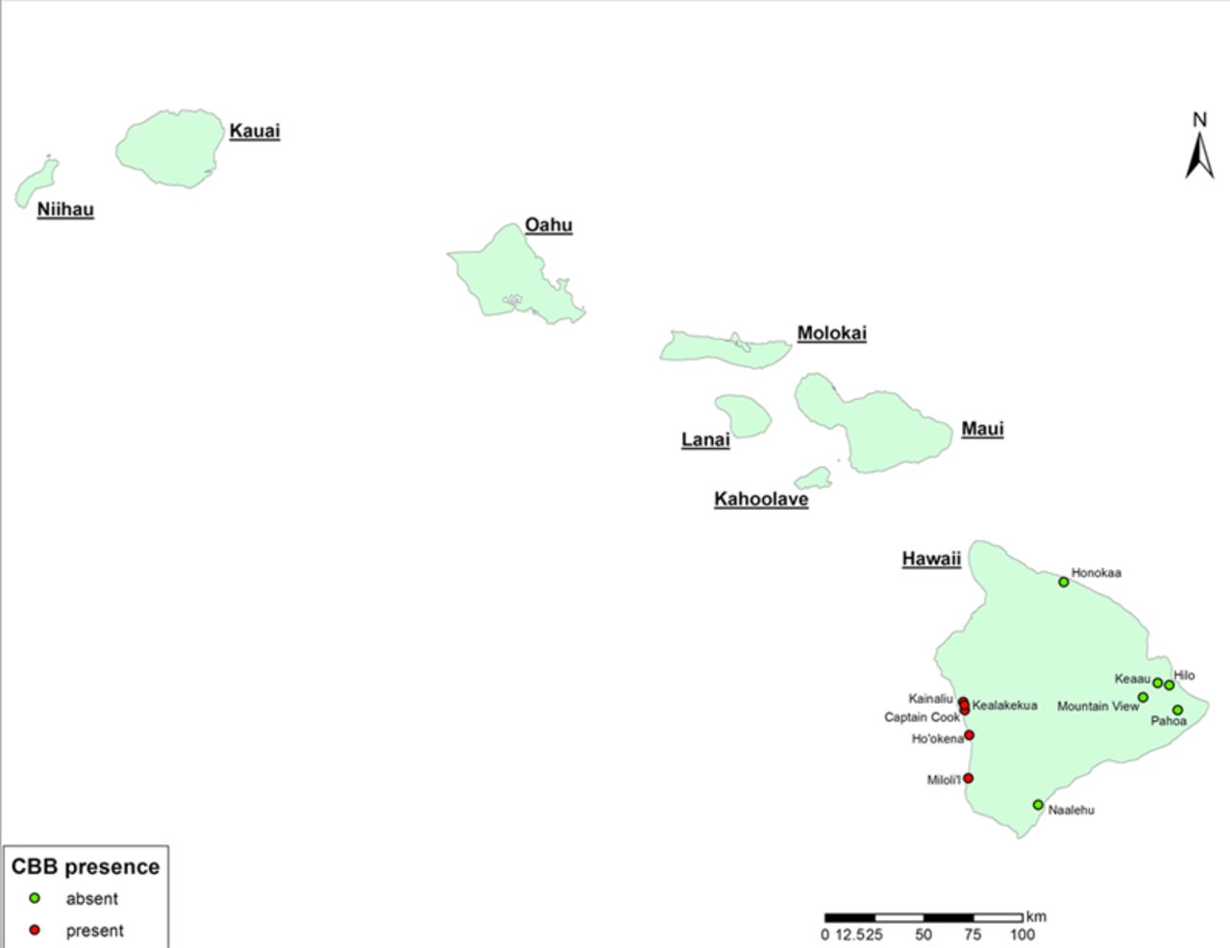
Figure 3. Distribution of Hypothenemus hampei in the district of Kona, Island of Hawai’i. Pest incidence data by Hawaii ...
Notes:
Figure 3. Distribution of Hypothenemus hampei in the district of Kona, Island of Hawai’i. Pest incidence data by Hawaii Department of Agriculture. Map courtesy of Kai Sonder, CIMMYT. High quality figures are available online.
Unless provided in the caption above, the following copyright applies to the content of this slide: This is an open access paper. We use the Creative Commons Attribution 3.0 license that permits unrestricted use, provided that the paper is properly attributed.This is an Open Access article distributed under the terms of the Creative Commons Attribution License (http://creativecommons.org/licenses/by/3.0/), which permits unrestricted reuse, distribution, and reproduction in any medium, providedthe original work is properly cited.

