Slide 1
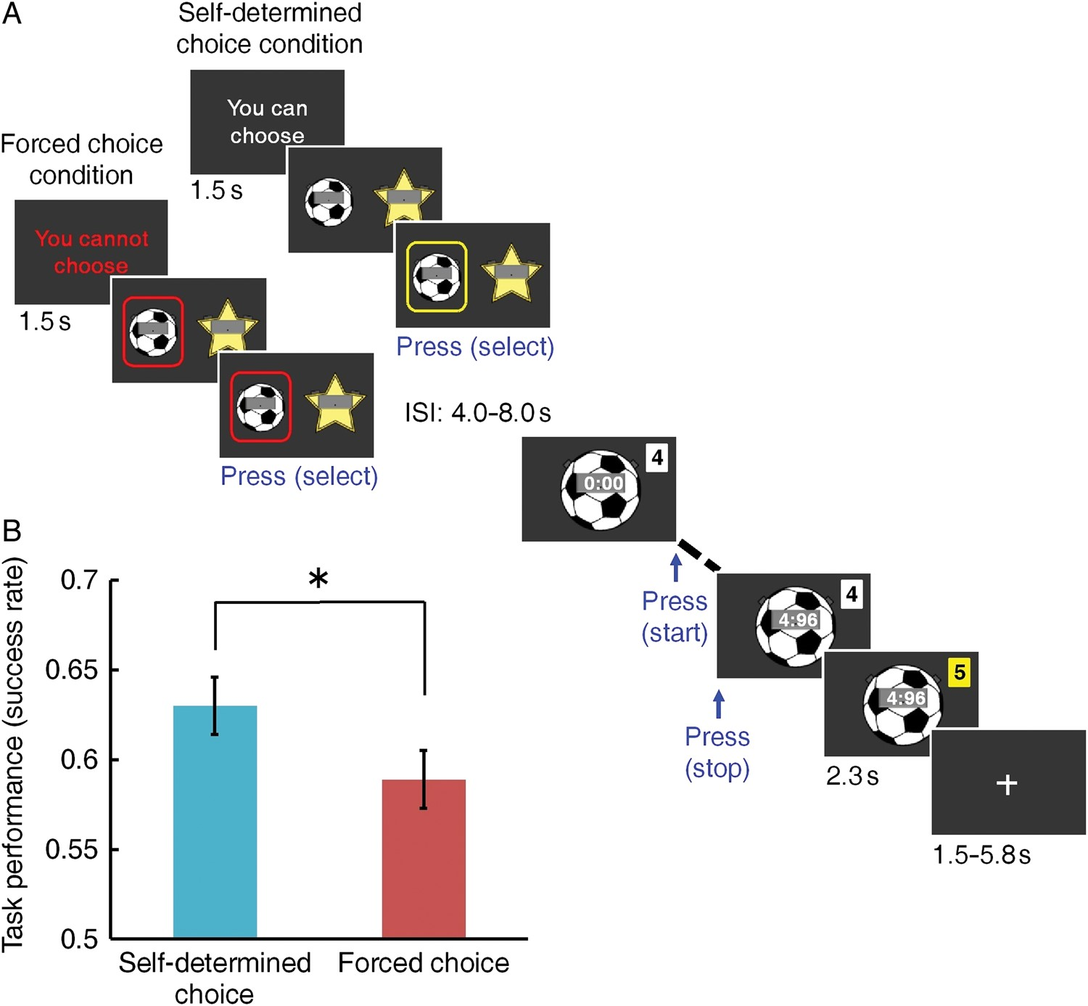
Figure 1. Experimental procedure, materials, and behavioral results. (A) Depiction of the experimental procedure. (B) ...
Notes:
Figure 1. Experimental procedure, materials, and behavioral results. (A) Depiction of the experimental procedure. (B) Means and standard errors of the performance of the stopwatch task (success rate). Self-determined-choice condition significantly enhanced task performance in comparison to forced-choice condition (t30 = 2.49, P = 0.018).
Unless provided in the caption above, the following copyright applies to the content of this slide: © The Author 2013. Published by Oxford University Press. All rights reserved. For Permissions, please e-mail: journals.permissions@oup.com

Slide 2
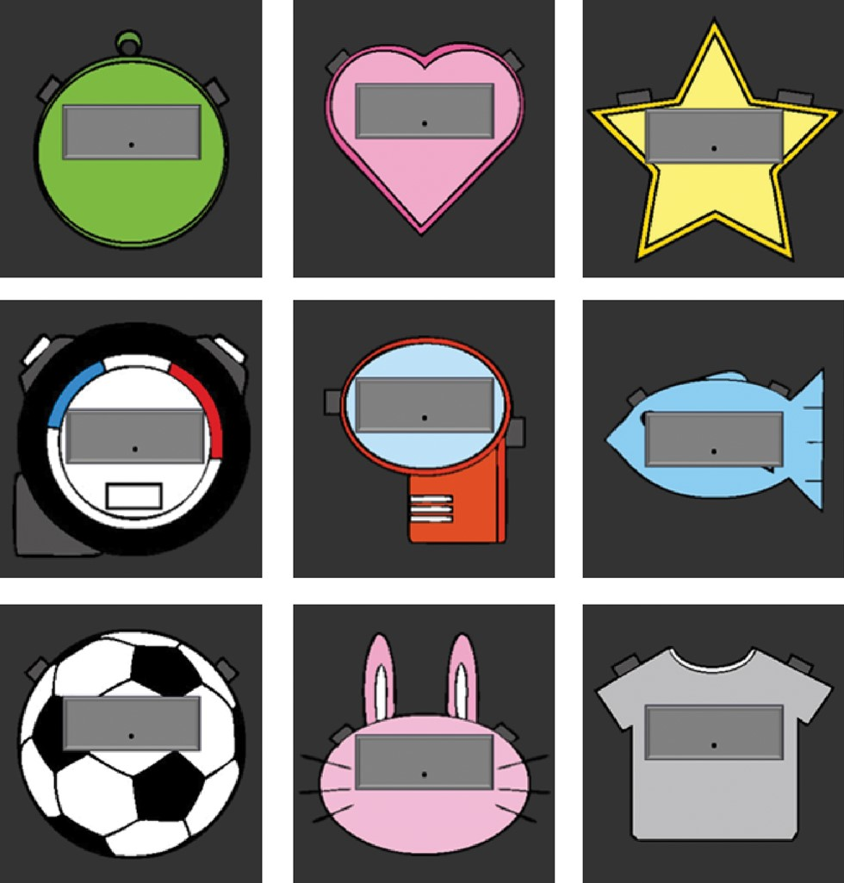
Figure 2. Nine types of stopwatches used in the current experiment. They are different in their appearance, but the ...
Notes:
Figure 2. Nine types of stopwatches used in the current experiment. They are different in their appearance, but the difficulty of the task was identical.
Unless provided in the caption above, the following copyright applies to the content of this slide: © The Author 2013. Published by Oxford University Press. All rights reserved. For Permissions, please e-mail: journals.permissions@oup.com

Slide 3
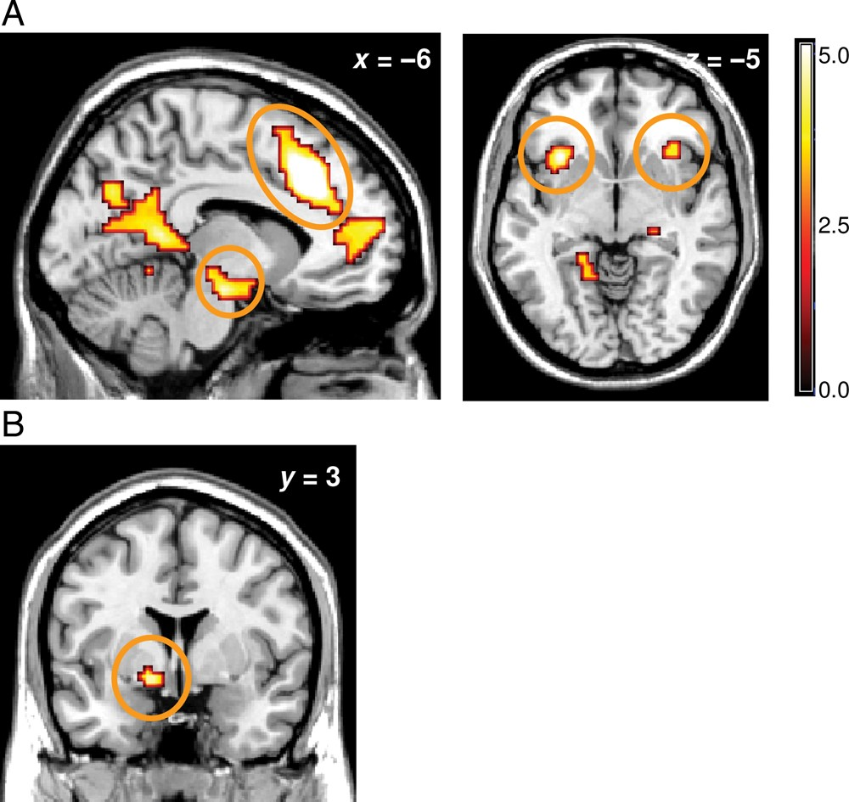
Figure 3. (A) Anterior cingulate cortex (left panel, upper circle), midbrain (left panel, bottom circle), and bilateral ...
Notes:
Figure 3. (A) Anterior cingulate cortex (left panel, upper circle), midbrain (left panel, bottom circle), and bilateral insula (right panel) activation elicited by self-determined-choice trials relative to forced-choice trials when participants were presented a task cue (P < 0.05, familywise error corrected; the image is shown at P < 0.001, uncorrected). Neural responses are displayed in sagittal and transaxial formats. (B) The ventral pallidum activation elicited by self-determined choice trials relative to forced choice trials when participants were presented a task cue (P < 0.005, uncorrected). Neural responses are displayed in coronal format.
Unless provided in the caption above, the following copyright applies to the content of this slide: © The Author 2013. Published by Oxford University Press. All rights reserved. For Permissions, please e-mail: journals.permissions@oup.com

Slide 4
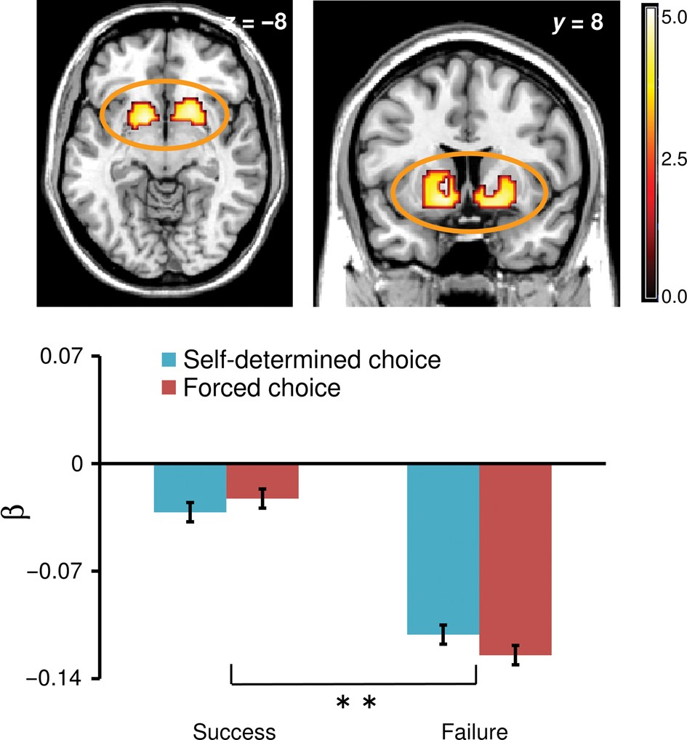
Figure 4. Bilateral striatum activation (peak at 21, 14, −5, and −12, 8, −8) showing a significant main effect of ...
Notes:
Figure 4. Bilateral striatum activation (peak at 21, 14, −5, and −12, 8, −8) showing a significant main effect of outcome feedback (P < 0.05, familywise error corrected; the image is shown at P < 0.001, uncorrected). Neural responses are displayed in transaxial and coronal formats. The bottom panel represents the mean β values (a 6-mm sphere centered on the peak) and corresponding SEs in the striatum as a function of choice condition (self-determined choice vs. forced choice) and outcome feedback (success vs. failure). Note that the graph plotted the activation in the right striatum to allow for reasonable comparison with Figure 5. The plot indicated that the striatum was strongly influenced by outcome feedback (positive vs. negative), but this effect was not modulated by choice condition.
Unless provided in the caption above, the following copyright applies to the content of this slide: © The Author 2013. Published by Oxford University Press. All rights reserved. For Permissions, please e-mail: journals.permissions@oup.com

Slide 5
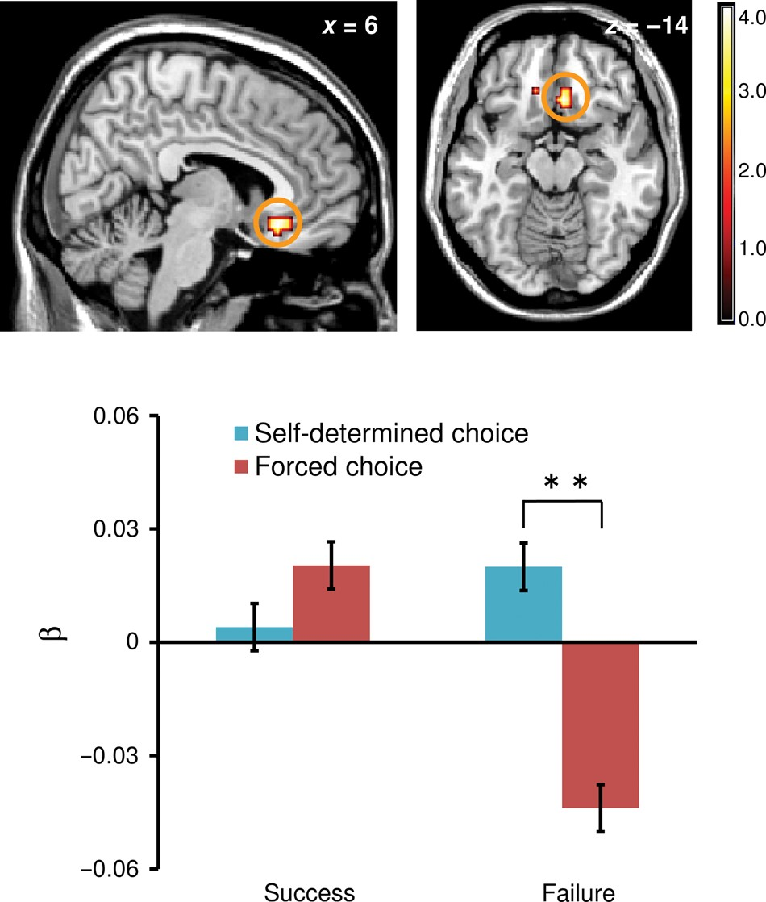
Figure 5. Right vmPFC activation (peak at 6, 26, −14) showing a significant choice condition by outcome feedback ...
Notes:
Figure 5. Right vmPFC activation (peak at 6, 26, −14) showing a significant choice condition by outcome feedback interaction in response to task feedback (P < 0.05, familywise error corrected; the image is shown at P < 0.001, uncorrected). Neural responses are displayed in sagittal and transaxial formats. The bottom panel represents the mean β values (a 6-mm sphere centered on the peak) and corresponding SEs as a function of choice condition (self-determined choice vs. forced choice) and outcome feedback (success vs. failure). The plot indicated that, in response to success feedback, the vmPFC activation in the self-determined-choice condition was not different from that in the forced-choice condition (F1,50 = 0.70, P = 0.41). On the other hand, the self-determined-choice condition showed higher vmPFC activation when compared with the forced-choice condition in response to failure feedback (F1,50 = 14.11, P < 0.01).
Unless provided in the caption above, the following copyright applies to the content of this slide: © The Author 2013. Published by Oxford University Press. All rights reserved. For Permissions, please e-mail: journals.permissions@oup.com

Slide 6
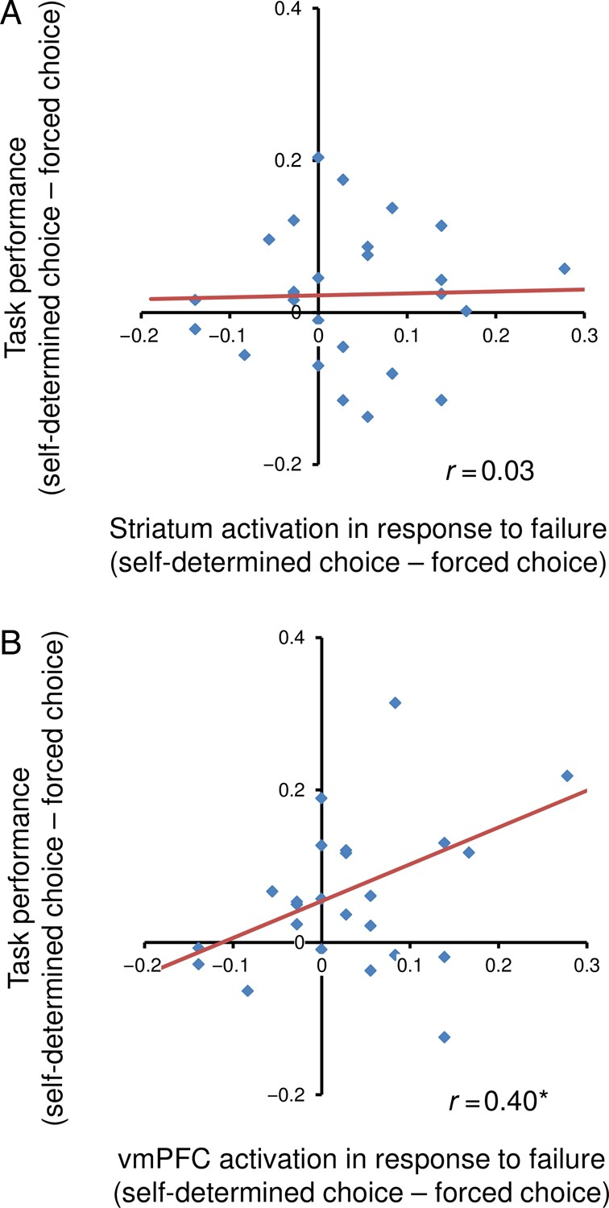
Figure 6. (A) Correlation between the promoted task performance due to self-determined choice (y-axis) and the ...
Notes:
Figure 6. (A) Correlation between the promoted task performance due to self-determined choice (y-axis) and the magnitude of the striatum resilience in the self-determined-choice condition (computed by subtracting the β values in the forced-choice condition from the β value in the self-determined-choice condition in response to failure feedback; x-axis). No significant positive correlation was observed (r = 0.03, P = 0.89), indicating that the striatum may be unrelated to promoted performance and motivation due to self-determined choice. (B) Correlation between the promoted task performance due to self-determined choice (y-axis) and the magnitude of the vmPFC resilience in the self-determined-choice condition (computed by subtracting the β values in the forced-choice condition from the β value in the self-determined-choice condition in response to failure feedback; x-axis). Significant positive correlation was observed (r = 0.40, P < 0.05), indicating that those who showed less activation drop in the self-determined-choice condition in response to failure feedback tended to show enhanced task performance in the self-determined-choice condition.
Unless provided in the caption above, the following copyright applies to the content of this slide: © The Author 2013. Published by Oxford University Press. All rights reserved. For Permissions, please e-mail: journals.permissions@oup.com

Slide 7
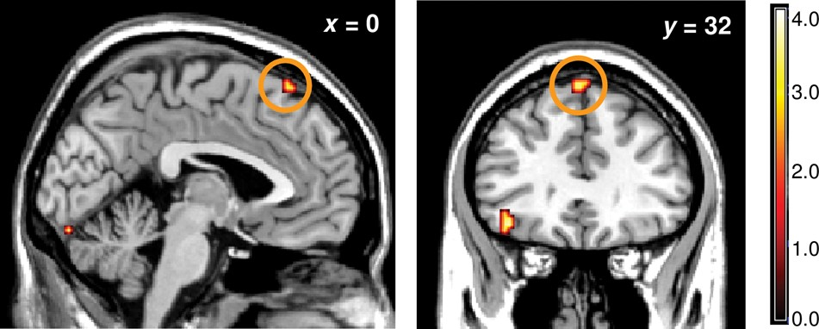
Figure 7. Pre-SMA responses elicited by self-determined-choice trials relative to forced-choice trials when ...
Notes:
Figure 7. Pre-SMA responses elicited by self-determined-choice trials relative to forced-choice trials when participants initiated the task (i.e., when participants pressed a button; P < 0.001, uncorrected). Neural responses are displayed in coronal and transaxial formats.
Unless provided in the caption above, the following copyright applies to the content of this slide: © The Author 2013. Published by Oxford University Press. All rights reserved. For Permissions, please e-mail: journals.permissions@oup.com

