Slide 1
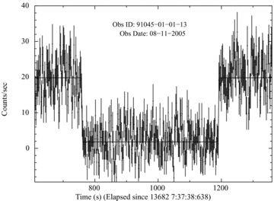
Figure 1 A sample of 2–20 keV, background subtracted light curve of XTE J1710-281, binned with 2 s and including an ...
Notes:
Figure 1 A sample of 2–20 keV, background subtracted light curve of XTE J1710-281, binned with 2 s and including an eclipse lasting for about 428 s. The line represents the best-fitting five-parameter model for the light curve. The best fit had a χ2 of 381 for 375 d.o.f.
Unless provided in the caption above, the following copyright applies to the content of this slide: © 2011 The Authors Monthly Notices of the Royal Astronomical Society © 2011 RAS

Slide 2
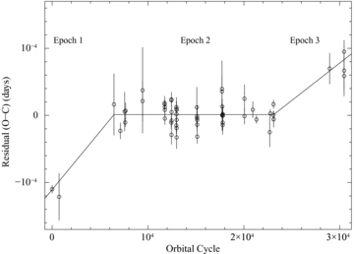
Figure 2 The observed minus calculated times (residuals, O − C) for eclipses observed in XTE J1710-281 during ...
Notes:
Figure 2 The observed minus calculated times (residuals, O − C) for eclipses observed in XTE J1710-281 during 1999–2010, obtained from RXTE-PCA observations. The O − C variation is plotted as a function of orbital cycle. The three distinct orbital period epochs are mentioned.
Unless provided in the caption above, the following copyright applies to the content of this slide: © 2011 The Authors Monthly Notices of the Royal Astronomical Society © 2011 RAS

Slide 3
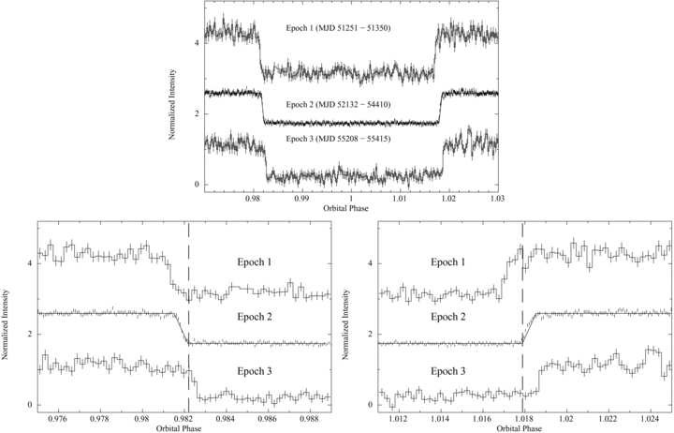
Figure 3 A sample of 2–20 keV folded light curves of XTE J1710-281. The light curves were folded with a period of ...
Notes:
Figure 3 A sample of 2–20 keV folded light curves of XTE J1710-281. The light curves were folded with a period of 0.1367109674 d at an epoch of MJD 51250.924540. The normalized intensities during epoch 1 and epoch 2 have been rescaled, by adding constant numbers to the curves. The solid line in the middle light curve (epoch 2) shows the best-fitting five-parameter model to the X-ray eclipse. The best fit had a reduced χ2 of 689 for 650 d.o.f. The top panel shows the complete eclipse, whereas, the bottom panels show the ingress and egress of the eclipse phase.
Unless provided in the caption above, the following copyright applies to the content of this slide: © 2011 The Authors Monthly Notices of the Royal Astronomical Society © 2011 RAS

