Slide 1
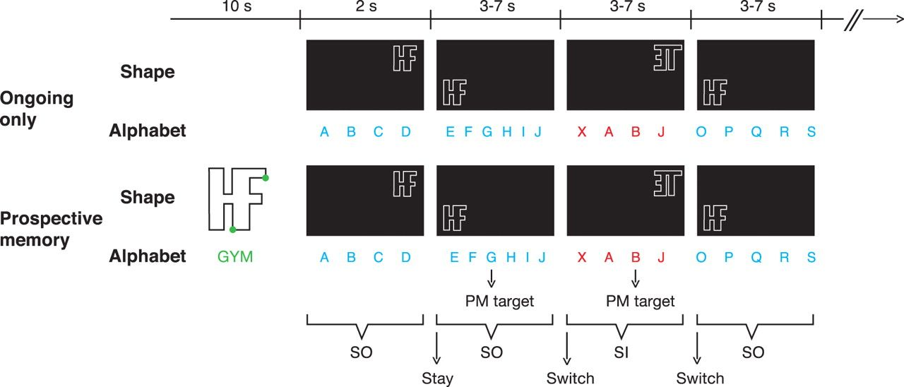
Figure 1. Illustration of the block structure. SO, stimulus-oriented; SI, stimulus-independent; PM, prospective ...
Notes:
Figure 1. Illustration of the block structure. SO, stimulus-oriented; SI, stimulus-independent; PM, prospective memory.
Unless provided in the caption above, the following copyright applies to the content of this slide: © The Authors 2011. Published by Oxford University Press.This is an Open Access article distributed under the terms of the Creative Commons Attribution Non-Commercial License (http://creativecommons.org/licenses/by-nc/3.0), which permits unrestricted non-commercial use, distribution, and reproduction in any medium, provided the original work is properly cited.

Slide 2
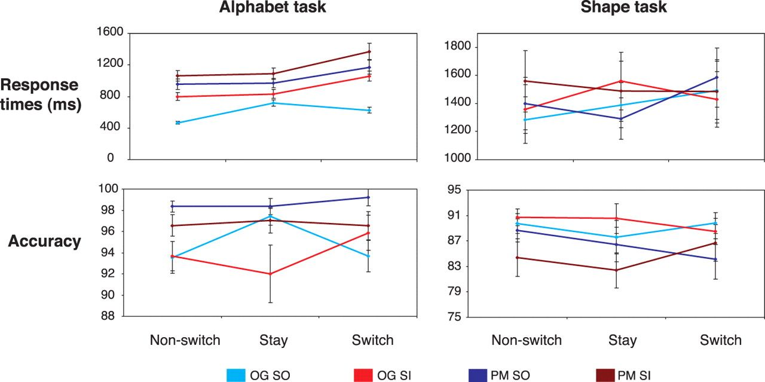
Figure 2. Behavioral results as a function of task, PM condition (OG, ongoing task only; PM, prospective memory), ...
Notes:
Figure 2. Behavioral results as a function of task, PM condition (OG, ongoing task only; PM, prospective memory), stimulus phase (SO, stimulus-oriented; SI, stimulus-independent), and trial type. Error bars indicate standard error of means.
Unless provided in the caption above, the following copyright applies to the content of this slide: © The Authors 2011. Published by Oxford University Press.This is an Open Access article distributed under the terms of the Creative Commons Attribution Non-Commercial License (http://creativecommons.org/licenses/by-nc/3.0), which permits unrestricted non-commercial use, distribution, and reproduction in any medium, provided the original work is properly cited.

Slide 3
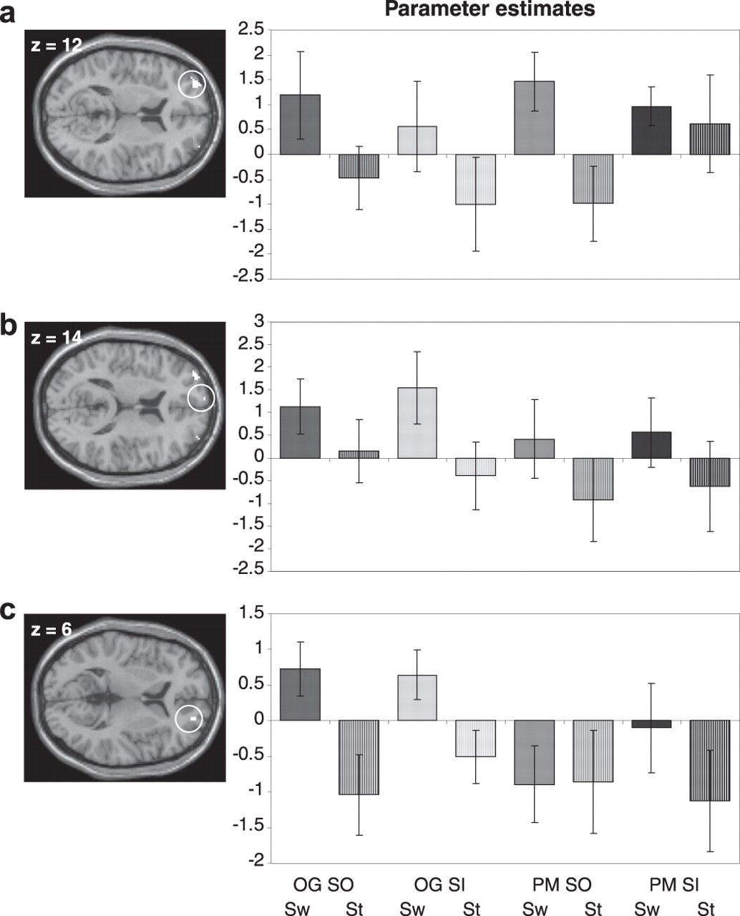
Figure 6. BOLD signal changes for the contrast switch versus stay and associated regressor estimates for (a) left ...
Notes:
Figure 6. BOLD signal changes for the contrast switch versus stay and associated regressor estimates for (a) left lateral, (b) medial, and (c) right lateral rPFC (thresholded at P < 0.05, FWE corrected for BA 10). OG, ongoing only; PM, prospective memory; SO, stimulus-oriented; SI, stimulus-independent; Sw: switch; St: stay.
Unless provided in the caption above, the following copyright applies to the content of this slide: © The Authors 2011. Published by Oxford University Press.This is an Open Access article distributed under the terms of the Creative Commons Attribution Non-Commercial License (http://creativecommons.org/licenses/by-nc/3.0), which permits unrestricted non-commercial use, distribution, and reproduction in any medium, provided the original work is properly cited.

Slide 4
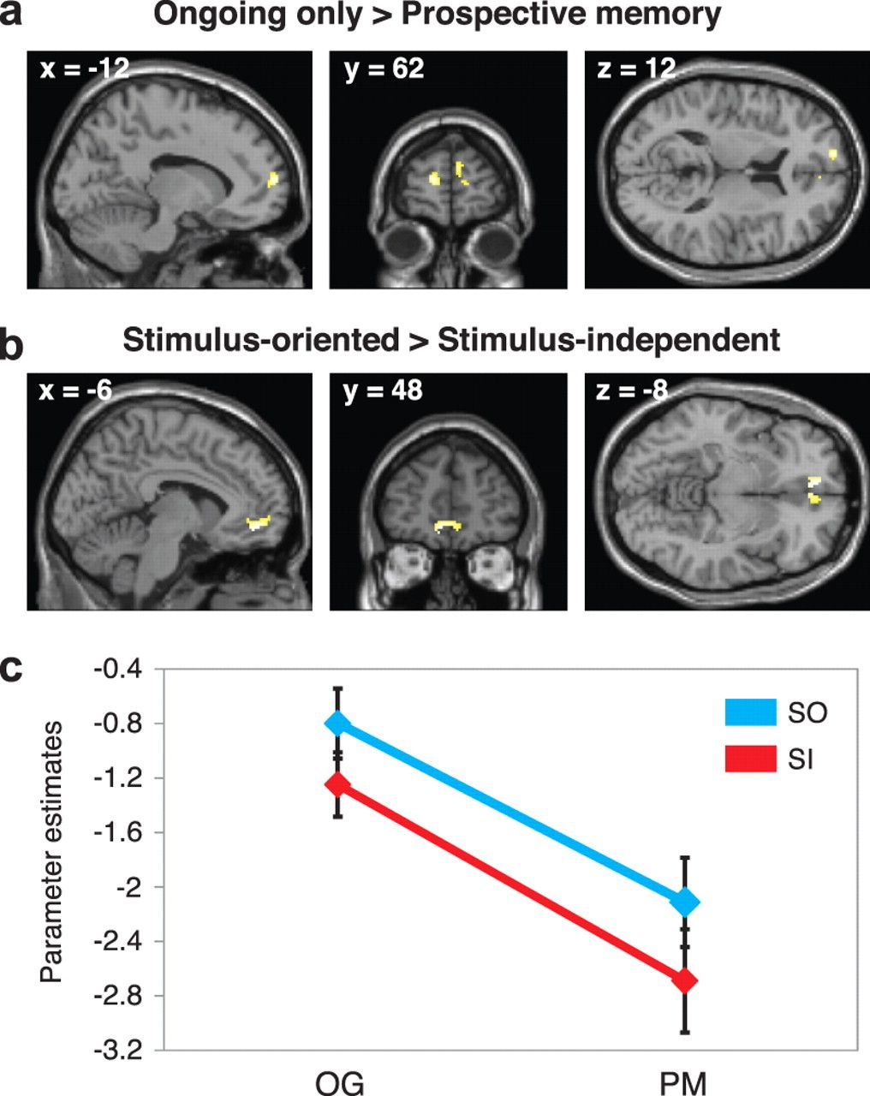
Figure 3. (a,b) BOLD signal changes within rPFC (thresholded at P < 0.05, FWE corrected for BA 10). (c) Parameter ...
Notes:
Figure 3. (a,b) BOLD signal changes within rPFC (thresholded at P < 0.05, FWE corrected for BA 10). (c) Parameter estimates from the peak of overlap between a and b. Error bars indicate standard error of means. OG, ongoing only; PM, prospective memory; SO, stimulus-oriented; SI, stimulus-independent.
Unless provided in the caption above, the following copyright applies to the content of this slide: © The Authors 2011. Published by Oxford University Press.This is an Open Access article distributed under the terms of the Creative Commons Attribution Non-Commercial License (http://creativecommons.org/licenses/by-nc/3.0), which permits unrestricted non-commercial use, distribution, and reproduction in any medium, provided the original work is properly cited.

Slide 5
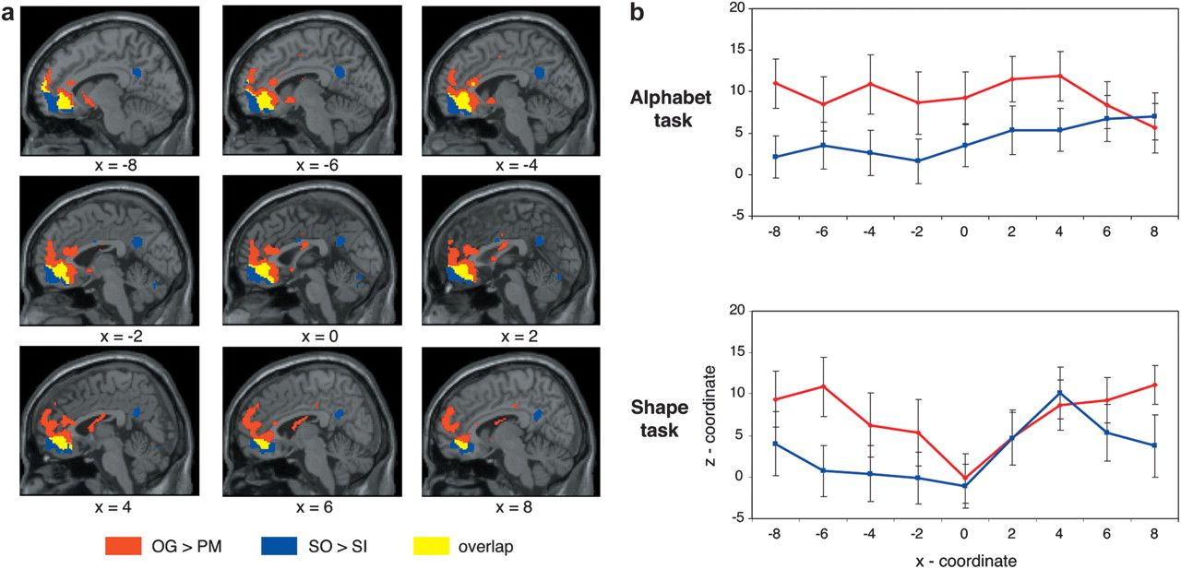
Figure 4. (a) BOLD signal changes for the contrasts 1) ongoing only versus prospective memory (OG > PM) and 2) ...
Notes:
Figure 4. (a) BOLD signal changes for the contrasts 1) ongoing only versus prospective memory (OG > PM) and 2) stimulus-oriented versus stimulus-independent (SO > SI), and 3) for the overlap between both contrasts (thresholded at P < 0.001, uncorrected; averaged across both tasks). (b) Mean z-coordinates of the peak voxels for the individual contrast within each sagittal plane of rostromedial prefrontal cortex. Error bars indicate standard error of means.
Unless provided in the caption above, the following copyright applies to the content of this slide: © The Authors 2011. Published by Oxford University Press.This is an Open Access article distributed under the terms of the Creative Commons Attribution Non-Commercial License (http://creativecommons.org/licenses/by-nc/3.0), which permits unrestricted non-commercial use, distribution, and reproduction in any medium, provided the original work is properly cited.

Slide 6
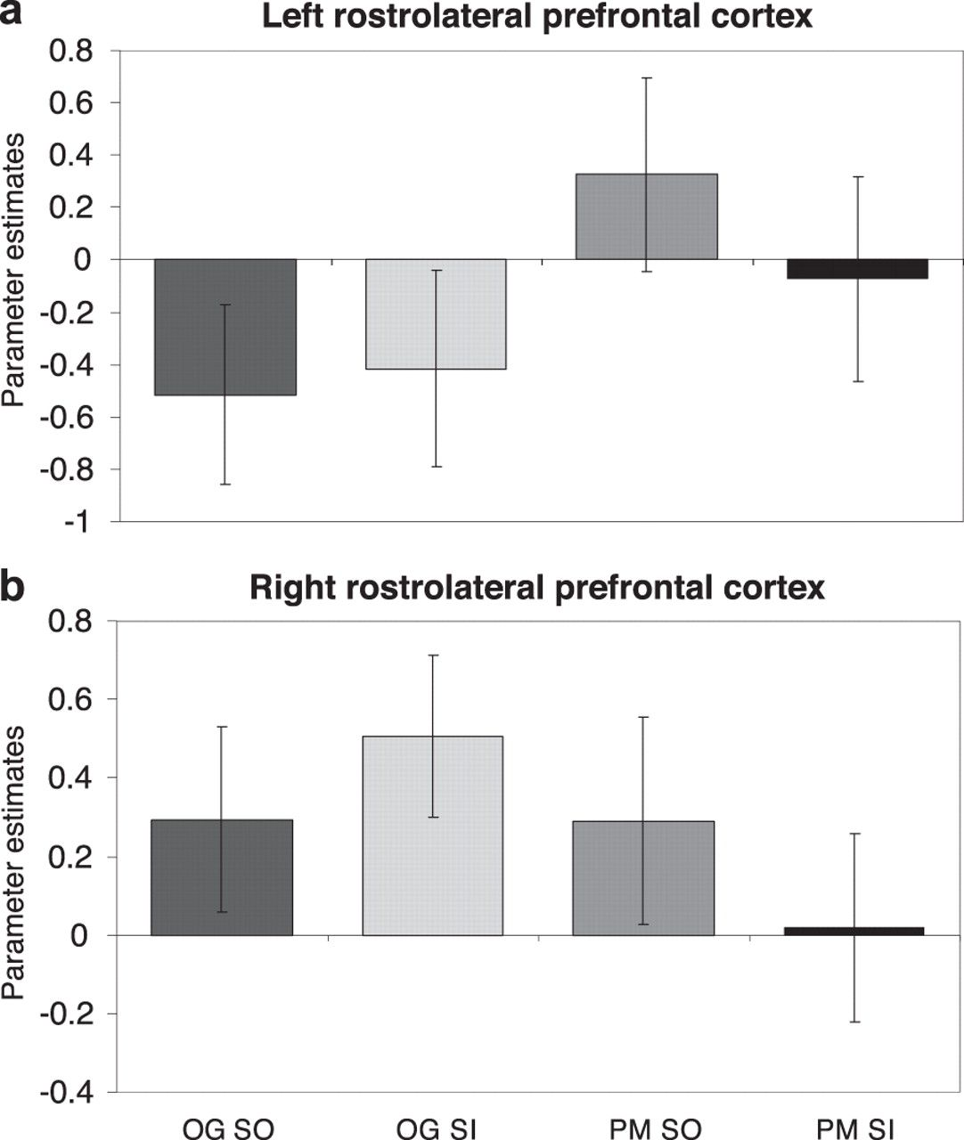
Figure 5. Parameter estimates from the ROI analyses within (a) left and (b) right rostrolateral prefrontal cortex. ...
Notes:
Figure 5. Parameter estimates from the ROI analyses within (a) left and (b) right rostrolateral prefrontal cortex. Error bars indicate standard error of means. OG, ongoing only; PM, prospective memory; SO, stimulus-oriented; SI, stimulus-independent.
Unless provided in the caption above, the following copyright applies to the content of this slide: © The Authors 2011. Published by Oxford University Press.This is an Open Access article distributed under the terms of the Creative Commons Attribution Non-Commercial License (http://creativecommons.org/licenses/by-nc/3.0), which permits unrestricted non-commercial use, distribution, and reproduction in any medium, provided the original work is properly cited.

