Slide 1
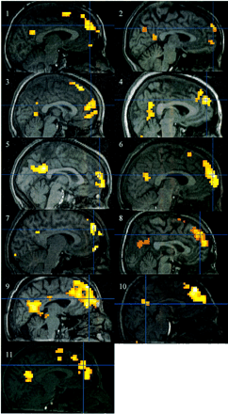
Fig. 1 Midsagittal view of each participant showing prefrontal activation during self‐reflective thought. The ...
Notes:
Fig. 1 Midsagittal view of each participant showing prefrontal activation during self‐reflective thought. The activations are superimposed on top of each participant’s anatomical scan. Note the consistent activation of the prefrontal cortex across subjects. For the purposes of this display, the statistical threshold was set to an uncorrected P‐value of 0.0005. These results are prior to any spatial standardization. The coordinates for the spatially standardized results for each individual are shown in Table 1.
Unless provided in the caption above, the following copyright applies to the content of this slide:

Slide 2
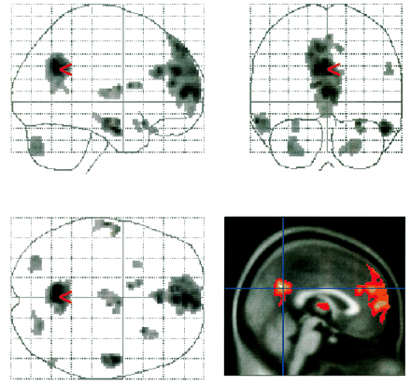
Fig. 2 Group activations for the self‐reflection versus general knowledge conditions. This maximum intensity ...
Notes:
Fig. 2 Group activations for the self‐reflection versus general knowledge conditions. This maximum intensity projection represents a random‐effects group analysis. Lower right: a midsagittal anatomical view is shown with the group activation superimposed. The results are thresholded at an uncorrected P‐value of 0.001, corresponding to a t‐statistic of 4.14. The main effect of activation occurred in anterior medial prefrontal cortex (maxima t = 13.0, corrected P = 0.05; x, y, z = 0, 54, 8, respectively; cluster size 2326 voxels) and the posterior cingulate (maxima t = 14.7, corrected P = 0.02; x, y, z = –2, –62, 32; cluster size 976 voxels). Other activated regions at this threshold included the thalamus (t = 7.53; x, y, z = 4, –4, 12), bilateral posterolateral orbital cortex (right orbital: t = 7.67; x, y, z = 28, 18, –18; left orbital: t = 7.51; x, y, z = –10, 6, 14), bilateral inferior temporal gyrus (right: t = 10.38; x, y, z = 52, –6, –24; left: t = 8.46; x, y, z = –62, –14, –16) and bilateral cerebellum (right: t = 6.13; x, y, z = 24, –74, –38; left: t = 6.12; x, y, z = –32, –78, –38).
Unless provided in the caption above, the following copyright applies to the content of this slide:

