Slide 1
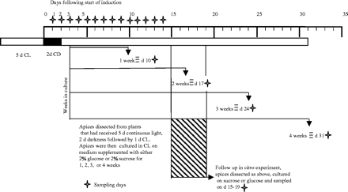
Fig. 1. Experimental design. Seeds were germinated and plants grown for 5 d in continuous light (CL) followed by 2 d ...
Notes:
Fig. 1. Experimental design. Seeds were germinated and plants grown for 5 d in continuous light (CL) followed by 2 d of continuous darkness (CD). In vivo sampling was carried out every day for 14 d following the start of induction. In vitro sampling followed the explant of shoot apices to tissue culture media on day 3 following the start of induction; sampling was once per week for 4 weeks equating with days 10, 17, 2, and 31 following the start of induction. A second more intensive sampling of cultures was carried out on days 15–19 following the start of induction.
Unless provided in the caption above, the following copyright applies to the content of this slide: Journal of Experimental Botany, Vol. 55, No. 406, © Society for Experimental Biology 2004; all rights reserved

Slide 2
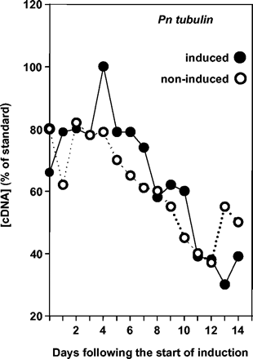
Fig. 2. Standardization. Temporal expression of the PnTUB1 gene in vivo in induced and in non-induced meristems. ...
Notes:
Fig. 2. Standardization. Temporal expression of the PnTUB1 gene in vivo in induced and in non-induced meristems. Means were calculated from duplicate PCRs of cDNA from two crops.
Unless provided in the caption above, the following copyright applies to the content of this slide: Journal of Experimental Botany, Vol. 55, No. 406, © Society for Experimental Biology 2004; all rights reserved

Slide 3
Fig. 3. Temporal expression patterns of (a) PnLFY1 (b) PnAG1, (c) PnAG2, and (d) PnYABBY in shoot apices sampled from ...
Notes:
Fig. 3. Temporal expression patterns of (a) PnLFY1 (b) PnAG1, (c) PnAG2, and (d) PnYABBY in shoot apices sampled from induced or non-induced plants in vivo. Means were calculated from duplicate PCRs of cDNA from each of two crops and applying the mean of the two correction factors assuming constant total RNA concentration and constant tubulin concentration). Hence the data are means from eight nested replicates. Where error bars are absent, the variation about the mean was ≤diameter of symbol. Using either Students t-test or the non-parametric Mann–Whitney test, highly significant differences (0.02–0.001) between treatments were found for (a) PnLFY on days 1–8, (b) PNAG1 on days 8–9, (c) PnAG2 on days 7–11, and (d) PnYABBY on day 8.
Unless provided in the caption above, the following copyright applies to the content of this slide: Journal of Experimental Botany, Vol. 55, No. 406, © Society for Experimental Biology 2004; all rights reserved

Slide 4
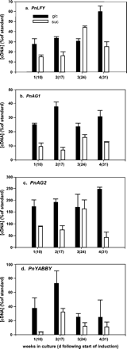
Fig. 4. Temporal expression patterns of (a) PnLFY1, (b) PnAG1, (c) PnAG2, and (d) PnYABBY (means ±SEs, n=2) in shoot ...
Notes:
Fig. 4. Temporal expression patterns of (a) PnLFY1, (b) PnAG1, (c) PnAG2, and (d) PnYABBY (means ±SEs, n=2) in shoot apices removed from induced plants 3 d following the start of induction and cultured in media supplemented with glucose (black bars) or sucrose (white bars) and were sampled at weekly intervals that correspond with days 10, 17, 24, and 31 following the start of induction. Means were calculated from duplicate PCRs of cDNA from two crops and applying the mean of the two correction factors (assuming constant total RNA concentration and assuming constant tubulin concentration).
Unless provided in the caption above, the following copyright applies to the content of this slide: Journal of Experimental Botany, Vol. 55, No. 406, © Society for Experimental Biology 2004; all rights reserved

Slide 5
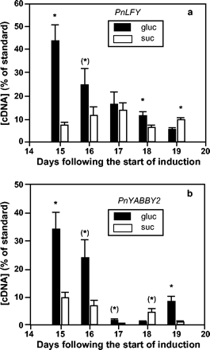
Fig. 5. Temporal expression patterns of PnLFY1 and PnYABBY (means ±SE, n=3) in shoot apices removed from induced ...
Notes:
Fig. 5. Temporal expression patterns of PnLFY1 and PnYABBY (means ±SE, n=3) in shoot apices removed from induced plants 3 d following the start of induction, and cultured in media supplemented with glucose (black bars) or sucrose (white bars) and sampled on days 15–19 following the start of induction, assuming a constant tubulin concentration. An asterisk indicates a significant difference by t-test (P≤0.05), an asterisk in parentheses indicates a marginal significant difference (P=0.05−0.1).
Unless provided in the caption above, the following copyright applies to the content of this slide: Journal of Experimental Botany, Vol. 55, No. 406, © Society for Experimental Biology 2004; all rights reserved

Slide 6
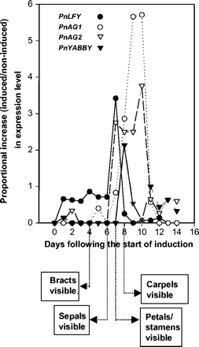
Fig. 6. Proportional increases in expression of: PnLFY, PnAG1, PnAG2, and PnYABBY in induced relative to non-induced ...
Notes:
Fig. 6. Proportional increases in expression of: PnLFY, PnAG1, PnAG2, and PnYABBY in induced relative to non-induced apices over the 14 d interval following the start of induction (the first morphological appearance of each whorl (Durdan, 1998) is also indicated).
Unless provided in the caption above, the following copyright applies to the content of this slide: Journal of Experimental Botany, Vol. 55, No. 406, © Society for Experimental Biology 2004; all rights reserved

