Slide 1
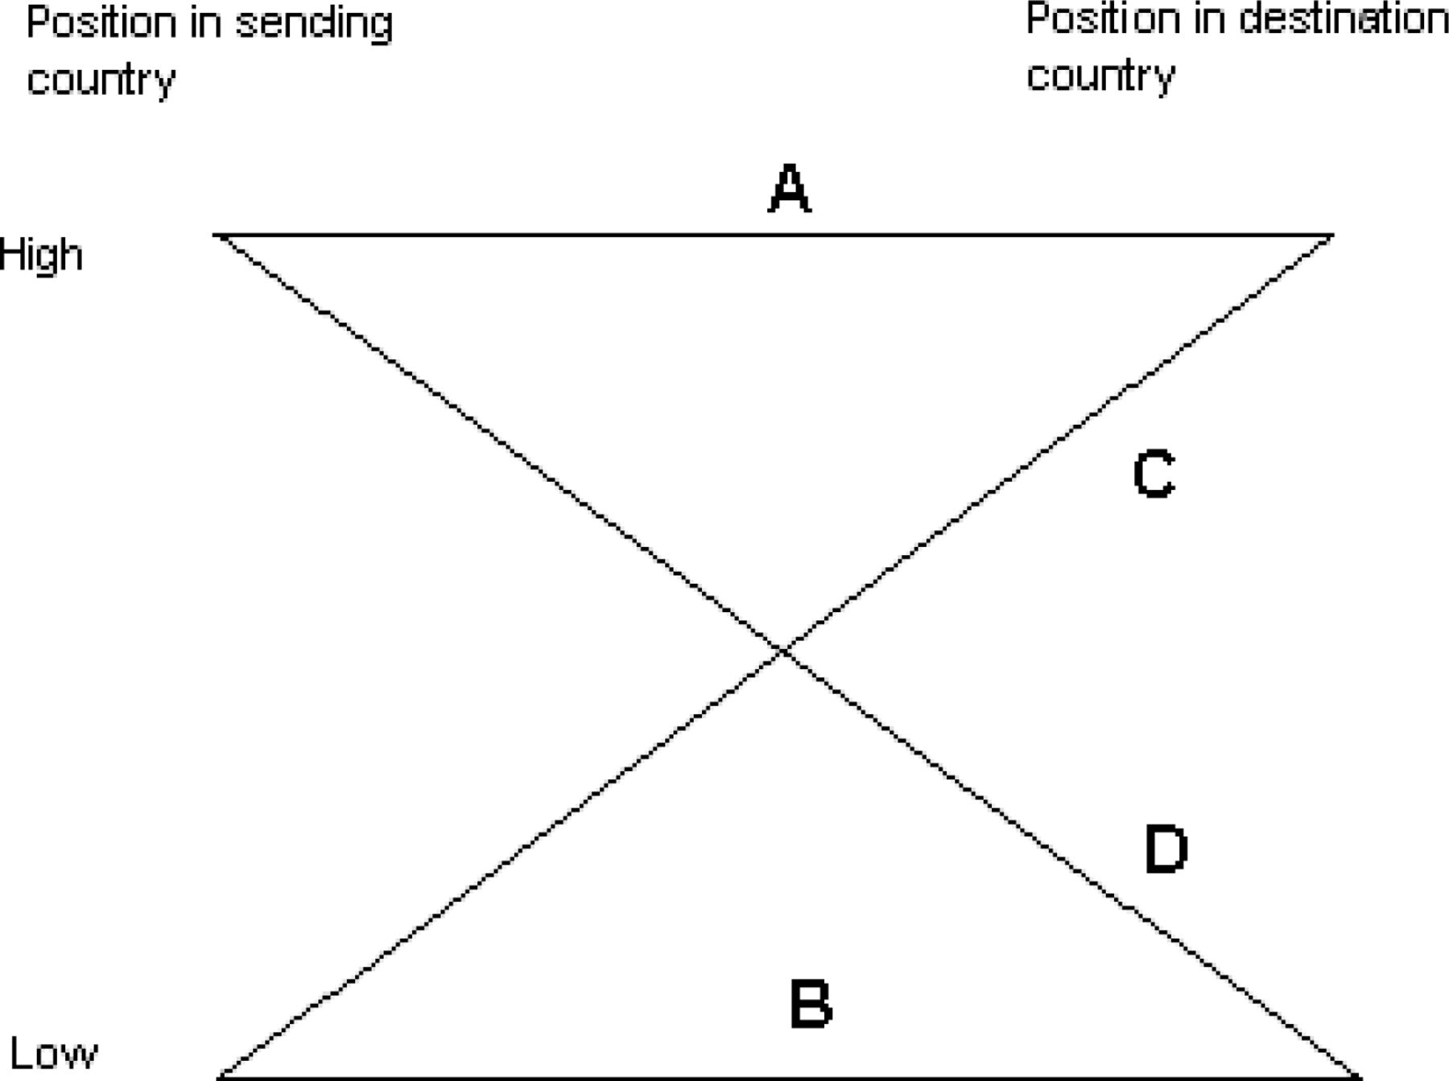
1 Comparison Trajectories
Notes:
1 Comparison Trajectories
Unless provided in the caption above, the following copyright applies to the content of this slide: © 2010 International Studies Association

