Slide 1
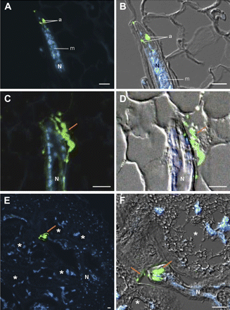
Fig. 1. Immunodetection of the MAP-1 protein (green) during Meloidogyne incognita parasitism in roots of Arabidopsis ...
Notes:
Fig. 1. Immunodetection of the MAP-1 protein (green) during Meloidogyne incognita parasitism in roots of Arabidopsis thaliana. (A, B) Localization of MAP-1 in the amphids of a migrating juvenile within the roots (7 DAI); (C, D) MAP-1 secretion alongside the nematode surface (arrow) during migration within the host root (7 DAI); (E, F) gall containing a sedentary nematode, showing the significant accumulation of MAP-1 in the amphids of the nematode and along the giant cell wall (arrow) within the apoplasm (21 DAI). Micrographs A, C, and E are overlay images of MAP-1 (green) and DAPI-stained nuclei (blue). Micrographs B, D, and F are overlays of images of MAP-1 (green), DAPI-stained nuclei (blue), and differential interference contrast (grey) to better visualize plant and nematode tissues. a, amphid; m, metacorpus; N, nematode. *, giant cells. Bars=10 μm.
Unless provided in the caption above, the following copyright applies to the content of this slide: © 2010 The Author(s).This is an Open Access article distributed under the terms of the Creative Commons Attribution Non-Commercial License (http://creativecommons.org/licenses/by-nc/2.5), which permits unrestricted non-commercial use, distribution, and reproduction in any medium, provided the original work is properly cited.This paper is available online free of all access charges (see http://jxb.oxfordjournals.org/open_access.html for further details)

Slide 2
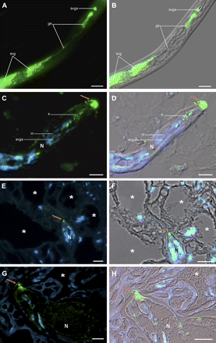
Fig. 2. Immunodetection of the Mi-ASP2 protein (green) within pre-parasitic juveniles of Meloidogyne incognita and ...
Notes:
Fig. 2. Immunodetection of the Mi-ASP2 protein (green) within pre-parasitic juveniles of Meloidogyne incognita and during parasitism of roots of Arabidopsis thaliana. (A, B) Localization of Mi-ASP2 in the subventral glands (svg), subventral gland extensions (ge), and subventral gland ampullae (svga) of pre-parasitic juveniles; (C, D) root containing a migrating nematode (7 DAI), showing the secretion of Mi-ASP2 protein into root tissue around the head of the nematode (arrow); (E, F) gall containing a sedentary nematode (14 DAI), displaying Mi-ASP2 accumulated at the tip of the stylet (arrow) near the giant cells; (G, H) gall containing a sedentary nematode (21 DAI), displaying Mi-ASP2 accumulated at the tip of the stylet and along the giant cell wall (arrow). Micrographs C, E, and G show overlay images of Mi-ASP2 (in green) and DAPI-stained nuclei (in blue). Micrographs D, F, and H show overlays of images of Mi-ASP2 (green), DAPI-stained nuclei (blue), and differential interference contrast (grey) to better visualize plant and nematode tissues. e, esophagus. m, metacorpus. svga, sub-ventral gland ampulla. N, nematode. *, giant cells. Bars=10 μm.
Unless provided in the caption above, the following copyright applies to the content of this slide: © 2010 The Author(s).This is an Open Access article distributed under the terms of the Creative Commons Attribution Non-Commercial License (http://creativecommons.org/licenses/by-nc/2.5), which permits unrestricted non-commercial use, distribution, and reproduction in any medium, provided the original work is properly cited.This paper is available online free of all access charges (see http://jxb.oxfordjournals.org/open_access.html for further details)

Slide 3
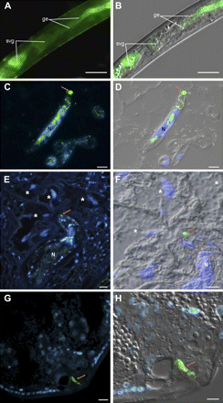
Fig. 3. Immunodetection of CBM2-bearing proteins (green) within pre-parasitic juveniles of Meloidogyne incognita and ...
Notes:
Fig. 3. Immunodetection of CBM2-bearing proteins (green) within pre-parasitic juveniles of Meloidogyne incognita and during parasitism of roots of Arabidopsis thaliana. (A, B) Localization of CBM2-bearing proteins in the subventral glands (svg) and subventral gland extensions (ge) of pre-parasitic juveniles; (C, D) root section containing a migrating nematode (7 DAI), showing the localization of CBM2-bearing proteins in the subventral glands of the nematode, and secreted into root tissue around the head of the nematode (arrow); (E, F) gall containing a sedentary nematode (14 DAI), displaying CBM2-bearing proteins accumulated at the tip of the stylet (arrow) near the giant cells; (G, H) localization of CBM2-bearing proteins accumulated in the vagina of adult females (55 DAI). Micrographs C, E, and G are overlay images of CBM2-bearing proteins (green) and DAPI-stained nuclei (blue). Micrographs D, F, and H are overlays of images of CBM2-bearing proteins (green), DAPI-stained nuclei (blue), and differential interference contrast (grey) to better visualize plant and nematode tissues. N, nematode. *, giant cells. Bars=10 μm.
Unless provided in the caption above, the following copyright applies to the content of this slide: © 2010 The Author(s).This is an Open Access article distributed under the terms of the Creative Commons Attribution Non-Commercial License (http://creativecommons.org/licenses/by-nc/2.5), which permits unrestricted non-commercial use, distribution, and reproduction in any medium, provided the original work is properly cited.This paper is available online free of all access charges (see http://jxb.oxfordjournals.org/open_access.html for further details)

Slide 4
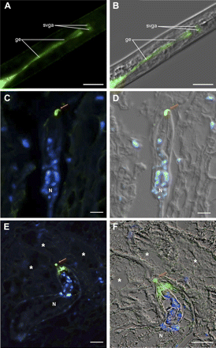
Fig. 4. Immunodetection of the Mi-PEL3 protein (green) within pre-parasitic juveniles of Meloidogyne incognita and ...
Notes:
Fig. 4. Immunodetection of the Mi-PEL3 protein (green) within pre-parasitic juveniles of Meloidogyne incognita and during parasitism of roots of Arabidopsis thaliana. (A, B) Localization of Mi-PEL3 in the subventral gland extensions (ge) and subventral gland ampullae (svga) of pre-parasitic juveniles; (C, D) localization of Mi-PEL3 in root sections at the tip of the stylet of the nematode (arrow) during migration (7 DAI); (E, F) gall containing a sedentary nematode, showing Mi-PEL3 accumulated at the tip of the stylet (arrow) near the giant cells (14 DAI). Micrographs C and E are overlays of images of Mi-PEL3 (green) and DAPI-stained nuclei (blue). Micrographs D and F are overlays of images of Mi-PEL3 (green), DAPI-stained nuclei (blue), and differential interference contrast (grey) to better visualize plant and nematode tissues. N, nematode. *, giant cells. Bars=10 μm.
Unless provided in the caption above, the following copyright applies to the content of this slide: © 2010 The Author(s).This is an Open Access article distributed under the terms of the Creative Commons Attribution Non-Commercial License (http://creativecommons.org/licenses/by-nc/2.5), which permits unrestricted non-commercial use, distribution, and reproduction in any medium, provided the original work is properly cited.This paper is available online free of all access charges (see http://jxb.oxfordjournals.org/open_access.html for further details)

Slide 5
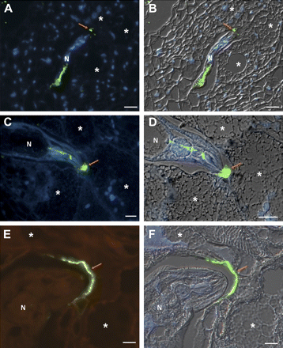
Fig. 5. Immunodetection of the 6D4 protein (green) during parasitism in roots of Arabidopsis thaliana. (A, B) ...
Notes:
Fig. 5. Immunodetection of the 6D4 protein (green) during parasitism in roots of Arabidopsis thaliana. (A, B) Localization of 6D4 on the head of the nematode (arrow) during early stages of giant cell development (14 DAI); (C, D) gall containing a sedentary nematode displaying 6D4 secreted and accumulated at the head of the nematode, and along the giant cell wall (arrow) within the apoplasm (21 DAI); (E, F) gall containing a sedentary nematode (30 DAI), showing 6D4 accumulated near the giant cells (arrow). Micrographs A, C, and E are overlays of images of 6D4 (green) and DAPI-stained nuclei (blue). Micrographs B, D, and F are overlays of images of 6D4 (green), DAPI-stained nuclei (blue), and differential interference contrast (grey) to better visualize plant and nematode tissues. N, nematode. *, giant cells. Bars=10 μm.
Unless provided in the caption above, the following copyright applies to the content of this slide: © 2010 The Author(s).This is an Open Access article distributed under the terms of the Creative Commons Attribution Non-Commercial License (http://creativecommons.org/licenses/by-nc/2.5), which permits unrestricted non-commercial use, distribution, and reproduction in any medium, provided the original work is properly cited.This paper is available online free of all access charges (see http://jxb.oxfordjournals.org/open_access.html for further details)

