Slide 1
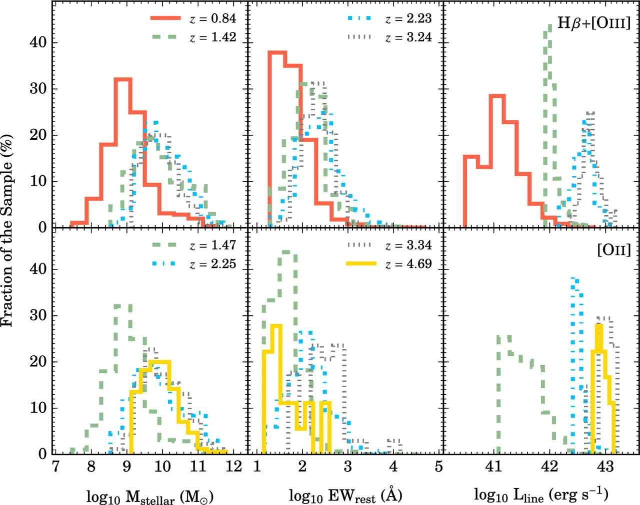
Figure 1. The stellar mass, EW_{rest}, and luminosity distributions for all of our samples. Based on the ...
Notes:
Figure 1. The stellar mass, EWrest, and luminosity distributions for all of our samples. Based on the luminosity distributions, it is clear that our high-z sample is limited to high line luminosities (L > 1042 erg s−1). Our lowest redshift sample is the deepest and covers a wider luminosity, stellar mass, and EWrest range which allows us to utilize the sample for tests of selection effects that can bias results at higher redshift.
Unless provided in the caption above, the following copyright applies to the content of this slide: © 2016 The Authors Published by Oxford University Press on behalf of the Royal Astronomical Society

Slide 2
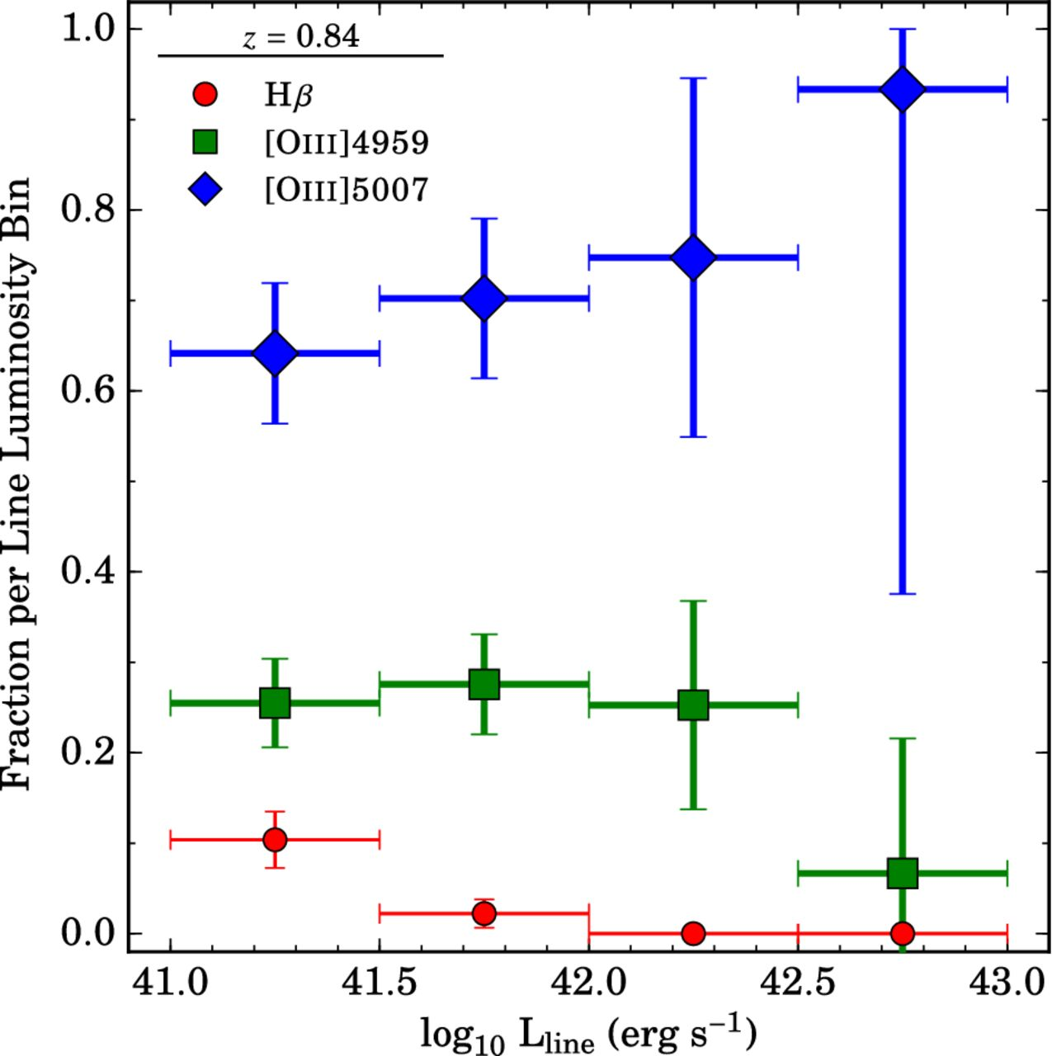
Figure 2. The dependence of the fraction of emitters versus the observed line luminosity for the z = 0.84 Hβ+[O iii] ...
Notes:
Figure 2. The dependence of the fraction of emitters versus the observed line luminosity for the z = 0.84 Hβ+[O iii] sample. All spectroscopic measurements used are described in Khostovan et al. (2015) and in Section 2. Errors shown here are Poisson and normalized to the total number of emitters per line luminosity bin. There is a clear trend that at fainter line luminosities, the fraction of [O iii]5007 emitters decreases, while the [O iii]4959 and Hβ fraction increases. Despite this change in the demographics of the sample at these line luminosities, we can still safely say that the sample is dominated by [O iii] emitters rather than Hβ emitters.
Unless provided in the caption above, the following copyright applies to the content of this slide: © 2016 The Authors Published by Oxford University Press on behalf of the Royal Astronomical Society

Slide 3
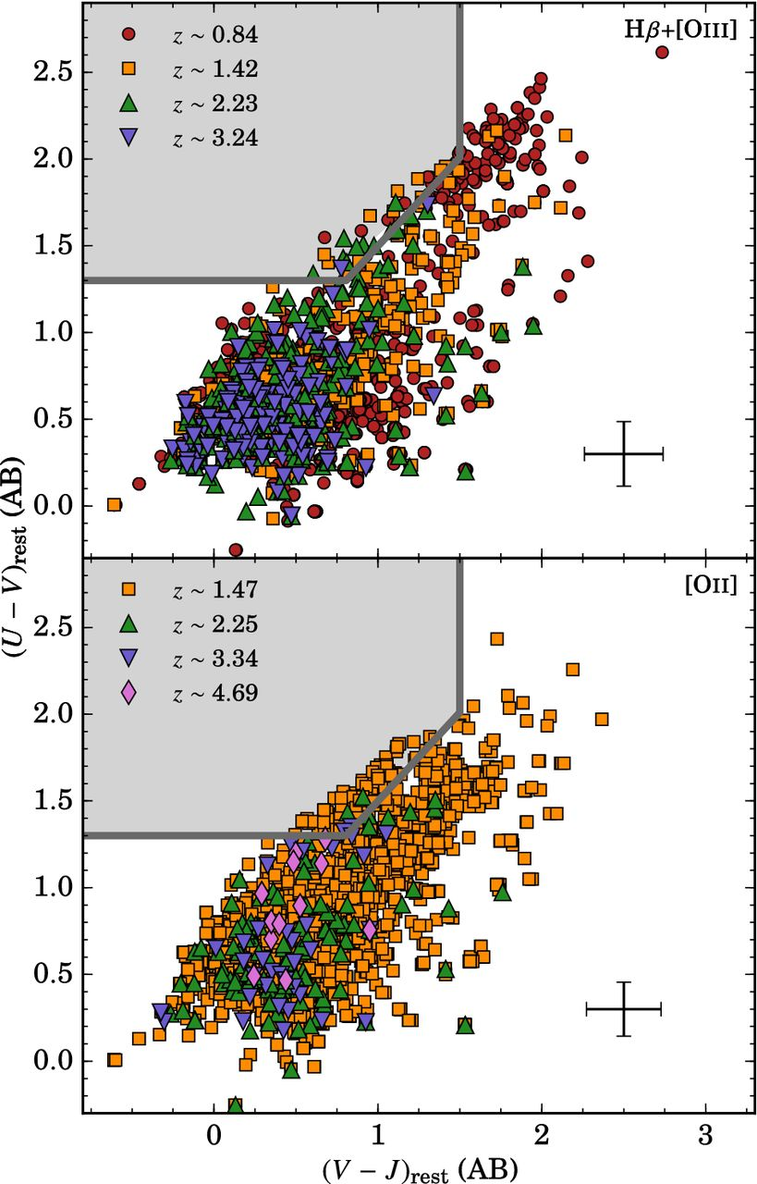
Figure 3. The rest-frame UVJ colour–colour diagnostic used to separate star-forming galaxies from quiescent galaxies. ...
Notes:
Figure 3. The rest-frame UVJ colour–colour diagnostic used to separate star-forming galaxies from quiescent galaxies. The highlighted region and grey boundaries are the Muzzin et al. (2013) quiescent selection region. Included is the typical 1σ range for all sources per emission line. We find that the majority of our sources reside within the star-forming classification region. Sources that are within the quiescent region are consistent with photometric scatter. We find a general trend in the UVJ plane where high-z sources tend to have bluer rest-frame UVJ colours that could be caused by changes in dust and/or the star formation efficiency (e.g. Papovich et al. 2015).
Unless provided in the caption above, the following copyright applies to the content of this slide: © 2016 The Authors Published by Oxford University Press on behalf of the Royal Astronomical Society

Slide 4
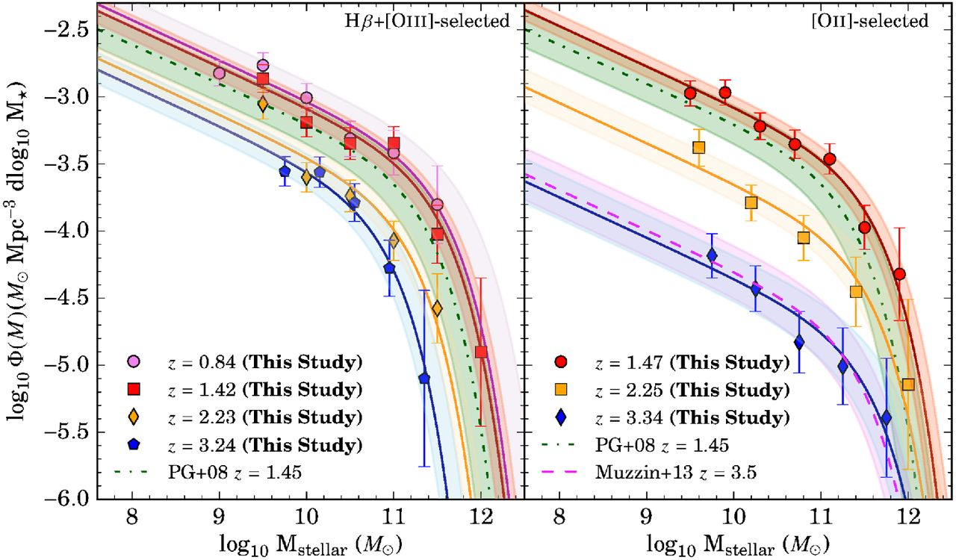
Figure 4. Left: Hβ+[O iii] SMFs and its evolution from z ∼ 0.84 to ∼3.24 for emission-line selected sources. We find ...
Notes:
Figure 4. Left: Hβ+[O iii] SMFs and its evolution from z ∼ 0.84 to ∼3.24 for emission-line selected sources. We find that around the z ∼ 2–3, there is no significant evolution until z < 2. Right: [O ii] SMFs between z = 1.47 and 3.34. For [O ii], we find a strong, increasing evolution with increasing redshift in ϕ⋆ while Hβ+[O iii] varies little. We also find that M⋆ is strongly decreasing with increasing redshift for Hβ+[O iii] and is relatively constant between z ∼ 1.47 to 3.34 for [O ii].
Unless provided in the caption above, the following copyright applies to the content of this slide: © 2016 The Authors Published by Oxford University Press on behalf of the Royal Astronomical Society

Slide 5
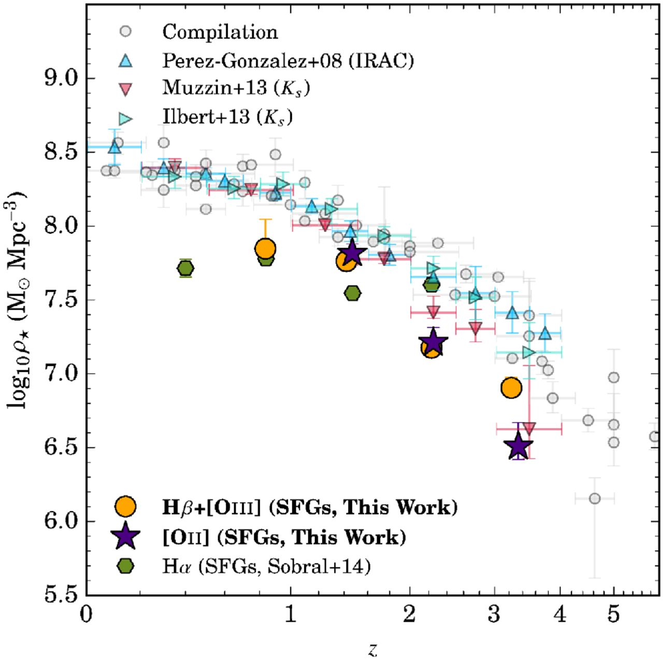
Figure 5. The cosmic SMD evolution of our Hβ+[O iii] and [O ii] sample. Overlaid are the full population (star-forming ...
Notes:
Figure 5. The cosmic SMD evolution of our Hβ+[O iii] and [O ii] sample. Overlaid are the full population (star-forming + quiescent) measurements from the Madau & Dickinson (2014) compilation. We also highlight the Pérez-González et al. (2008), Ilbert et al. (2013), and Muzzin et al. (2013) SMD measurements. We find that our measurements match the general picture of a fast stellar mass build-up from z ∼ 3.3 to ∼1. By z ∼ 1, we find that our measurements diverge from the full population literature measurements, implying that star formation activity in emission-line selected galaxies is decreasing resulting in a slower stellar mass assembly growth and a population transition from star-forming/active to quiescent/passive systems.
Unless provided in the caption above, the following copyright applies to the content of this slide: © 2016 The Authors Published by Oxford University Press on behalf of the Royal Astronomical Society

Slide 6
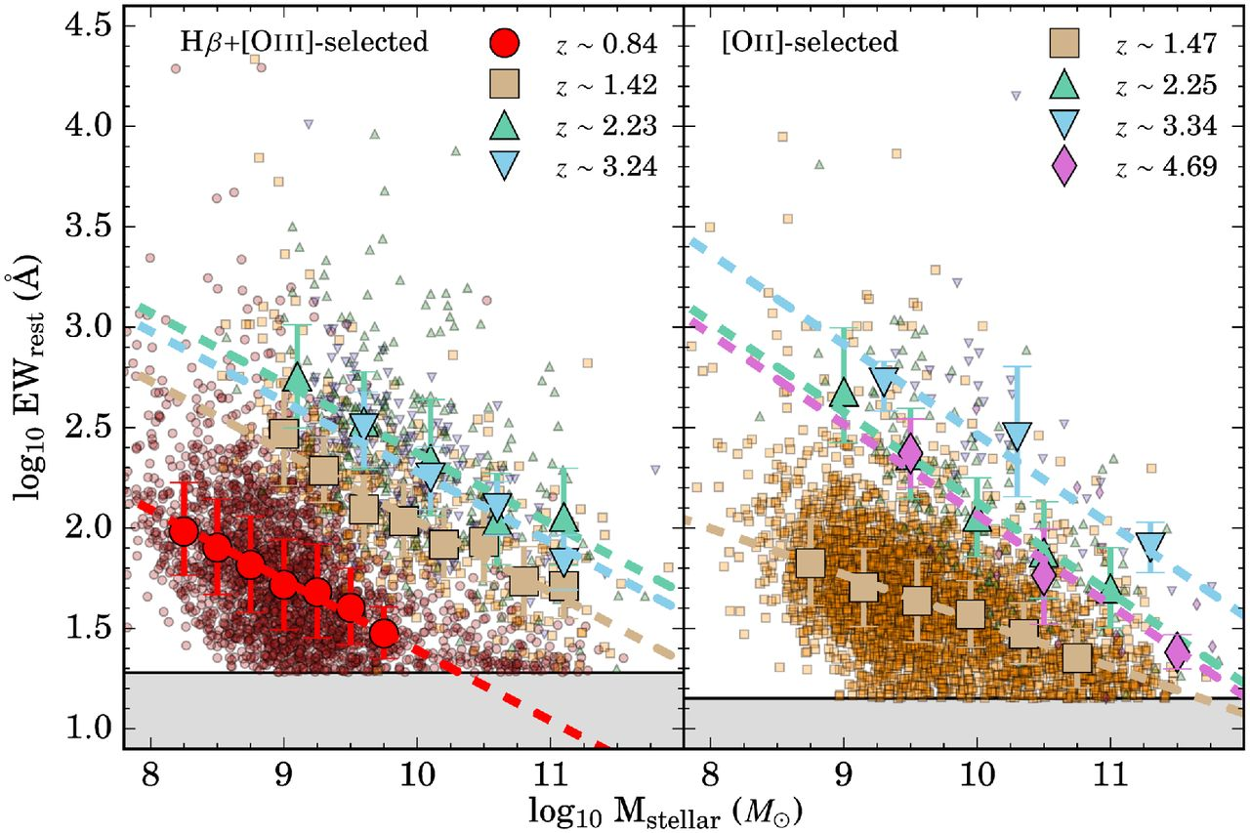
Figure 6. Shown is a scatter plot of the EW_{rest} versus M_{stellar} for all our samples. We also ...
Notes:
Figure 6. Shown is a scatter plot of the EWrest versus Mstellar for all our samples. We also include, as larger symbols, the median EWrest for given stellar mass bins. Highlighted in grey is the EWrest limit, which results in an incompleteness in our sample for the high-mass sources. This effect is only seen in the Hβ+[O iii] z = 0.84 sample and to some extent in the [O ii] z = 1.47 sample. For the other high-z samples, the EWrest limit does not cause any incompleteness in the high-mass end as we do not probe high enough masses (low EWrest) for which it must be considered.
Unless provided in the caption above, the following copyright applies to the content of this slide: © 2016 The Authors Published by Oxford University Press on behalf of the Royal Astronomical Society

Slide 7
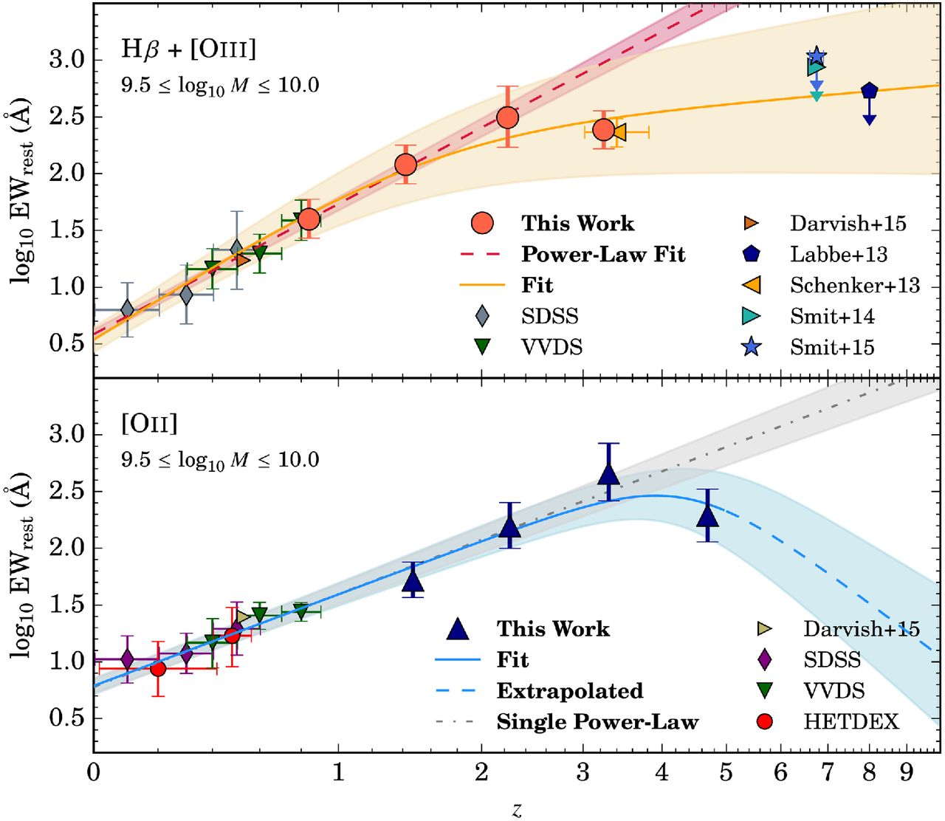
Figure 7. Presented is the EW_{rest} evolution for sources that have 9.5 < log 10M_{stellar} < ...
Notes:
Figure 7. Presented is the EWrest evolution for sources that have 9.5 < log 10Mstellar < 10 M⊙. We also include measurements from the literature to constrain the low-z end and to compare to our extrapolated fits in the high-z regime. We fit single power-law and mixed power-law functions (combination of two power laws) to our measurements and those from the literature. Included for each fit is the shaded 1σ region. We find that the EWrest evolution for Hβ+[O iii] flattens out to z > 5 and the [O ii] drops in this regime. In terms of the ionization state of the gas, we find that the EWrest evolution of both emission-lines hints to a harder ionizing source, although other factors such as metallicities and abundances can affect the evolution as well.
Unless provided in the caption above, the following copyright applies to the content of this slide: © 2016 The Authors Published by Oxford University Press on behalf of the Royal Astronomical Society

Slide 8
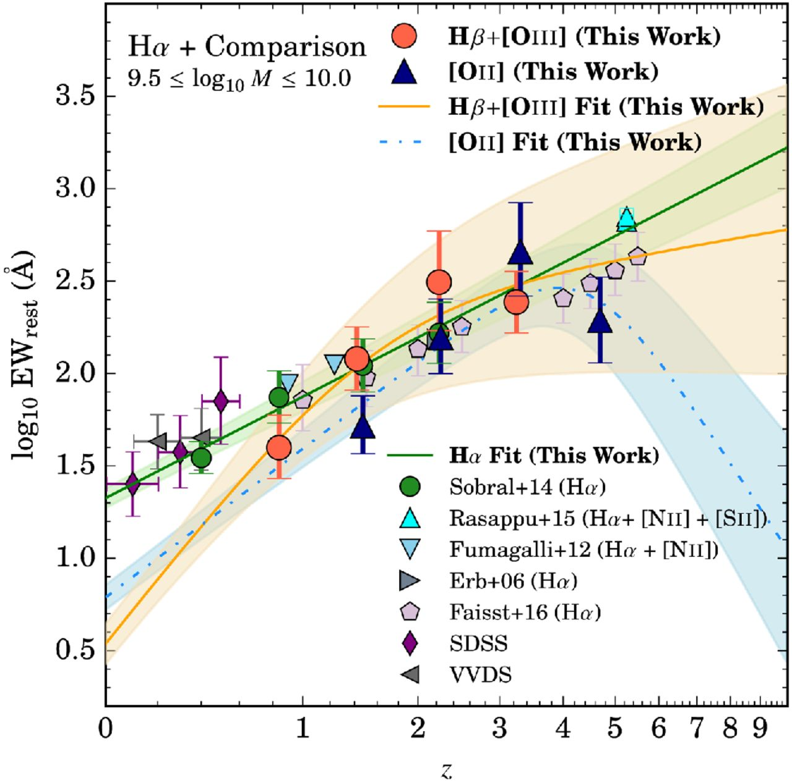
Figure 8. The EW_{rest} evolution of major rest-frame optical emission lines within 9.5 < ...
Notes:
Figure 8. The EWrest evolution of major rest-frame optical emission lines within 9.5 < log10Mstellar < 10 M⊙. We include our empirical fits of the Hβ+[O iii] and [O ii] EWrest evolution in order to study how the EWrest evolves per nebular emission line. We find that the Hβ+[O iii] EWrest drops faster from high-z to low-z than the other emission lines. This is followed by [O ii] and then by Hα such that the Hβ+[O iii] EWrest at z = 0 is weaker compared to [O ii], which is also weaker than Hα. The drops are in order of higher to lower ionization potentials such that in the low-z Universe, higher ionization potential lines have lower EWrest relative to low ionization potential lines. We also find that the Hβ+[O iii] EWrest is much higher than [O ii] for z > 5, implying a Universe with extreme ionizing sources that easily can produce the [O iii] line.
Unless provided in the caption above, the following copyright applies to the content of this slide: © 2016 The Authors Published by Oxford University Press on behalf of the Royal Astronomical Society

Slide 9
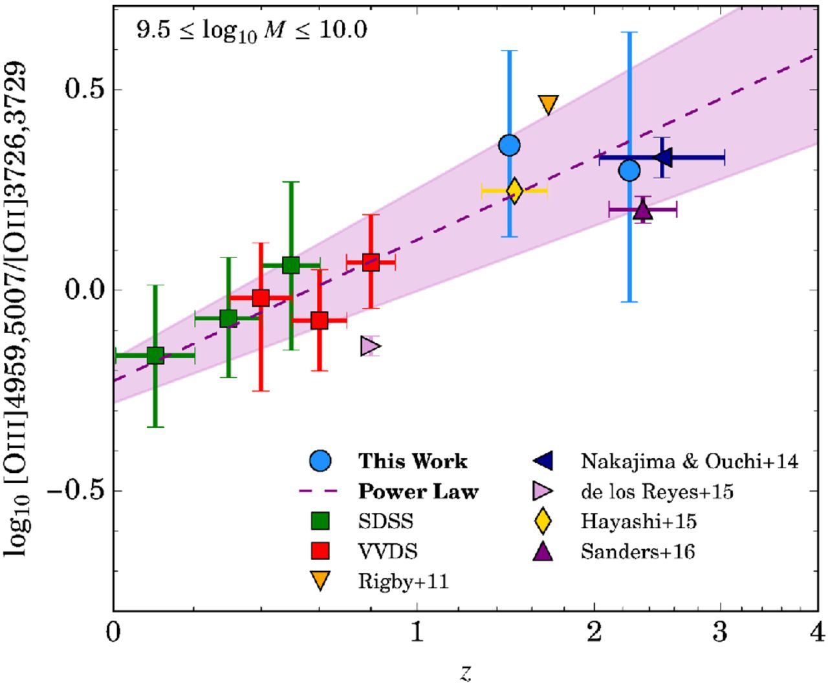
Figure 9. Shown is the [O iii]/[O ii] evolution. Included are measurements from SSDS and VVDS, as well as other ...
Notes:
Figure 9. Shown is the [O iii]/[O ii] evolution. Included are measurements from SSDS and VVDS, as well as other spectroscopic measurements from the literature. We find that the [O iii]/[O ii] increases with redshift suggesting an increasing ionization parameter with redshift, which can be attributed to a harder ionization field and/or changes in metallicity and electron densities. Overall, the [O iii]/[O ii] evolution shown here explains why recent studies have detected emission lines that require high ionization potentials at z > 6 (e.g. Vanzella et al. 2010; Sobral et al. 2015a; Stark et al. 2015a,b).
Unless provided in the caption above, the following copyright applies to the content of this slide: © 2016 The Authors Published by Oxford University Press on behalf of the Royal Astronomical Society

Slide 10
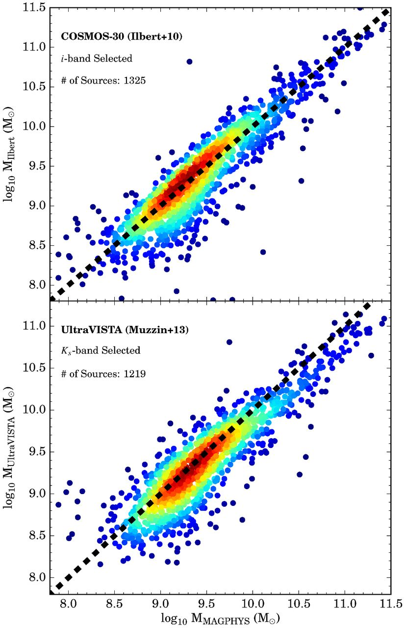
Figure B1. Present is the comparison between the stellar masses measured by Ilbert et al. (2010, top panel) and Muzzin ...
Notes:
Figure B1. Present is the comparison between the stellar masses measured by Ilbert et al. (2010, top panel) and Muzzin et al. (2013, bottom panel) versus the stellar masses we measure using magphys. The dashed black line is the 1:1 relation. We find that, overall, our measurements are consistent with those from the comparison samples. The scatter in the measurements is most probably arising from the different sets of assumptions (e.g. SF history, metallicity range, dust prescription). We eliminate the scatter arising from differing redshifts by only comparing sources that have a Δz < 0.1, where Δz represents the difference between the photometric redshift measured by Khostovan et al. (2015) and the comparison studies.
Unless provided in the caption above, the following copyright applies to the content of this slide: © 2016 The Authors Published by Oxford University Press on behalf of the Royal Astronomical Society

Slide 11
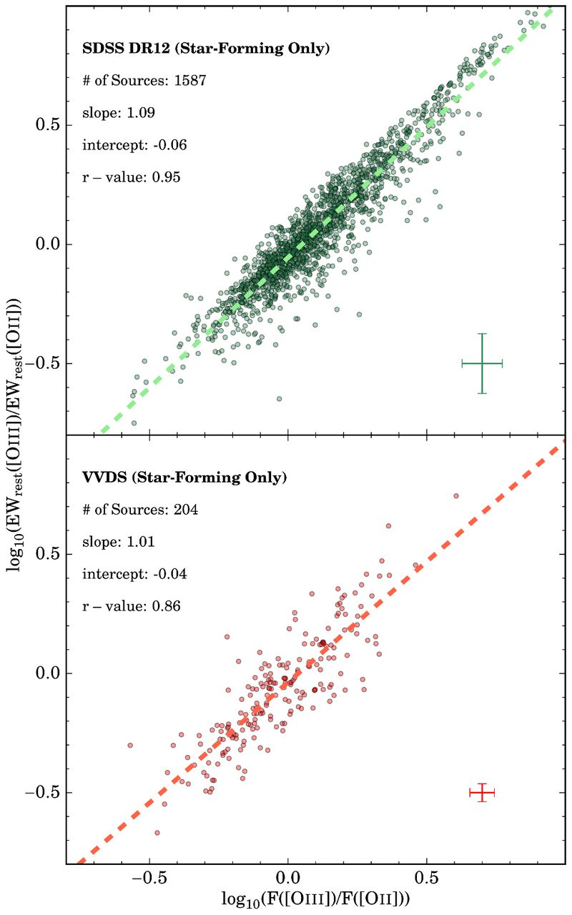
Figure E1. The comparison between the [O iii]/[O ii] determined by the ratio of the EW_{rest} and the line ...
Notes:
Figure E1. The comparison between the [O iii]/[O ii] determined by the ratio of the EWrest and the line fluxes in log-space. The intercept represents the ratio of the continuum fluxes. We find that the intercepts are ∼0 and the slopes of the correlation are near unity, such that the ratio of the EWrest directly traces the [O iii]/[O ii] line ratio with negligible systematic offsets introduced by differing continuum fluxes.
Unless provided in the caption above, the following copyright applies to the content of this slide: © 2016 The Authors Published by Oxford University Press on behalf of the Royal Astronomical Society

