Slide 1
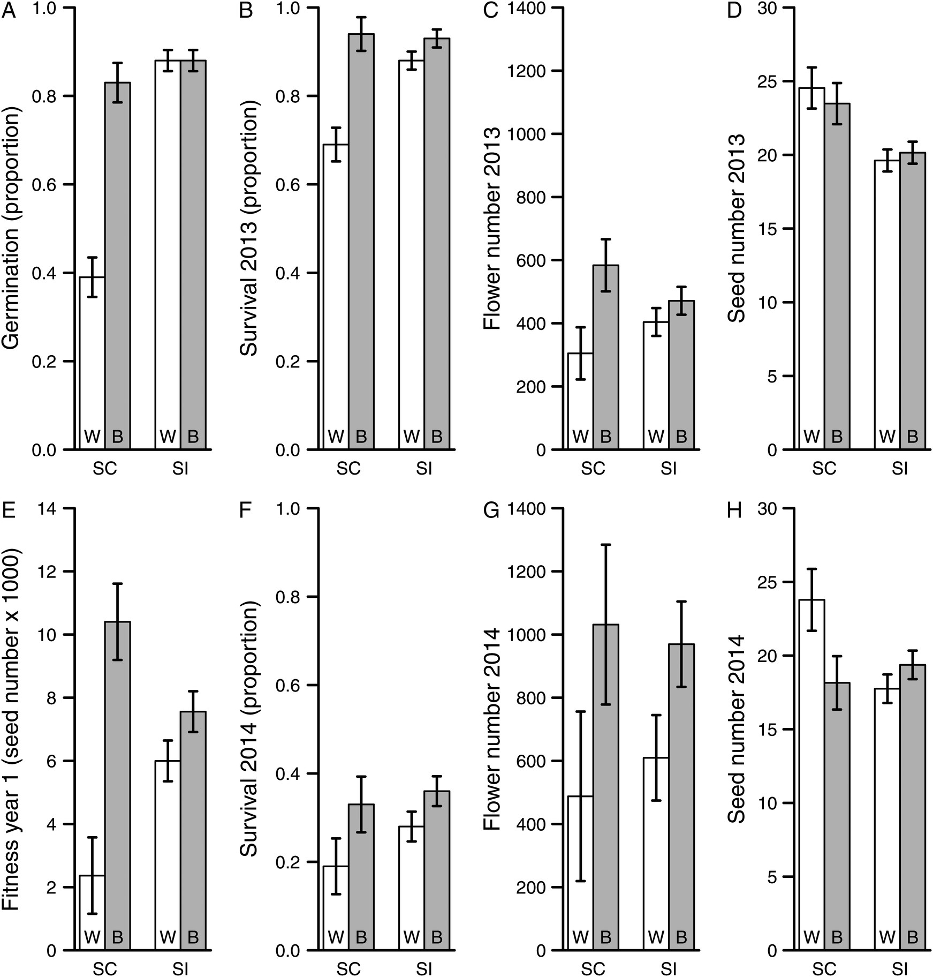
Figure 1. Least square mean values (±1 SE) for the heterosis experiment. Fitness components (A–D; F–H) and cumulative ...
Notes:
Figure 1. Least square mean values (±1 SE) for the heterosis experiment. Fitness components (A–D; F–H) and cumulative fitness in the first year (E) are given for each mating system category (SC, self-compatible; SI, self-incompatible) and cross type (W, within-population crosses; B, between-population crosses).
Unless provided in the caption above, the following copyright applies to the content of this slide: Published by Oxford University Press on behalf of the Annals of Botany Company.This is an Open Access article distributed under the terms of the Creative Commons Attribution License (http://creativecommons.org/licenses/by/4.0/), which permits unrestricted reuse, distribution, and reproduction in any medium, provided the original work is properly cited.

Slide 2
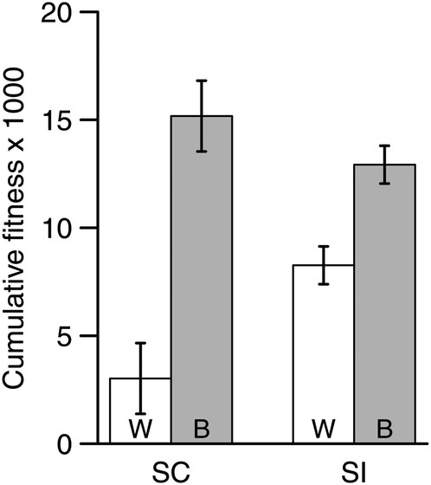
Figure 2. Least square mean (±1 SE) cumulative fitness over 2 years for the heterosis experiment. Least square means ...
Notes:
Figure 2. Least square mean (±1 SE) cumulative fitness over 2 years for the heterosis experiment. Least square means are given by mating system category (SC, self-compatible; SI, self-incompatible) and cross type (W, within-population crosses; B, between-population crosses).
Unless provided in the caption above, the following copyright applies to the content of this slide: Published by Oxford University Press on behalf of the Annals of Botany Company.This is an Open Access article distributed under the terms of the Creative Commons Attribution License (http://creativecommons.org/licenses/by/4.0/), which permits unrestricted reuse, distribution, and reproduction in any medium, provided the original work is properly cited.

Slide 3
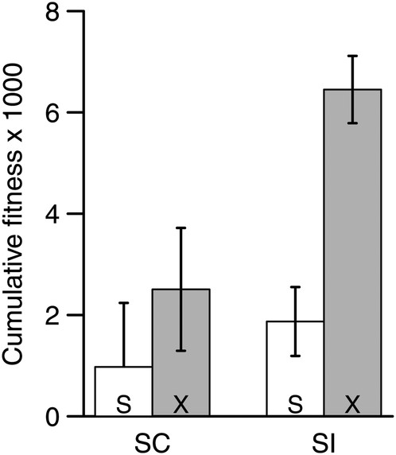
Figure 3. Least square mean (±1 SE) cumulative fitness over 2 years for the inbreeding depression experiment. Least ...
Notes:
Figure 3. Least square mean (±1 SE) cumulative fitness over 2 years for the inbreeding depression experiment. Least square means are given by mating system category (SC, self-compatible; SI, self-incompatible) and cross type (S, bud selfed; X, bud outcrossed).
Unless provided in the caption above, the following copyright applies to the content of this slide: Published by Oxford University Press on behalf of the Annals of Botany Company.This is an Open Access article distributed under the terms of the Creative Commons Attribution License (http://creativecommons.org/licenses/by/4.0/), which permits unrestricted reuse, distribution, and reproduction in any medium, provided the original work is properly cited.

Slide 4
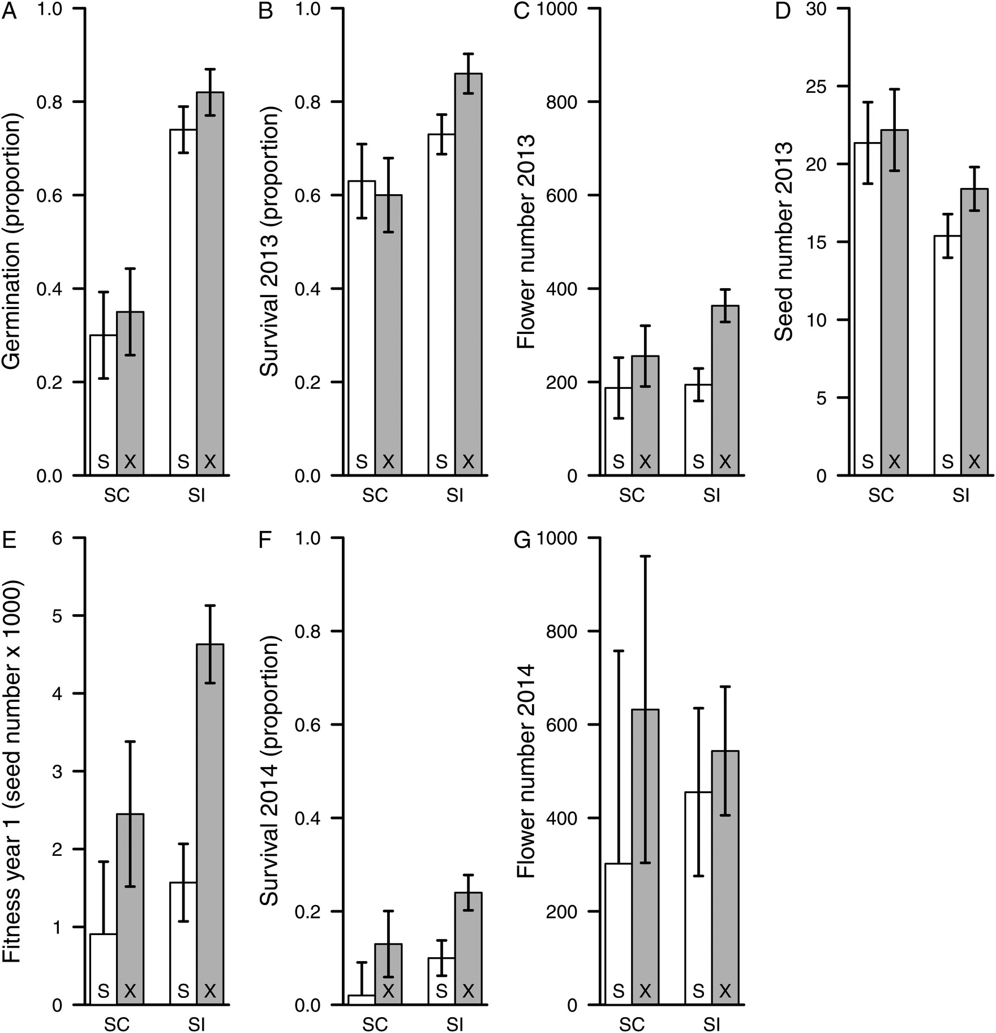
Figure 4. Least square mean values (±1 SE) for fitness components and cumulative fitness in the first year for the ...
Notes:
Figure 4. Least square mean values (±1 SE) for fitness components and cumulative fitness in the first year for the inbreeding depression experiment. Least square means are given by mating system category (SC, self-compatible; SI, self-incompatible) and cross type (S, bud selfed; X, bud outcrossed).
Unless provided in the caption above, the following copyright applies to the content of this slide: Published by Oxford University Press on behalf of the Annals of Botany Company.This is an Open Access article distributed under the terms of the Creative Commons Attribution License (http://creativecommons.org/licenses/by/4.0/), which permits unrestricted reuse, distribution, and reproduction in any medium, provided the original work is properly cited.

