Slide 1
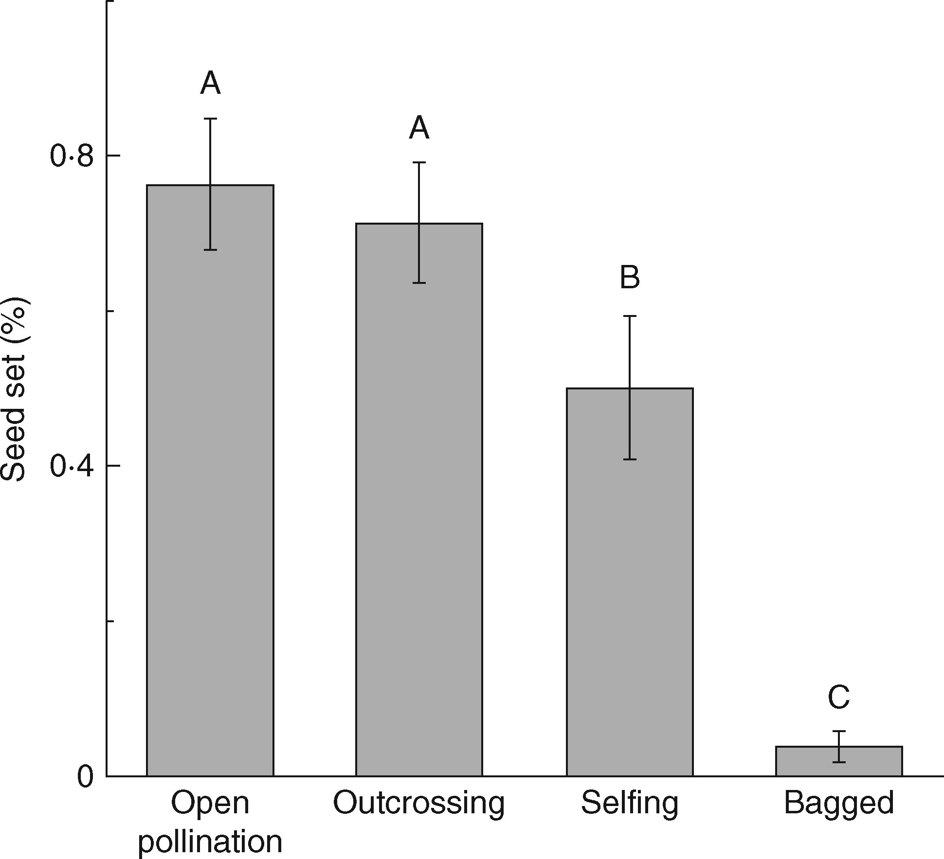
Fig. 1. Mean seed set (± s.e.) of Salvia przewalskii under four different pollination treatments: open pollination, ...
Notes:
Fig. 1. Mean seed set (± s.e.) of Salvia przewalskii under four different pollination treatments: open pollination, outcrossing, selfing and bagged. Different letters indicate that differences are significant at P < 0·05.
Unless provided in the caption above, the following copyright applies to the content of this slide: © The Author 2017. Published by Oxford University Press on behalf of the Annals of Botany Company. All rights reserved. For Permissions, please email: journals.permissions@oup.com

Slide 2
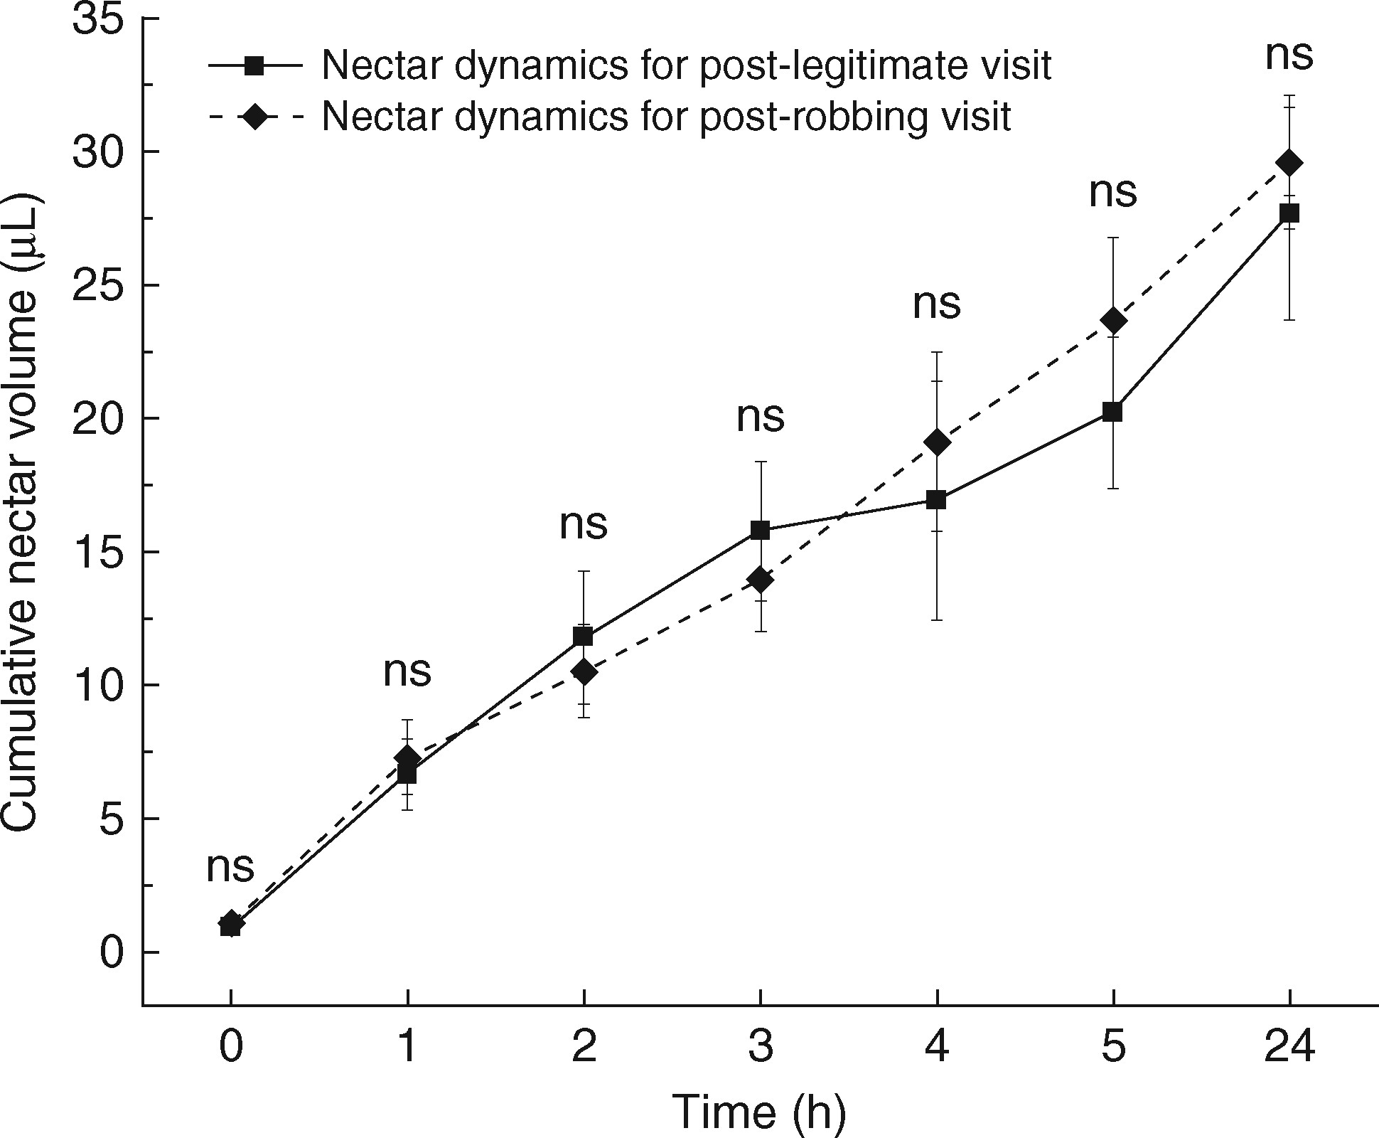
Fig. 2. Comparison of nectar production rate at different stages for flowers after receiving a single visit by ...
Notes:
Fig. 2. Comparison of nectar production rate at different stages for flowers after receiving a single visit by legitimate visitors or nectar robbers. Data are presented as cumulative nectar volume (μL ± s.e.), and ns indicates that there was no significant difference between flowers of two groups at each stage.
Unless provided in the caption above, the following copyright applies to the content of this slide: © The Author 2017. Published by Oxford University Press on behalf of the Annals of Botany Company. All rights reserved. For Permissions, please email: journals.permissions@oup.com

Slide 3
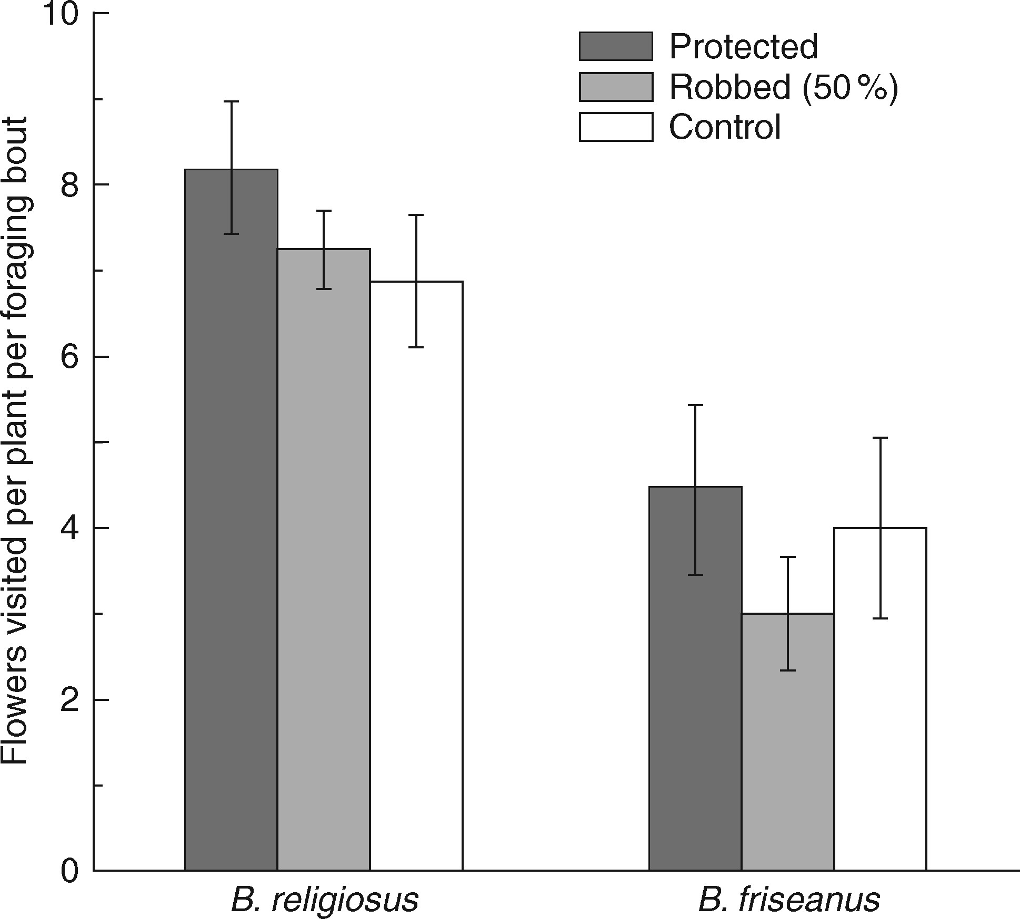
Fig. 3. Flowers visited per plant for a bumble bee within a foraging bout (± s.e.) by Bombus religiosus and B. ...
Notes:
Fig. 3. Flowers visited per plant for a bumble bee within a foraging bout (± s.e.) by Bombus religiosus and B. friseanus when they legitimately visited plants under treatments, with 0, 50 and 92 % nectar-robbed flowers within a plant.
Unless provided in the caption above, the following copyright applies to the content of this slide: © The Author 2017. Published by Oxford University Press on behalf of the Annals of Botany Company. All rights reserved. For Permissions, please email: journals.permissions@oup.com

Slide 4
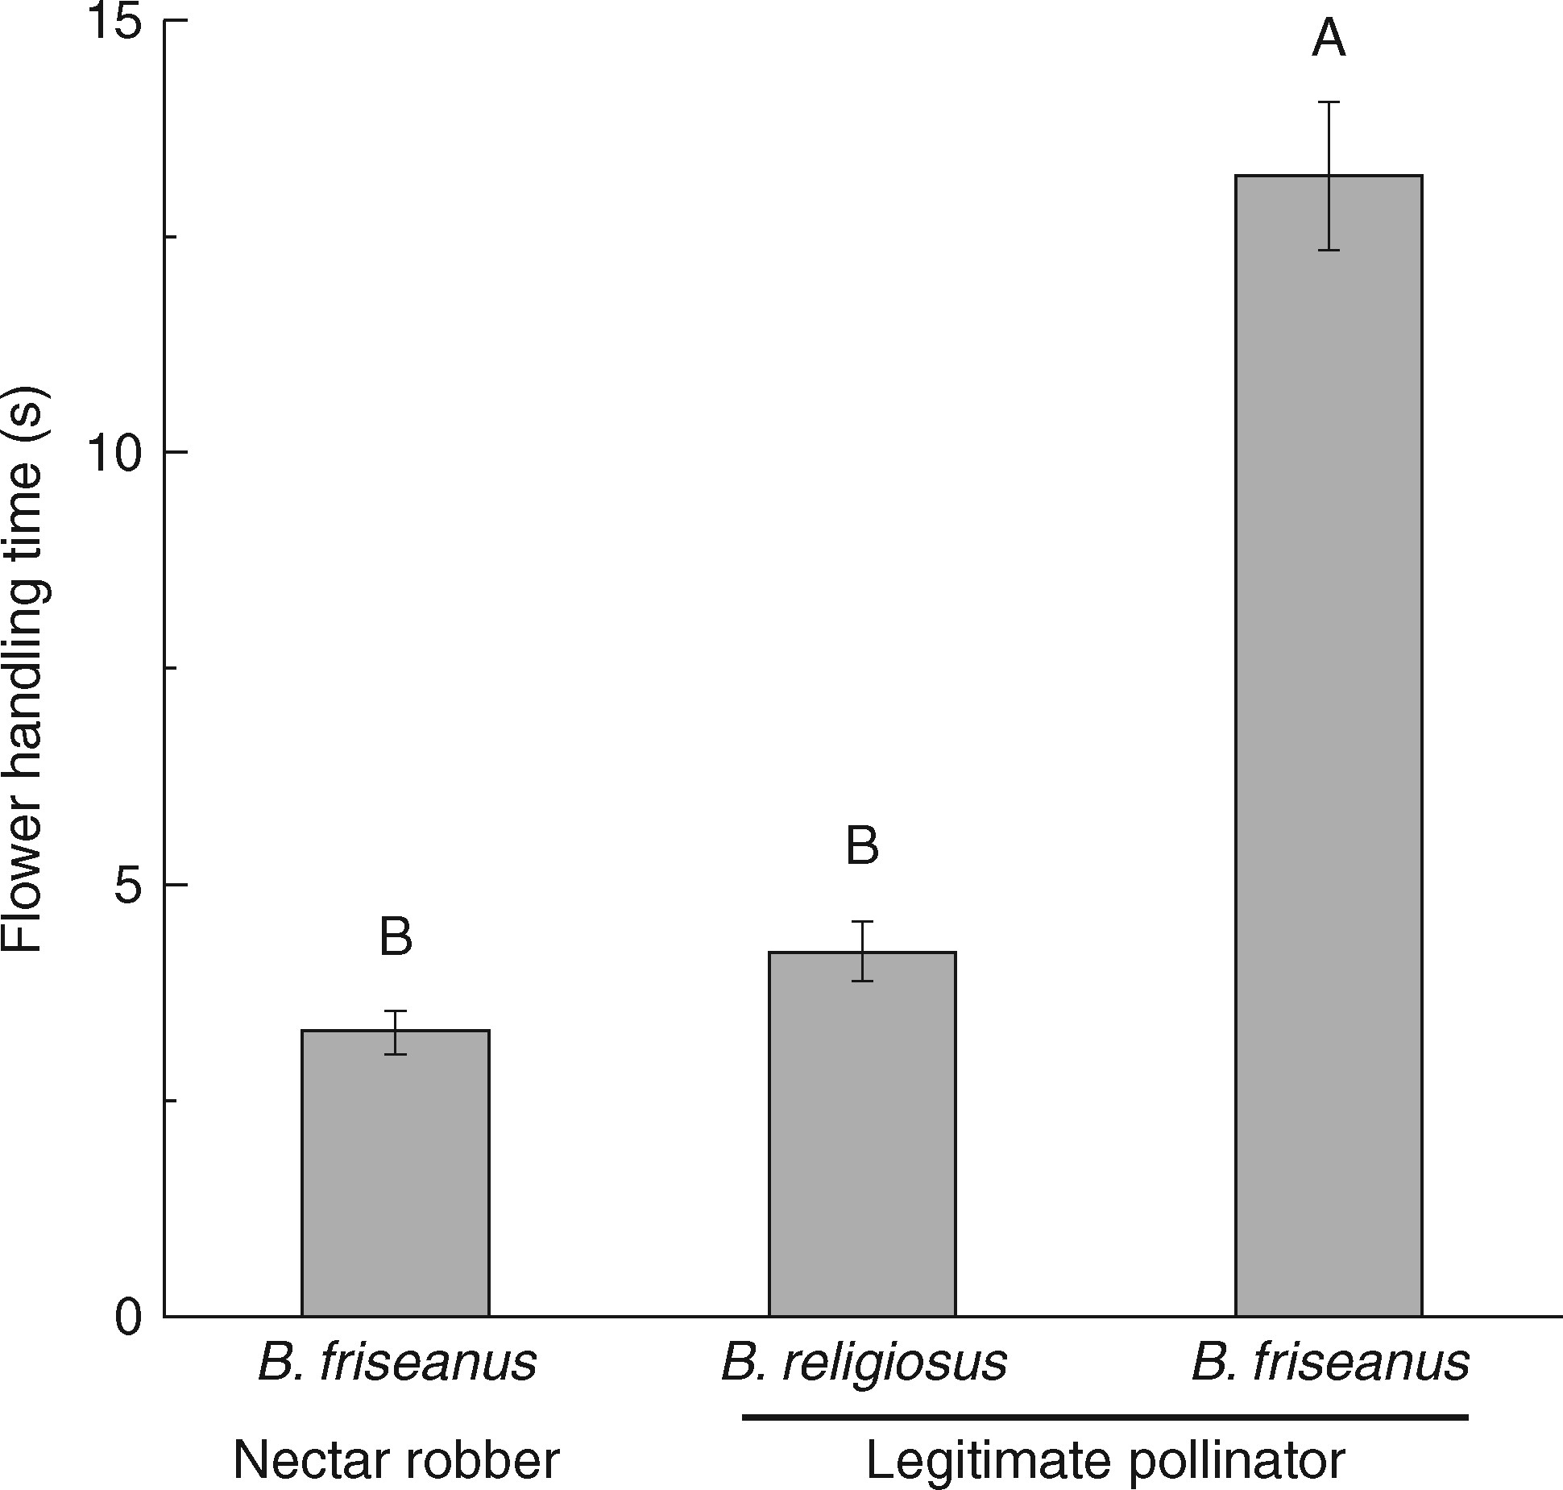
Fig. 4. Flower handling time (± s.e.) of Bombus religiosus (the legitimate visitors) and B. friseanus as nectar ...
Notes:
Fig. 4. Flower handling time (± s.e.) of Bombus religiosus (the legitimate visitors) and B. friseanus as nectar robber and legitimate visitor. Bars with different letters differ significantly at the P < 0·05 level.
Unless provided in the caption above, the following copyright applies to the content of this slide: © The Author 2017. Published by Oxford University Press on behalf of the Annals of Botany Company. All rights reserved. For Permissions, please email: journals.permissions@oup.com

