Slide 1
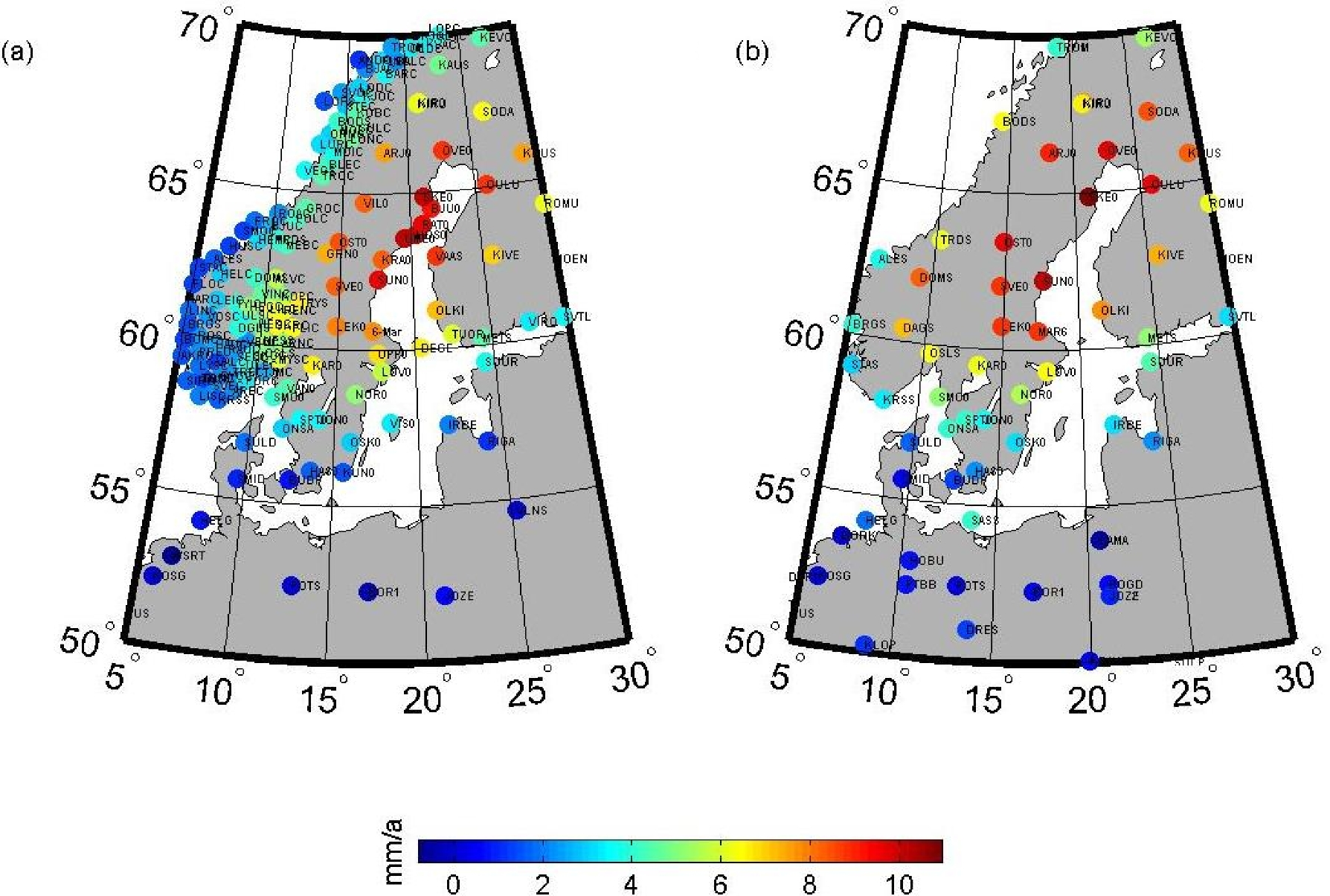
Figure 1. The uplift rate in mm a^{–1} from GPS data up to (a) 2014 (Kierulf et al. 2014) and (b) 2010 BIFROST ...
Notes:
Figure 1. The uplift rate in mm a–1 from GPS data up to (a) 2014 (Kierulf et al. 2014) and (b) 2010 BIFROST (Lidberg et al. 2010) data.
Unless provided in the caption above, the following copyright applies to the content of this slide: © The Authors 2017. Published by Oxford University Press on behalf of The Royal Astronomical Society.

Slide 2
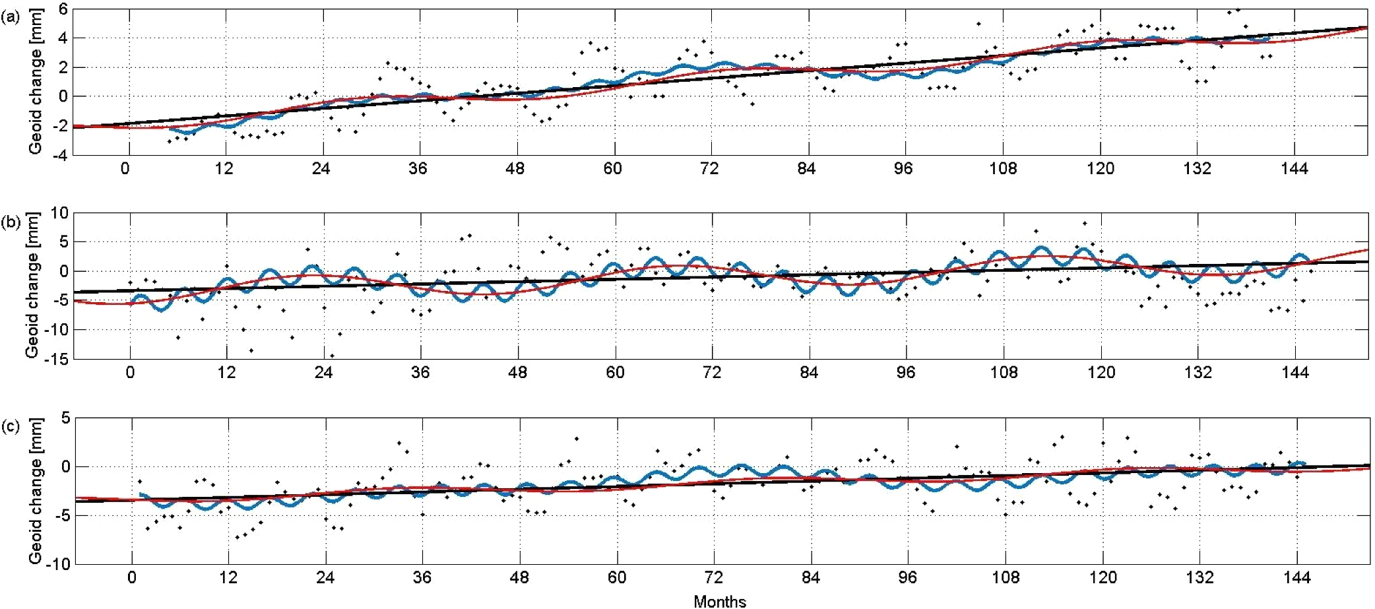
Figure 2. An example of the time series of the geoid from (a) CNES, (b) GFZ and (c) CSR data. The black dots show the ...
Notes:
Figure 2. An example of the time series of the geoid from (a) CNES, (b) GFZ and (c) CSR data. The black dots show the monthly geoid data in mm, the solid line is the linear secular trend for the least squares fit using only the linear term (eq. 12), the red curve is the fit including also the 3.7 yr periodic term (eq. 11, J = 1) and the blue curve shows the model including the linear and the periodicities with 161 d, 3.7 and 7.7 yr (eq. 11, J = 3).
Unless provided in the caption above, the following copyright applies to the content of this slide: © The Authors 2017. Published by Oxford University Press on behalf of The Royal Astronomical Society.

Slide 3
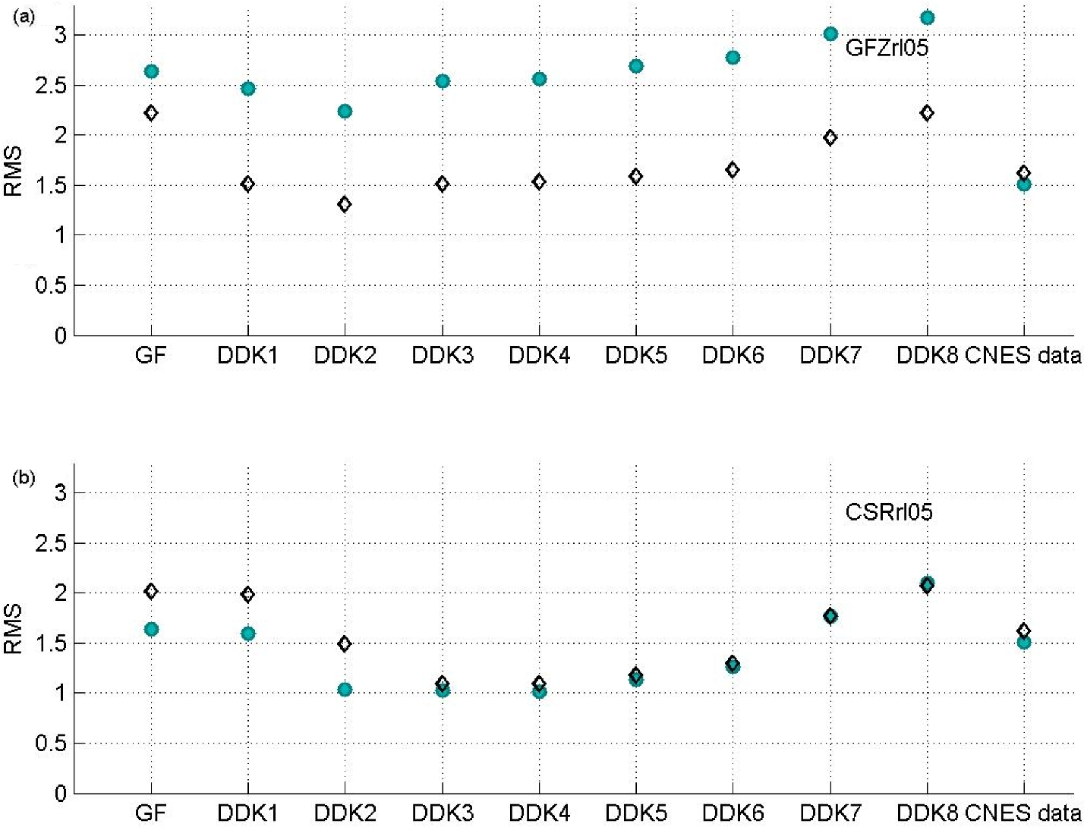
Figure 3. The rms differences of Equivalent land uplift rates from (a) GFZ and (b) CSR RL05, minus 2014 GPS data (green ...
Notes:
Figure 3. The rms differences of Equivalent land uplift rates from (a) GFZ and (b) CSR RL05, minus 2014 GPS data (green circles) and 2010 GPS data (diamonds). The CNES data (no filtering) is shown in the last column. The Gaussian filter (GF, half-wavelength radius 450 km) and eight anisotropic filters with the strongest DDK1 to the weakest DDK8 smoothing power (Kusche et al. 2009) are denoted in the abscissa. Units are in mm a–1.
Unless provided in the caption above, the following copyright applies to the content of this slide: © The Authors 2017. Published by Oxford University Press on behalf of The Royal Astronomical Society.

Slide 4
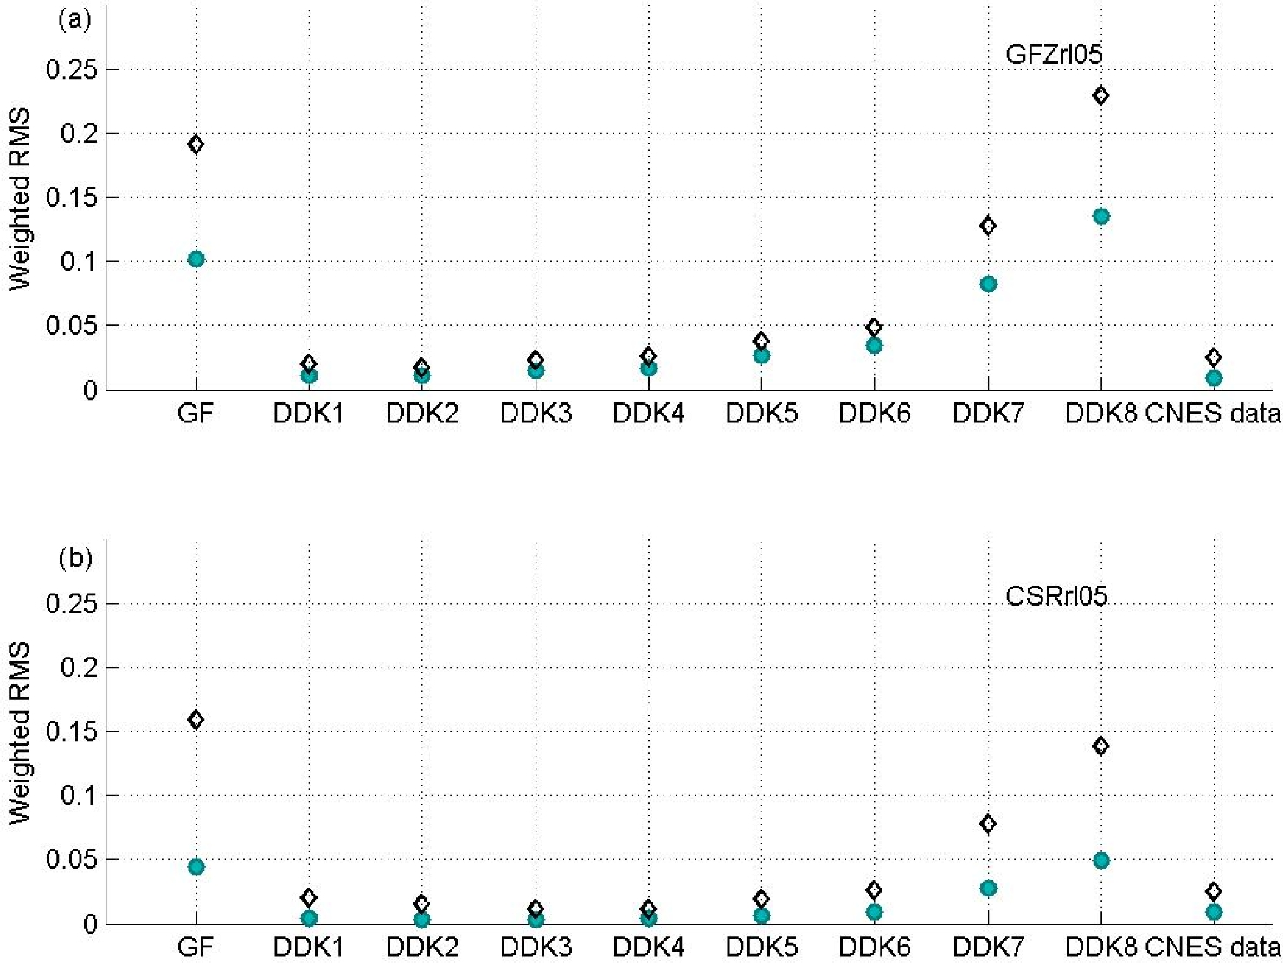
Figure 4. The weighted rms (WRMS) differences of Equivalent land uplift rates from (a) GFZ and (b) CSR RL05, minus 2014 ...
Notes:
Figure 4. The weighted rms (WRMS) differences of Equivalent land uplift rates from (a) GFZ and (b) CSR RL05, minus 2014 GPS data (green circles) and 2010 GPS data (diamonds). The CNES data (no filtering) is in the last column. The Gaussian filter (GF, half-wavelength radius 450 km) and eight anisotropic filters with the strongest DDK1 to the weakest DDK8 smoothing power (Kusche et al. 2009) are denoted in the abscissa. Units are in mm a–1.
Unless provided in the caption above, the following copyright applies to the content of this slide: © The Authors 2017. Published by Oxford University Press on behalf of The Royal Astronomical Society.

Slide 5
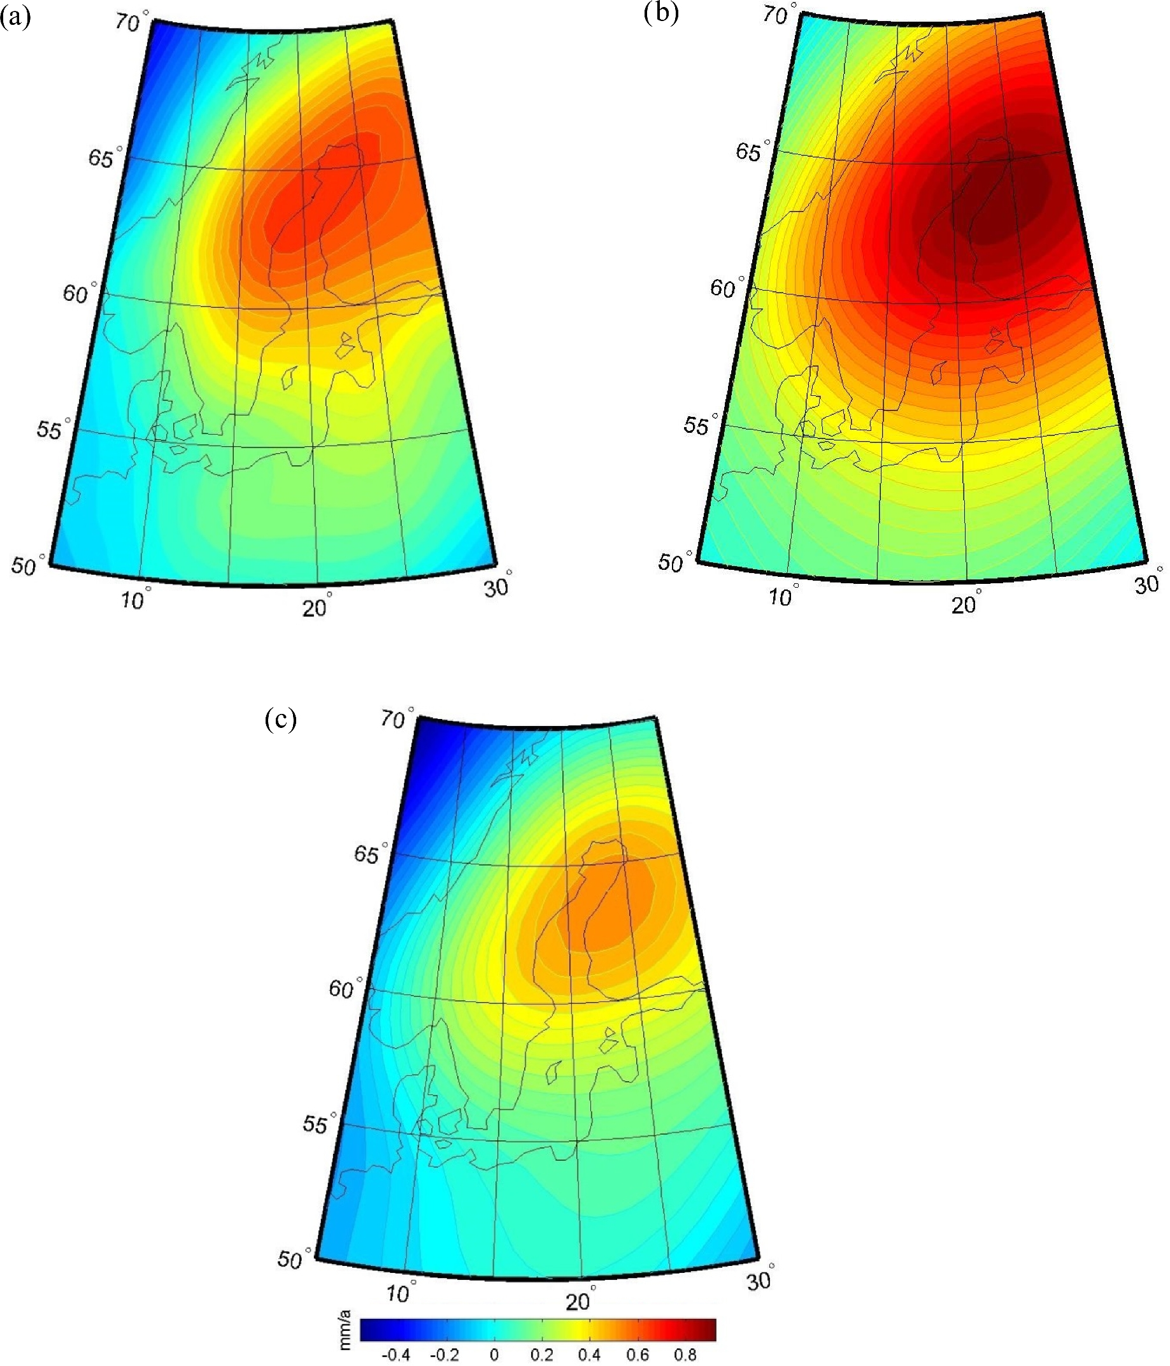
Figure 5. The secular linear trends of the geoid height change for (a) CNES RL03 (no filtering), (b) GFZ RL05 (filter ...
Notes:
Figure 5. The secular linear trends of the geoid height change for (a) CNES RL03 (no filtering), (b) GFZ RL05 (filter in use DDK2) and (c) CSR RL05 (filter in use DDK4).
Unless provided in the caption above, the following copyright applies to the content of this slide: © The Authors 2017. Published by Oxford University Press on behalf of The Royal Astronomical Society.

Slide 6
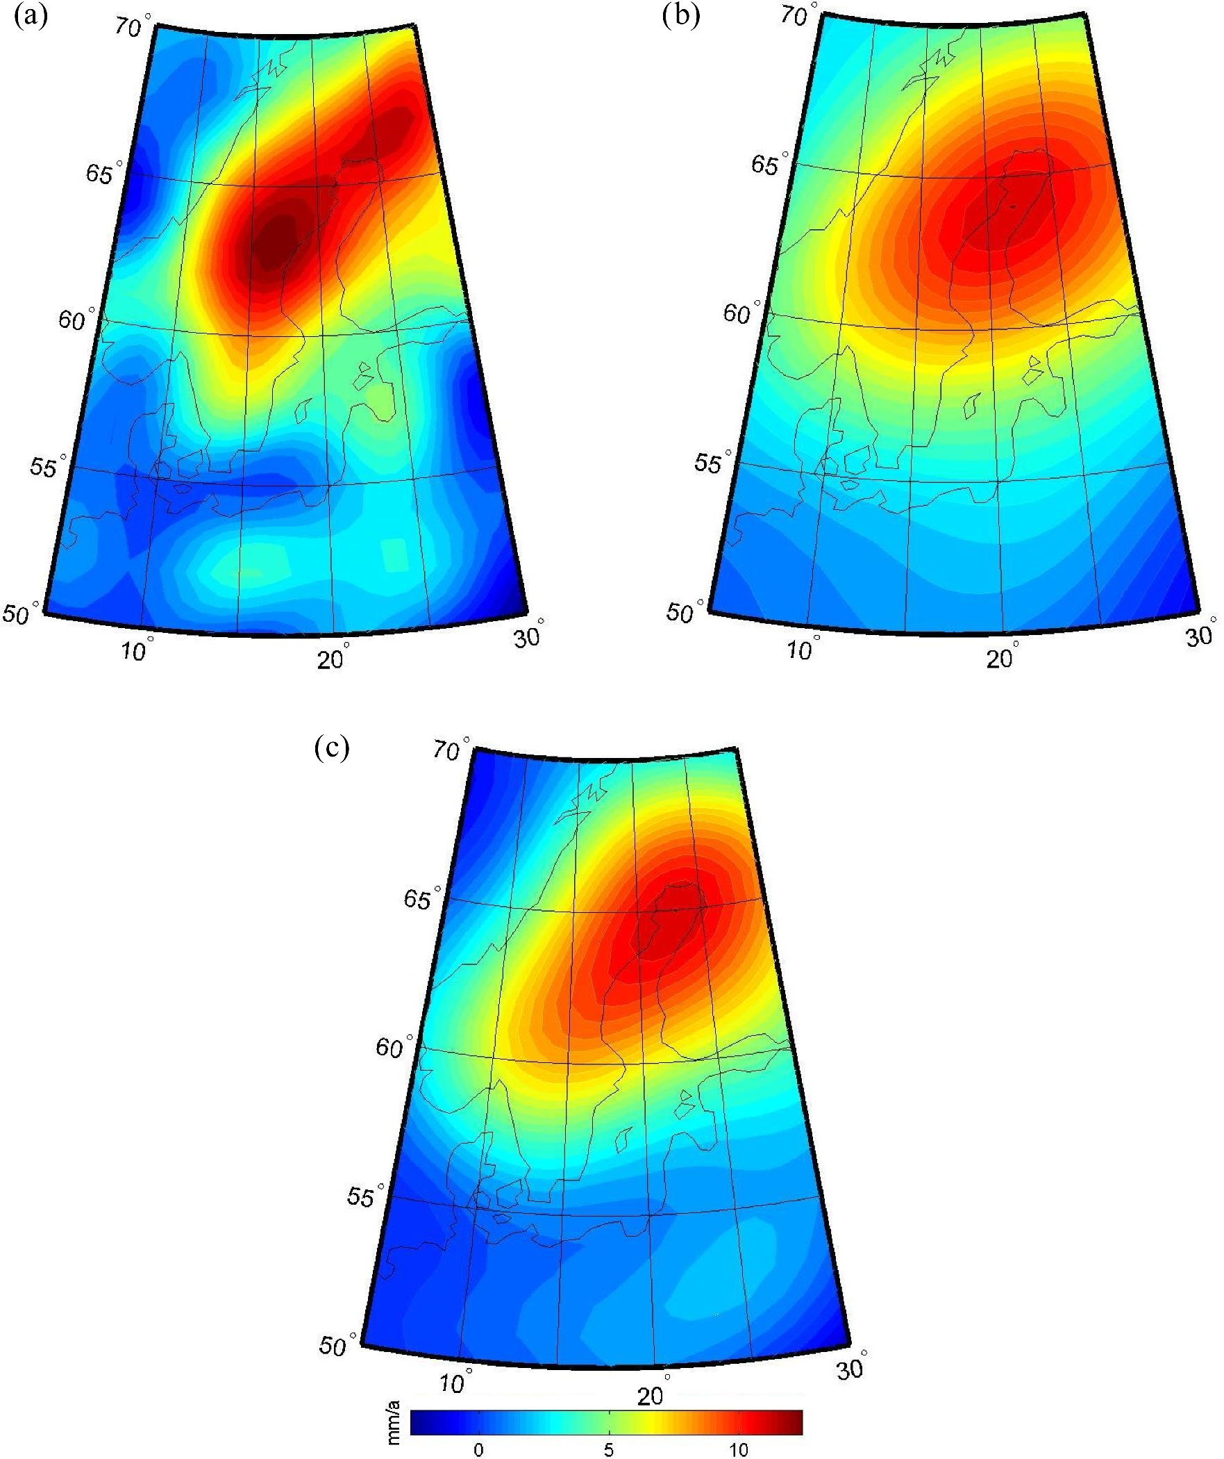
Figure 6. The secular equivalent land uplift rates from (a) CNES rl03 and from (b) GFZ RL05 using the DDK2 and (c) CSR ...
Notes:
Figure 6. The secular equivalent land uplift rates from (a) CNES rl03 and from (b) GFZ RL05 using the DDK2 and (c) CSR RL05 using the DDK4 filter.
Unless provided in the caption above, the following copyright applies to the content of this slide: © The Authors 2017. Published by Oxford University Press on behalf of The Royal Astronomical Society.

Slide 7
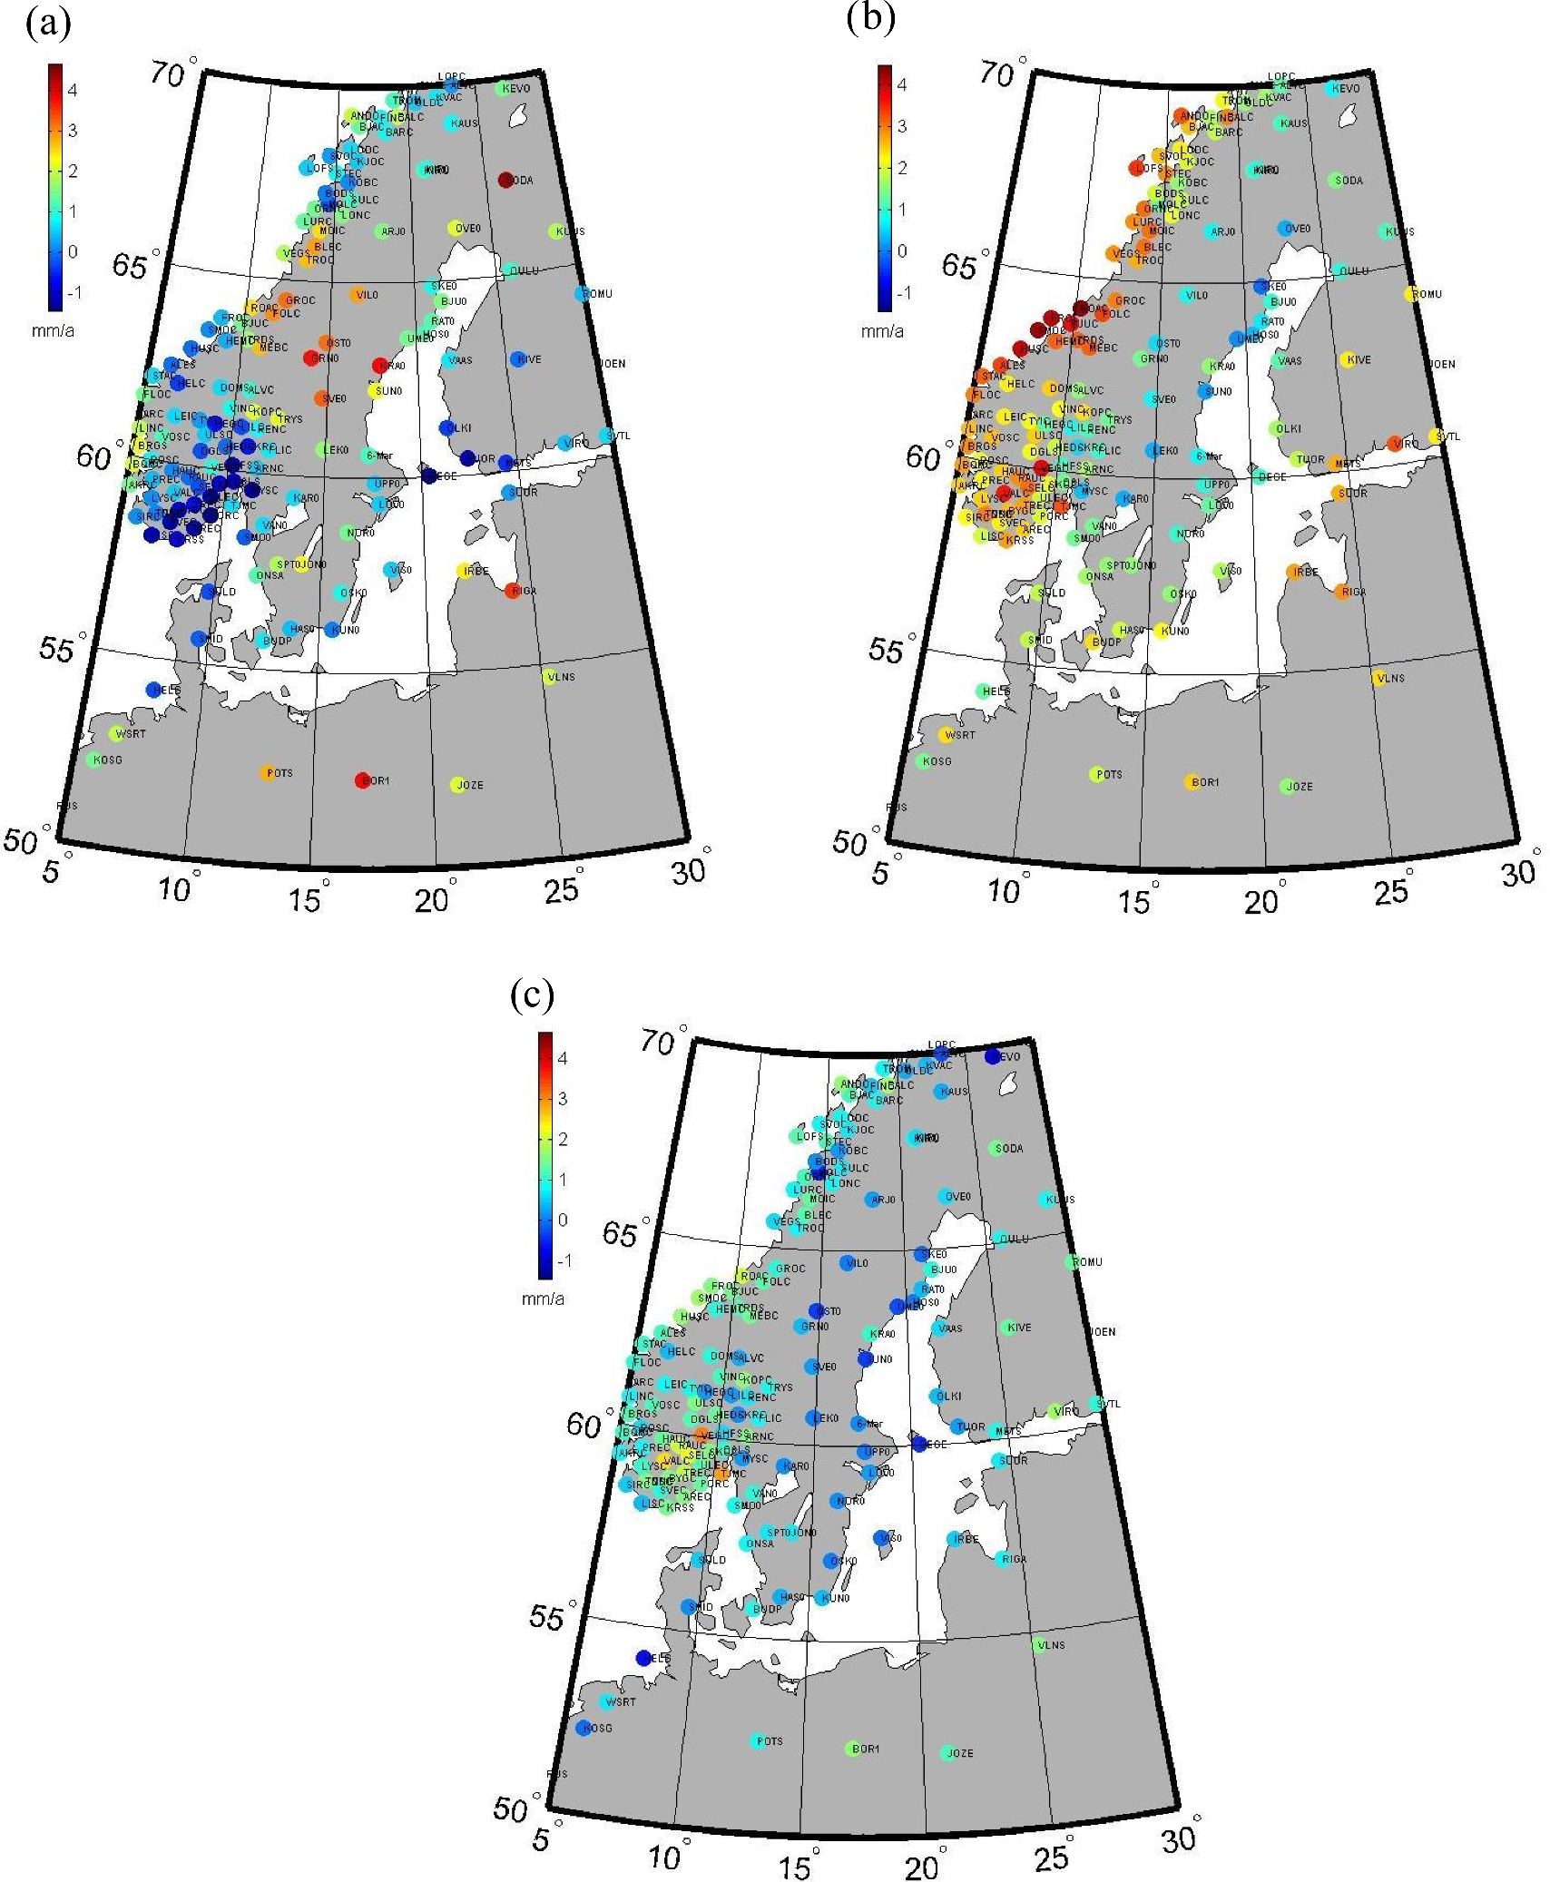
Figure 7. The differences between land uplift rates from (a) CNES rl03, (b) GFZ and (c) CSR RL05, minus GPS ...
Notes:
Figure 7. The differences between land uplift rates from (a) CNES rl03, (b) GFZ and (c) CSR RL05, minus GPS observations.
Unless provided in the caption above, the following copyright applies to the content of this slide: © The Authors 2017. Published by Oxford University Press on behalf of The Royal Astronomical Society.

Slide 8
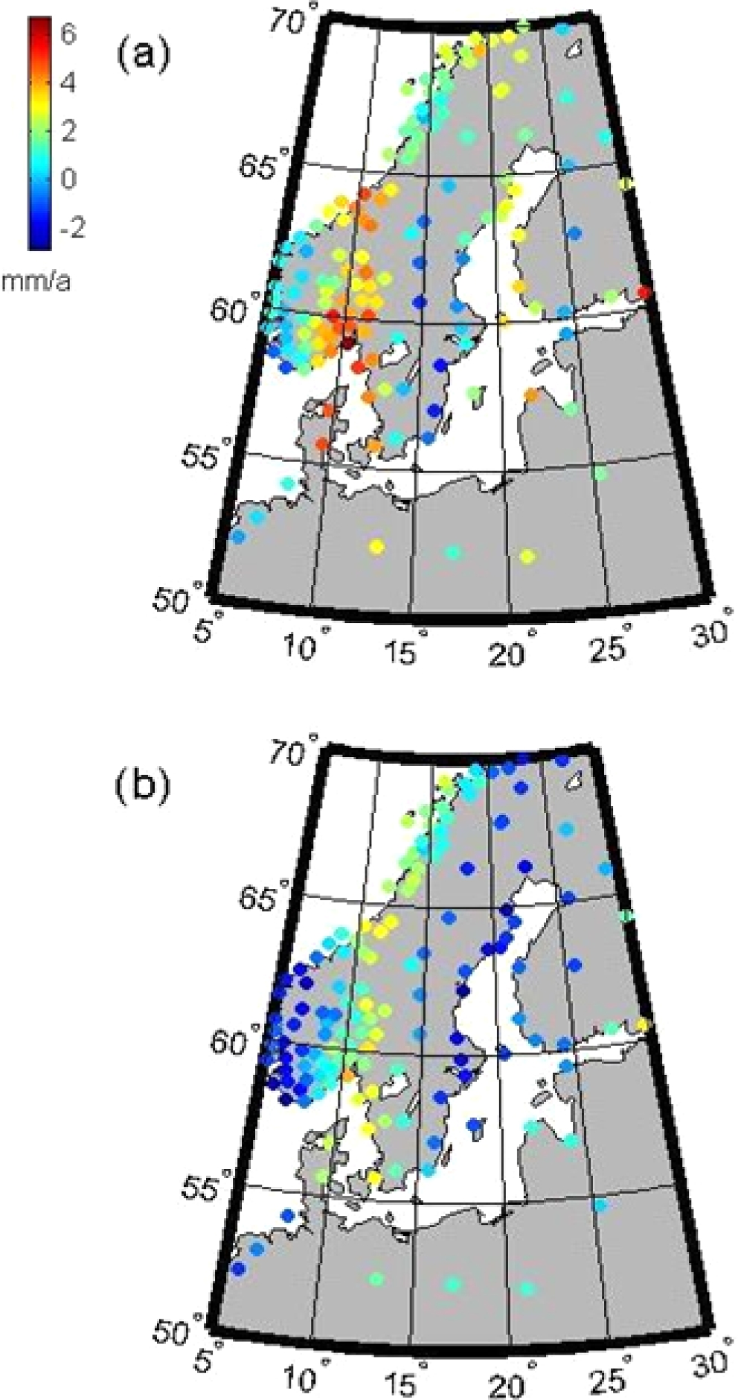
Figure 8. The differences between land uplift rates from (a) GFZ (b) CSR RL05 using Gaussian Filter minus GPS ...
Notes:
Figure 8. The differences between land uplift rates from (a) GFZ (b) CSR RL05 using Gaussian Filter minus GPS observations.
Unless provided in the caption above, the following copyright applies to the content of this slide: © The Authors 2017. Published by Oxford University Press on behalf of The Royal Astronomical Society.

Slide 9
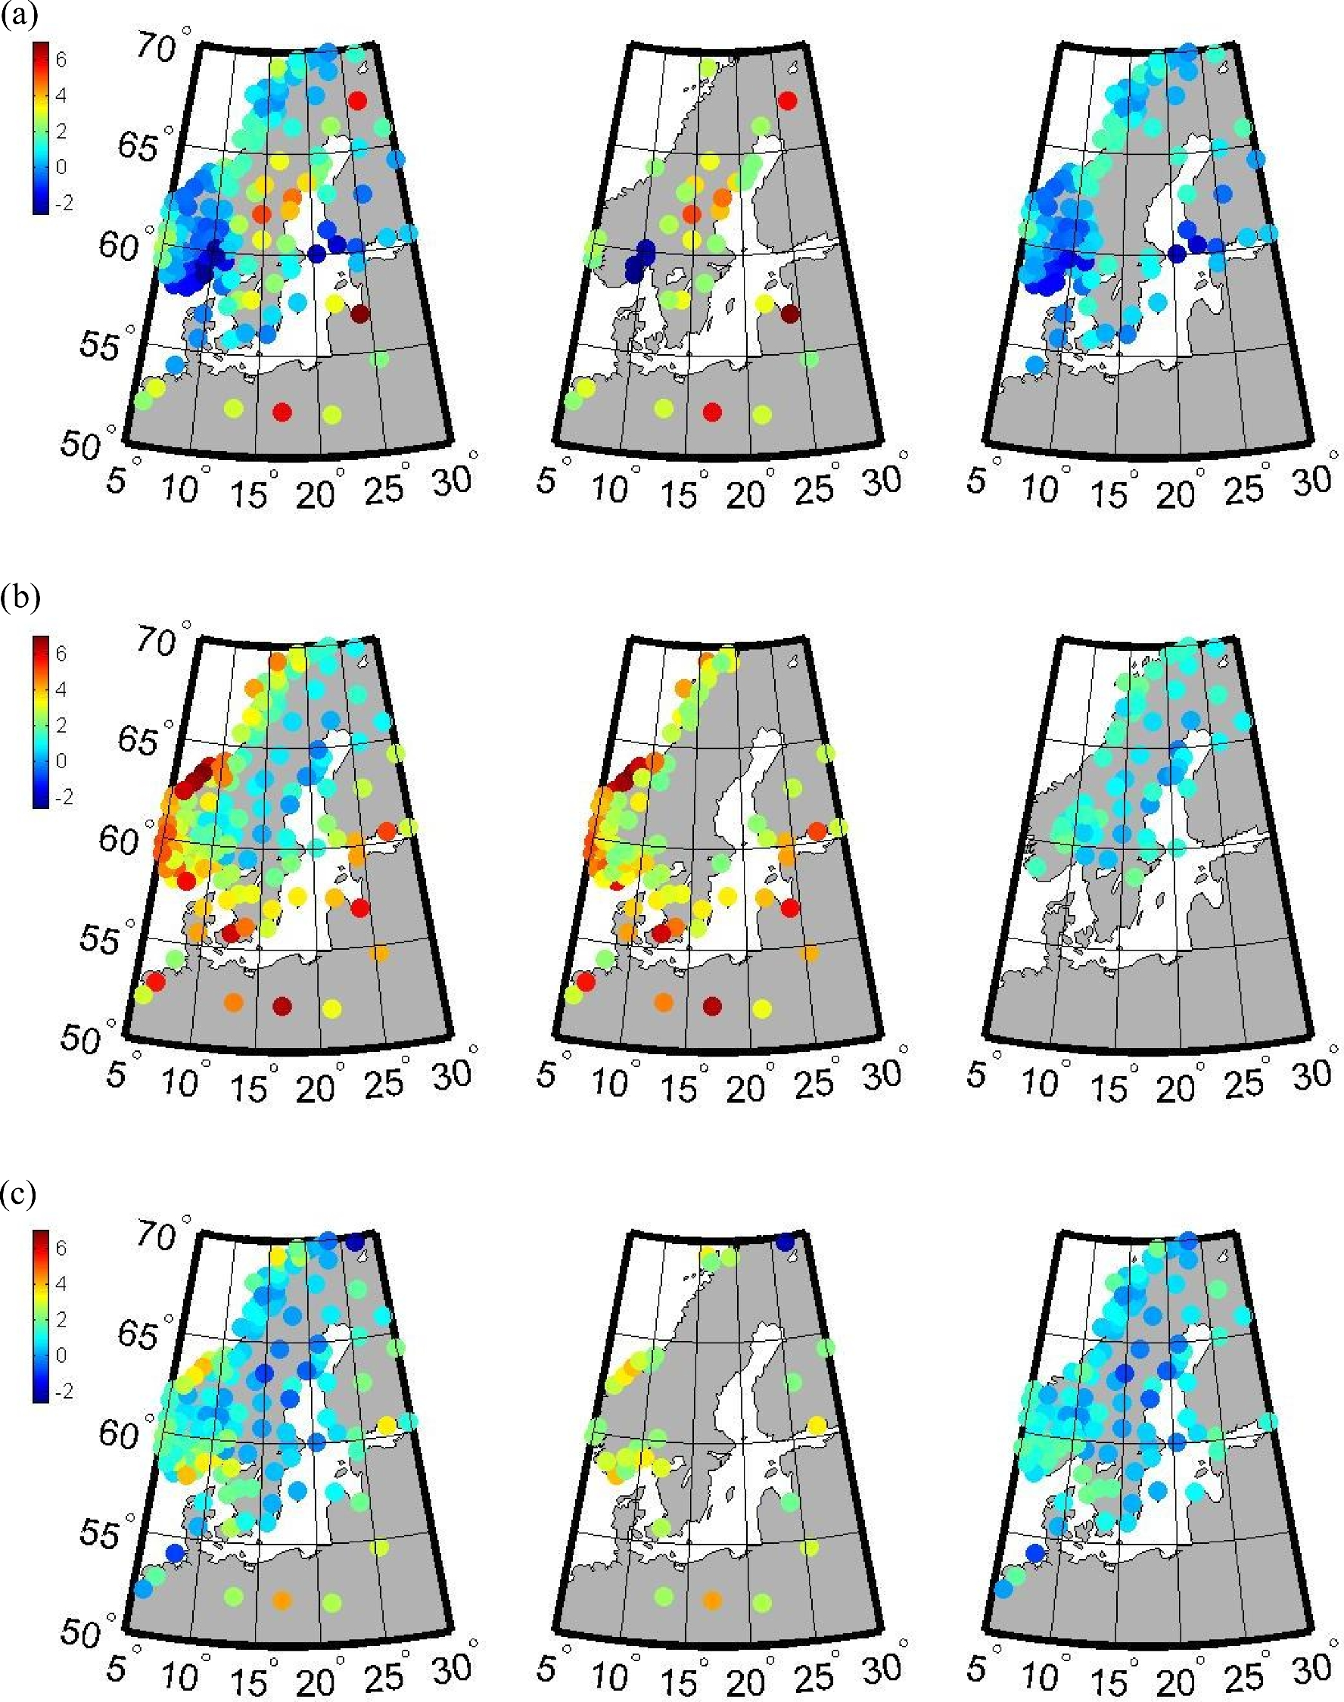
Figure 9. The T values of the differences between land uplift rates from (a) CNES, (b) GFZ and (c) CSR, and the GPS ...
Notes:
Figure 9. The T values of the differences between land uplift rates from (a) CNES, (b) GFZ and (c) CSR, and the GPS 2014 for all stations in the left-hand column, and for those with significant and insignificant differences in the middle and right-hand column, respectively.
Unless provided in the caption above, the following copyright applies to the content of this slide: © The Authors 2017. Published by Oxford University Press on behalf of The Royal Astronomical Society.

