Slide 1
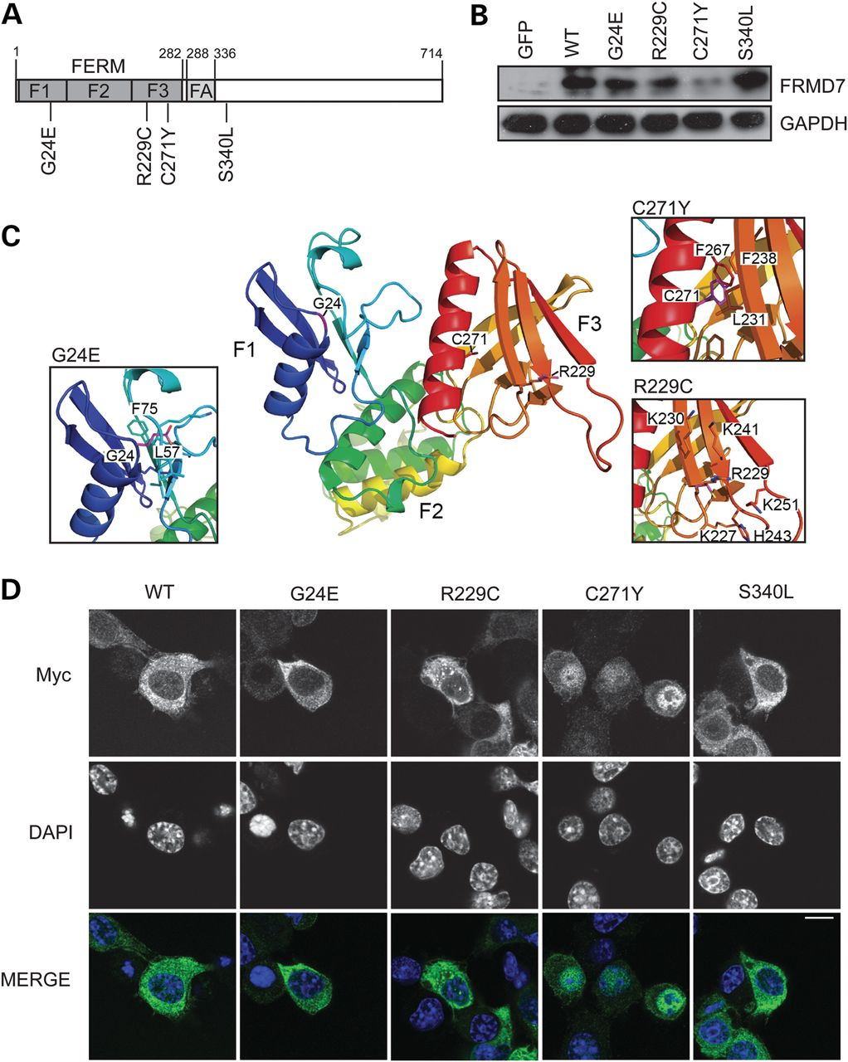
Figure 1. IIN-associated mutations disrupt FRMD7 protein expression and localization. (A) Schematic representation of ...
Notes:
Figure 1. IIN-associated mutations disrupt FRMD7 protein expression and localization. (A) Schematic representation of the domain organization of FRMD7, containing an N-terminal FERM domain, comprising F1, F2 and F3 lobes, and FERM-adjacent (FA) domain. Locations of IIN-associated mutations used in the study are indicated. Sequences are based on the 714-residue FRMD7 isoform (ENST00000298542). (B) Neuro2A cells were transiently transfected with GFP-tagged WT or mutant FRMD7. Cell lysates were immunoblotted with anti-FRMD7 and anti-GAPDH antibodies. (C) Structural model of the FRMD7 FERM domain highlighting the location of the mutations G24E, R229C and C271Y. Insets depict magnified regions of the three mutations; in each case, the sidechain of the mutated residue is shown in magenta. (D) Neuro2A cells were seeded onto coverslips, transiently transfected with myc-tagged WT or mutant FRMD7 and fixed in methanol. Immunofluorescence microscopy was then performed using anti-myc antibodies (green in merged image) and DAPI to stain chromatin (blue in merged image). Cells with higher expression were chosen for imaging to allow clear visualization of protein localization and are therefore not representative of expression level. Scale bar, 10 µm.
Unless provided in the caption above, the following copyright applies to the content of this slide: © The Author 2013. Published by Oxford University Press.This is an Open Access article distributed under the terms of the Creative Commons Attribution License (http://creativecommons.org/licenses/by-nc/3.0/), which permits non-commercial use, distribution, and reproduction in any medium, provided the original work is properly cited. For commercial re-use, please contact journals.permission@oup.com

Slide 2
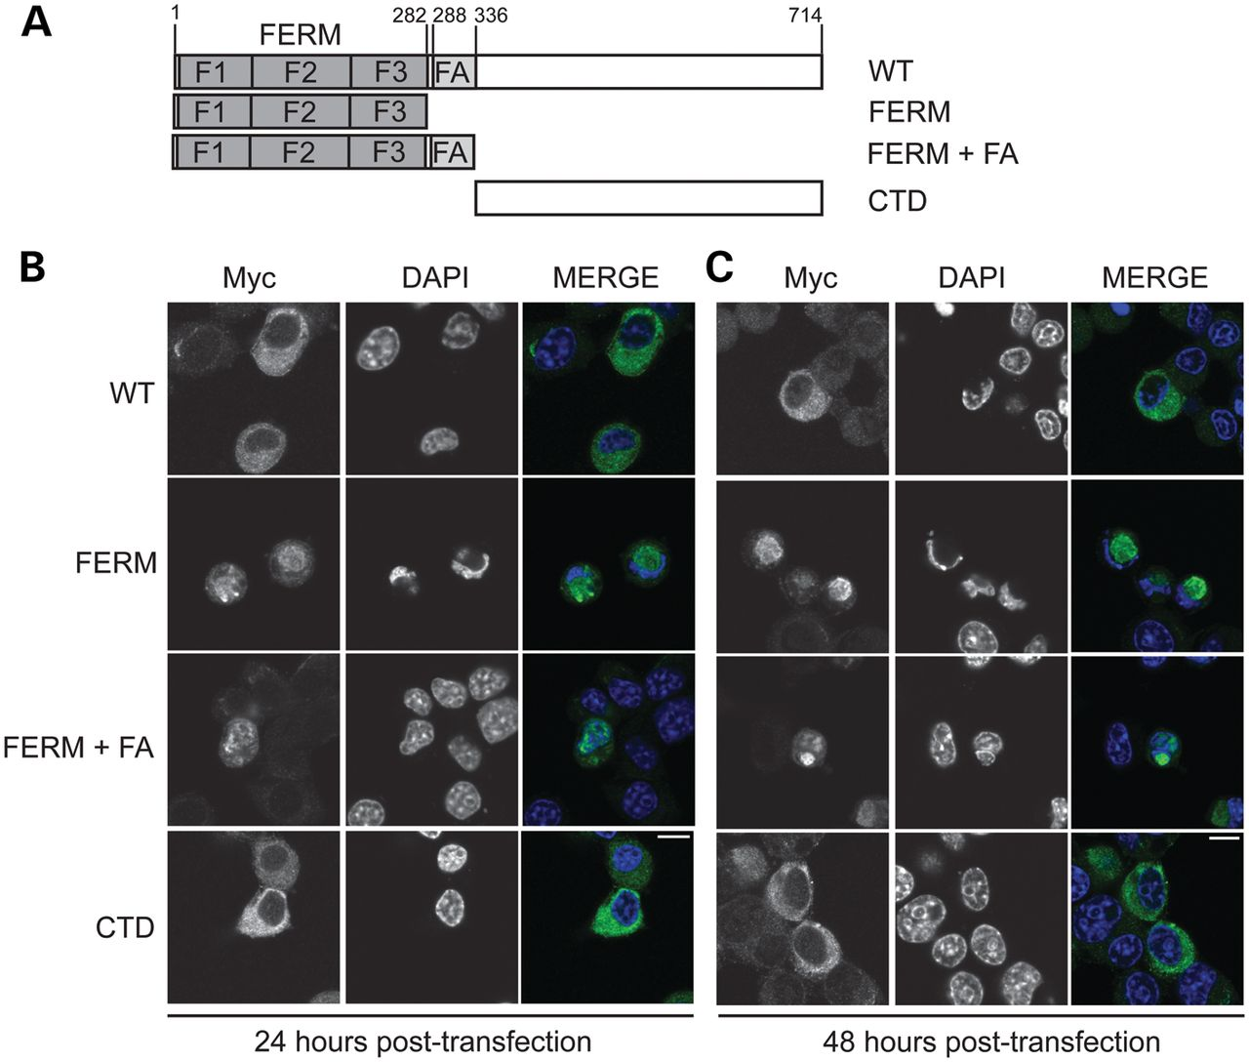
Figure 2. The N-terminus of FRMD7 determines nuclear localization. (A) Schematic representation of the FRMD7 deletion ...
Notes:
Figure 2. The N-terminus of FRMD7 determines nuclear localization. (A) Schematic representation of the FRMD7 deletion constructs used in this study. (B and C) Neuro2A cells were seeded onto coverslips, transiently transfected with myc-tagged WT or mutant FRMD7 and fixed in methanol 24 (B) or (C) 48 h later. Immunofluorescence microscopy was then performed using anti-myc antibodies (green in merged image) and DAPI to stain chromatin (blue in merged image). Scale bar, 10 µm.
Unless provided in the caption above, the following copyright applies to the content of this slide: © The Author 2013. Published by Oxford University Press.This is an Open Access article distributed under the terms of the Creative Commons Attribution License (http://creativecommons.org/licenses/by-nc/3.0/), which permits non-commercial use, distribution, and reproduction in any medium, provided the original work is properly cited. For commercial re-use, please contact journals.permission@oup.com

Slide 3
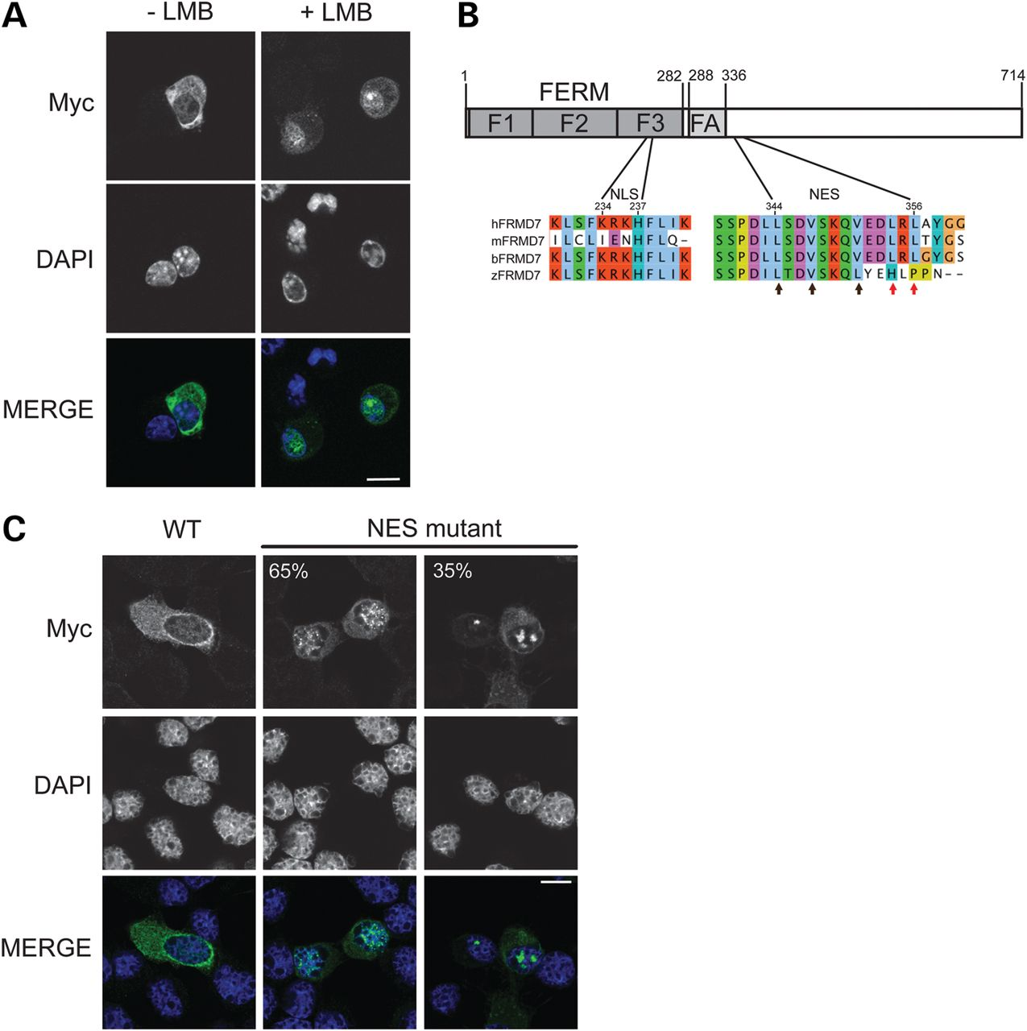
Figure 3. FRMD7 contains a functional NES and can translocate between the nucleus and cytoplasm. (A) Neuro2A cells were ...
Notes:
Figure 3. FRMD7 contains a functional NES and can translocate between the nucleus and cytoplasm. (A) Neuro2A cells were seeded onto coverslips, transiently transfected with myc-tagged WT FRMD7 and then treated with 20 nM leptomycin B (+LMB) or 70% methanol (−LMB) for 4 h before fixing in methanol. Immunofluorescence microscopy was then performed using anti-myc antibodies (green in merged image) and DAPI to stain chromatin (blue in merged image). Scale bar, 10 µm. (B) Schematic representation of the location of the predicted nuclear import sequence (NLS) and nuclear export sequence (NES) within FRMD7. Multiple species sequence alignments show the high degree of conservation of the motifs. Arrows indicate conserved hydrophobic residues forming the predicted NES. Red arrows indicate residues mutated in the NES mutant. (C) Neuro2A cells were seeded onto coverslips, transiently transfected with myc-tagged WT FRMD7 or the NES mutant (p.L354S/p.L356S) and processed for immunofluorescence microscopy as in (A). Sixty-five percent of the cells transfected with the NES mutant showed diffuse nuclear staining while 35% of the cells showed aggregation of the protein within the nucleus.
Unless provided in the caption above, the following copyright applies to the content of this slide: © The Author 2013. Published by Oxford University Press.This is an Open Access article distributed under the terms of the Creative Commons Attribution License (http://creativecommons.org/licenses/by-nc/3.0/), which permits non-commercial use, distribution, and reproduction in any medium, provided the original work is properly cited. For commercial re-use, please contact journals.permission@oup.com

Slide 4
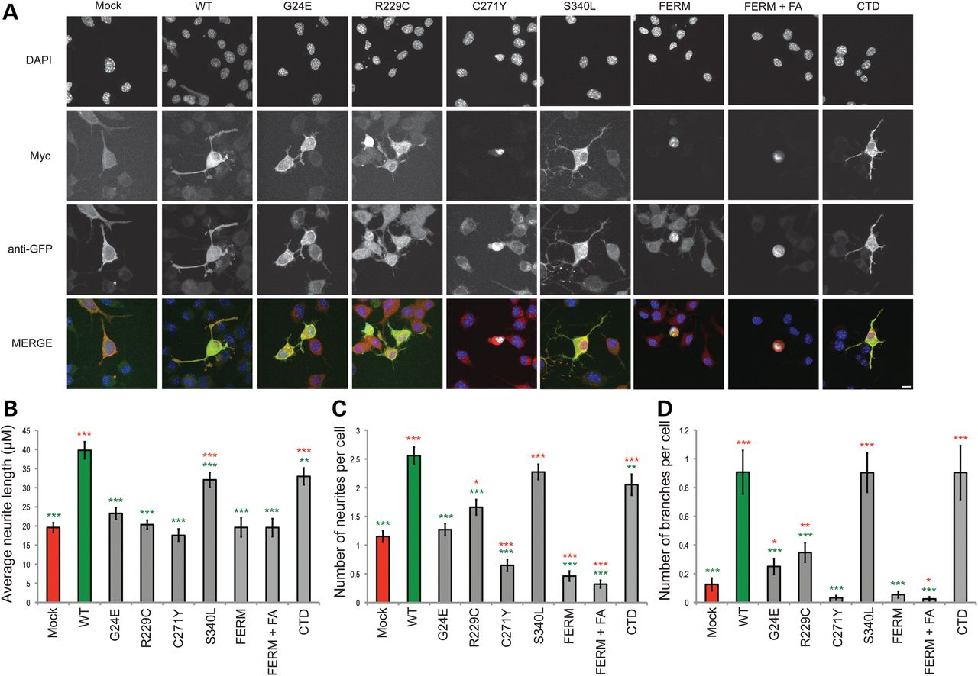
Figure 4. FRMD7 mutants inhibit the formation and extension of neurites. (A) Neuro2A cells were transiently ...
Notes:
Figure 4. FRMD7 mutants inhibit the formation and extension of neurites. (A) Neuro2A cells were transiently co-transfected with myc-tagged WT or mutant FRMD7 together with GFP to allow visualization of neurites. The cells were replated onto coverslips 24 h after transfection and differentiated with 10 μm retinoic acid in cell-culture medium containing 2% FBS. Cells were fixed in methanol 24 h post-differentiation and immunfluorescence microscopy was performed. Cells were co-stained using anti-myc (red) and anti-GFP (green) antibodies and chromatin visualized with DAPI (blue). Representative images for each condition were captured by taking a Z-series and then flattened in Fiji so that the entire neuron could be visualized in one image. Scale bar 10 µm. (B–D) Coverslips prepared in (A) were re-analyzed using a TE300 Nikon semi-automatic microscope. Neurite lengths (B), number of neurites per cell (C) and the number of neurite branches per cell (D) were calculated from a minimum of 116 cells. The average of three experiments is shown ±S.E. ***P<0.001, **P<0.005, *P<0.05. Red asterisks indicate significance compared with mock-transfected cells, green asterisks indicated significance compared with WT FRMD7.
Unless provided in the caption above, the following copyright applies to the content of this slide: © The Author 2013. Published by Oxford University Press.This is an Open Access article distributed under the terms of the Creative Commons Attribution License (http://creativecommons.org/licenses/by-nc/3.0/), which permits non-commercial use, distribution, and reproduction in any medium, provided the original work is properly cited. For commercial re-use, please contact journals.permission@oup.com

Slide 5
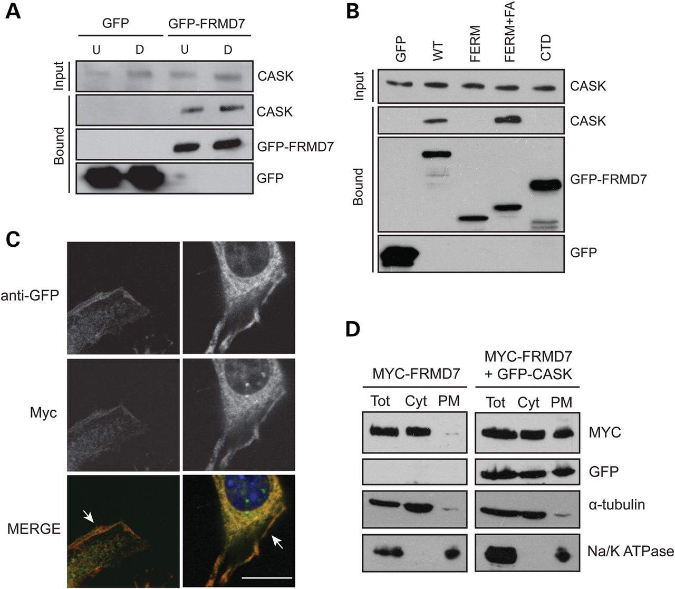
Figure 5. FRMD7 interacts and co-localizes with CASK at the plasma membrane in Neuro2A cells. (A) Neuro2A cells were ...
Notes:
Figure 5. FRMD7 interacts and co-localizes with CASK at the plasma membrane in Neuro2A cells. (A) Neuro2A cells were transiently transfected with GFP or GFP-tagged FRMD7 and either treated with 10 μm retinoic acid in culture medium containing 2% FBS for 43 h to differentiate the cells (D) or they were left undifferentiated by maintaining them in culture medium containing 10% FBS (U). The GFP-tagged proteins were precipitated from cell lysates using GFP-Trap A beads and immunoblotted with anti-CASK antibodies. Precipitates were also immunoblotted with anti-GFP antibodies to confirm that the pull-downs were successful. (B) Neuro2A cells were transiently transfected with GFP or GFP-tagged WT FRMD7 or deletion constructs, as indicated. The GFP-tagged proteins were precipitated from cell lysates and bound CASK was detected as in (A). (C) Neuro2A cells were seeded onto coverslips, transiently co-transfected with myc-tagged WT FRMD7 and GFP-tagged WT CASK and then fixed in methanol 24 h later. Immunofluorescence microscopy was performed using anti-myc (green) and anti-GFP (red) antibodies and chromatin was stained with DAPI (blue). Arrows indicate areas of FRMD7 and CASK co-localization at the plasma membrane. Scale bar, 10 µm. (D) Neuro2A cells were transiently transfected with myc-FRMD7 alone (left panels), or in combination with GFP-CASK (right panels). Cells were harvested 24 h later and fractionated using a plasma membrane protein extraction kit. Total protein (Tot), cytoplasmic (Cyt) and plasma membrane (PM) fractions were analyzed by imunoblotting. Antibodies against α-tubulin and Na/K ATPase were used as markers of cytoplasm and plasma membrane, respectively.
Unless provided in the caption above, the following copyright applies to the content of this slide: © The Author 2013. Published by Oxford University Press.This is an Open Access article distributed under the terms of the Creative Commons Attribution License (http://creativecommons.org/licenses/by-nc/3.0/), which permits non-commercial use, distribution, and reproduction in any medium, provided the original work is properly cited. For commercial re-use, please contact journals.permission@oup.com

Slide 6
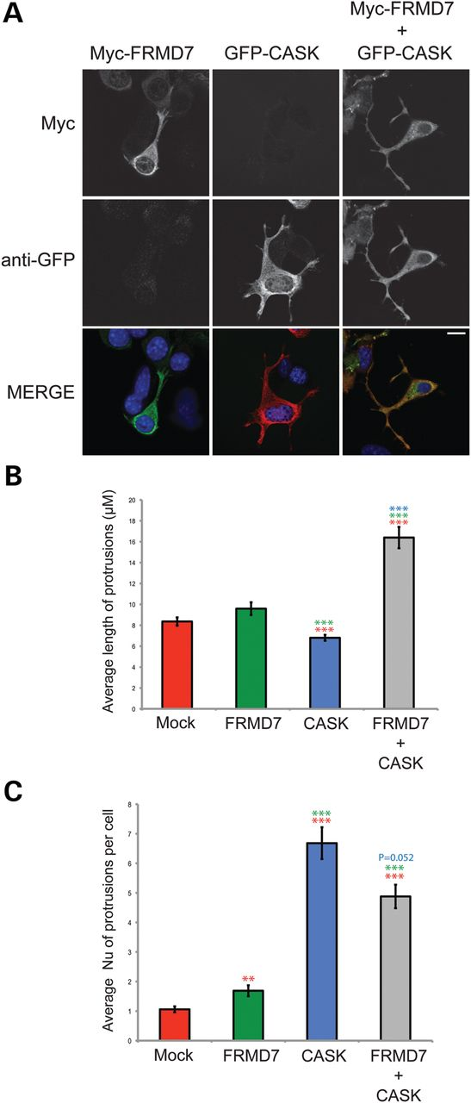
Figure 6. FRMD7 promotes elongation of CASK-induced membrane protrusions. (A) Neuro2A cells were seeded onto ...
Notes:
Figure 6. FRMD7 promotes elongation of CASK-induced membrane protrusions. (A) Neuro2A cells were seeded onto coverslips, transiently transfected with myc-tagged WT FRMD7 and GFP-tagged WT CASK, either alone or in combination, and fixed in methanol 24 h later. Immunofluorescence microscopy was performed using anti-myc (green) and anti-GFP (red) antibodies and chromatin was stained with DAPI (blue). (B and C) Coverslips prepared as in (A), except with the inclusion of empty vectors where appropriate, were analyzed using a TE300 Nikon semi-automatic microscope. Average lengths (B) and number of neurites per cell (C) were calculated from a minimum of 49 cells. The average of three experiments is shown ±S.E. ***P<0.001. Red asterisks indicate significance compared with mock-transfected cells, green asterisks indicated significance compared with cells expressing FRMD7 alone and blue asterisks indicate significance compared with CASK alone.
Unless provided in the caption above, the following copyright applies to the content of this slide: © The Author 2013. Published by Oxford University Press.This is an Open Access article distributed under the terms of the Creative Commons Attribution License (http://creativecommons.org/licenses/by-nc/3.0/), which permits non-commercial use, distribution, and reproduction in any medium, provided the original work is properly cited. For commercial re-use, please contact journals.permission@oup.com

Slide 7
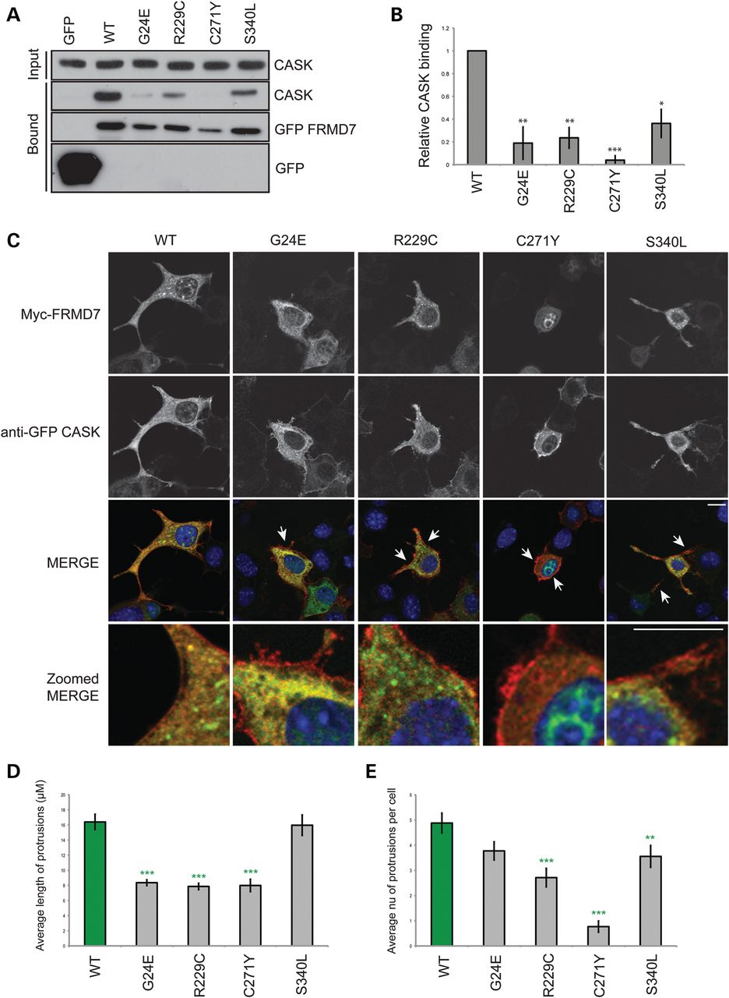
Figure 7. IIN associated mutations disrupt the interaction between FRMD7 and CASK. (A) Neuro2A cells were transiently ...
Notes:
Figure 7. IIN associated mutations disrupt the interaction between FRMD7 and CASK. (A) Neuro2A cells were transiently transfected with GFP-tagged WT FRMD7 or IIN-associated mutants (G24E, R229C, C271Y and S340L). Twenty-four hours post-transfection, GFP-Trap A beads were used to precipitate the GFP-tagged proteins and co-precipitating CASK was detected by immunoblotting, (B) Binding of CASK to each mutant was quantified by densitometry with respect to the amount of each FRMD7 mutant precipitated and is expressed relative to the value obtained for WT FRMD7. The average of three experiments is shown ±S.E. *P<0.05; **P<0.01; ***P<0.001. (C) Neuro2A cells were seeded onto coverslips and transiently co-transfected with GFP-CASK and either WT myc-FRMD7 or IIN mutants and then fixed in methanol. Immunofluorescence microscopy was performed and transfected proteins detected using anti-myc (green) and anti-GFP (red) antibodies. Chromatin was visualized with DAPI (blue). Arrows highlight areas in the membrane in which CASK and FRMD7 fail to co-localize. Representative images from three experiments are shown. Scale bar, 10 µm. (D and E) Coverslips from (C) were analyzed using a TE300 Nikon semi-automatic microscope. Average lengths (D) and number of protrusions per cell (E) were calculated from a minimum of 43 cells. The average of three experiments is shown ±S.E. ***P<0.001; **P<0.001. Green asterisks indicate significance compared with wild-type (WT) FRMD7.
Unless provided in the caption above, the following copyright applies to the content of this slide: © The Author 2013. Published by Oxford University Press.This is an Open Access article distributed under the terms of the Creative Commons Attribution License (http://creativecommons.org/licenses/by-nc/3.0/), which permits non-commercial use, distribution, and reproduction in any medium, provided the original work is properly cited. For commercial re-use, please contact journals.permission@oup.com

Slide 8
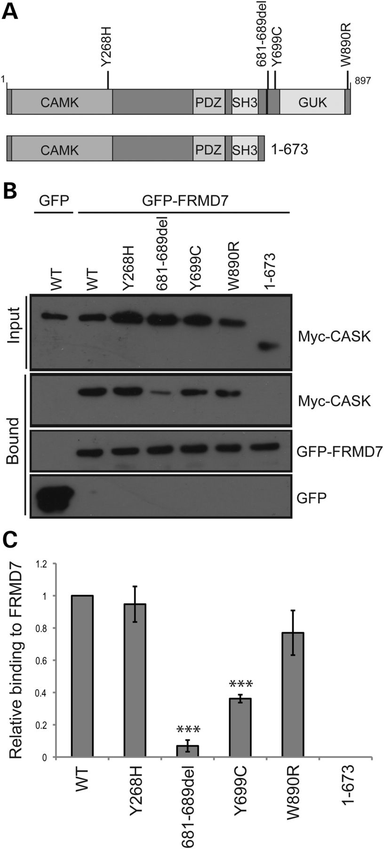
Figure 8. CASK mutants associated with XLMR and nystagmus disrupt the interaction between FRMD7 and CASK. (A) Schematic ...
Notes:
Figure 8. CASK mutants associated with XLMR and nystagmus disrupt the interaction between FRMD7 and CASK. (A) Schematic representation of the domain organization of CASK and deletion mutant 1-673. CAMK, calmodulin kinase-like domain; GUK, guanylate kinase domain. Black bar indicates the hook domain. The mutants used in the study are indicated. Sequences are based on the CASK isoform that encodes 897 residues (ENST00000421587) and lacks residues 340–345 and 580–602 compared with the 926-residue isoform reported by Hackett et al. (8). (B) Neuro2A cells were transiently co-transfected with GFP-tagged WT FRMD7 and myc-tagged WT or mutant CASK. Twenty-four hours post-transfection, GFP-Trap A beads were used to precipitate the GFP-FRMD7 and co-precipitating CASK was detected by immunoblotting. (C) Binding of WT and mutant CASK to FRMD7 was quantified by densitometry with respect to CASK input and bound FRMD7 and is expressed relative to the value obtained for wild-type CASK. The average of three experiments is shown ±S.E. ***P<0.001.
Unless provided in the caption above, the following copyright applies to the content of this slide: © The Author 2013. Published by Oxford University Press.This is an Open Access article distributed under the terms of the Creative Commons Attribution License (http://creativecommons.org/licenses/by-nc/3.0/), which permits non-commercial use, distribution, and reproduction in any medium, provided the original work is properly cited. For commercial re-use, please contact journals.permission@oup.com

