Slide 1
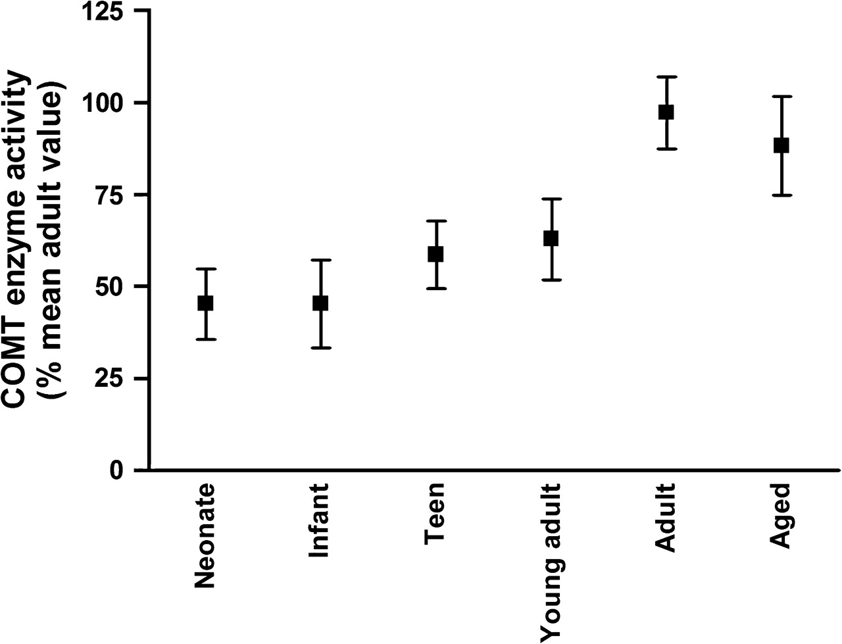
Figure 1. COMT enzyme activity in dorsolateral PFC across human postnatal development. There is a significant increase ...
Notes:
Figure 1. COMT enzyme activity in dorsolateral PFC across human postnatal development. There is a significant increase in COMT enzyme activity (expressed as a percentage of mean adult values) in the PFC during human postnatal development. COMT enzyme activity does not peak until adulthood, at which point it is significantly greater than in all other groups, except aged individuals (see Table 2).
Unless provided in the caption above, the following copyright applies to the content of this slide: Published by Oxford University Press 2006.

Slide 2
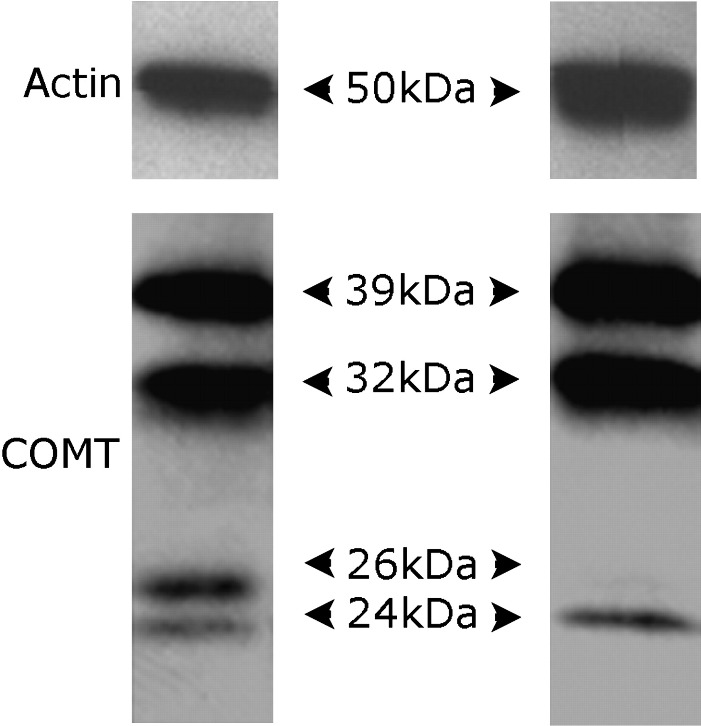
Figure 2. Examples of COMT and actin immunoblots in 2 different subjects. Immunoblotting with an anti-COMT antibody ...
Notes:
Figure 2. Examples of COMT and actin immunoblots in 2 different subjects. Immunoblotting with an anti-COMT antibody produced 4 major bands at 39, 32, 26, and 24 kDa (see left-hand panel). The 26-kDa band was not visible in some individuals (see example in right-hand panel). Immunoblotting with an antiactin antibody produced a single band at 50 kDa, the predicted size of β-actin.
Unless provided in the caption above, the following copyright applies to the content of this slide: Published by Oxford University Press 2006.

Slide 3
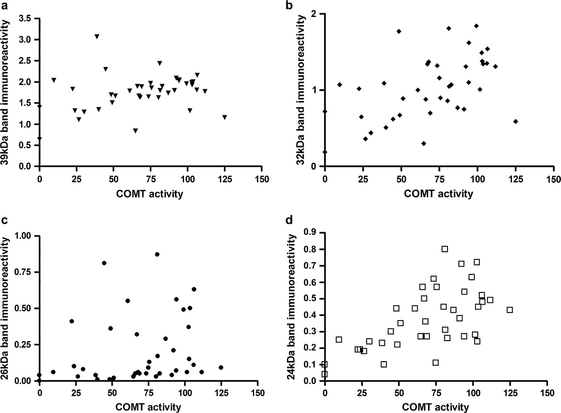
Figure 3. Correlations between COMT immunoreactive bands and COMT enzyme activity (expressed as % mean adult values). ...
Notes:
Figure 3. Correlations between COMT immunoreactive bands and COMT enzyme activity (expressed as % mean adult values). (a) There was a trend level positive correlation between 39-kDa band immunoreactivity and COMT enzyme activity (r = 0.28; P < 0.1). (b) There was a significant positive correlation between immunoreactivity of the 32-kDa band and COMT enzyme activity (r = 0.51; P < 0.001). (c) There was no significant correlation between 26-kDa band immunoreactivity and COMT enzyme activity (r = 0.21). (d) There was a significant positive correlation between 24-kDa band immunoreactivity and COMT enzyme activity (r = 0.61; P < 0.001).
Unless provided in the caption above, the following copyright applies to the content of this slide: Published by Oxford University Press 2006.

Slide 4
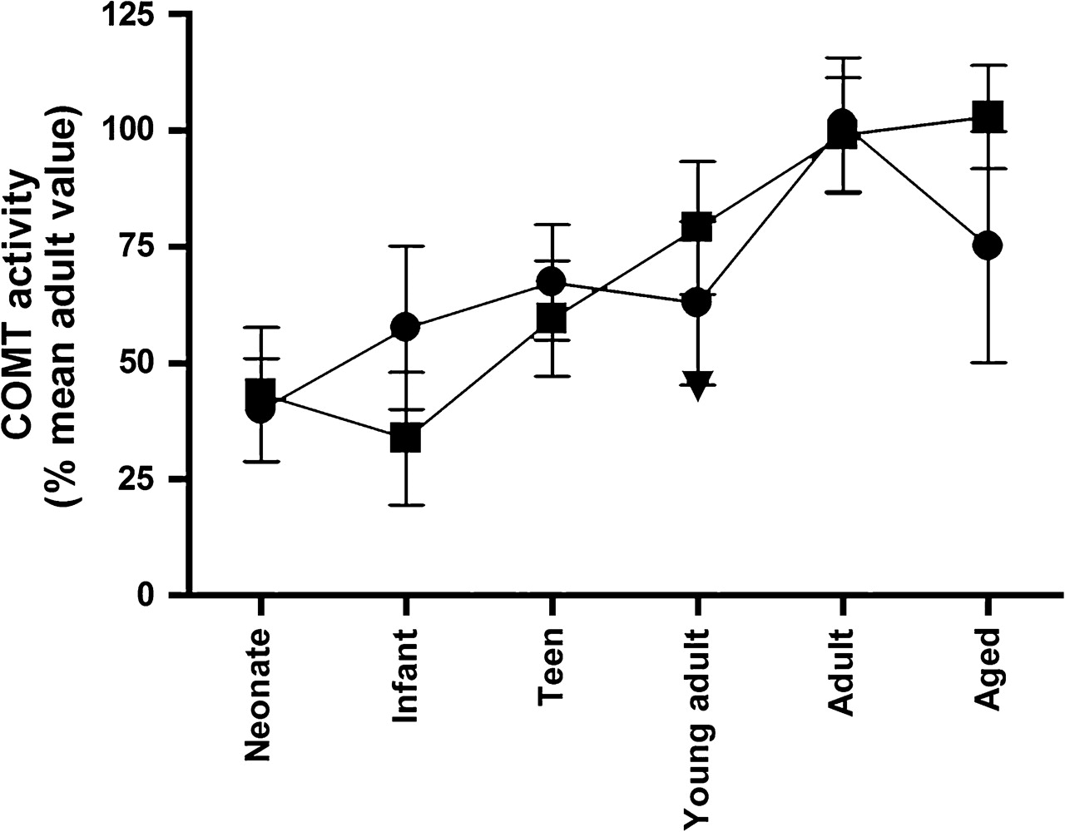
Figure 4. COMT enzyme activity increases in dorsolateral PFC during human postnatal development in both ...
Notes:
Figure 4. COMT enzyme activity increases in dorsolateral PFC during human postnatal development in both Val158Met genotype groups. COMT enzyme activity (expressed as a percentage of the mean adult value) increased with age in both Val/Val (indicated with squares) and Val/Met (indicated with circles) genotype groups. The single Met/Met individual is indicated with a triangle (young adult group).
Unless provided in the caption above, the following copyright applies to the content of this slide: Published by Oxford University Press 2006.

