Slide 1
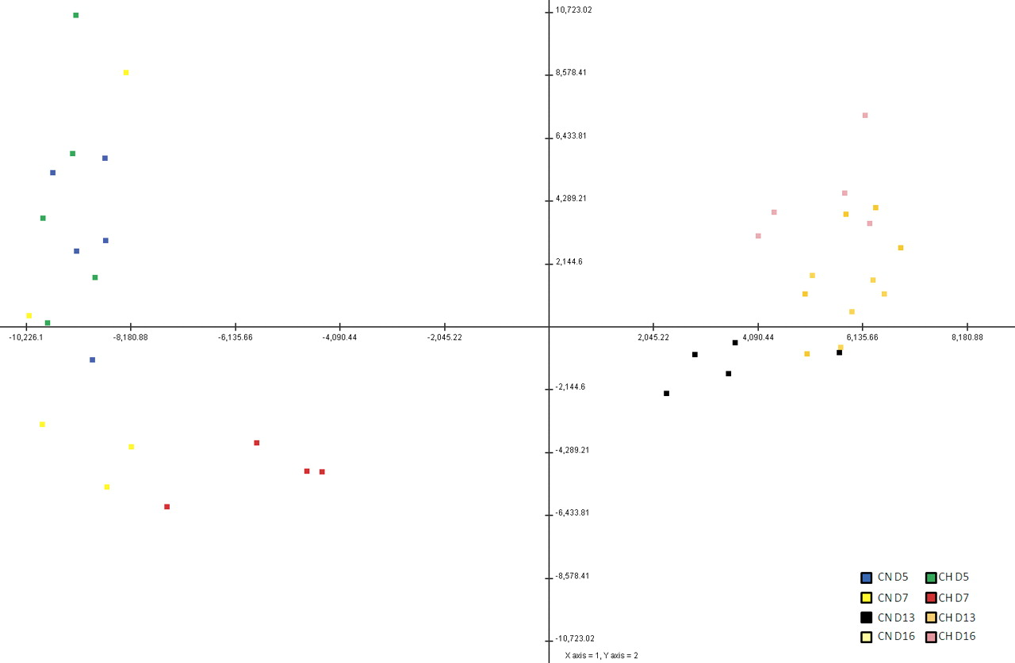
Fig. 1 Principal component analysis (PCA) plot indicating the source of greatest variation in the overall ...
Notes:
Fig. 1 Principal component analysis (PCA) plot indicating the source of greatest variation in the overall transcriptional profile of all 40 cyclic endometrial samples. Samples recovered from cyclic endometria on Days 5 and 7 cluster together, and samples recovered from endometria on Days 13 and 16 of the estrous cycle cluster together, indicating the source of greatest variation in endometrial gene expression is time.
Unless provided in the caption above, the following copyright applies to the content of this slide: © 2011 by the Society for the Study of Reproduction, Inc.

Slide 2
Fig. 2 Numbers of DEGs that were temporally regulated in the endometrium of cyclic beef heifers with normal (CN) or ...
Notes:
Fig. 2 Numbers of DEGs that were temporally regulated in the endometrium of cyclic beef heifers with normal (CN) or high (CH) concentrations of circulating P4. Numbers indicate the number of different genes for each comparison. Venn diagrams indicate the number of common and unique genes that change across time between treatments.
Unless provided in the caption above, the following copyright applies to the content of this slide: © 2011 by the Society for the Study of Reproduction, Inc.

Slide 3
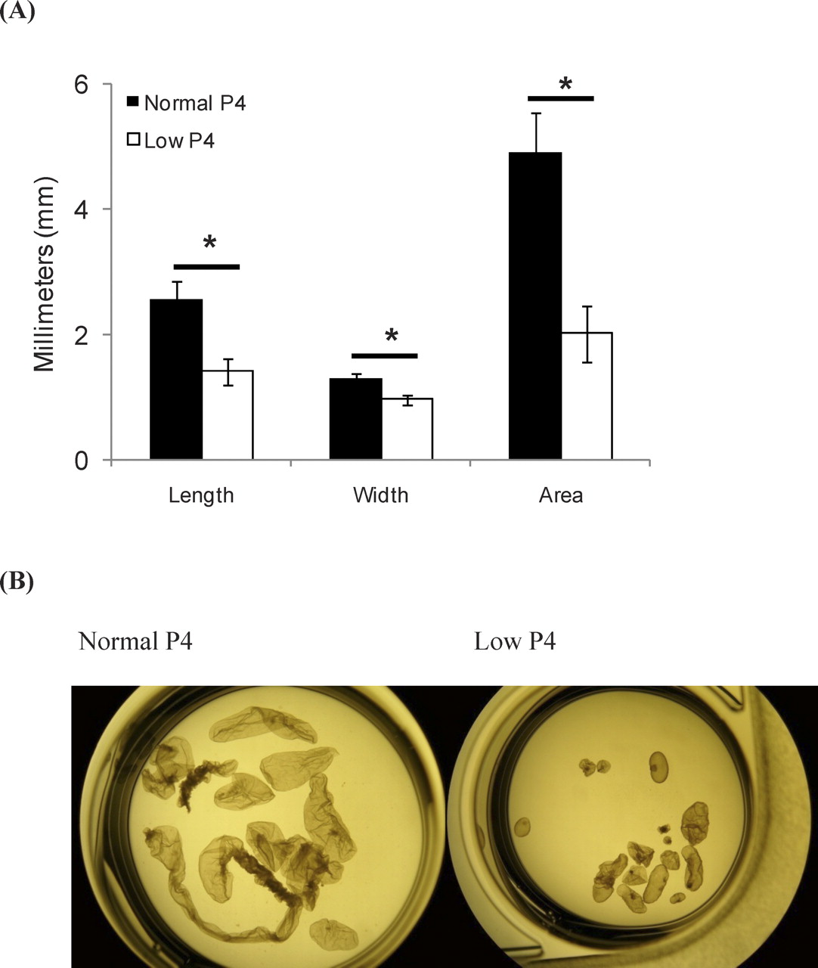
Fig. 11 Mean ± SEM Day-14 embryo dimensions (A) and representative images of Day-14 elongating embryos (B) following ...
Notes:
Fig. 11 Mean ± SEM Day-14 embryo dimensions (A) and representative images of Day-14 elongating embryos (B) following transfer of Day-7 blastocysts to synchronized recipient heifers with normal or low circulating P4 and recovery at slaughter on Day 14. Original magnification ×4. *Significant difference in embryos recovered from normal compared to low P4 recipients (P < 0.05).
Unless provided in the caption above, the following copyright applies to the content of this slide: © 2011 by the Society for the Study of Reproduction, Inc.

Slide 4
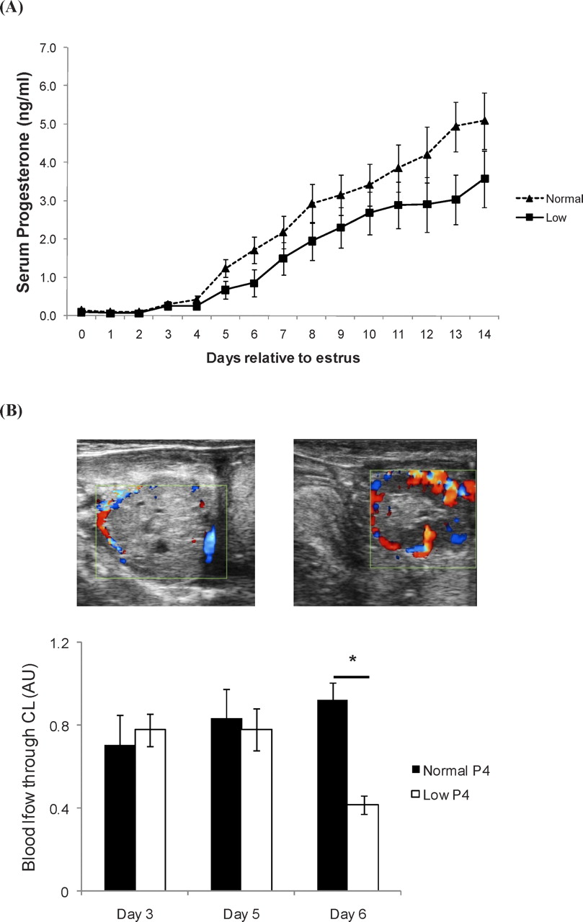
Fig. 10 A) Mean serum P4 concentrations ± SEM (ng/ml) in control heifers (n = 9) and those administered PGF2α on Days ...
Notes:
Fig. 10 A) Mean serum P4 concentrations ± SEM (ng/ml) in control heifers (n = 9) and those administered PGF2α on Days 3, 3.5, and 4 postestrus (n = 11) to induce low P4. Treatment with PGF2α resulted in a significant decrease in P4 concentrations in treated animals from Day 5 (24 h after last PGF2α injection) until slaughter on Day 14, indicated by an asterisk (*P > 0.05). B) Blood flow intensity and representative images through a CL on Day 6 of the estrous cycle in a heifer induced to have low P4 (left) compared with a control heifer (right), as measured by color Doppler ultrasound.
Unless provided in the caption above, the following copyright applies to the content of this slide: © 2011 by the Society for the Study of Reproduction, Inc.

Slide 5
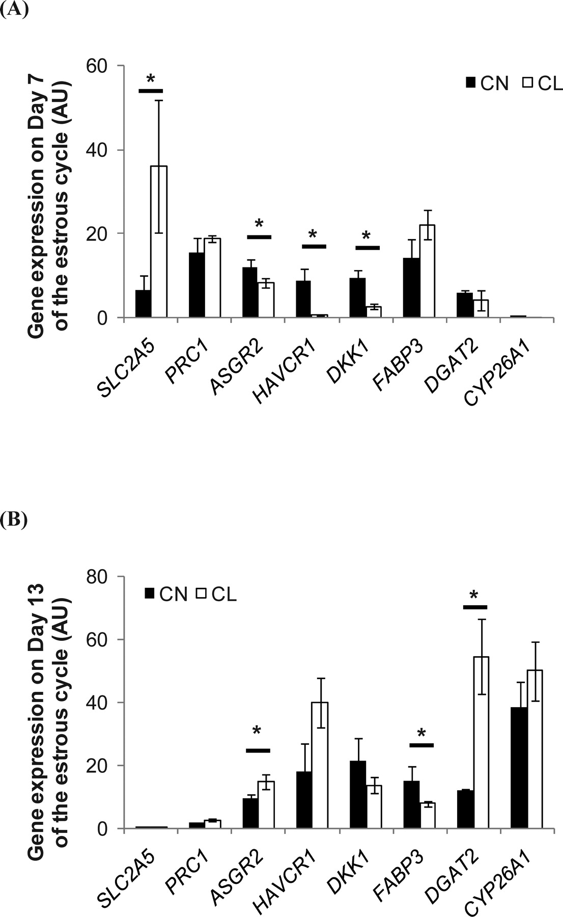
Fig. 6 Q-RT-PCR analysis of eight candidate genes identified from Experiment 1 in the endometrium of cyclic beef ...
Notes:
Fig. 6 Q-RT-PCR analysis of eight candidate genes identified from Experiment 1 in the endometrium of cyclic beef heifers with normal (CN, black bars) or low (CL, open bars) concentrations of circulating P4 on Day 7 (A) and Day 13 (B) of the estrous cycle. *Significant difference (P > 0.05).
Unless provided in the caption above, the following copyright applies to the content of this slide: © 2011 by the Society for the Study of Reproduction, Inc.

Slide 6
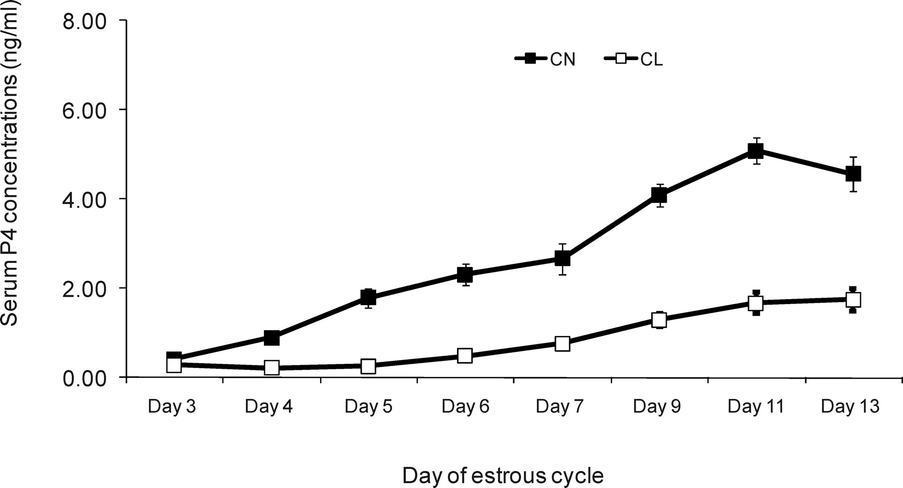
Fig. 5 P4 profiles for control heifers with normal circulating P4 (CN) and those induced to have low P4 by repeated ...
Notes:
Fig. 5 P4 profiles for control heifers with normal circulating P4 (CN) and those induced to have low P4 by repeated administration of PGF2α (CL) (Experiment 2).
Unless provided in the caption above, the following copyright applies to the content of this slide: © 2011 by the Society for the Study of Reproduction, Inc.

Slide 7
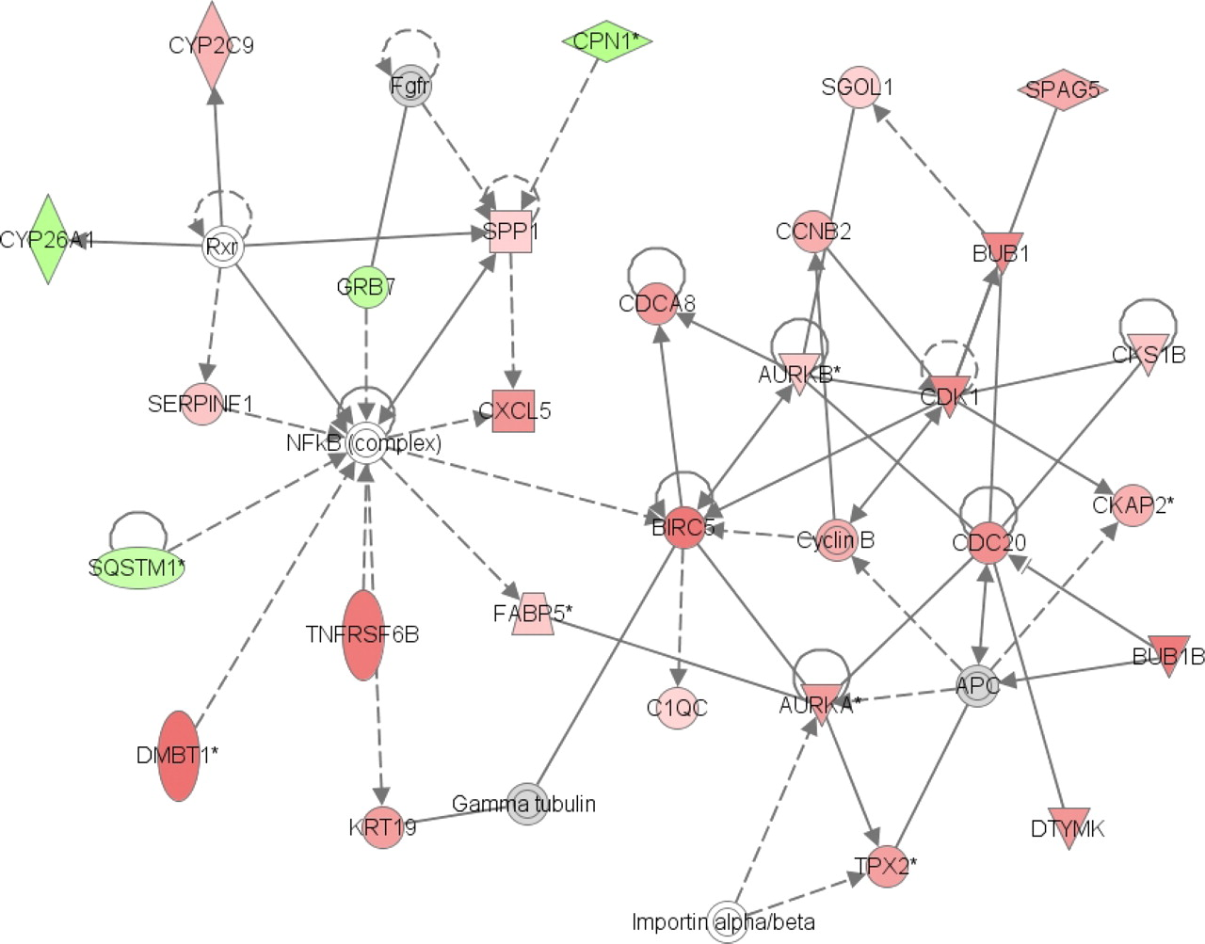
Fig. 4 Graphical representation of an ingenuity pathway interaction network analysis generated from the DEGs between ...
Notes:
Fig. 4 Graphical representation of an ingenuity pathway interaction network analysis generated from the DEGs between Days 5 and 7 of the estrous cycle in heifers with high P4. These DEGs were involved in cell cycle, cancer, and genetic disorder are displayed as colored shapes. The gray nodes are indicative of protein complexes and/or nonspecified members of a gene family that are important components of the interaction network, but are not DEGs. The network displays nodes (genes/gene products) and edges (the biological relationship between nodes). The color intensity of the nodes indicates the fold change (increase [red] or decrease [green]) associated with a particular gene on Day 7 compared with Day 5. A solid line indicates a direct interaction between nodes (genes/gene products), and a dashed line indicates an indirect relationship between nodes. The shape of the node is indicative of its function (see Supplemental Key, available online).
Unless provided in the caption above, the following copyright applies to the content of this slide: © 2011 by the Society for the Study of Reproduction, Inc.

Slide 8
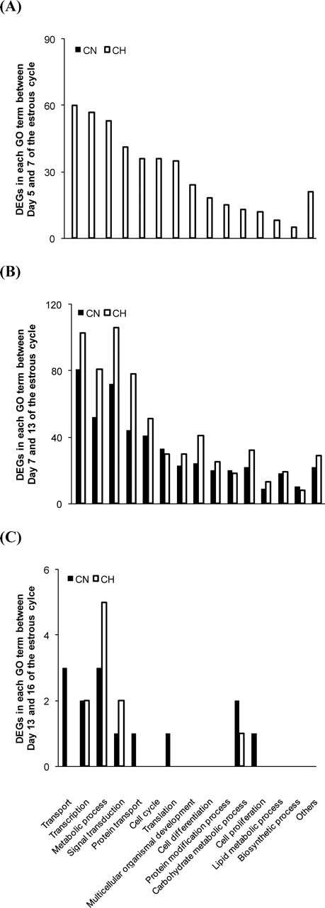
Fig. 3 Bar graph representing GO slim terms and numbers of DEGs associated with each term between Days 5 and 7 (A), ...
Notes:
Fig. 3 Bar graph representing GO slim terms and numbers of DEGs associated with each term between Days 5 and 7 (A), Days 7 and 13 (B), and Days 13 and 16 (C) in the endometrium of cyclic beef heifers with normal (CN, black bars) or high (CH, open bars) concentrations of circulating P4. GO slim terms are only included when five or more genes are associated with the term in at least one category.
Unless provided in the caption above, the following copyright applies to the content of this slide: © 2011 by the Society for the Study of Reproduction, Inc.

Slide 9
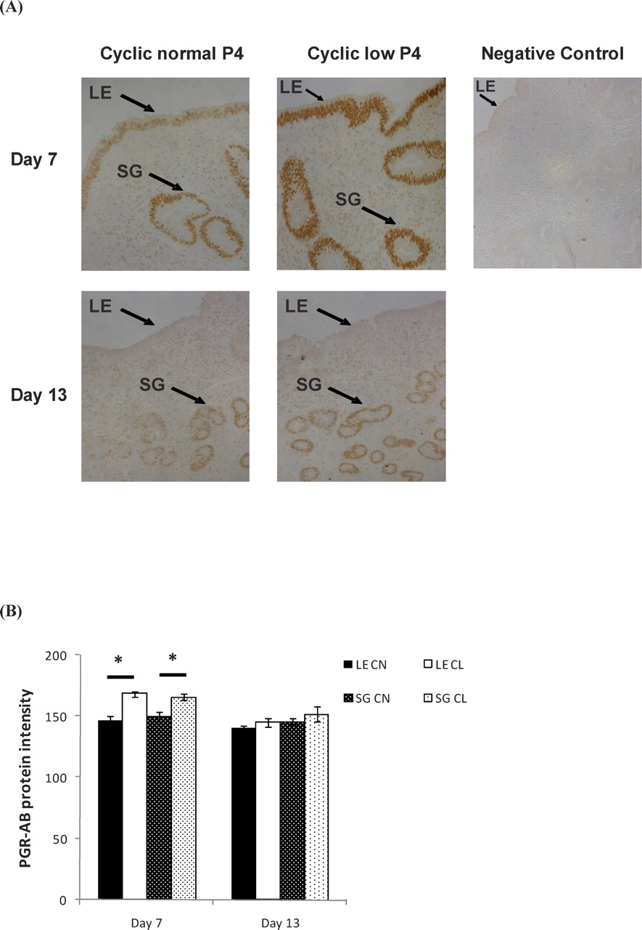
Fig. 9 A) Representative images depicting the localization of PGR-AB protein in the LE, SGs, and STR of the bovine ...
Notes:
Fig. 9 A) Representative images depicting the localization of PGR-AB protein in the LE, SGs, and STR of the bovine endometrium on Days 7 and 13 of the estrous cycle of heifers with normal (CN) or low (CL) P4. Original magnification ×10. B) Graphical representation of the intensity of PGR-AB protein isoform localized within the LE or SG in uterine cross sections of cyclic heifers with normal (CN, black bars) or low (CL, open bars) P4 on Days 7 and 13 of the estrous cycle. *Significant difference in protein intensities between P4 treatments (P < 0.05).
Unless provided in the caption above, the following copyright applies to the content of this slide: © 2011 by the Society for the Study of Reproduction, Inc.

Slide 10
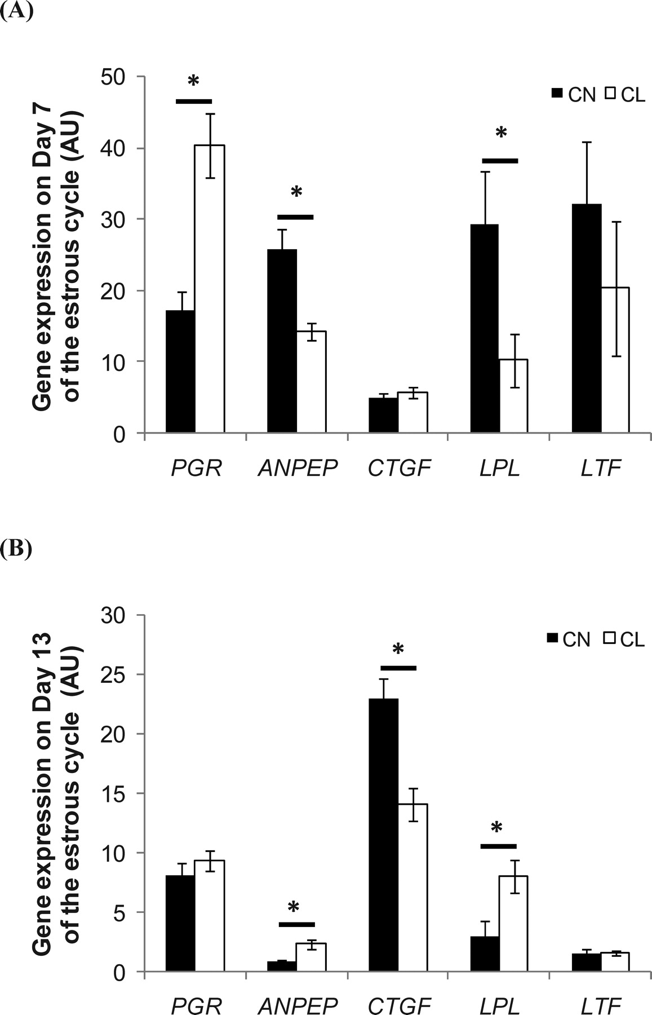
Fig. 8 Q-RT-PCR analysis of five candidate genes, the expression of which has been shown previously to be important ...
Notes:
Fig. 8 Q-RT-PCR analysis of five candidate genes, the expression of which has been shown previously to be important in an optimal uterine environment [18, 19], in the endometrium of cyclic beef heifers with normal (CN, black bars) or low (CL, open bars) concentrations of circulating P4 on Day 7 (A) and Day 13 (B) of the estrous cycle. *Significant difference (P > 0.05).
Unless provided in the caption above, the following copyright applies to the content of this slide: © 2011 by the Society for the Study of Reproduction, Inc.

Slide 11
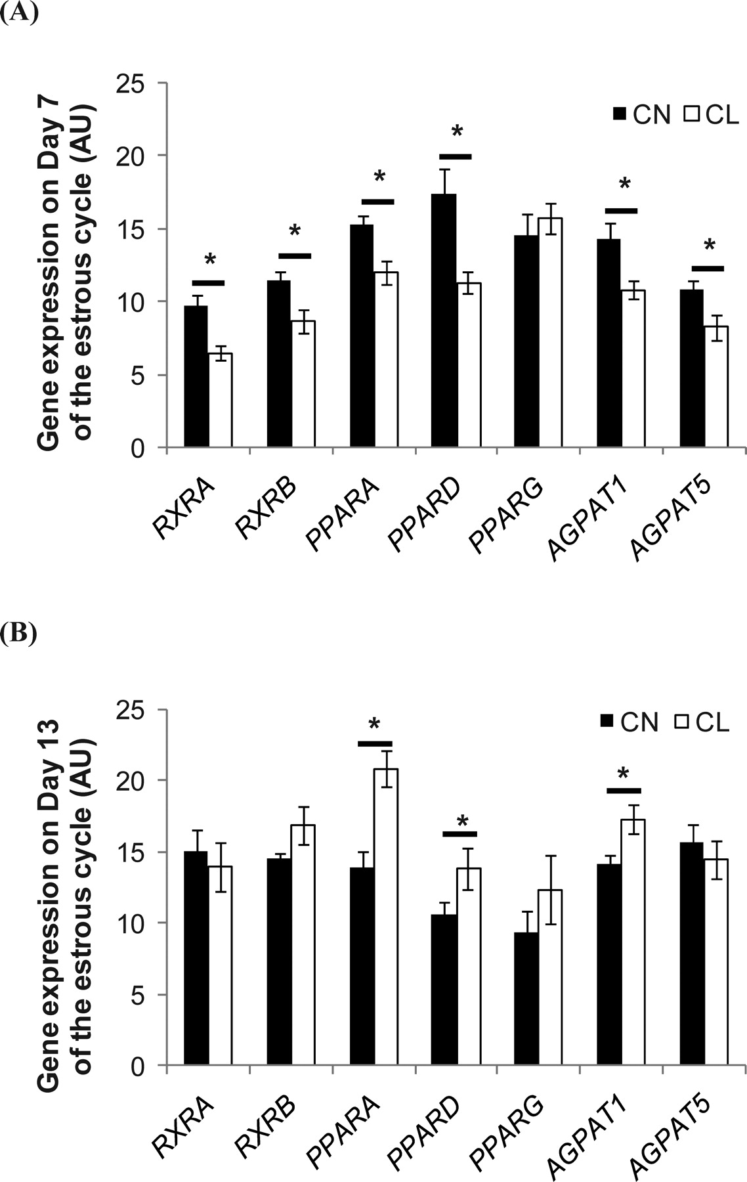
Fig. 7 Q-RT-PCR analysis of seven candidate genes involved in the DGAT2 and FABP3 pathways in the endometrium of ...
Notes:
Fig. 7 Q-RT-PCR analysis of seven candidate genes involved in the DGAT2 and FABP3 pathways in the endometrium of cyclic beef heifers with normal (CN, black bars) or low (CL, open bars) concentrations of circulating P4 on Day 7 (A) and Day 13 (B) of the estrous cycle. *Significant difference (P > 0.05).
Unless provided in the caption above, the following copyright applies to the content of this slide: © 2011 by the Society for the Study of Reproduction, Inc.

