Slide 1
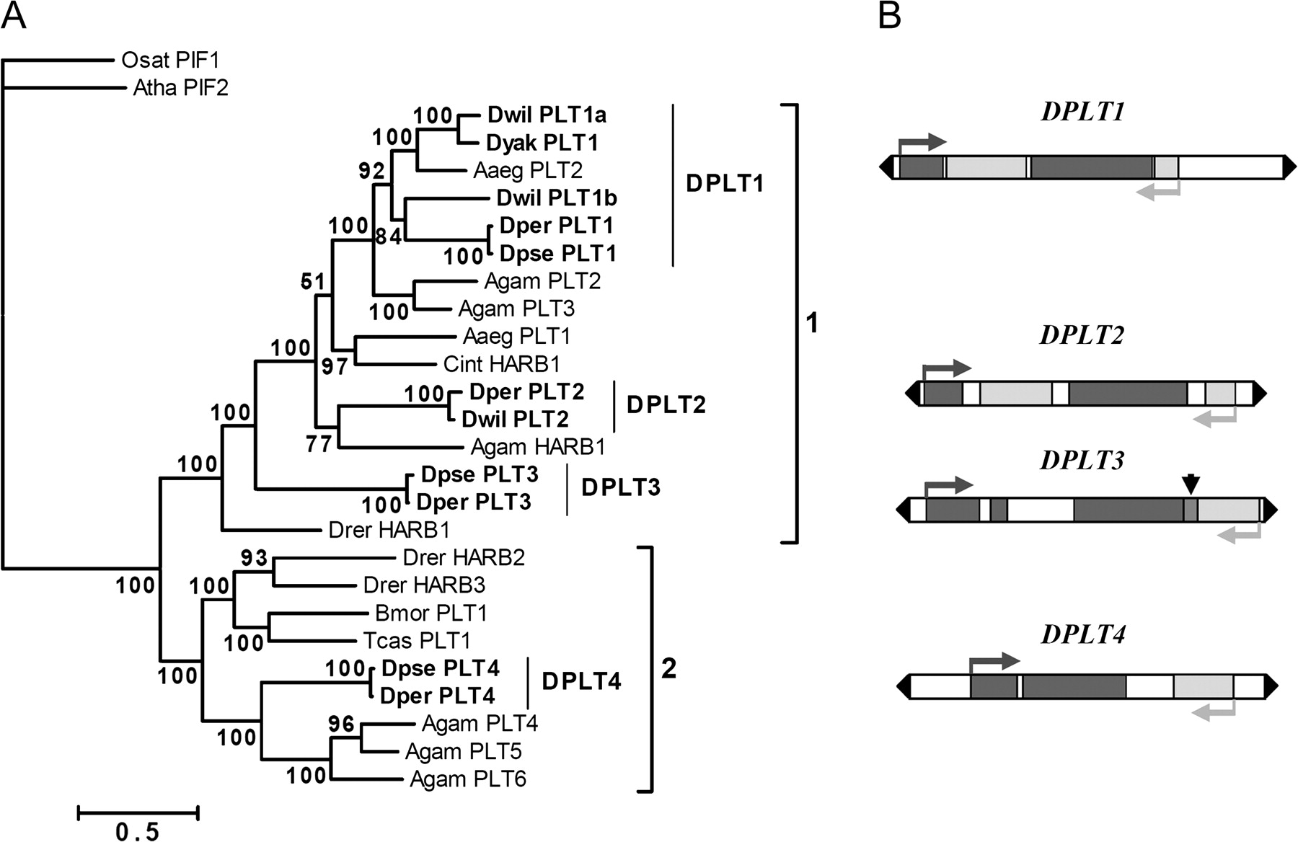
FIG. 1.— Phylogenetic relationships and structures of Drosophila PIF-like transposons. (A) Phylogenetic tree of ...
Notes:
FIG. 1.— Phylogenetic relationships and structures of Drosophila PIF-like transposons. (A) Phylogenetic tree of PIF-like transposons based on the multialignment of 223 best aligneable residues of their transposases. The tree has been inferred using MrBayes as described in Materials and Methods. Numbers in the nodes represent the posterior probability. The brackets include the two clades of protostome/deuterostome PIFtransposons. The name HARB (Harbinger) has been maintained for PIF-like transposons deposited in Repbase. New lineages found in Drosophila and other insects are named PLT and progressively numbered. Drosophila PIF-like transposons are in bold and their different lineages (DPLT1-4) are reported. HARB: Harbinger. Aaeg: Aedes aegypti; Agam: Anopheles gambiae; Bmor: Bombyx mori; Cint: Ciona intestinalis; Drer: Danio rerio; Tcas: Tribolium castaneum. Osat_PIF1 and Atha_PIF2 are plant PIF transposases used as outgroup, encoded by Oryza sativa and Arabidopsis thaliana elements, respectively. (B) Schematic representation of DPLTs structure. TPase exons and PIFp2 exons are in dark and light gray, respectively. Arrows of the same gray shading highlight the orientation of TPase and PIFp2 genes. The overlapping region of TPase third exon and PIFp2 exon in DPLT3 is pointed by the black arrowhead. TIRs are reported as black triangles.
Unless provided in the caption above, the following copyright applies to the content of this slide: © The Author 2007. Published by Oxford University Press on behalf of the Society for Molecular Biology and Evolution. All rights reserved. For permissions, please e-mail: journals.permissions@oxfordjournals.org

Slide 2
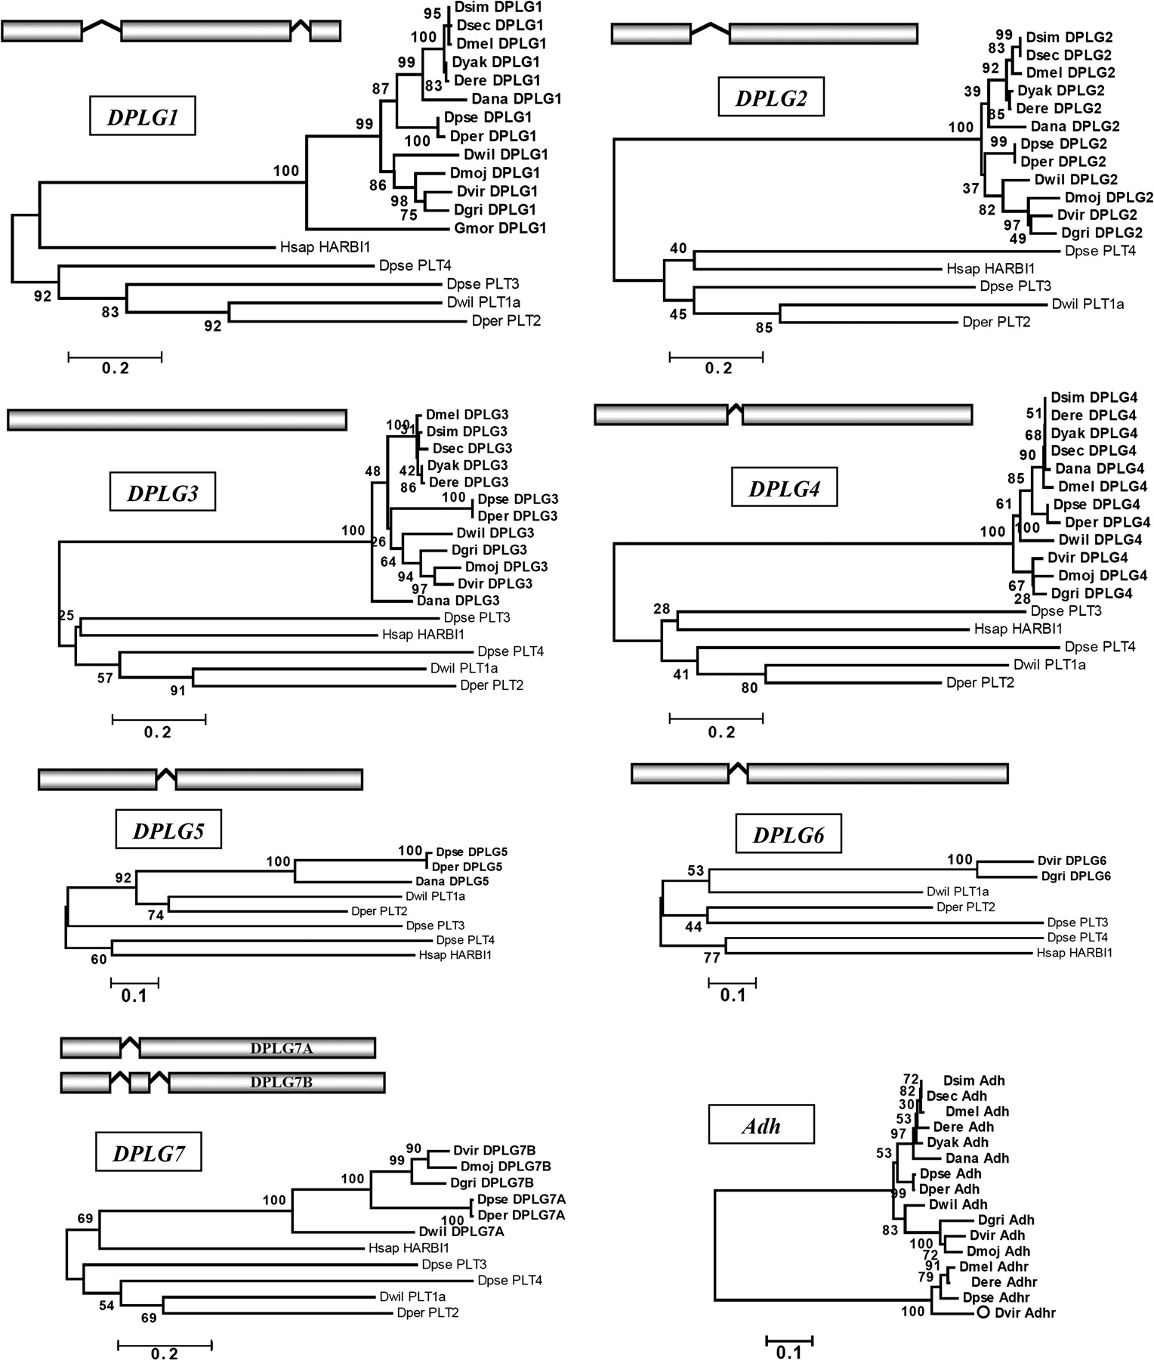
FIG. 3.— Phylogenetic tree and the gene structure of each DPLG gene family with transposases from the four DPLT ...
Notes:
FIG. 3.— Phylogenetic tree and the gene structure of each DPLG gene family with transposases from the four DPLT lineages and the human protein HARBI1. The multialignment of the proteins have been created using the L-INS-i algorithm of the MAFFT package, and edited to remove regions poorly conserved and gaps, giving a final alignment of about 200–250 residues. The phylogeny of Adh orthologs from the twelve Drosophila species is shown at the bottom right corner, together with four Adhr genes as outgroups. Each tree has been built using the neighbor-joining method implemented in the MEGA3.1 software package. Numbers on the nodes show bootstrap values after 1000 replicates. Exons are represented by bars, introns by the symbol “ ”. Abbreviations as in table 1, figure 1 and 2, except: Hsap_HARBI1: Homo sapiens protein encoded by the HARBI1gene. The trees are drawn to scale.
Unless provided in the caption above, the following copyright applies to the content of this slide: © The Author 2007. Published by Oxford University Press on behalf of the Society for Molecular Biology and Evolution. All rights reserved. For permissions, please e-mail: journals.permissions@oxfordjournals.org

Slide 3
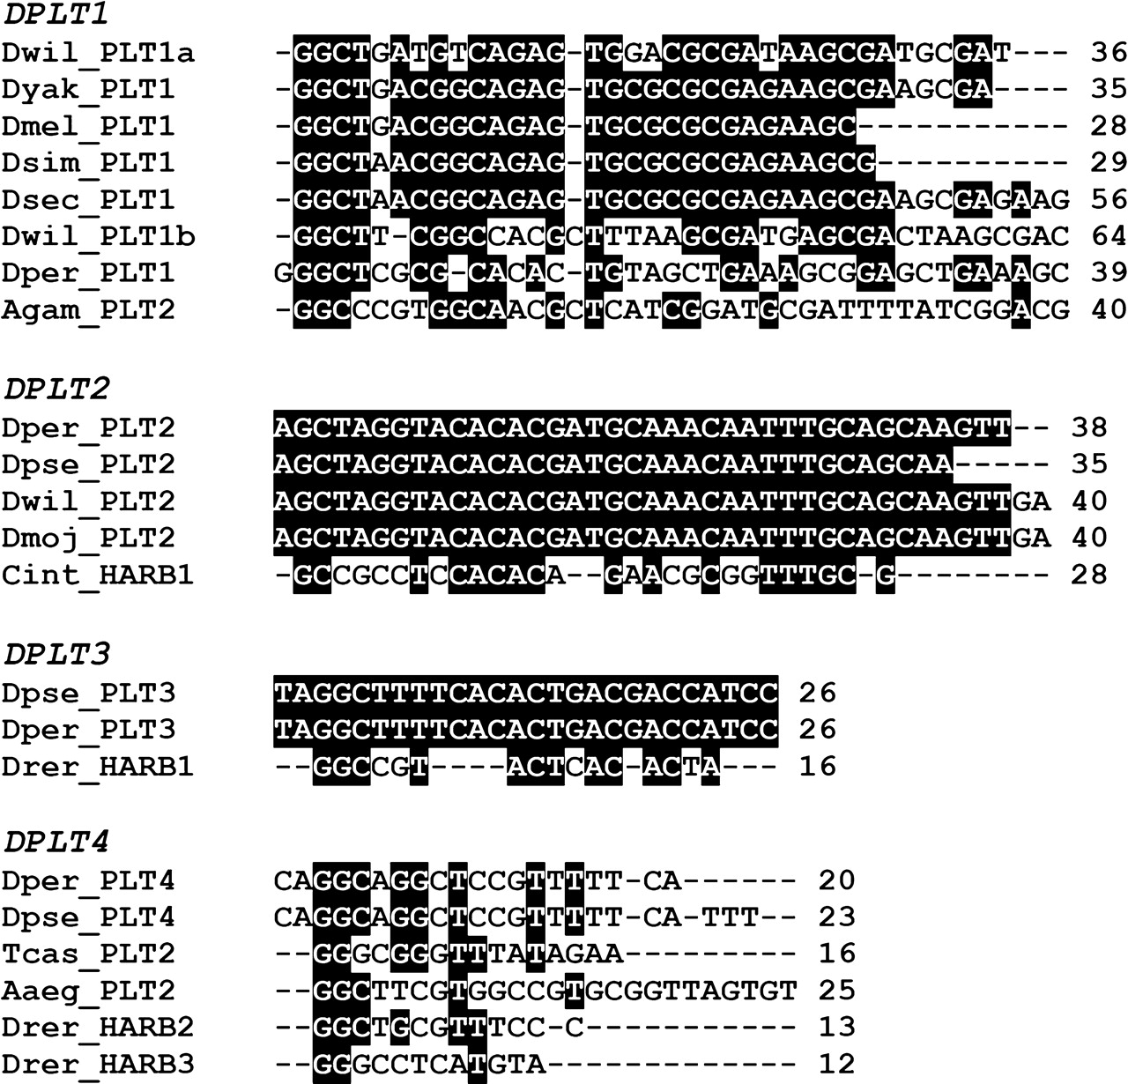
FIG. 2.— Terminal inverted repeats sequence of DPLT1-4 transposons and related elements. Multialignments where ...
Notes:
FIG. 2.— Terminal inverted repeats sequence of DPLT1-4 transposons and related elements. Multialignments where generated using TCoffee and manually edited. Nucleotides conserved in 50% of sequences are black-shaded. For the first Drosophila lineage, the TIRs from three MITEs are also reported. DPLT1 TIRs have been trimmed at their 3′end, numbers indicate the total length of the repeats. Transposon names as in figure 1.
Unless provided in the caption above, the following copyright applies to the content of this slide: © The Author 2007. Published by Oxford University Press on behalf of the Society for Molecular Biology and Evolution. All rights reserved. For permissions, please e-mail: journals.permissions@oxfordjournals.org

Slide 4
FIG. 4.— Microarray data comparison of DPLG1 and DPLG4 expression pattern in different stages of Drosophila life ...
Notes:
FIG. 4.— Microarray data comparison of DPLG1 and DPLG4 expression pattern in different stages of Drosophila life cycle, modified from UCSC Genome Browser (data from Arbeitman et al. 2002). Red and green bars indicate, respectively, higher and lower abundance of the DPLG transcripts compared to a reference sample, as described in Arbeitman et al. (2002). Adult expression in females (F) and males (M) is reported.
Unless provided in the caption above, the following copyright applies to the content of this slide: © The Author 2007. Published by Oxford University Press on behalf of the Society for Molecular Biology and Evolution. All rights reserved. For permissions, please e-mail: journals.permissions@oxfordjournals.org

Slide 5
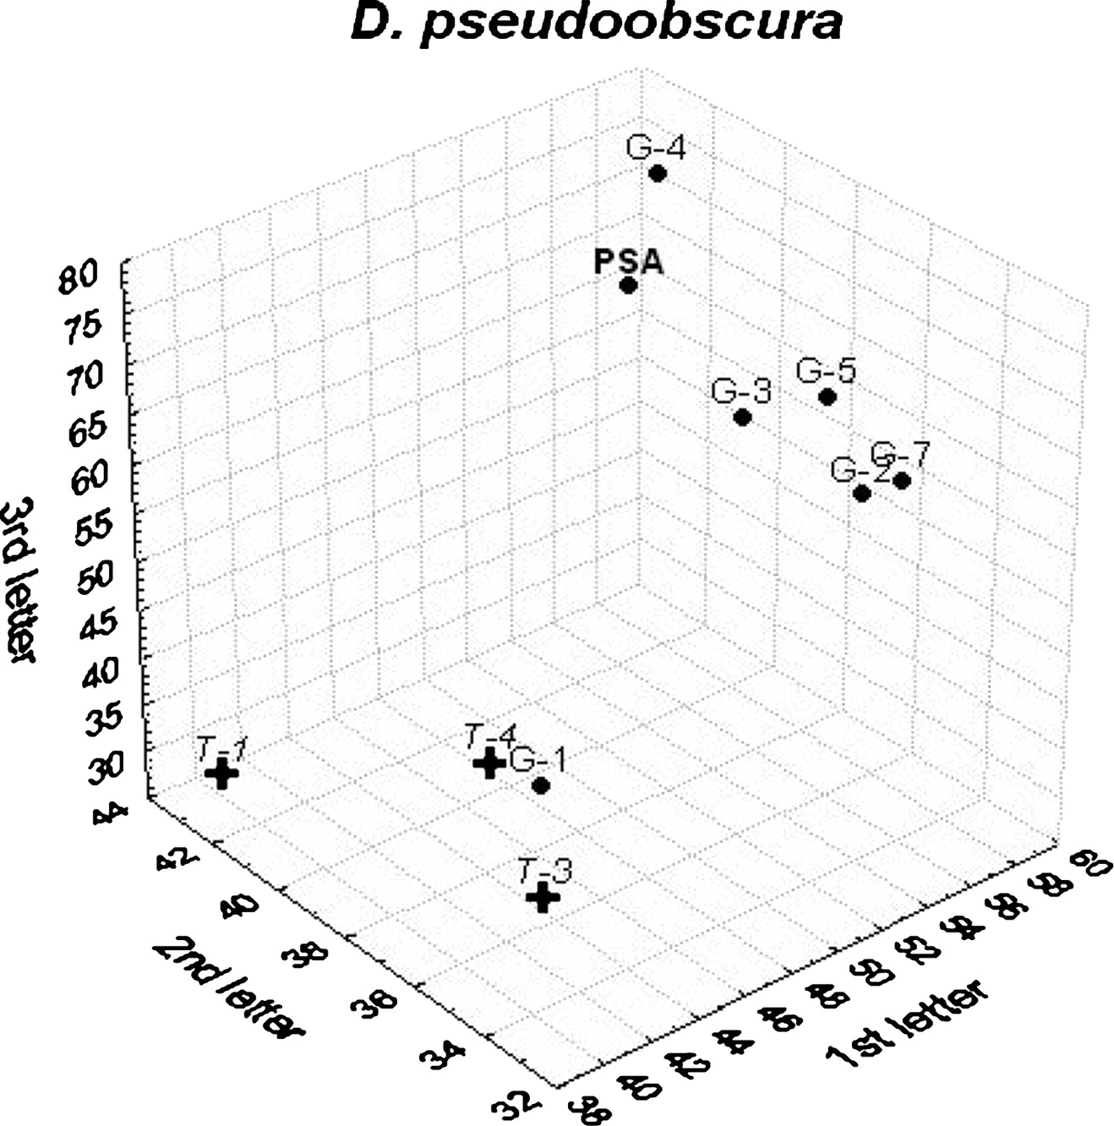
FIG. 5.— Representation of the GC values of D. pseudoobscuraspecific gene pool average (PSA), DPLGs (dots, G-1 through ...
Notes:
FIG. 5.— Representation of the GC values of D. pseudoobscuraspecific gene pool average (PSA), DPLGs (dots, G-1 through G-5, and G-7), and DPLTs (crosses, TPase genes T-1, T-3and T-4). Consensus sequences of DPLT TPase genes have been used; very similar distributions were observed plotting single transposons.
Unless provided in the caption above, the following copyright applies to the content of this slide: © The Author 2007. Published by Oxford University Press on behalf of the Society for Molecular Biology and Evolution. All rights reserved. For permissions, please e-mail: journals.permissions@oxfordjournals.org

Slide 6
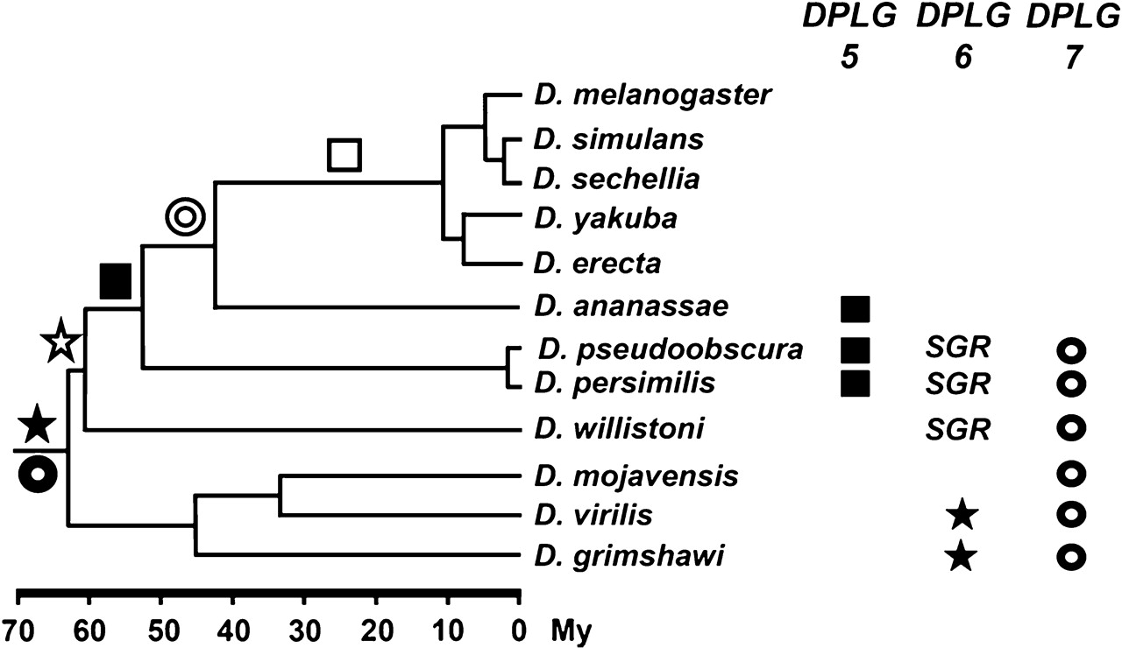
FIG. 6.— Distribution and evolutionary pathway of the three genes DPLG5-7 in Drosophila. Filled symbols on the ...
Notes:
FIG. 6.— Distribution and evolutionary pathway of the three genes DPLG5-7 in Drosophila. Filled symbols on the phylogenetic tree represent gene domestication, open symbols indicate gene loss. SGR: syntenic gene relic.
Unless provided in the caption above, the following copyright applies to the content of this slide: © The Author 2007. Published by Oxford University Press on behalf of the Society for Molecular Biology and Evolution. All rights reserved. For permissions, please e-mail: journals.permissions@oxfordjournals.org

Slide 7
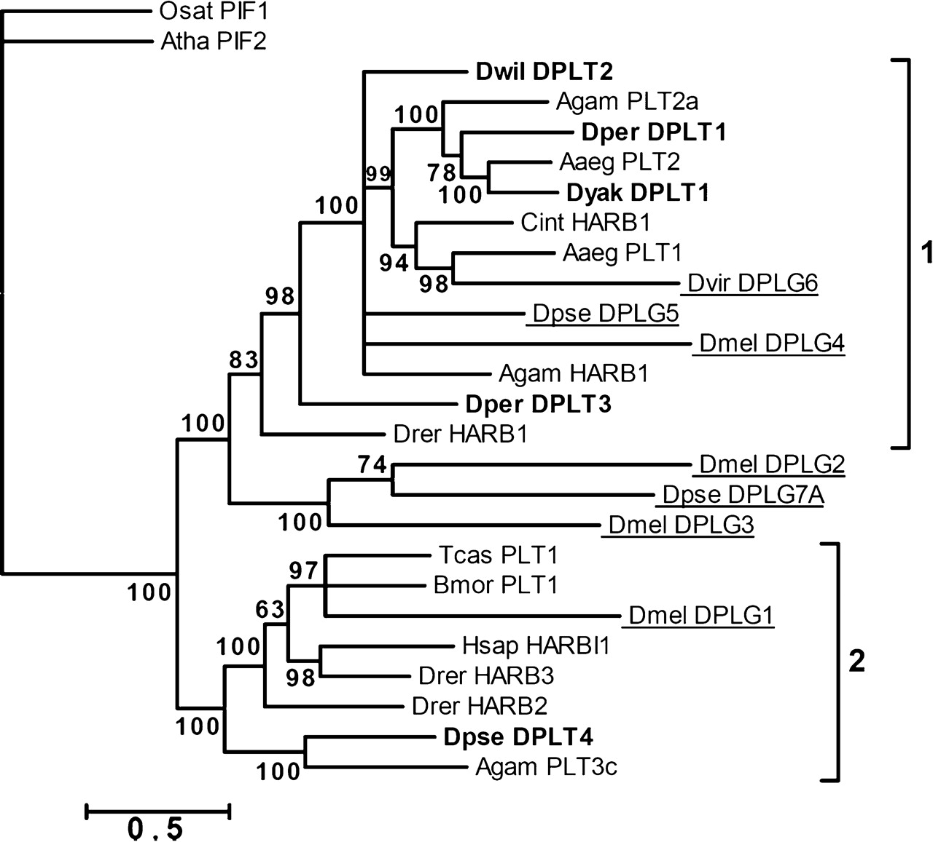
FIG. 7.— Phylogenetic tree of PIF-like transposases and DPLG proteins. The multialignment has been created using the ...
Notes:
FIG. 7.— Phylogenetic tree of PIF-like transposases and DPLG proteins. The multialignment has been created using the MAFFT package, and edited to remove poorly conserved regions; the final alignment comprises 293 residues. The tree has been built using Mr Bayes as described in Materials and Methods. Numbers in the nodes represent the posterior probability. The brackets include the two clades of protostome/deuterostome PIF transposons. DPLG proteins are underlined, DPLT TPases are in bold. Abbreviations as in figure 1 and table 2.
Unless provided in the caption above, the following copyright applies to the content of this slide: © The Author 2007. Published by Oxford University Press on behalf of the Society for Molecular Biology and Evolution. All rights reserved. For permissions, please e-mail: journals.permissions@oxfordjournals.org

Slide 8
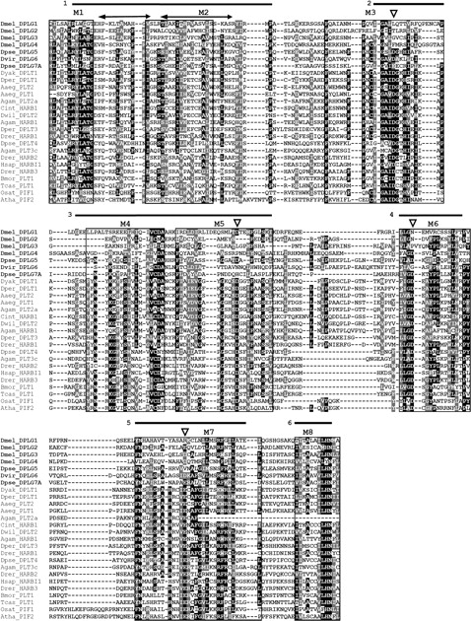
FIG. 8.— MAFFT multialignment of PIF-like transposases, DPLGs (names in boldface) and HARBI1 proteins. The sequence ...
Notes:
FIG. 8.— MAFFT multialignment of PIF-like transposases, DPLGs (names in boldface) and HARBI1 proteins. The sequence extremities have been trimmed because they are not aligneable. Conserved sites (cut off 50%) are reported: identical residues are in white on black background, similar residues are in white on gray background. The eight conserved motifs M1–M8 of PIF transposases are squared. The black bars show the six motifs identified by Kapitonov and Jurka (2004). The three transposases catalytic residue DDE are indicated by empty triangles, with the first putative catalytic residue located in motif 3 or motif 5. The two helices of the HTH motif are highlighted by double-headed arrows. Abbreviations as in table 1and figure 1.
Unless provided in the caption above, the following copyright applies to the content of this slide: © The Author 2007. Published by Oxford University Press on behalf of the Society for Molecular Biology and Evolution. All rights reserved. For permissions, please e-mail: journals.permissions@oxfordjournals.org

Slide 9
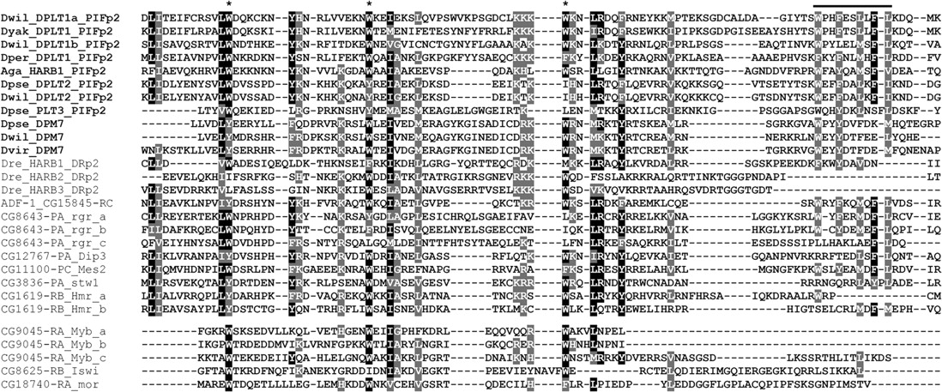
FIG. 9.— Multialignment of the MADF domain from PIFp2/DPM7 proteins and D. melanogaster Dip3, Mes2, stw1 and Hmr ...
Notes:
FIG. 9.— Multialignment of the MADF domain from PIFp2/DPM7 proteins and D. melanogaster Dip3, Mes2, stw1 and Hmr proteins, and Myb/SANT domain from D. melanogaster Myb, Iswi and mor proteins, using the FFT-NS-I method of the MAFFT package. Drosophila and Anopheles PIFp2/DPM7 proteins names are in boldface. Asterisks mark three tryptophane conserved in Myb/SANT/MADF domains. The bar covers the conserved region at the C-terminal of MADF domain that is absent in Myb/SANT domain. Conserved sites (cut off 50%) are reported: identical residues are in white on black background, similar residues are in white on gray background. Abbreviations as in table 1and figure 1.
Unless provided in the caption above, the following copyright applies to the content of this slide: © The Author 2007. Published by Oxford University Press on behalf of the Society for Molecular Biology and Evolution. All rights reserved. For permissions, please e-mail: journals.permissions@oxfordjournals.org

