Slide 1
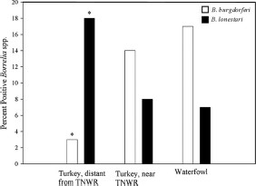
Fig. 4 Comparison of Borrelia spp. Positive samples among three avian groups. The percentages of samples determined ...
Notes:
Fig. 4 Comparison of Borrelia spp. Positive samples among three avian groups. The percentages of samples determined to contain B. burgdorferi are represented by the open bars, whereas B. lonestari samples are indicated by solid bars. *P < 0.001 compared with Borrelia spp. detected among the other bird groups.
Unless provided in the caption above, the following copyright applies to the content of this slide: © 2009 Entomological Society of America

Slide 2
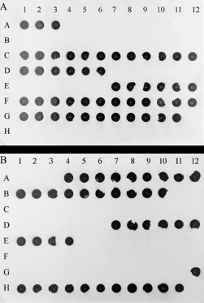
Fig. 3 Dot blot hybridization of Borrelia-specific probes. (A) Hybridized with a probe specific for B. burgdorferi. ...
Notes:
Fig. 3 Dot blot hybridization of Borrelia-specific probes. (A) Hybridized with a probe specific for B. burgdorferi. (B) Hybridized with a B. lonestari–specific probe. A dark dot indicates probe binding. Amplified samples from wild turkeys more distant from theTNWR were placed in wells A1through B10 on each blot. PCR products from wild turkeys collected near the TNWR were placed in positions C1 through E4. Products from migratory birds were located in positions E7 through H11. Wells B11, B12, E5, E6, and H12 were left blank.
Unless provided in the caption above, the following copyright applies to the content of this slide: © 2009 Entomological Society of America

Slide 3
Fig. 1 Location of counties in Tennessee where birds were harvested. Counties where wild turkeys were collected more ...
Notes:
Fig. 1 Location of counties in Tennessee where birds were harvested. Counties where wild turkeys were collected more distant from the TNWR area appear black. The counties in light gray were locations of wild turkey harvests near the TNWR area, indicated by the heavy black lines (running through Stewart County). This turkey population resided in or near the habitat populated with migratory waterfowl. The counties in dark gray indicate locations where migrating waterfowl were collected. (Map template provided by the Center of Excellence for Field Biology, APSU.)
Unless provided in the caption above, the following copyright applies to the content of this slide: © 2009 Entomological Society of America

Slide 4
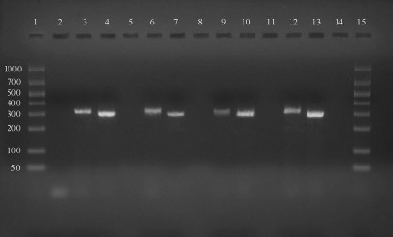
Fig. 2 Gel electrophoresis of nested PCR products. Lanes 1 and 15 contain the DNA ladder, BioMarker Low ...
Notes:
Fig. 2 Gel electrophoresis of nested PCR products. Lanes 1 and 15 contain the DNA ladder, BioMarker Low (BioVentures, Murfreesboro, TN). Standard sizes are 1,000, 700, 525/500, 400, 300, 200, 100, and 50 bp. Lanes 5, 8, 11, and 14 are blank. Lane 2 contains a negative control; lane 3 contains a positive control for B. burgdorferi (expected fragment size, 319 bp), and lane 4 contains a positive control for B. lonestari (expected fragment size, 298 bp). Lanes 6 and 7 contain PCR product samples from migratory waterfowl. Lanes 9 and 10 are samples from wild turkeys residing near the TNWR, and lanes 12 and 13 represent samples from wild turkeys more distant from the refuge. Fragment sizes characteristic of B. burgdorferi were placed in the first lane of each bird set (lanes 6, 9, and 12),whereas samples showing a size corresponding to B. lonestari appear in the second lane of each set (lanes 7, 10, and 13).
Unless provided in the caption above, the following copyright applies to the content of this slide: © 2009 Entomological Society of America

