Slide 1
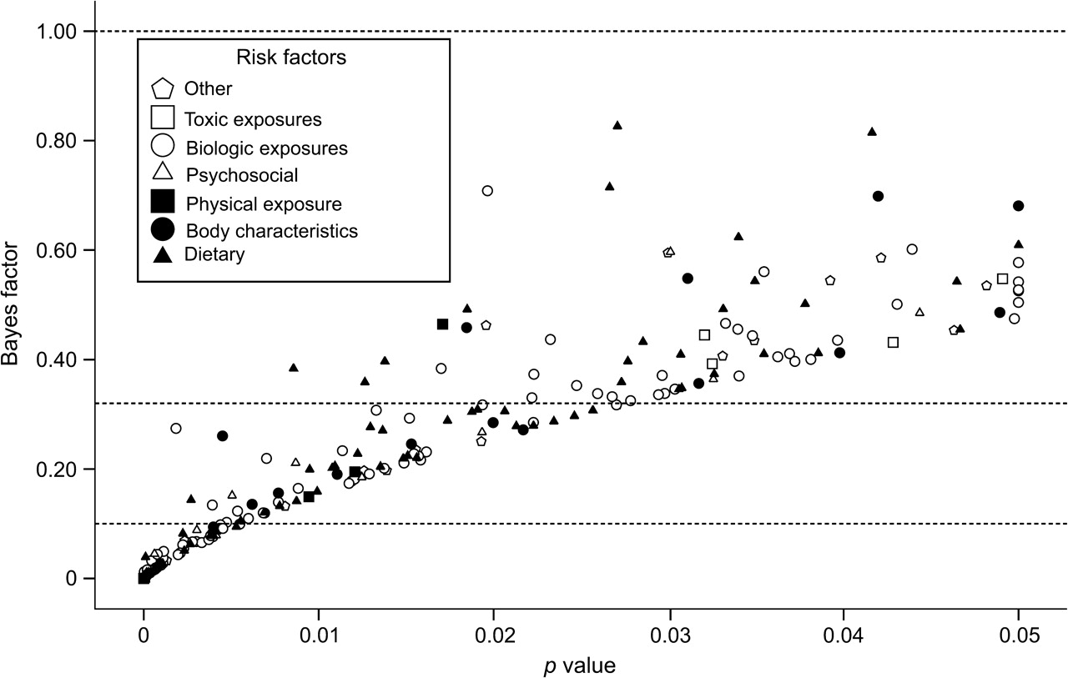
FIGURE 1. Estimated Bayes factors for 272 epidemiologic studies with formally statistically significant results. The ...
Notes:
FIGURE 1. Estimated Bayes factors for 272 epidemiologic studies with formally statistically significant results. The Bayes factor is plotted against the observed p value in each study. Shown are calculations assuming θA of 0.50 (relative risk = 1.65). The dashed lines correspond to threshold values (1.00, 0.32, 0.10) separating different Bayes factor categories.
Unless provided in the caption above, the following copyright applies to the content of this slide: American Journal of Epidemiology © The Author 2008. Published by the Johns Hopkins Bloomberg School of Public Health. All rights reserved. For permissions, please e-mail: journals.permissions@oxfordjournals.org.

Slide 2
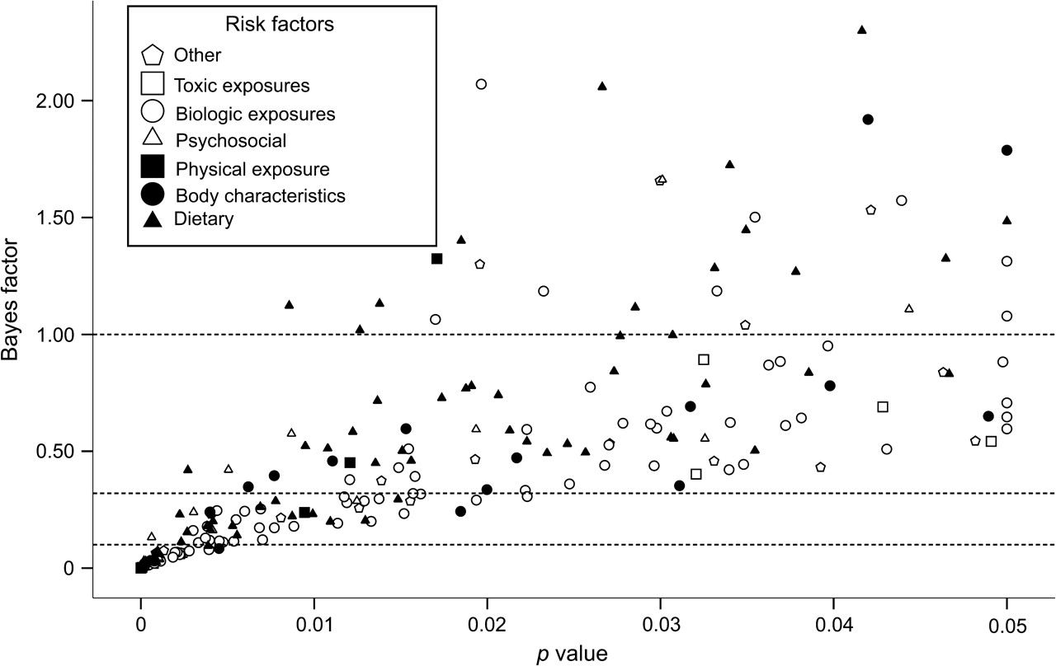
FIGURE 2. Estimated Bayes factors for 272 epidemiologic studies with formally statistically significant results. The ...
Notes:
FIGURE 2. Estimated Bayes factors for 272 epidemiologic studies with formally statistically significant results. The Bayes factor is plotted against the observed p value in each study. Shown are calculations assuming θA of 1.50 (relative risk = 4.48). The dashed lines correspond to threshold values (1.00, 0.32, 0.10) separating different Bayes factor categories.
Unless provided in the caption above, the following copyright applies to the content of this slide: American Journal of Epidemiology © The Author 2008. Published by the Johns Hopkins Bloomberg School of Public Health. All rights reserved. For permissions, please e-mail: journals.permissions@oxfordjournals.org.

Slide 3
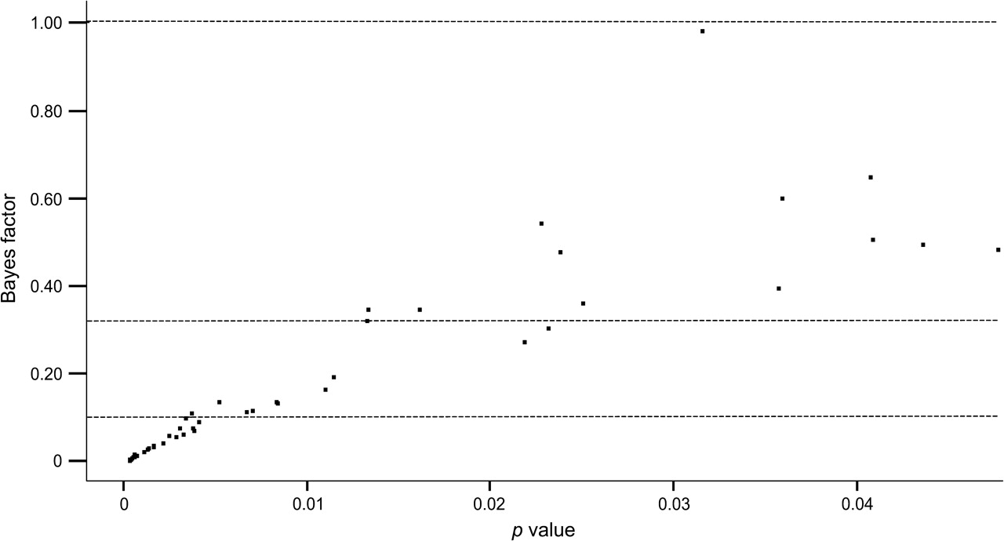
FIGURE 3. Estimated Bayes factors for 50 meta-analyses of genetic associations with formally statistically significant ...
Notes:
FIGURE 3. Estimated Bayes factors for 50 meta-analyses of genetic associations with formally statistically significant results. The Bayes factor is plotted against the observed p value in each meta-analysis. Calculations assume θA equal to the median relative risk observed in the 50 genetic associations (relative risk = 1.44). The dashed lines correspond to threshold values (1.00, 0.32, 0.10) separating different Bayes factor categories.
Unless provided in the caption above, the following copyright applies to the content of this slide: American Journal of Epidemiology © The Author 2008. Published by the Johns Hopkins Bloomberg School of Public Health. All rights reserved. For permissions, please e-mail: journals.permissions@oxfordjournals.org.

