Slide 1
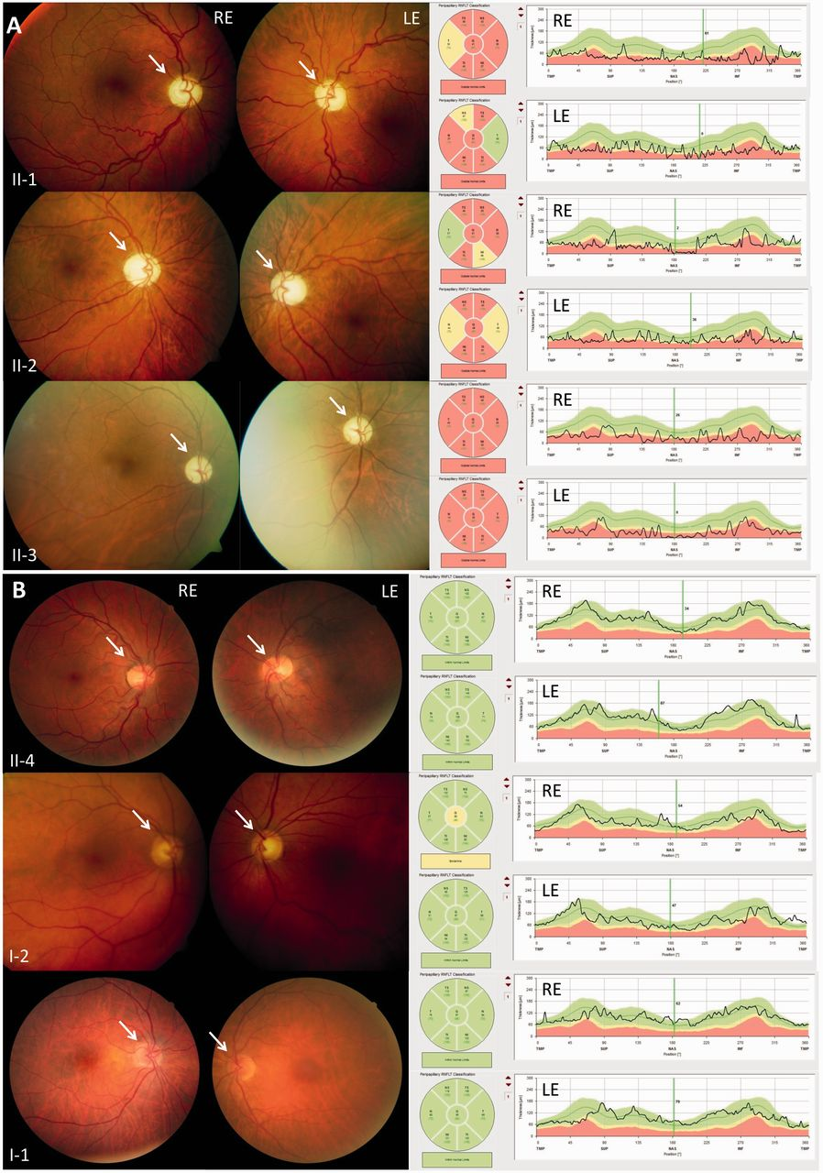
Figure 1 Funduscopy and optical coherence tomography (OCT) in affected and non-affected members of Family OAK 587. (A) ...
Notes:
Figure 1 Funduscopy and optical coherence tomography (OCT) in affected and non-affected members of Family OAK 587. (A) Affected family members (Subjects II:1, II:2 and II:3): paleness of the optic nerve heads (white arrow) indicating atrophy of the optic nerve (left column), the optical coherence tomography scan demonstrates a thinning of the peripapillary retinal nerve fibre layer (right column). Both findings are most severe in the subject with the longest disease duration (Subject II:3). LE = left eye; RE = right eye. (B) Family members without clinical manifestation (Subjects II:4, I:2 and I:1): optical nerve heads showing the normal orange-pink appearance, thickness of the peripapillary retinal nerve fibre layer within normal limits.
Unless provided in the caption above, the following copyright applies to the content of this slide: © The Author (2014). Published by Oxford University Press on behalf of the Guarantors of Brain. All rights reserved. For Permissions, please email: journals.permissions@oup.com

Slide 2
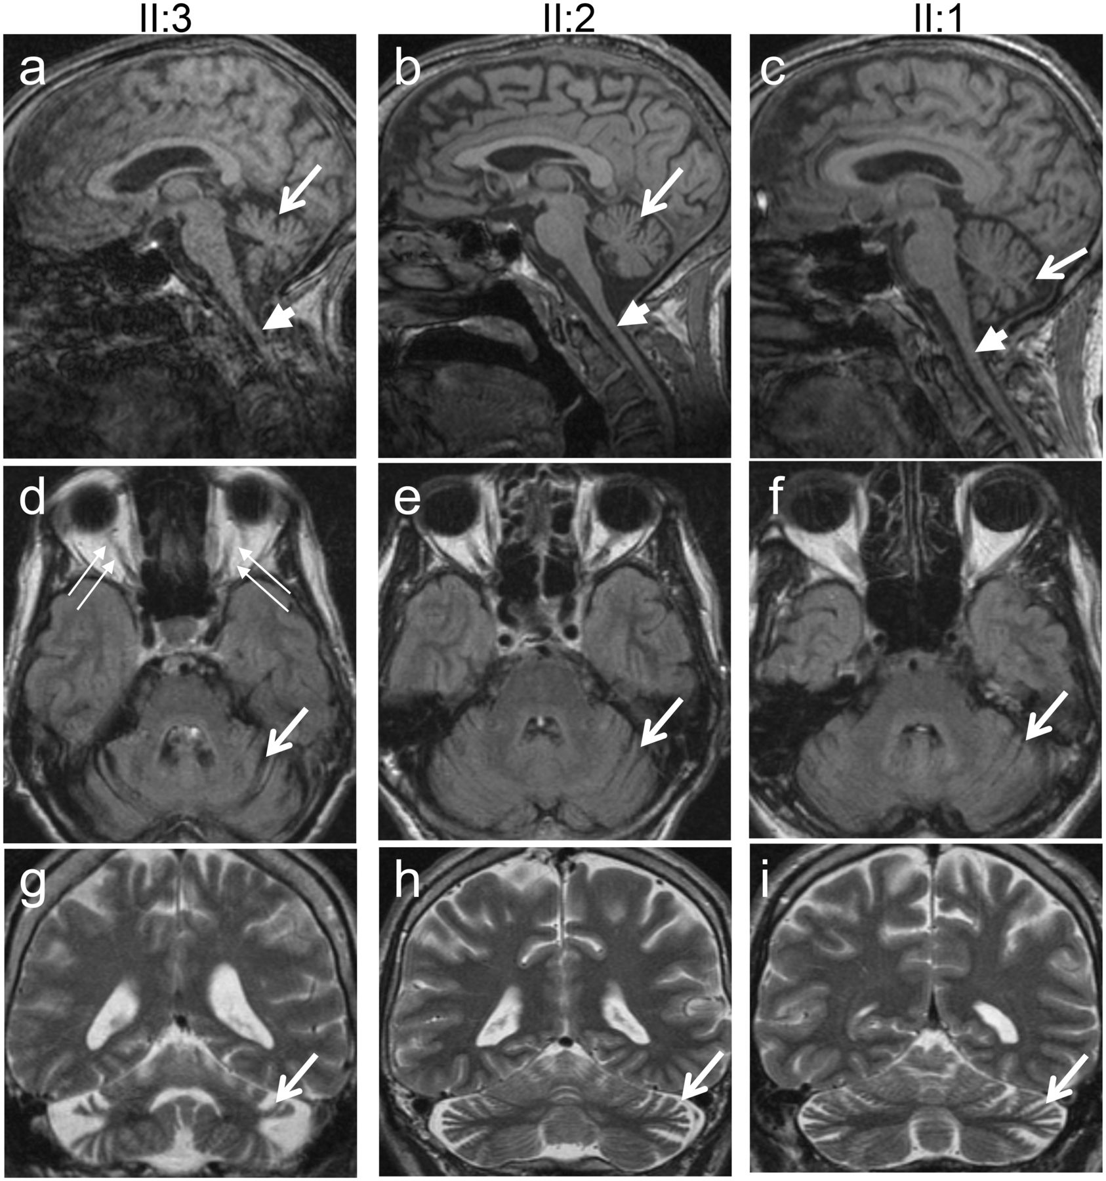
Figure 2 MRI of the brain and cervical spinal cord of affected members of Family OAK 587. MRI of the cerebrum and the ...
Notes:
Figure 2 MRI of the brain and cervical spinal cord of affected members of Family OAK 587. MRI of the cerebrum and the upper cervical spinal cord (A–C, sagittal T1; D–F axial FLAIR; G–I coronal T2) demonstrates cerebellar atrophy in all three affected subjects (long arrows), most severely in the subject with the longest disease duration and highest ataxia score (Subject II:3; A, D and G). All three subjects also show, to a variable degree, atrophy of the upper cervical spinal cord (short arrows in A–C).
Unless provided in the caption above, the following copyright applies to the content of this slide: © The Author (2014). Published by Oxford University Press on behalf of the Guarantors of Brain. All rights reserved. For Permissions, please email: journals.permissions@oup.com

Slide 3
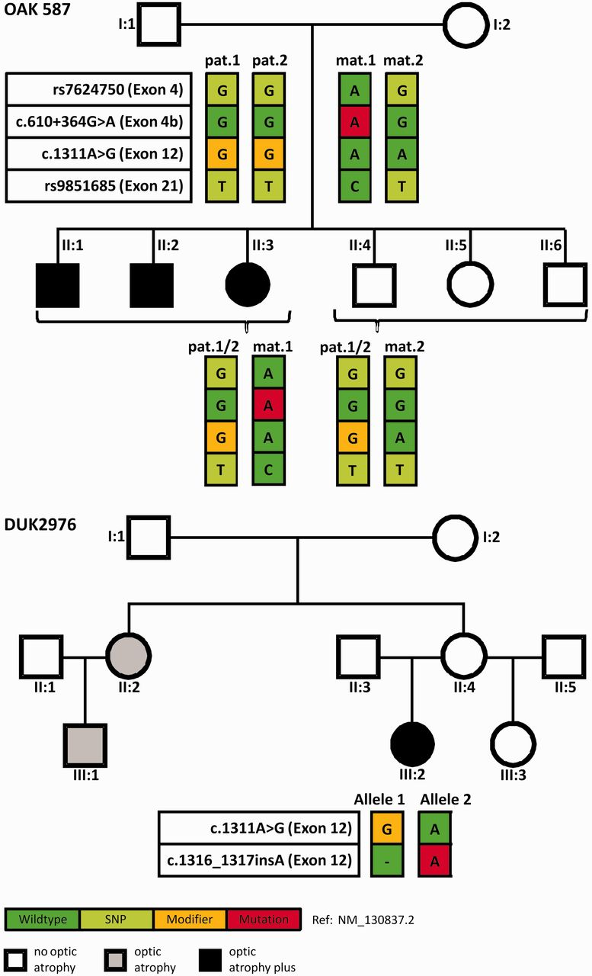
Figure 3 Pedigrees of the Families OAK 587 and DUK2976 including the segregation of OPA1 mutations and coding SNPs. ...
Notes:
Figure 3 Pedigrees of the Families OAK 587 and DUK2976 including the segregation of OPA1 mutations and coding SNPs. Upper pedigree: All affected siblings of Family OAK 587 inherited the same maternal OPA1 allele (mat.1), comprising the c.610+364G>A deep intronic mutation (red square), whereas all unaffected children inherited the non-mutant maternal OPA1 allele (mat.2). The father, Subject I:1, is homozygous for p.I437M (yellow square), therefore all children are heterozygous for this variant. Note that Subject I:1 is homozygous for all analysed variants in OPA1, most likely due to identity-by-descent. Coding SNPs in exon 4 and exon 21 were used to perform pyrosequencing for discrimination of allelic representation on complementary DNA level. Affected family members are indicated by black symbols and healthy family members by white symbols. Lower pedigree: In Family DUK2976 Subject III:2 is compound heterozygous for p.I437M and c.1316_1317insA/p.N440Kfs*14, and presents with a severe optic atrophy plus phenotype. In contrast, her parents—likely heterozygous for only one of the two OPA1 variants—present only with mild visual disturbances and no symptoms at all, respectively. However, the sister II:2 of the unaffected mother II:4 as well as her daughter III:1 present with non-syndromic optic atrophy (grey).
Unless provided in the caption above, the following copyright applies to the content of this slide: © The Author (2014). Published by Oxford University Press on behalf of the Guarantors of Brain. All rights reserved. For Permissions, please email: journals.permissions@oup.com

Slide 4
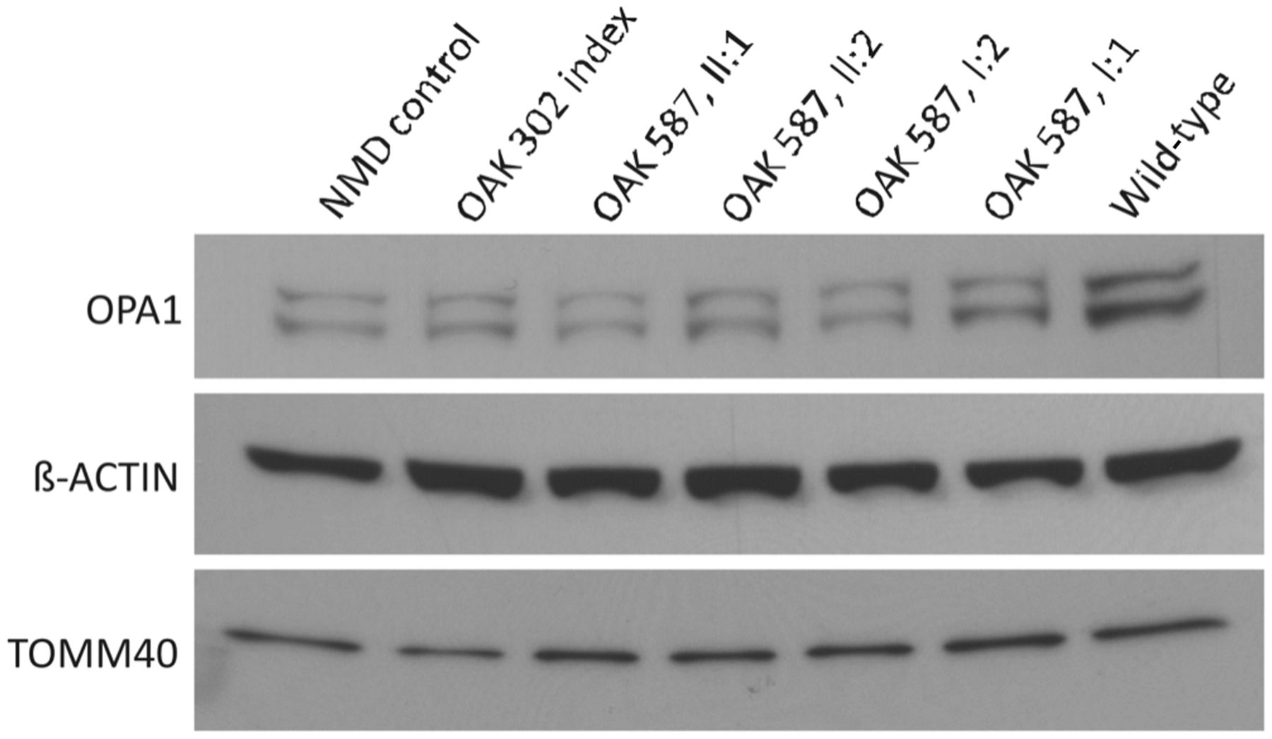
Figure 6 Reduced OPA1 protein amount in patients with deep intronic mutation. Semi-quantitative western blot ...
Notes:
Figure 6 Reduced OPA1 protein amount in patients with deep intronic mutation. Semi-quantitative western blot immunodetection with antibodies against OPA1 (top), ACTB (centre) and TOMM40 (bottom) in whole fibroblast cell lysates from a patient with autosomal dominant optic atrophy with heterozygous c.868C>T/p.Arg290stop in OPA1 (nonsense-mediated messenger RNA decay control), the affected index patient of Family OAK 302, two affected patients (Subjects II:1 and II:2) as well as the parents of Family OAK 587, and a healthy control (wild-type) (from left to right). A clear reduction in OPA1 protein amount can be observed in all samples except the control and the unaffected father (only slight reduction).
Unless provided in the caption above, the following copyright applies to the content of this slide: © The Author (2014). Published by Oxford University Press on behalf of the Guarantors of Brain. All rights reserved. For Permissions, please email: journals.permissions@oup.com

Slide 5
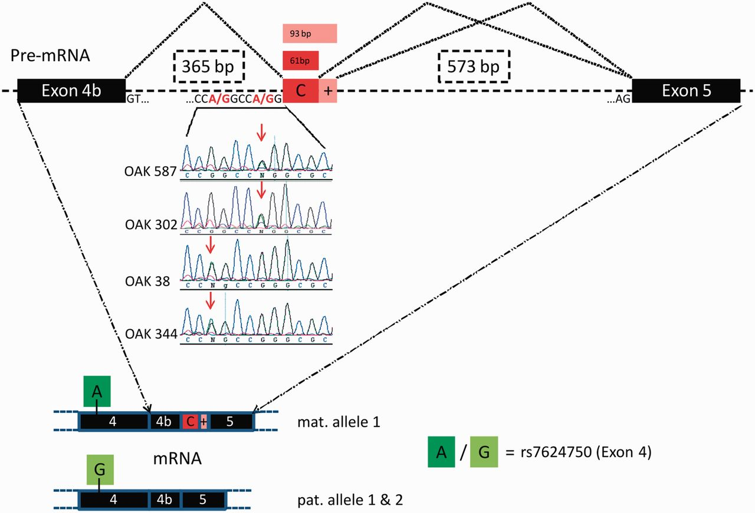
Figure 5 Novel splicing acceptor sites in intron 4b of OPA1 and resulting cryptic exon inclusion. Base transitions of ...
Notes:
Figure 5 Novel splicing acceptor sites in intron 4b of OPA1 and resulting cryptic exon inclusion. Base transitions of G>A at positions 360 bp or 364 bp downstream of exon 4b create novel splice acceptor sites that exonize downstream sequences of 65 bp / 97 bp or 61 bp/93 bp. Top: Family OAK 587 (index) and Family OAK 302 share the c.610+364G>A mutation, whereas Families OAK 38 and OAK 344 share the mutation c.610+360G>A (centre). The cryptic exon is exclusively found in transcripts of the maternal allele (Family OAK 587) which can be determined e.g. by an SNP in exon 4 (rs7624750, bottom panel). Black bars = exons; dashed lines = introns; red bars = cryptic exons.
Unless provided in the caption above, the following copyright applies to the content of this slide: © The Author (2014). Published by Oxford University Press on behalf of the Guarantors of Brain. All rights reserved. For Permissions, please email: journals.permissions@oup.com

Slide 6
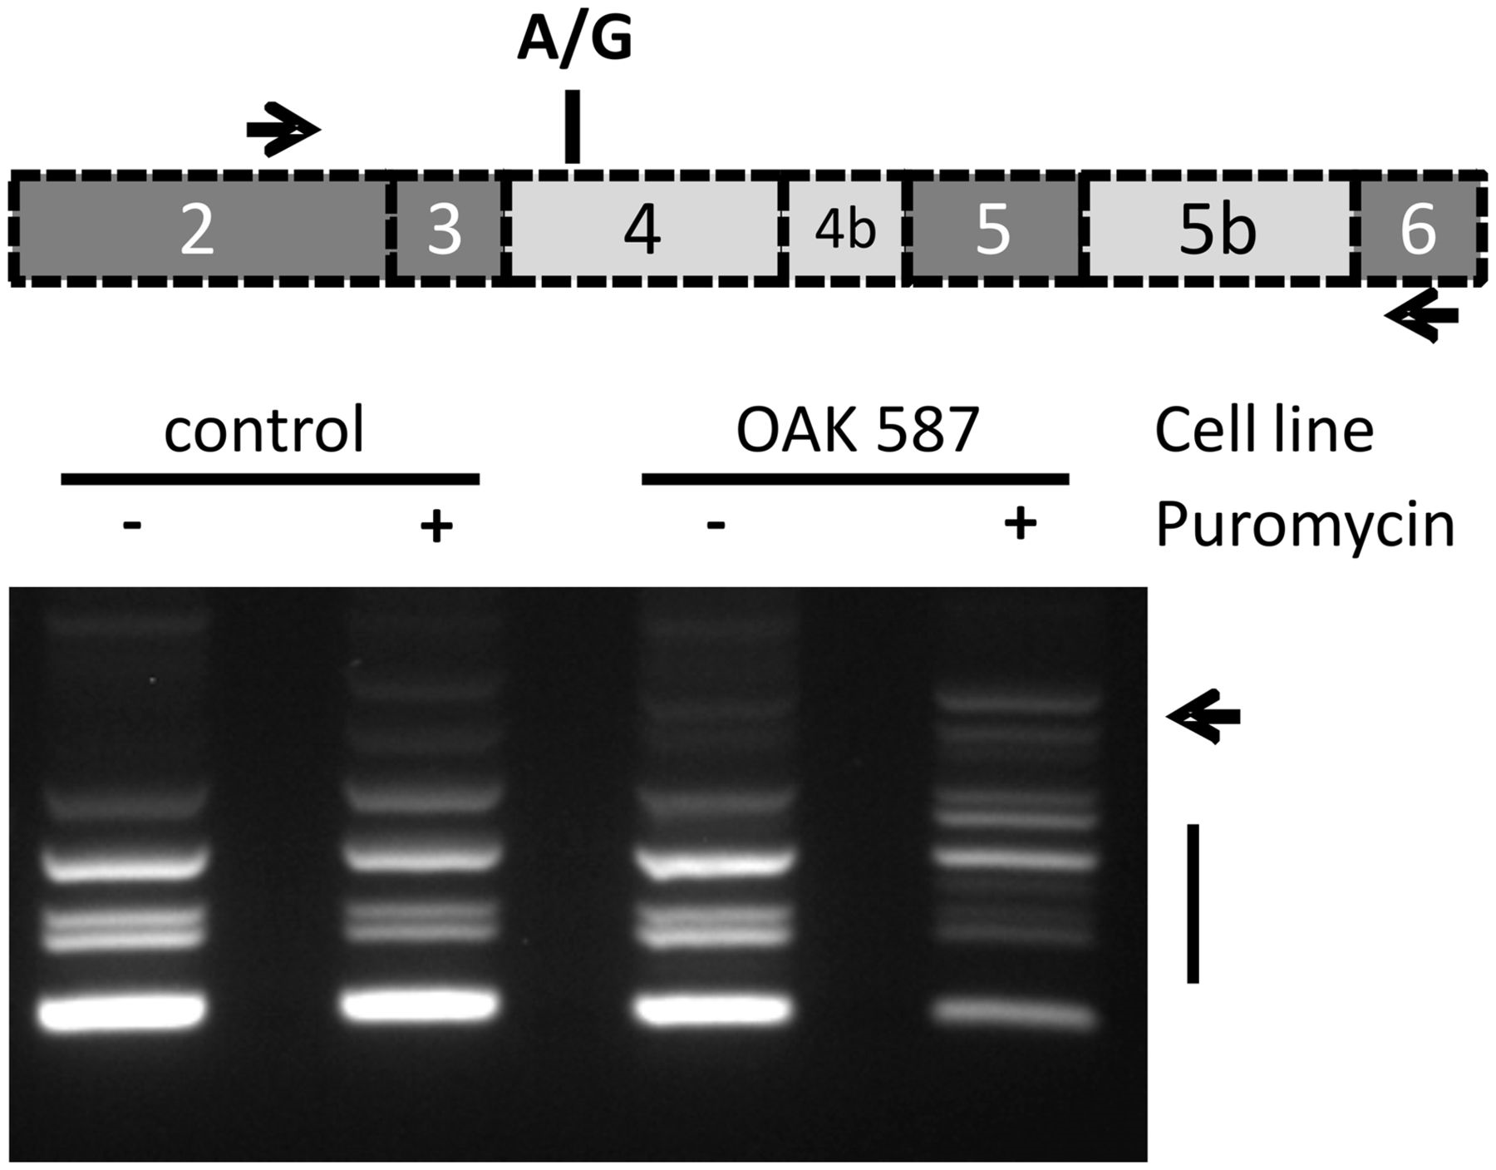
Figure 4 Unmasking of aberrant OPA1 transcripts in puromycin treated patient fibroblasts. Deep intronic mutations in ...
Notes:
Figure 4 Unmasking of aberrant OPA1 transcripts in puromycin treated patient fibroblasts. Deep intronic mutations in OPA1 reverse transcriptase PCR amplification with primers located in exons 2 and 6 result in multiple cDNA products due to the alternation of constitutively (dark grey in scheme) and facultatively spliced exons (light grey) in this part of the OPA1 gene. The presence of a heterozygous coding SNP in exon 4 (rs7624750; depicted as A/G in the scheme) enabled to differentiate between maternal and paternal-allele derived transcripts in the analysed patient (see text). The pattern of reverse transcriptase PCR products obtained with RNA from untreated fibroblasts of Subject II:1 and the control is virtually identical. However treatment of the patient’s fibroblasts with puromycin before RNA isolation resulted in a drastically altered pattern with additional bands (arrow) and reduced amounts of regular fragments.
Unless provided in the caption above, the following copyright applies to the content of this slide: © The Author (2014). Published by Oxford University Press on behalf of the Guarantors of Brain. All rights reserved. For Permissions, please email: journals.permissions@oup.com

Slide 7
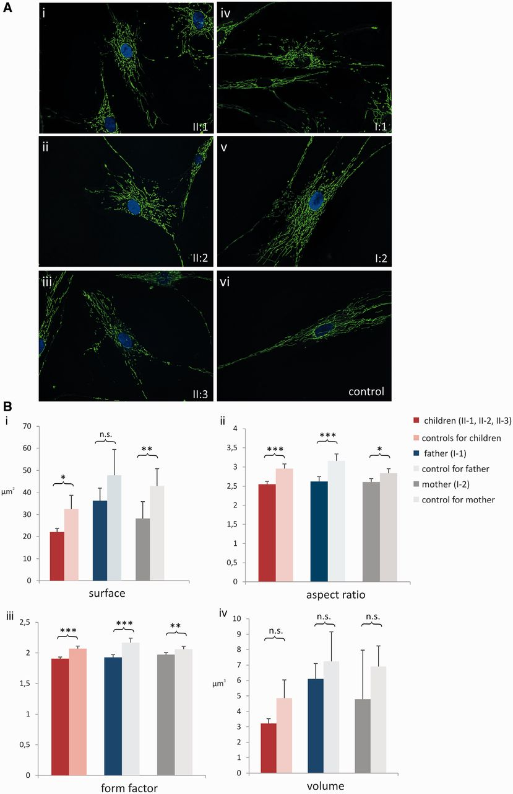
Figure 7 Mitochondrial morphometry. (A) Mitochondrial network stained with MitoTracker Green FM(R) and visualized with ...
Notes:
Figure 7 Mitochondrial morphometry. (A) Mitochondrial network stained with MitoTracker Green FM(R) and visualized with a fluorescence microscope. Compared to an exemplary control (i), where mitochondria build a network of lengthy and closely connected mitochondrial alignments, the mitochondrial network is fragmented in all three affected siblings (ii–iv). Similarly, also mitochondria of the mother (vi, Subject I:2) show signs of fragmentation and, to a lesser extent, mitochondria of the father as well (v, Subject I:1). (B) Statistical analysis of mitochondrial morphometry in fibroblasts of the three affected siblings (dark red), the father (dark blue) and the mother (dark grey) of Family OAK 587 compared to age-matched controls. Four aspects of morphology were analysed: (i) surface; (ii) aspect ratio (major axis/minor axis); (iii) form factor (surface2/4 π volume); and (iv) volume. *P < 0.05; **P < 0.01; ***P < 0.001; n.s. = not significant.
Unless provided in the caption above, the following copyright applies to the content of this slide: © The Author (2014). Published by Oxford University Press on behalf of the Guarantors of Brain. All rights reserved. For Permissions, please email: journals.permissions@oup.com

