Slide 1
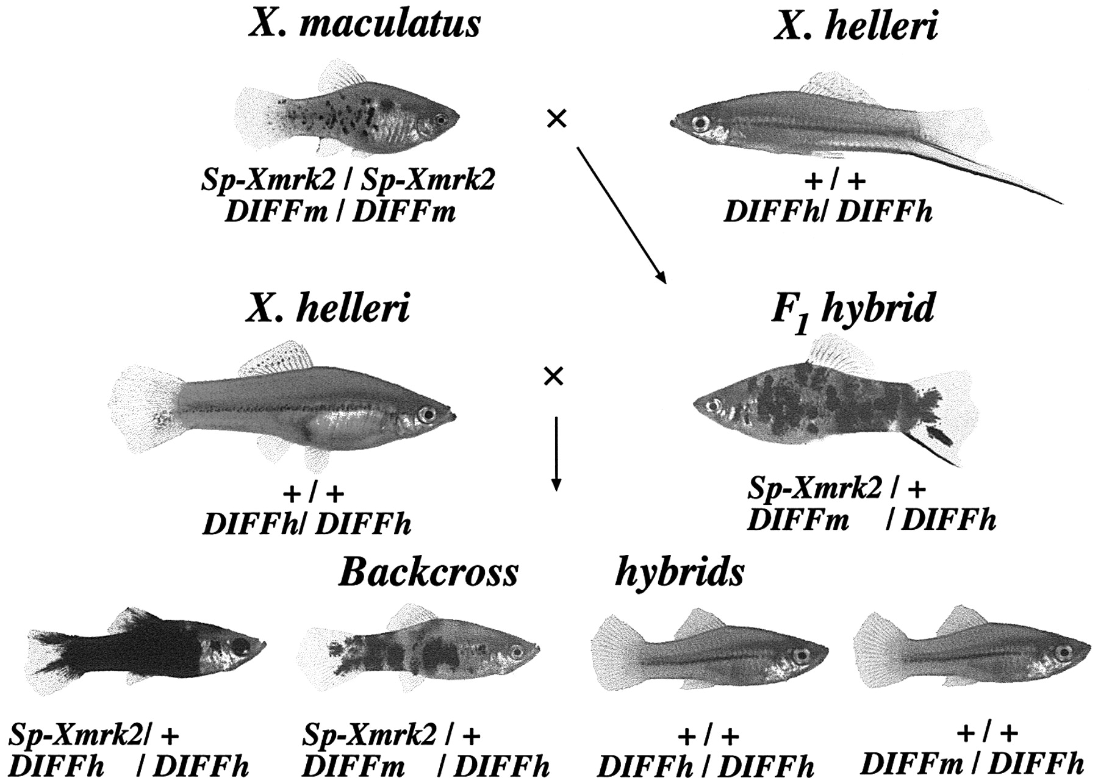
Fig. 1. Growth inhibition by 1,25(OH)₂D₃ in HBL100 and ZR75-1 cells. Cells were seeded at a ...
Notes:
Fig. 1. Growth inhibition by 1,25(OH)2D3 in HBL100 and ZR75-1 cells. Cells were seeded at a density of 1000 cells/well in 96-well plates and treated with the indicated concentrations of 1,25(OH)2D3 for 7 days. Cell viability was then determined by the MTT assay. The results are shown for duplicate cultures. Similar results were obtained in three independent experiments. The error bar represents standard deviation.
Unless provided in the caption above, the following copyright applies to the content of this slide: © Oxford University Press

Slide 2
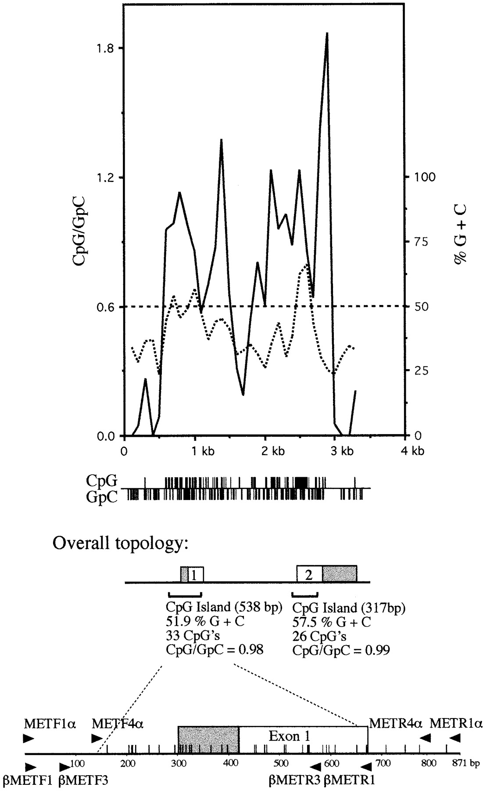
Fig. 2. Expression of VDR in HBL100 and ZR75-1 cells. Cell extracts were prepared from HBL100 and ZR75-1 cells ...
Notes:
Fig. 2. Expression of VDR in HBL100 and ZR75-1 cells. Cell extracts were prepared from HBL100 and ZR75-1 cells treated with or without 10 nM 1,25(OH)2D3 for 24 h and analyzed for the expression of VDR by western blot analysis using a polyclonal anti-VDR antibody. The results shown are from one of the two independent experiments.
Unless provided in the caption above, the following copyright applies to the content of this slide: © Oxford University Press

Slide 3
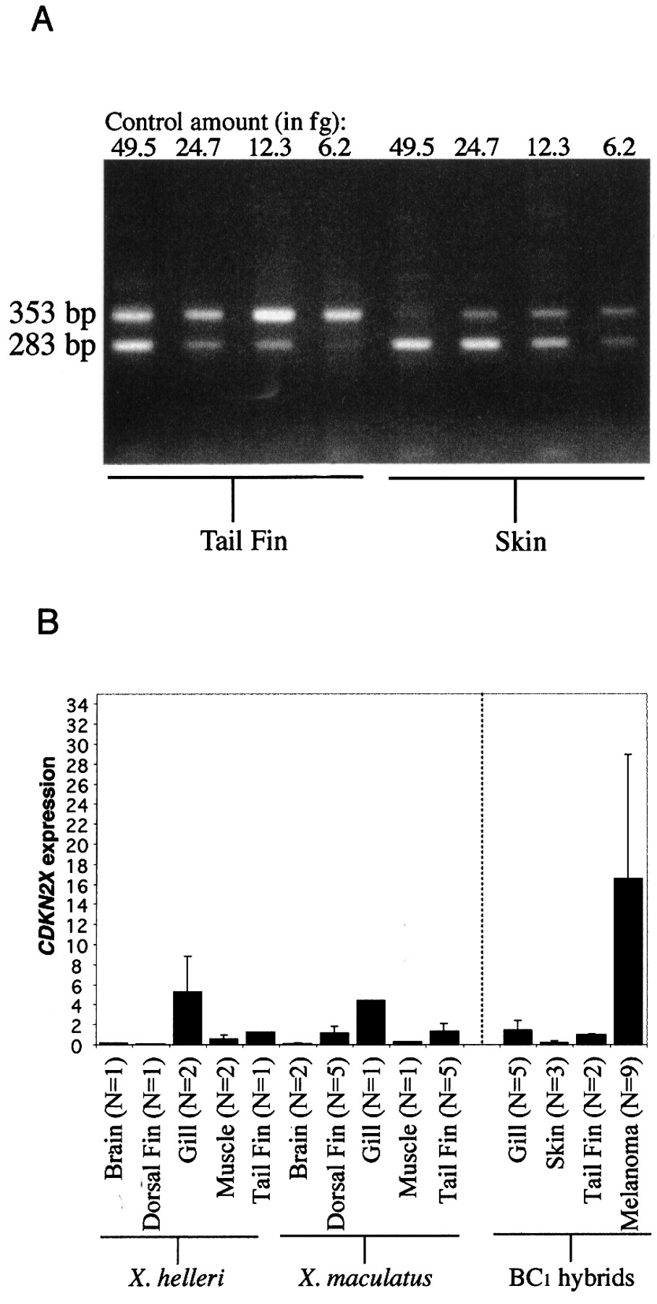
Fig. 3. VDRE binding of nuclear proteins prepared from HBL100 and ZR75-1 cells. Nuclear proteins were prepared from ...
Notes:
Fig. 3. VDRE binding of nuclear proteins prepared from HBL100 and ZR75-1 cells. Nuclear proteins were prepared from HBL100 and ZR75-1 cells untreated or treated with 10 nM 1,25(OH)2D3 for 24 h and analyzed for their DNA binding activity using VDRE as a probe. For comparison, the binding of VDR/RXRα heterodimers using in vitro synthesized receptor proteins is shown. Arrow indicates the specific VDRE binding complex. The results of the gel shift shown here are from duplicate reactions of the two independent experiments. Relative binding activity was determined after densitometric analysis. Binding of nuclear proteins prepared from HBL100 cells in the absence of 1,25(OH)2D3 was defined as 1. HBL100 cells treated with dihydroxyvitamin D3 showed relative intensities of 1 and 3; whereas ZR75-1 cells treated with dihydroxyvitamin D3 showed the relative binding values of 9 and 12.
Unless provided in the caption above, the following copyright applies to the content of this slide: © Oxford University Press

Slide 4
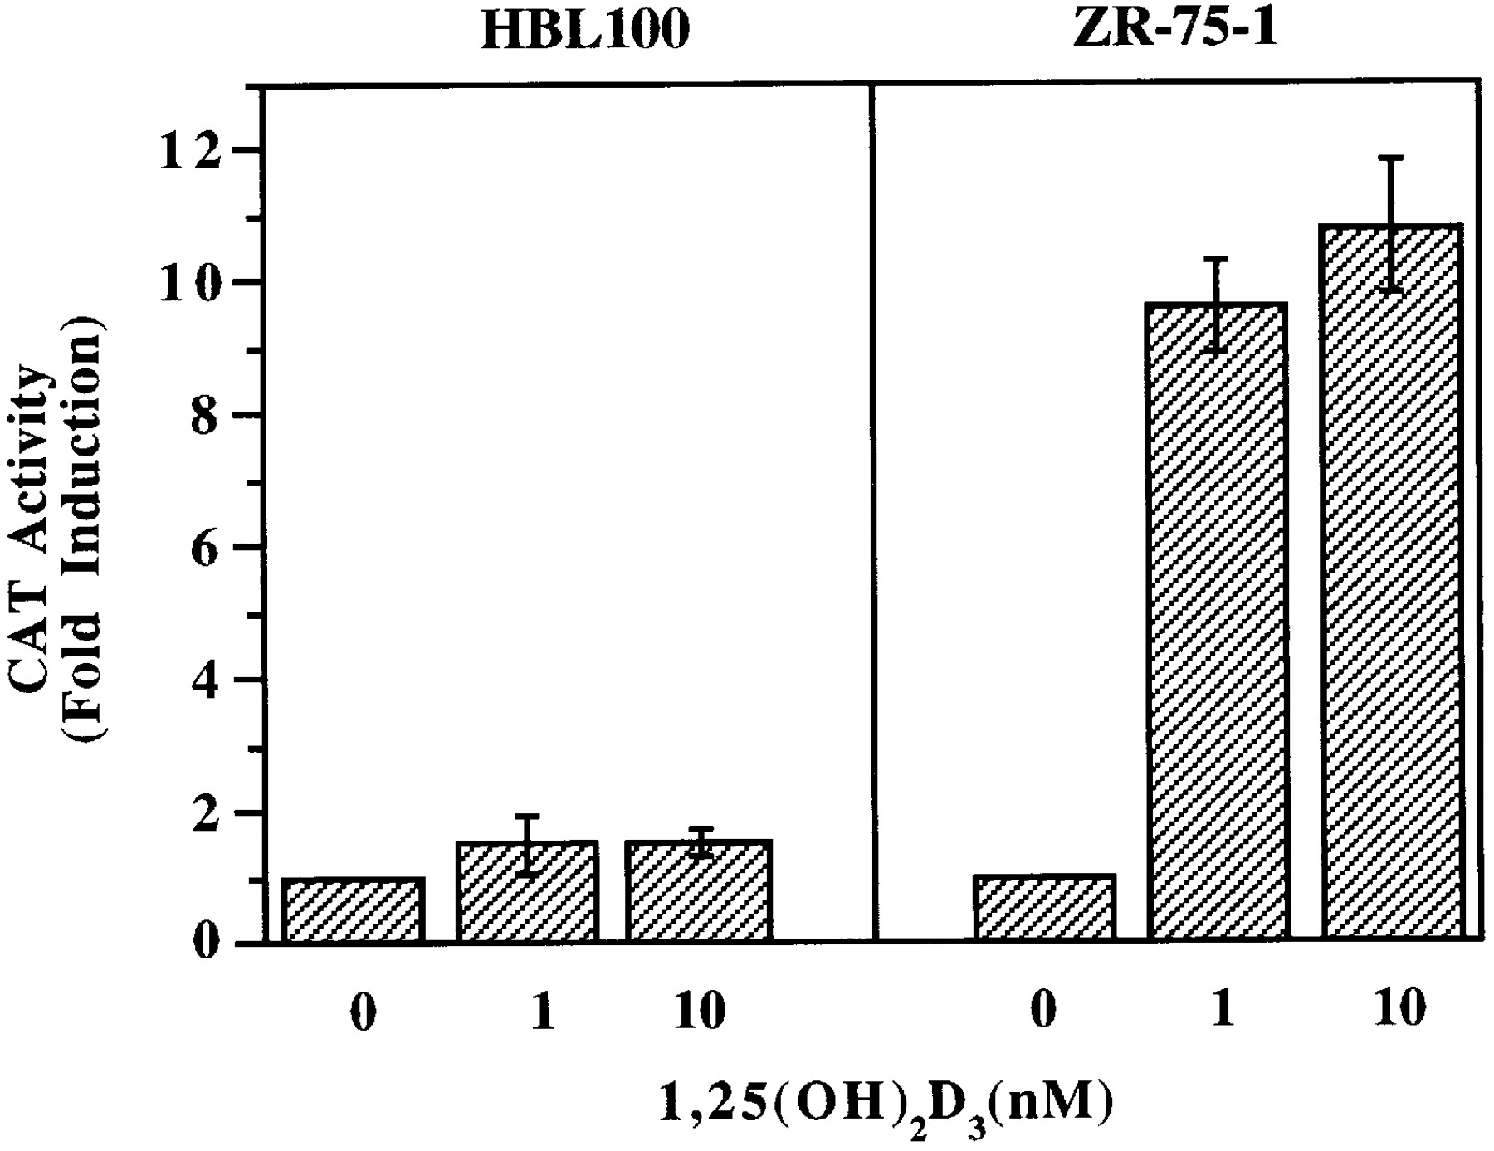
Fig. 4. Transcriptional activity of VDRE in HBL100 and ZR75-1 cells. The VDRE-tk-CAT was transiently transfected into ...
Notes:
Fig. 4. Transcriptional activity of VDRE in HBL100 and ZR75-1 cells. The VDRE-tk-CAT was transiently transfected into HBL100 and ZR75-1 cells. After transfection, the cells were treated with the indicated concentrations of 1,25(OH)2D3 and harvested 24 h later. CAT activities were then determined. β-gal activities were measured to normalize transfection efficiency. Results represent means ± SD. The experiment was repeated twice.
Unless provided in the caption above, the following copyright applies to the content of this slide: © Oxford University Press

Slide 5
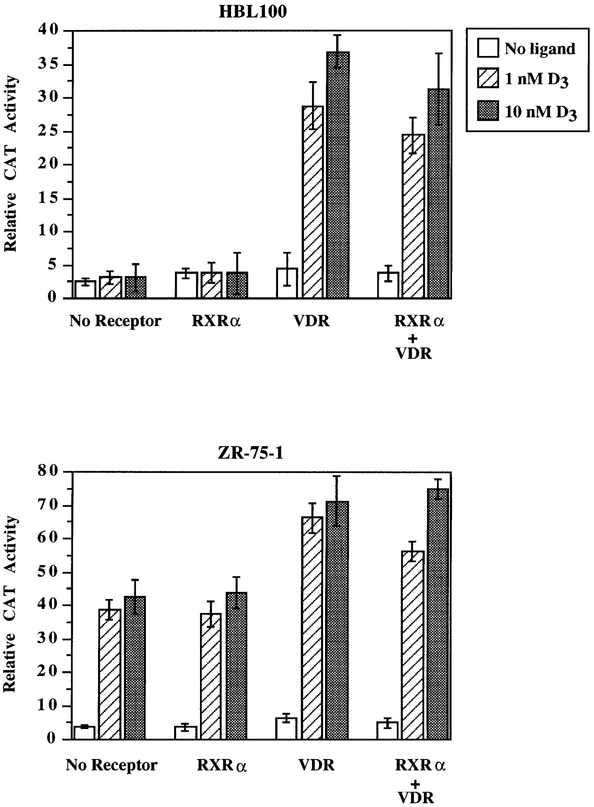
Fig. 5. Effect of exogenous VDR and RXRα on VDRE transcriptional activity in HBL100 and ZR75-1 cells. The VDRE-tk-CAT ...
Notes:
Fig. 5. Effect of exogenous VDR and RXRα on VDRE transcriptional activity in HBL100 and ZR75-1 cells. The VDRE-tk-CAT was transiently transfected into HBL100 and ZR75-1 cells together with RXRα- (20 ng) and/or VDR- (100 ng) expressing vectors. After transfection, the cells were treated with the indicated concentrations of 1,25(OH)2D3 for 24 h. The cells were harvested and CAT activities were determined. β-gal activities were measured to normalize transfection efficiency. Results represent means ± SD. The experiment was repeated twice.
Unless provided in the caption above, the following copyright applies to the content of this slide: © Oxford University Press

Slide 6
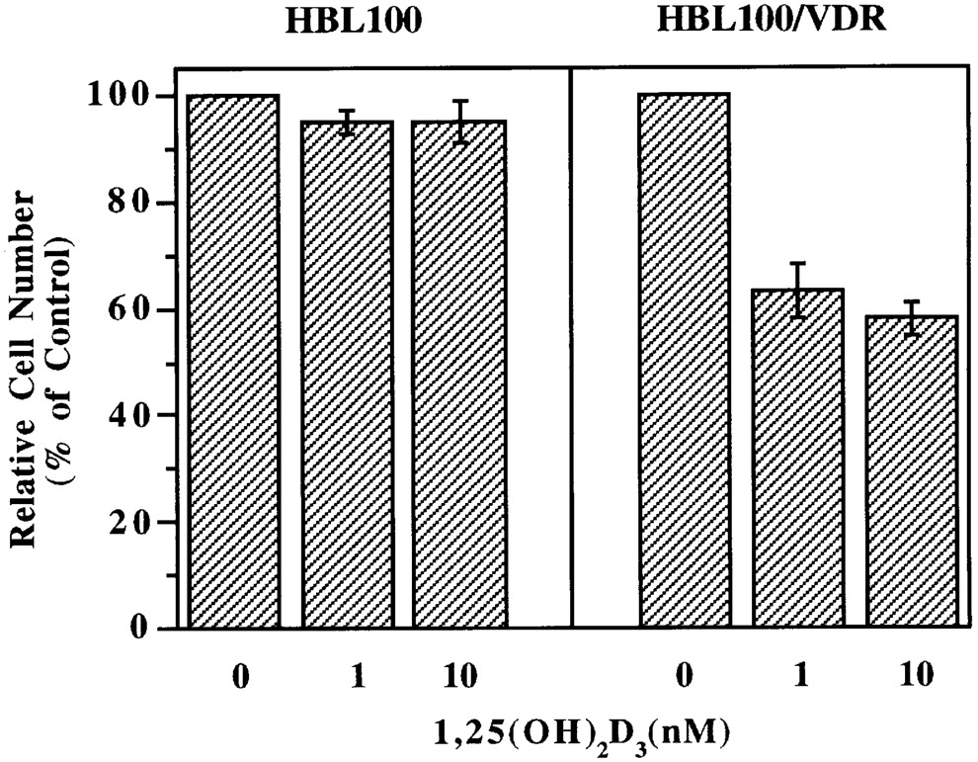
Fig. 6. Stable expression of VDR restores 1,25(OH)₂D₃ sensitivity in HBL100 cells. VDR was ...
Notes:
Fig. 6. Stable expression of VDR restores 1,25(OH)2D3 sensitivity in HBL100 cells. VDR was stably transfected into HBL100 cells. A stable clone (HBL100/VDR) that expressed exogenous VDR was analyzed for the growth inhibitory effect of 1,25(OH)2D3. Growth inhibition assay and cell viability were performed as discussed in the legends for Figure 1. Data shown are representative of at least three independent experiments (± SD).
Unless provided in the caption above, the following copyright applies to the content of this slide: © Oxford University Press

Slide 7
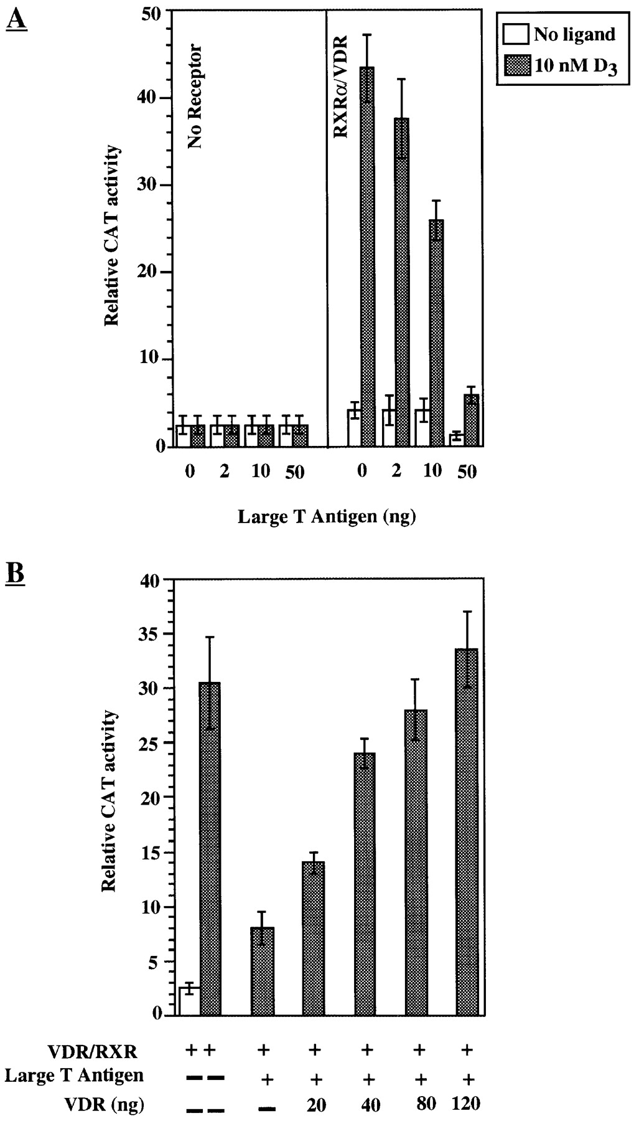
Fig. 7. Effect of the expression of SV40 large T antigen and VDR on VDRE transcriptional activity in CV-1 cells. (A) ...
Notes:
Fig. 7. Effect of the expression of SV40 large T antigen and VDR on VDRE transcriptional activity in CV-1 cells. (A) Inhibition of 1,25(OH)2D3-induced VDRE activity by large T antigen. The VDRE-tk-CAT was transiently transfected into CV-1 cells with or without VDR (20 ng) and RXRα (10 ng) in the presence of the indicated amount of large T antigen. (B) Reversal of the inhibitory effect of large T antigen by co-transfection of VDR. The VDRE-tk-CAT was transiently transfected into CV-1 cells together with the indicated amounts of VDR (20 ng), RXRα (10 ng) and large T antigen (50 ng) expression vectors. The cells were then treated with 1,25(OH)2D3 and assayed for CAT as described in the legends for Figures 4 and 5. Results represent means ± SD. The experiment was repeated twice.
Unless provided in the caption above, the following copyright applies to the content of this slide: © Oxford University Press

