Slide 1
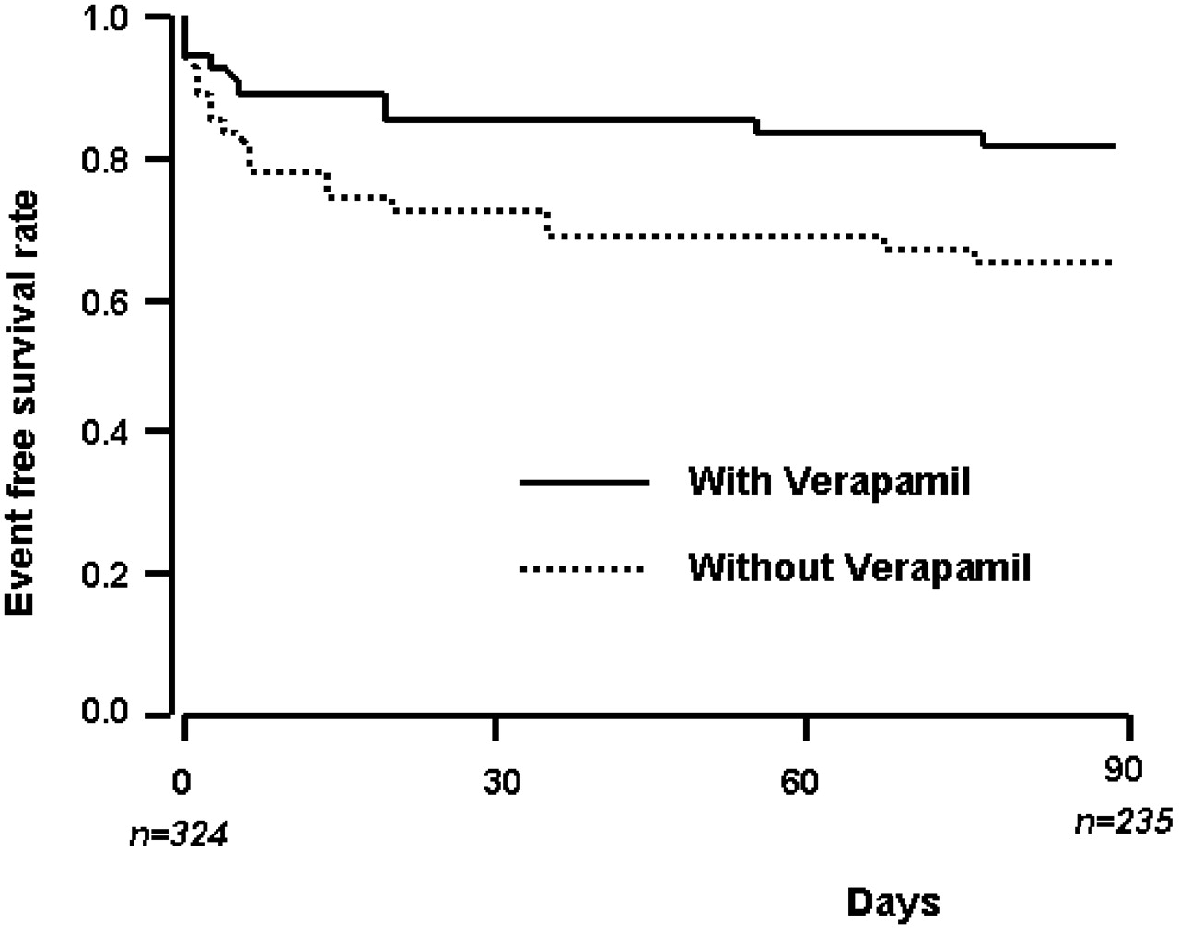
Fig. 1 Event free survival Cox curve for patient with and without verapamil therapy. Survival curves are age and AF ...
Notes:
Fig. 1 Event free survival Cox curve for patient with and without verapamil therapy. Survival curves are age and AF duration corrected.
Unless provided in the caption above, the following copyright applies to the content of this slide: The European Society of Cardiology

