Slide 1
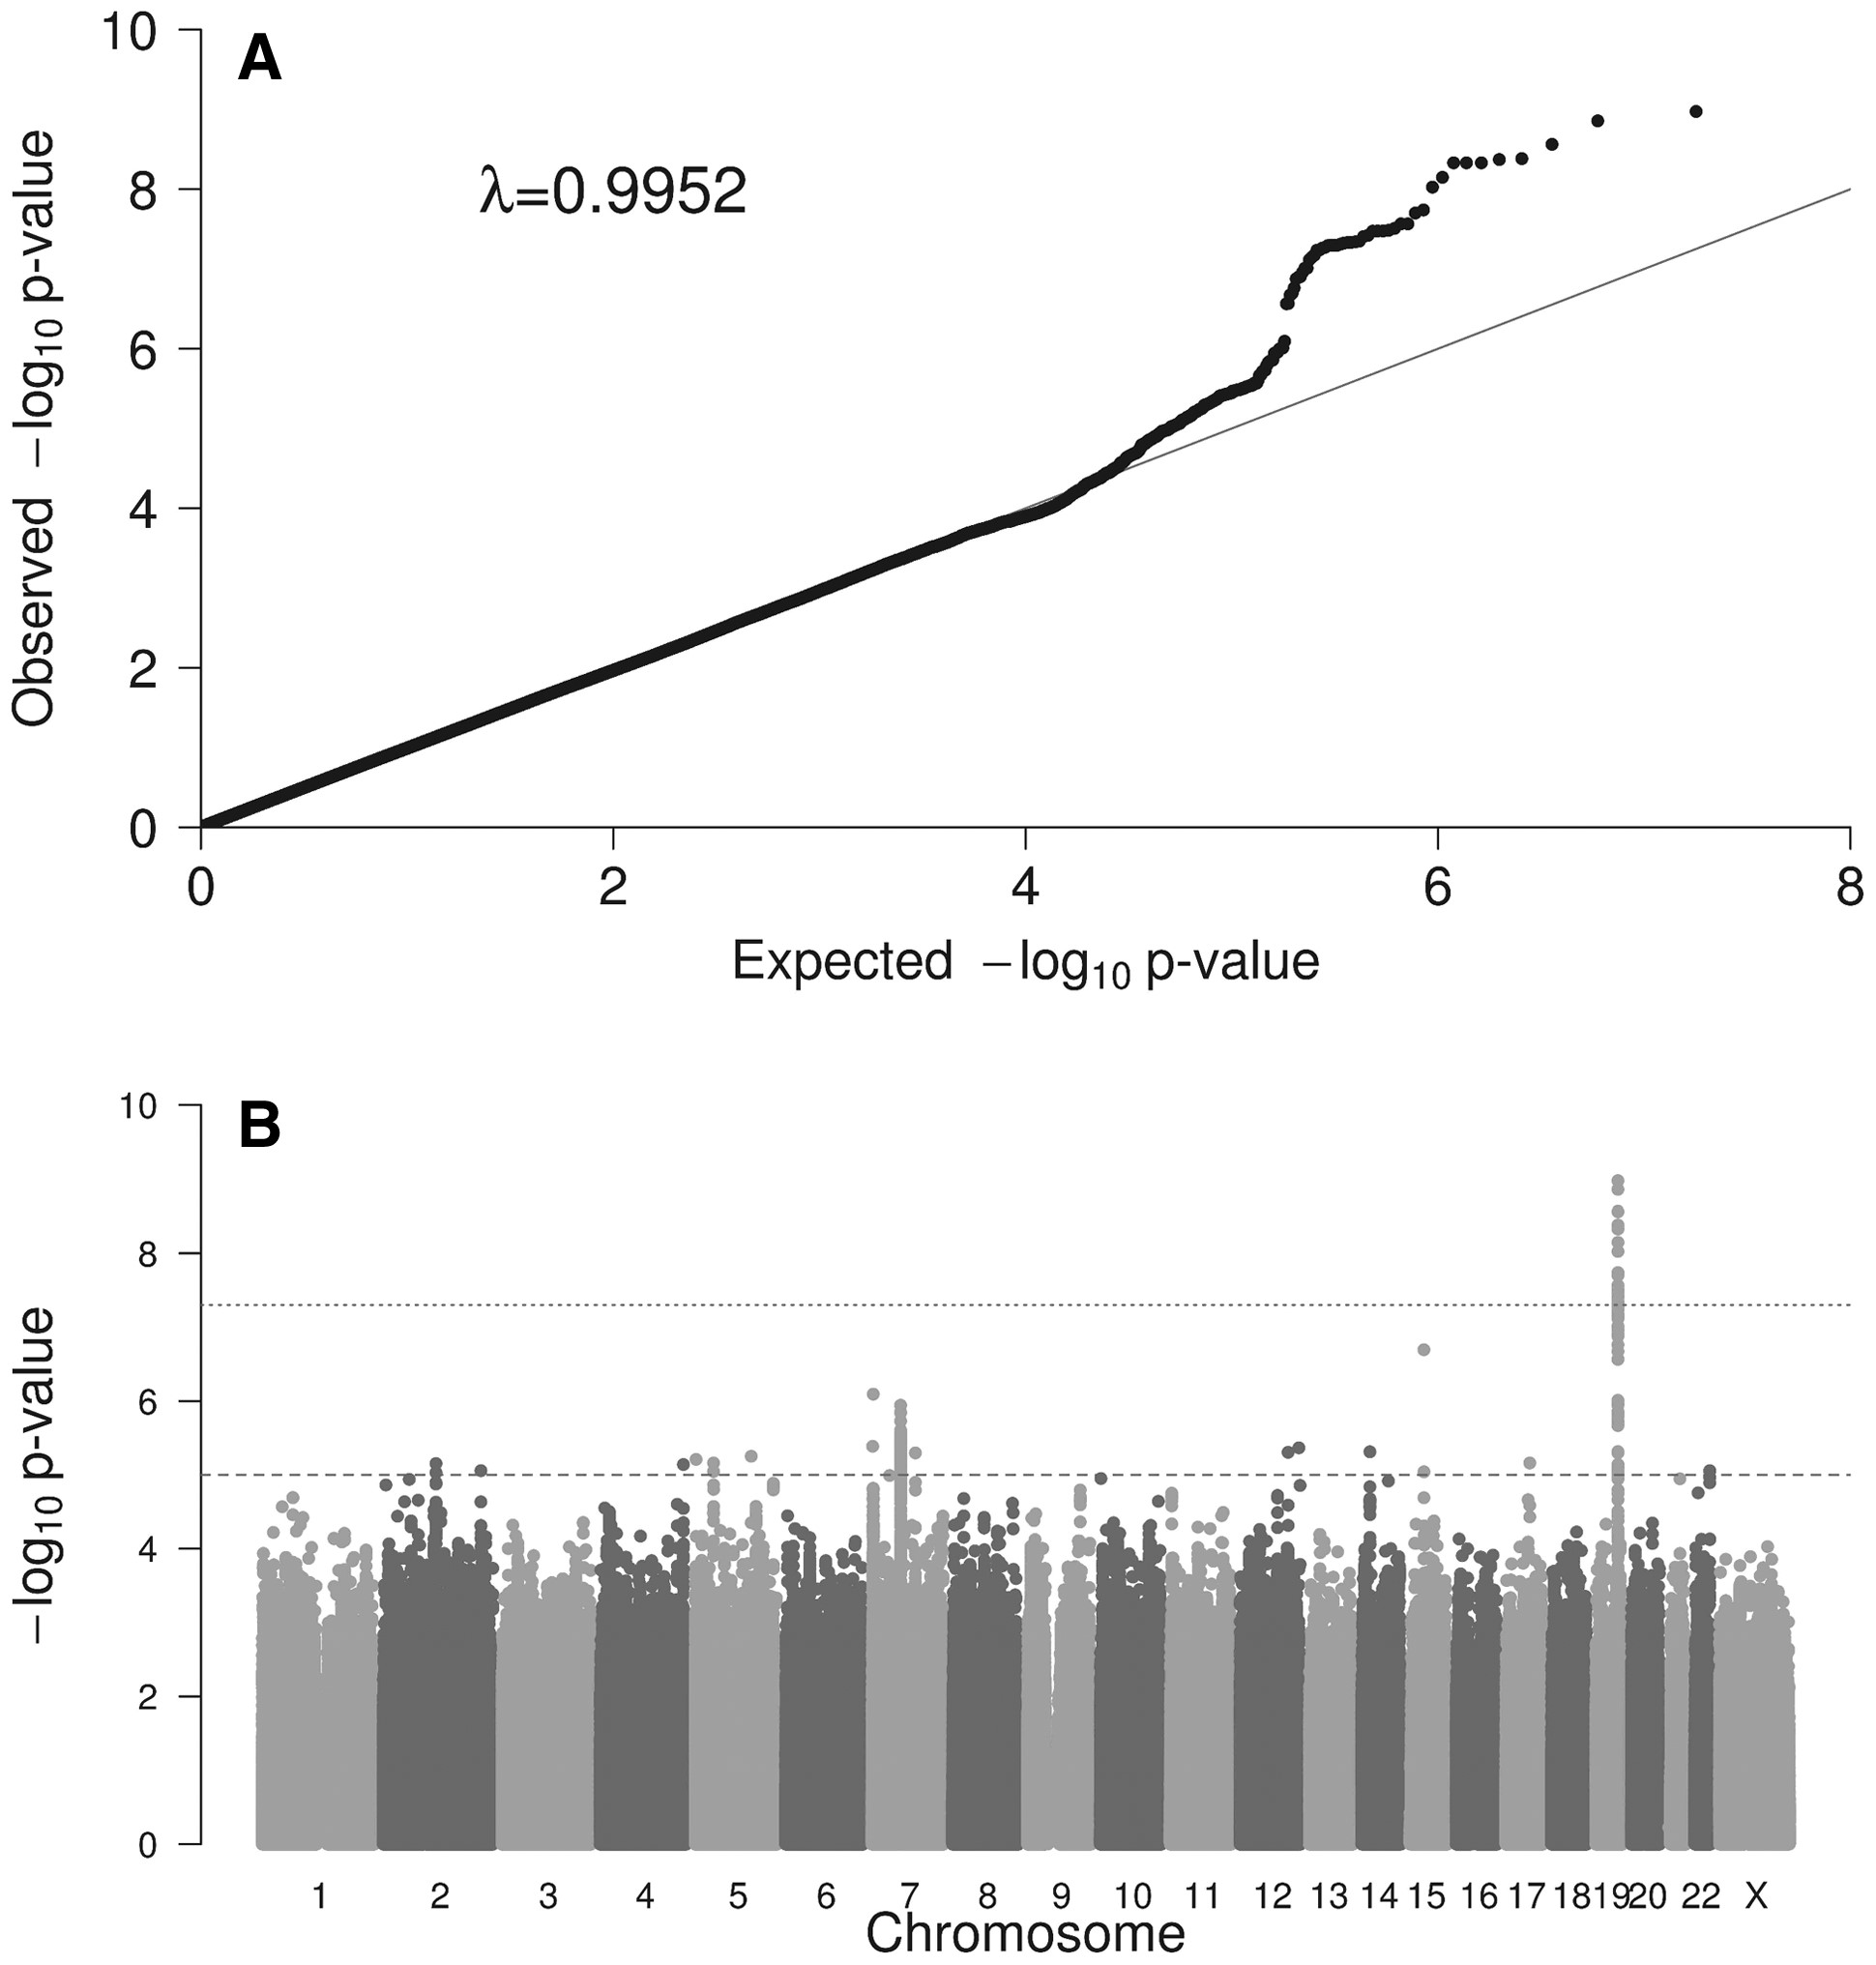
Figure 1. (A) Quantile-quantile (Q-Q) plots showing the probability values from GWAS meta-analysis of diarrhoeal ...
Notes:
Figure 1. (A) Quantile-quantile (Q-Q) plots showing the probability values from GWAS meta-analysis of diarrhoeal disease at age 1 year (D1Y). The line indicates the distribution under the null hypothesis. Lambda value is shown. (B) Manhattan plot of the GWAS meta-analysis of diarrhoeal disease at age 1 year (D1Y). The x-axis represents the autosomal chromosomes and the y-axis represents –log10(P). The dotted line indicates genome-wide significance (P = 5.00E−08), and the dashed line indicates suggestive genome-wide significance (P = 1.00E−05).
Unless provided in the caption above, the following copyright applies to the content of this slide: © The Author 2016. Published by Oxford University Press. All rights reserved. For Permissions, please email: journals.permissions@oup.com

Slide 2
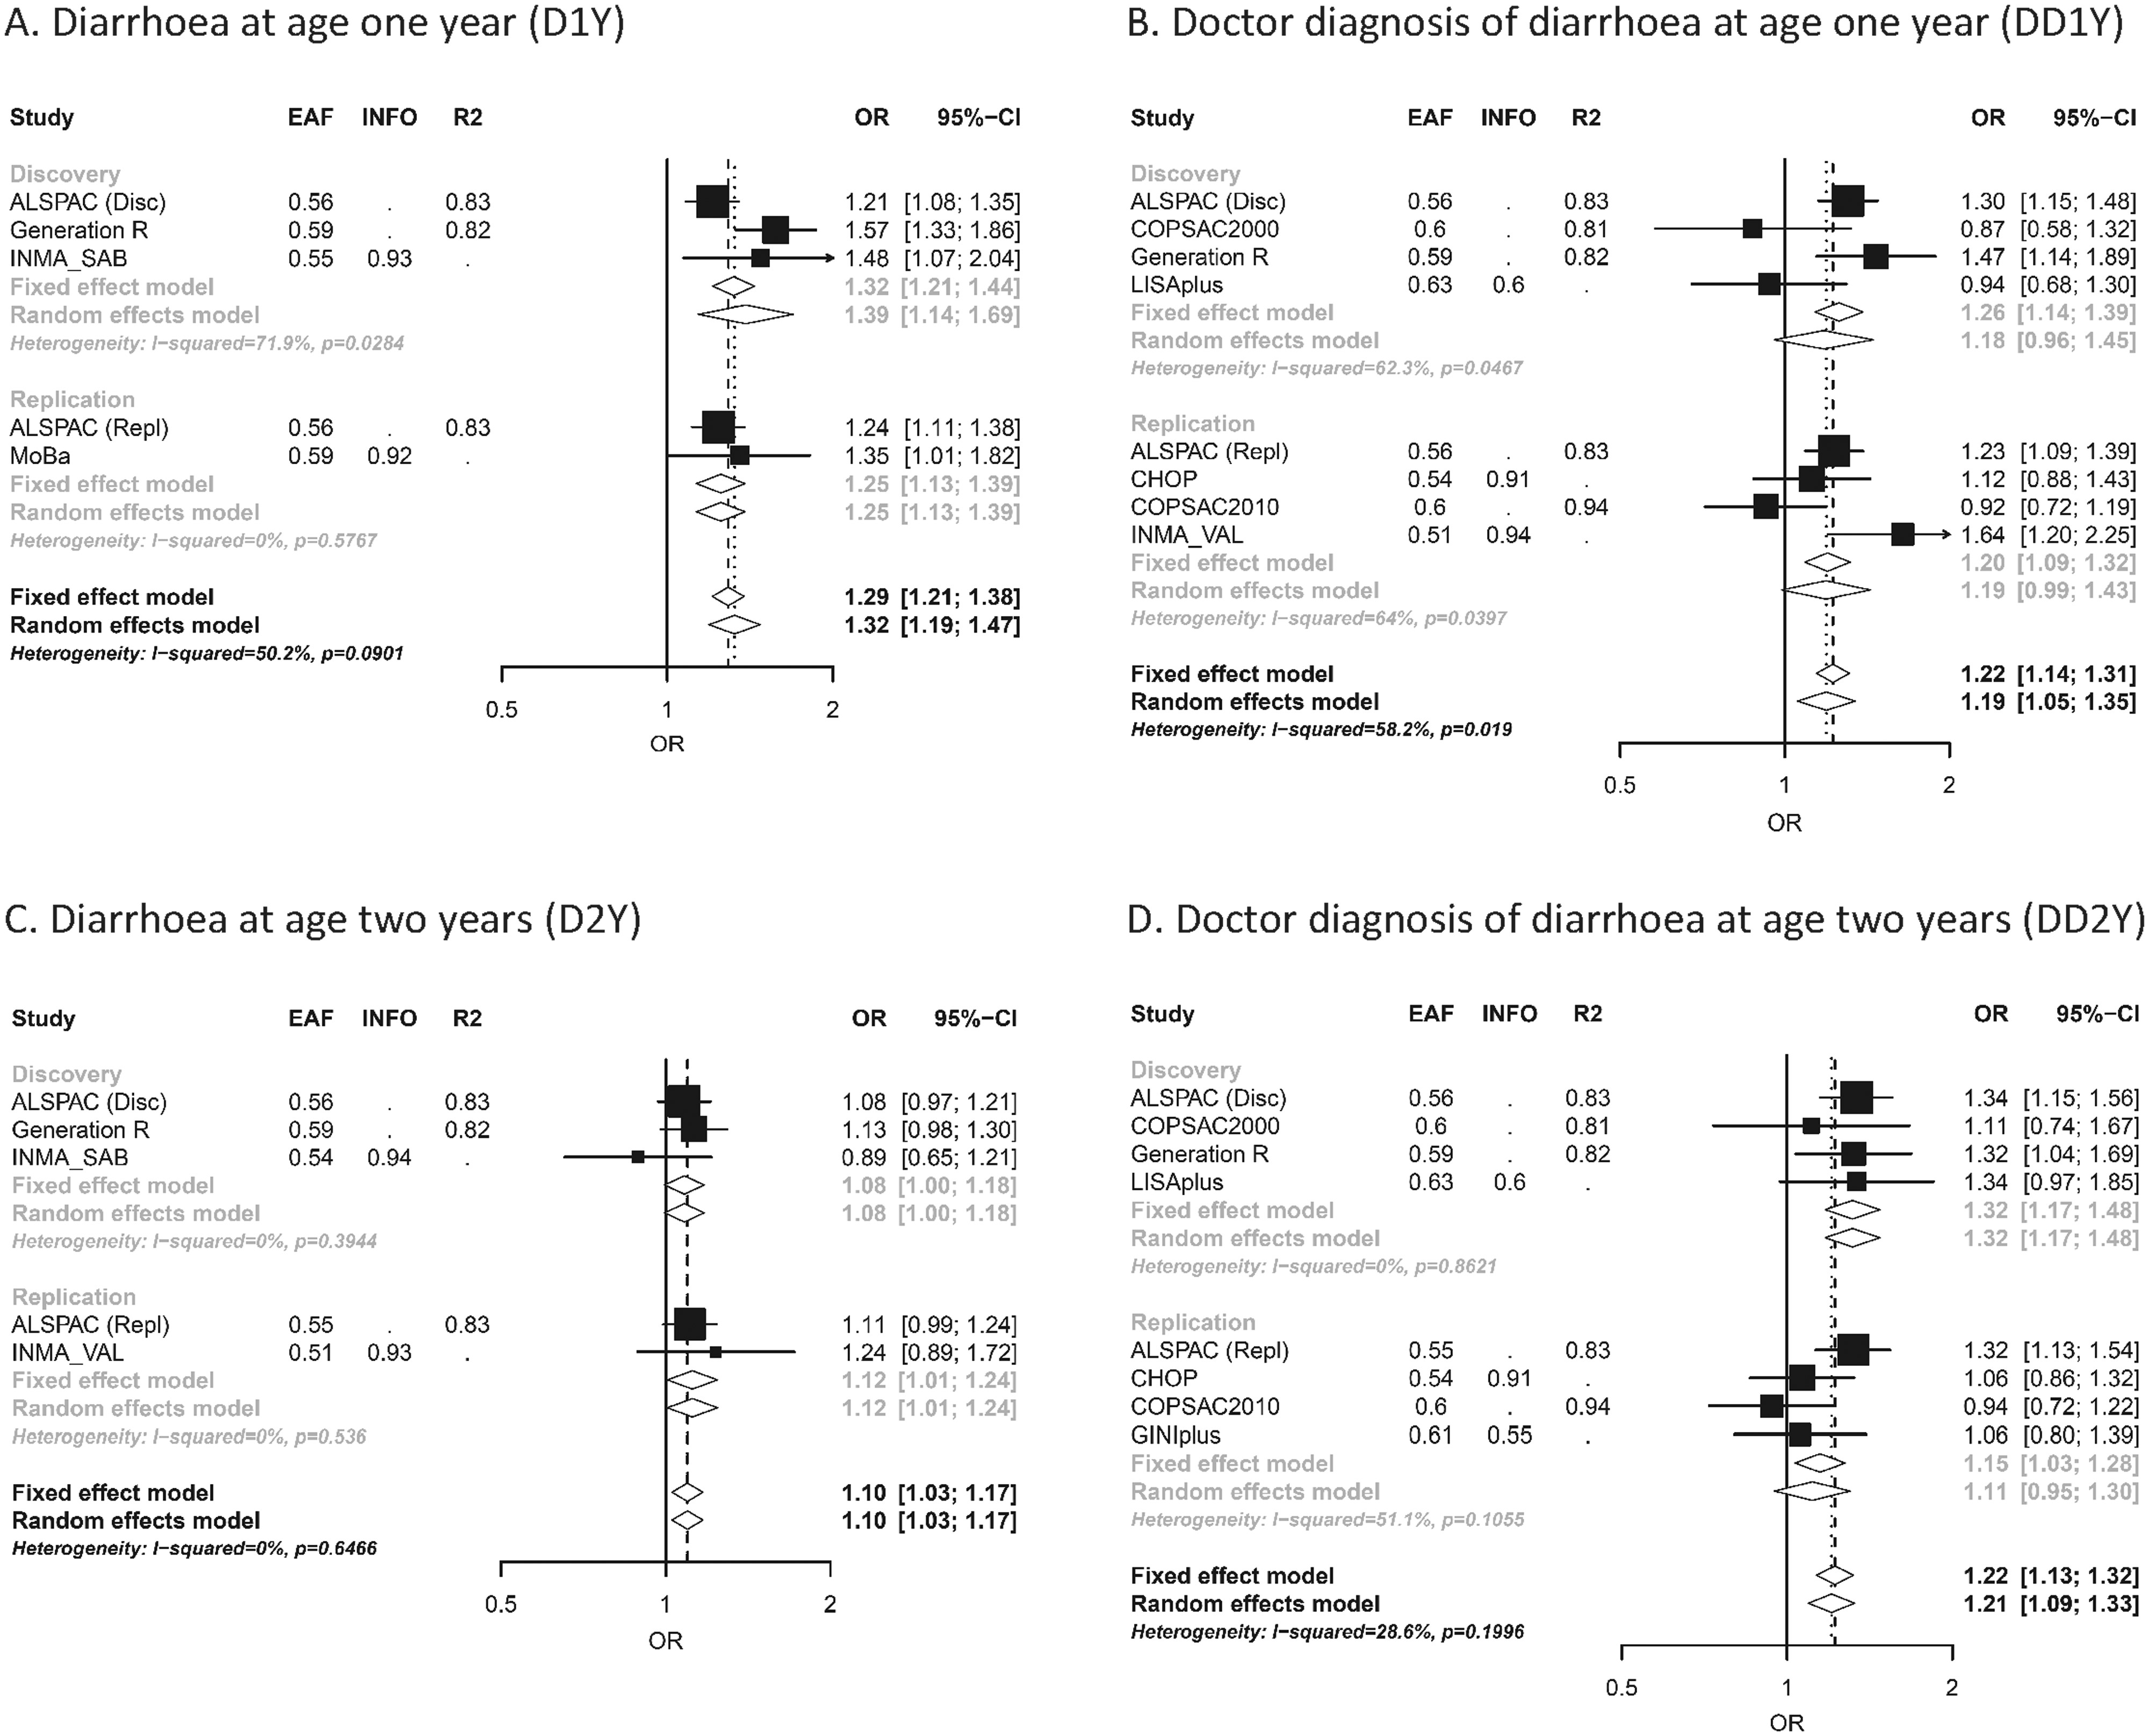
Figure 2. Forest plots for rs8111874 at 19q13.33 for the four diarrhoeal outcomes: (A) Diarrhoea at age 1 year (D1Y); ...
Notes:
Figure 2. Forest plots for rs8111874 at 19q13.33 for the four diarrhoeal outcomes: (A) Diarrhoea at age 1 year (D1Y); (B) Doctor diagnosis of diarrhoea at age 1 year (DD1Y); (C) Diarrhoea at age 2 years (D2Y); (D) Doctor diagnosis of diarrhoea at age 2 years (DD2Y). In the vertical panel, the studies participating in the discovery or replication phase are presented. In the horizontal lines, the sizes of the boxes represent precision and the lines the confidence intervals. The diamond shapes represent the pooled effect estimates, for both the fixed- and random-effect models. The horizontal axis shows the scale of the effect estimates. The effect allele is G, and the other allele is A. Results from the fixed effect meta-analysis for diarrhoeal disease at age 1 year (D1Y) by discovery and replication phase. DiscoveryaReplicationbCombinedMarkerrs_numberChrPosEANEAEAFNORlCIuCIP-valueP-value hetEffectsN variants/ locusGeneNORlCIUCIp-valueNORlCIUCIp-valuep-value het19:49168942:SNPrs81118741949168942GA0.5757581.321.211.441.06E−092.99 E − 02 +++71NTN5 and SEC1P (intronic)37681.251.131.391.69 E − 0595261.291.211.388.05 E − 149.01 E − 0215:50562847:SNPrs620203301550562847AG0.9753962.161.612.882.02 E − 075.05 E − 02 ++?24.7kb 5' of HDC31950.990.691.439.72 E − 0185911.601.272.004.97 E − 051.35 E − 037:2930941:SNPrs171392672930941CT0.6957581.371.211.558.06 E − 075.68 E − 01 +++115kb 3' of CARD1119561.070.921.253.58 E − 0177141.241.131.371.04 E − 051.23 E − 017:63621349:SNPrs139755348763621349CT0.7357580.790.710.871.14 E − 069.29 E − 01—8946kb 5' of ZNF73537681.060.951.192.96 E − 0195260.890.830.962.59 E − 032.60 E − 037:1599067:SNPrs11241118271599067TC0.9553961.71.362.134.10 E − 068.75 E − 01 ++?13kb 5' of TMEM184A37680.780.601.027.26 E − 0291641.231.041.461.76 E − 021.38 E − 0412:130325960:SNPrs3418047712130325960GA0.9353960.580.460.734.30 E − 064.93 E − 01–?1TMEM132D (intronic)30091.210.961.531.04 E − 0184050.840.710.983.24 E − 021.55 E − 0514:38210286:SNPrs747314211438210286GA0.9753961.811.42.334.87 E − 068.07 E − 01 ++?1146kb 5' of FOXA137680.910.691.225.42 E − 0191641.341.111.632.32 E − 036.59 E − 0312:106438211:INDELc12106438211RD0.5257581.261.141.394.95 E − 068.07 E − 01 +++119kb of 3' NUAK14071.200.851.683.01 E − 0161651.261.141.382.73 E − 069.15 E − 017:96366342:SNPrs12704876796366342TC0.5157580.830.770.95.04 E − 068.45 E − 01—127kb 5' of SHFM137681.101.001.204.94 E − 0295260.930.880.992.74 E − 022.32 E − 045:1695532:SNPrs7941130651695532CT0.9553960.550.420.716.17 E − 064.86 E − 01–?113kb 3' of MIR427731360.890.711.133.55 E − 0185320.720.600.851.79 E − 043.61 E − 025:40474267:SNPrs116560909540474267CT0.9753961.91.442.526.90 E − 065.52 E − 01 ++?2206kb 5' of PTGER437681.080.781.496.63 E − 0191641.501.211.852.03 E − 041.74 E − 0217:52598239:INDELc1752598239RD0.9453961.571.291.926.90 E − 066.76 E − 01 ++?1380kb 5' of TOM1L14071.290.592.805.20 E − 0158031.561.281.886.00 E − 068.13 E − 012:116776614:SNPrs126158692116776614AG0.9453961.541.281.877.02 E − 065.62 E − 01 ++?2174kb 3' of DPP1037681.110.901.373.38 E − 0191641.331.161.536.57 E − 051.25 E − 014:184501675:SNPrs76627494184501675CT0.7257580.810.740.897.24 E − 068.53 E − 01—159kb 3' of RWDD437681.020.921.146.55 E − 0195260.900.840.961.69 E − 032.69 E − 0222:49732481:SNPrs57702552249732481GA0.7657581.231.121.358.77 E − 067.32 E − 01 +++2281kb 3' of C22orf3437680.940.841.052.83 E − 0195261.101.031.195.95 E − 034.69 E − 03Variants with a p-value < 1. E − 05 in the discovery phase are shown. Cohort designs: ALSPAC, COPSAC2010, Generation R, INMA_VAL, INMA_GIP, LISAplus, GINIplus and MOBA are unselected population-based birth cohorts. COPSAC2000 is a prospective clinical study of a birth cohort of infants born to mothers with a history of asthma. CHOP is a random collection of paediatric patients from a hospital centre. Only the most significant variant per locus is shown. Variants in the same locus are defined in a 1 Mb window. N variants/locus indicates the number of SNPs in the locus with a P-value < 1E−05. Only genetic variants with a minimal of 5000 samples are shown. EA: effect allele; NEA: non effect allele; EAF: effect allele frequency; N: sample size; OR: odds ratio; lCI: 95% lower confidence interval; uCI: 95% upper confidence interval; P-value het: P-value for the heterogeneity test. aCohorts in the discovery phase are included in alphabetical order: ALSPAC (Disc), Generation R and INMA_SAB. bCohorts included in the replication phase are: ALSPAC (Repl) and MoBa. cALSPAC (Repl) has no data for these markers. Bonferroni correction for 15 variants considered in the replication phase: P-value = 3.33E − 03.
Unless provided in the caption above, the following copyright applies to the content of this slide: © The Author 2016. Published by Oxford University Press. All rights reserved. For Permissions, please email: journals.permissions@oup.com

Slide 3
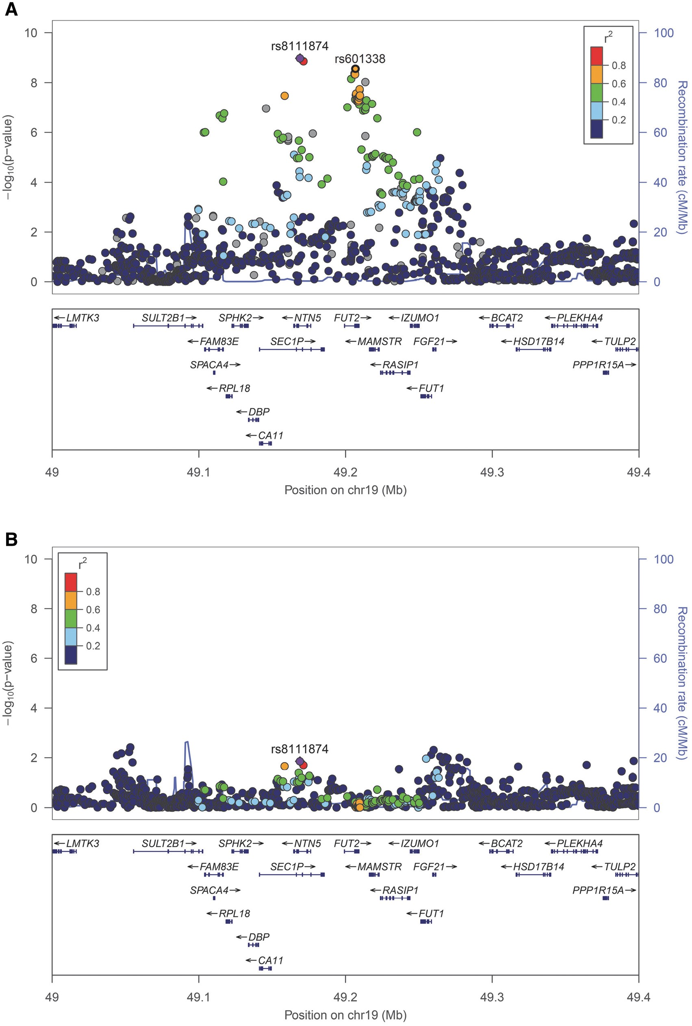
Figure 3. (A) Regional association of 19q13.33 locus (top SNP: rs8111874, chr19:49168942) with diarrhoeal disease at ...
Notes:
Figure 3. (A) Regional association of 19q13.33 locus (top SNP: rs8111874, chr19:49168942) with diarrhoeal disease at age 1 year (D1Y) (N = 5758). The top variant is indicated with a diamond in purple and the flanking variants in circles, coloured according to their linkage disequilibrium (LD). Variant rs601338 is shown in a black circle. The plot was constructed using the 1000 Genomes CEU population (Northern and Western European ancestry). (B) Regional association of 19q13.33 locus (top SNP: rs8111874, chr19:49168942) with diarrhoeal disease at age 1 year (D1Y) conditioned to rs601338 (N = 5758). The associations of the genetic variants in the region were attenuated. Conditional analysis at 19q13.33 locus (rs8111874 and rs601338) Crude results for rs8111874Results for rs8111874 conditioned to rs601338Markerrs_numberEANEAEAFIMPOutcomeORlCIuCIP-valueNORlCIuCIP-value19:49168942:SNPrs8111874GA0.570.82-0.93D1Y1.321.211.441.06 E − 095214.71.081.011.141.40 E − 02DD1Y1.261.131.391.17 E − 055576.71.050.981.122.00 E − 01D2Y1.080.991.186.56 E − 025385.91.000.951.069.12 E − 01DD2Y1.321.171.482.74 E − 065672.71.081.001.174.77 E − 02Crude results for rs601338Results for rs601338 conditioned to rs8111874Markerrs_numberEANEAEAFIMPOutcomeORlCIuCIP-valueORlCIuCIP-value19:49206674:SNPrs601338G (W)A (X)0.521D1Y1.281.181.392.74 E − 096224.81.061.001.123.93 E − 02DD1Y1.251.141.371.99 E − 066872.81.071.011.142.48 E − 02D2Y1.101.021.181.84 E − 026471.11.040.991.091.40 E − 01DD2Y1.271.141.45.90 E − 066976.71.060.991.131.16 E − 01EA: effect allele; NEA: non effect allele; EAF: effect allele frequency; IMP: imputation quality (from–to); D1Y: any diarrhoea at age one year; DD1Y: doctor’s confirmed diagnosis of diarrhoea at age 1 year; D2Y any diarrhoea at age two years; DD2y doctor’s confirmed diagnosis of diarrhoea at age 2 years. Distance between SNPs is 37.7 kb.
Unless provided in the caption above, the following copyright applies to the content of this slide: © The Author 2016. Published by Oxford University Press. All rights reserved. For Permissions, please email: journals.permissions@oup.com

