Slide 1
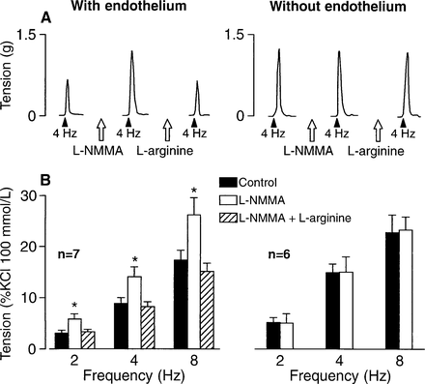
Figure 2. Graphs of the effects of irbesartan 75 mg/kg body wt/day on body weight (A), serum cholesterol (B), systolic ...
Notes:
Figure 2. Graphs of the effects of irbesartan 75 mg/kg body wt/day on body weight (A), serum cholesterol (B), systolic blood pressure (C), and heart rate (D) in Watanabe heritable hyperlipidemic rabbits.
Unless provided in the caption above, the following copyright applies to the content of this slide: © American Journal of Hypertension, Ltd. 1999

