Slide 1
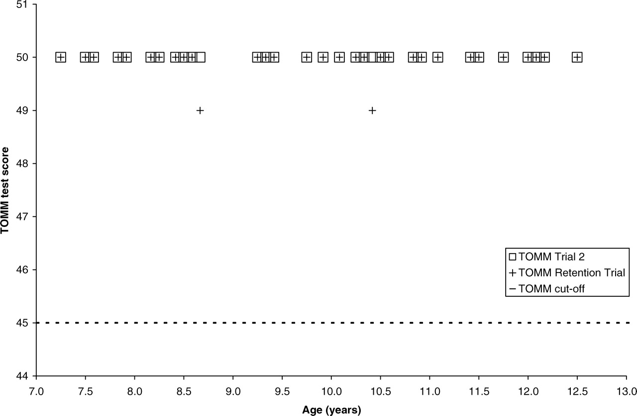
Fig. 1. Distribution Test of Memory Malingering (TOMM) scores by age.
Notes:
Fig. 1. Distribution Test of Memory Malingering (TOMM) scores by age.
Unless provided in the caption above, the following copyright applies to the content of this slide: © The Author 2010. Published by Oxford University Press. All rights reserved. For permissions, please e-mail: journals.permissions@oxfordjournals.org.

Slide 2
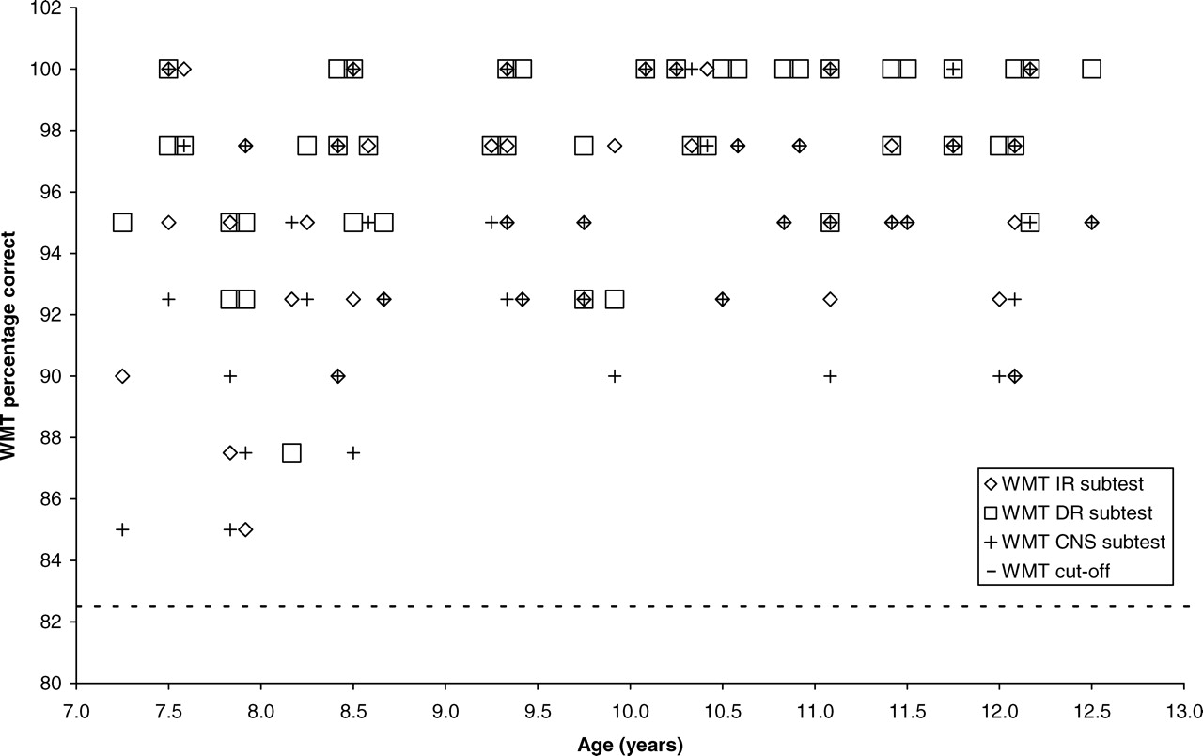
Fig. 2. Distribution Word Memory Test (WMT) subtest scores by age.
Notes:
Fig. 2. Distribution Word Memory Test (WMT) subtest scores by age.
Unless provided in the caption above, the following copyright applies to the content of this slide: © The Author 2010. Published by Oxford University Press. All rights reserved. For permissions, please e-mail: journals.permissions@oxfordjournals.org.

Slide 3
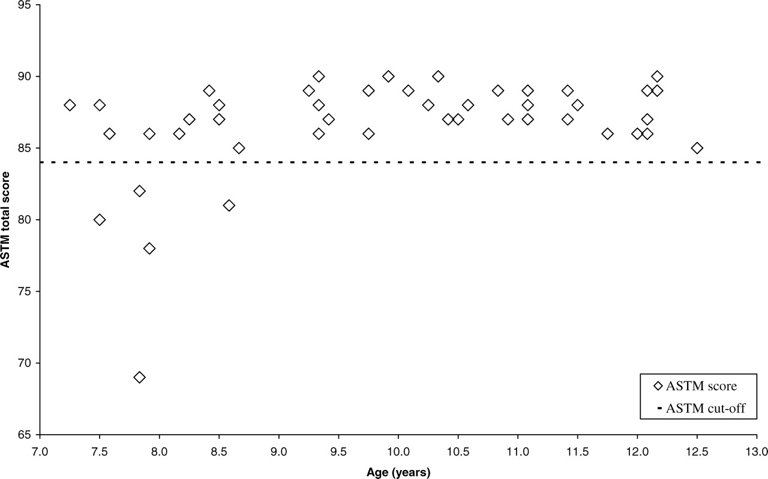
Fig. 3. Distribution Amsterdam Short-Term Memory (ASTM) test scores by age.
Notes:
Fig. 3. Distribution Amsterdam Short-Term Memory (ASTM) test scores by age.
Unless provided in the caption above, the following copyright applies to the content of this slide: © The Author 2010. Published by Oxford University Press. All rights reserved. For permissions, please e-mail: journals.permissions@oxfordjournals.org.

Slide 4
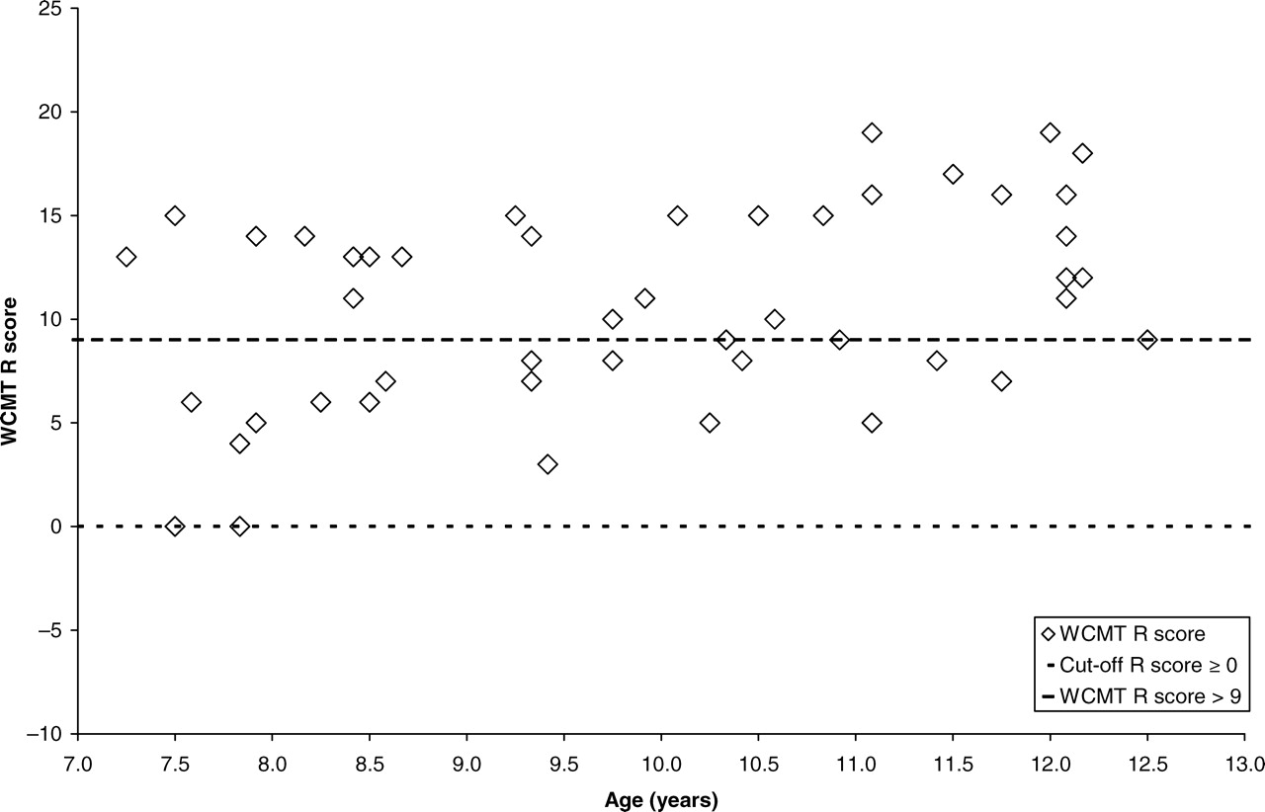
Fig. 4. Distribution Word Completion Memory Test (WCMT) scores by age.
Notes:
Fig. 4. Distribution Word Completion Memory Test (WCMT) scores by age.
Unless provided in the caption above, the following copyright applies to the content of this slide: © The Author 2010. Published by Oxford University Press. All rights reserved. For permissions, please e-mail: journals.permissions@oxfordjournals.org.

