Slide 1
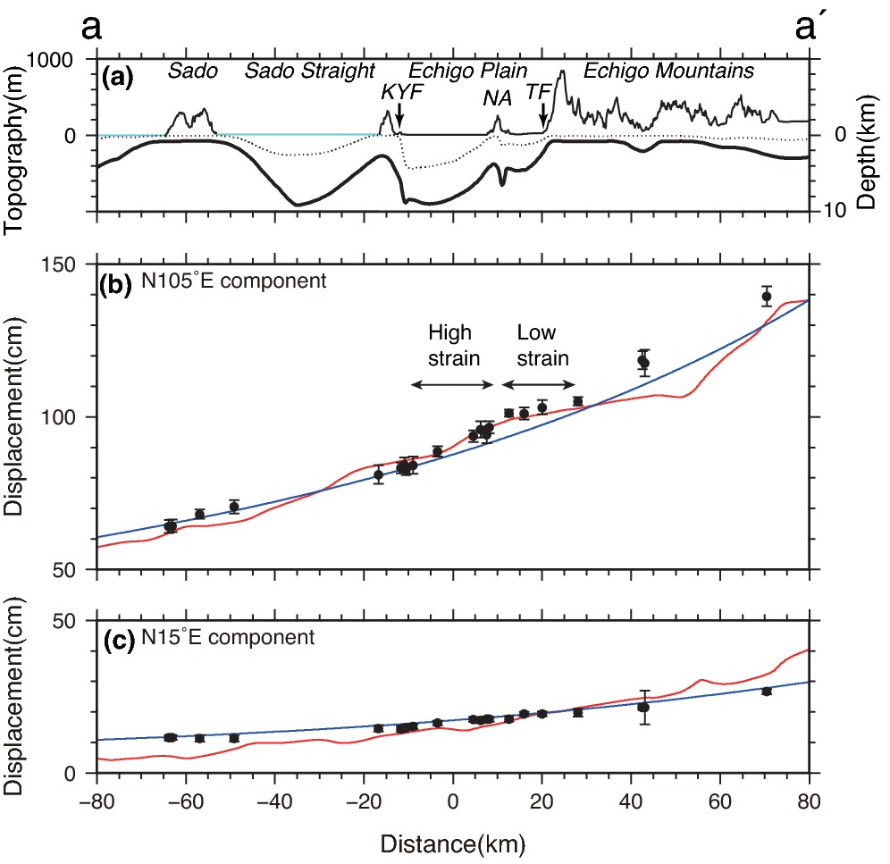
Figure 2. Displacement along profile a–a′ (Fig. 1) from 2010 to 2011. (a) Topography and subsurface structure along the ...
Notes:
Figure 2. Displacement along profile a–a′ (Fig. 1) from 2010 to 2011. (a) Topography and subsurface structure along the profile. Thin, dotted and thick lines show the elevation of topography and the depths for layers with Vs = 1.7 and 2.7 km s−1 in the J-SHIS structure model (Fujiwara et al.2008), respectively. Sky blue topography represents sea level. KYF, NA and TF denote the Kakuda-Yahiko fault, Niitsu anticline and Tsukioka fault, respectively. (b) Displacement components parallel to the profile (i.e. N105°E). Black circles represent the displacement observed at GNSS stations within 10 km of the profile between 2010 and 2011. Error bars represent 3σ. Blue and red curves are 1.28 times coseismic displacement of the Tohoku-oki earthquake predicted using homogeneous and heterogeneous structure models, respectively (see the text). Arbitrary offsets for calculated displacement are added to compare a spatial pattern of relative calculated displacement with that of the observed displacement. (c) Displacement perpendicular to the profile.
Unless provided in the caption above, the following copyright applies to the content of this slide: © The Authors 2016. Published by Oxford University Press on behalf of The Royal Astronomical Society.

Slide 2
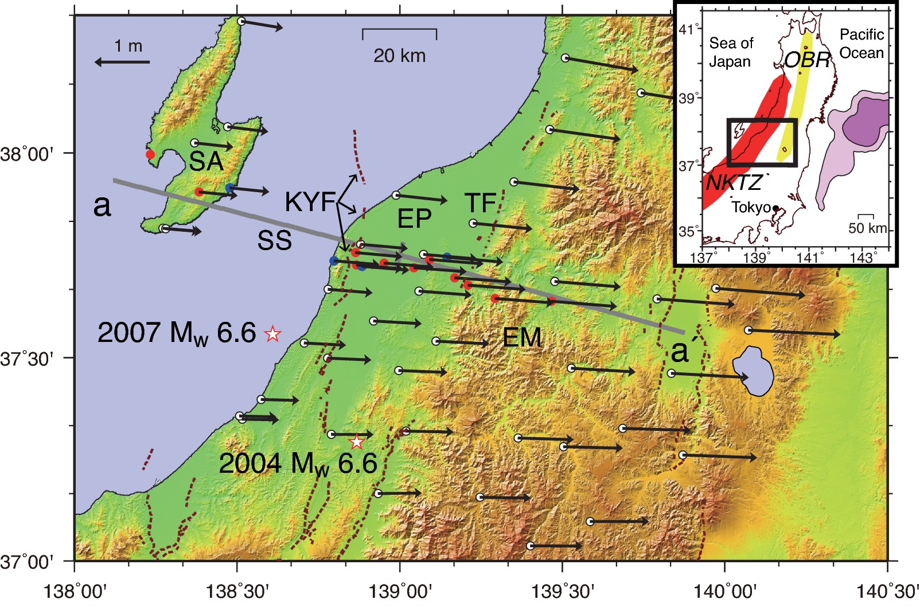
Figure 1. Displacement from 2010 to 2011, including coseismic displacement associated with the 2011 Tohoku-oki ...
Notes:
Figure 1. Displacement from 2010 to 2011, including coseismic displacement associated with the 2011 Tohoku-oki earthquake, observed at global navigation satellite system (GNSS) stations. Blue and red circles denote continuous and campaign GNSS stations, respectively, white circles denote continuous GNSS Earth Observation Network System (GEONET) stations and brown lines denote surface traces of active faults (Earthquake Research Committee, http://www.jishin.go.jp/main/index-e.html, last accessed 14 March 2016). SA, SS, EP, EM, KYF and TF denote the Sado, Sado Straight, Echigo Plain, Echigo Mountains, Kakuda-Yahiko fault and Tsukioka fault, respectively. The inset regional map shows the location of the study area enclosed in the black rectangle. The red and yellow shaded regions denote the Niigata-Kobe Tectonic Zone (NKTZ) and the Ou Backbone Range (OBR). Pale and bright pink regions represent the coseismic slip areas of the Tohoku-oki earthquake with ≥5 and ≥20 m slips, respectively (Ozawa et al. 2012).
Unless provided in the caption above, the following copyright applies to the content of this slide: © The Authors 2016. Published by Oxford University Press on behalf of The Royal Astronomical Society.

