Slide 1
Figure 1 Representative examples of left ventricular pressure–volume loops during caval occlusion. Dotted lines ...
Notes:
Figure 1 Representative examples of left ventricular pressure–volume loops during caval occlusion. Dotted lines represent the end-systolic pressure–volume relationship with slope Ees (index for systolic contractility and stiffness); dashed lines represent the end-diastolic pressure–volume relationship (EDPVR linear), the slope of which is an index of diastolic stiffness. The ob/ob mouse is characterized by large stroke volumes and large Ved and a depression of the Ees. In DKO mice, a leftward shift and steep slope of the end-systolic pressure–volume relationship and small stroke volumes and low Ved are observed. Also the slope EDPVR was steeper in these mice.
Unless provided in the caption above, the following copyright applies to the content of this slide: Published on behalf of the European Society of Cardiology. All rights reserved. © The Author 2007. For permissions please email: journals.permissions@oxfordjournals.org

Slide 2
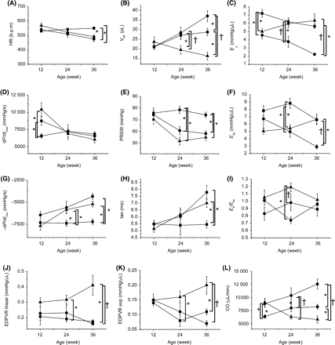
Figure 2 Baseline haemodynamic parameters. (A) Heart rate (HR), (B) end-diastolic volume (V_{ed}), (C) ...
Notes:
Figure 2 Baseline haemodynamic parameters. (A) Heart rate (HR), (B) end-diastolic volume (Ved), (C) arterial elastance (Ea), (D) dP/dtmax, (E) preload-recruitable stroke work (PRSW), (F) end-systolic elastance (Ees), (G) dP/dtmin, (H) τ, (I) ratio Ea/Ees, (J) end-diastolic pressure volume relationship fitted linearly (EDPVR linear), (K) end-diastolic pressure volume relationship fitted exponentially (EDPVR exp), and (L) cardiac output (CO) in WT (filled square), ob/ob (filled circle), and DKO (filled triangle) mice of 12, 24, and 36 weeks of age. Data are mean ± SEM. *P < 0.05 vs. WT, †P < 0.05 vs. ob/ob.
Unless provided in the caption above, the following copyright applies to the content of this slide: Published on behalf of the European Society of Cardiology. All rights reserved. © The Author 2007. For permissions please email: journals.permissions@oxfordjournals.org

Slide 3
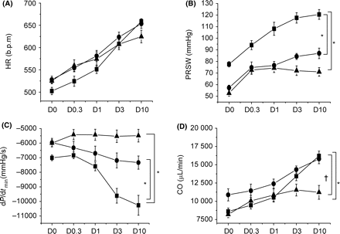
Figure 3 Cardiac performance during beta-adrenergic stimulation in 24 weeks old mice. Incremental doses of dobutamine ...
Notes:
Figure 3 Cardiac performance during beta-adrenergic stimulation in 24 weeks old mice. Incremental doses of dobutamine (D0–D10 µg/kg/min) were administered by continuous infusion to test cardiac reserve during stress. Dose-response curve for (A) heart rate (HR), (B) preload-recruitable stroke work (PRSW), (C) dP/dtmin, and (D) cardiac output (CO) in WT (filled square), ob/ob (filled circle), and DKO (filled triangle) mice. Whereas the chronotropic response was normal, ob/ob and DKO mice displayed an impaired inotropic and lusitropic response during dobutamine-infusion, as outlined by, respectively, PRSW and dP/dtmin. Data are mean ± SEM. *P < 0.05 vs. WT, †P < 0.05 vs. ob/ob.
Unless provided in the caption above, the following copyright applies to the content of this slide: Published on behalf of the European Society of Cardiology. All rights reserved. © The Author 2007. For permissions please email: journals.permissions@oxfordjournals.org

Slide 4
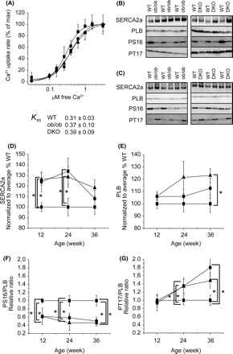
Figure 4 Analysis of the SR Ca²⁺ reuptake. (A) Oxalate supported Ca²⁺ uptake measurements in 36 ...
Notes:
Figure 4 Analysis of the SR Ca2+ reuptake. (A) Oxalate supported Ca2+ uptake measurements in 36 weeks old WT (filled square), ob/ob (filled circle), and DKO (filled triangle) mice. Ca2+ uptake rates are normalized to the maximal uptake rate of the group. (B and C) Representative examples of western blots of total ventricular homogenates. Blots were probed with antibodies to SERCA2a, PLB, PLB phosphorylated on Serine 16 (PS16) and PLB phosphorylated on Threonine 17 (PT17) in mice of 12 (B) and 36 (C) weeks of age. (D–G) The graphs show the relative expression levels obtained by western blots. Experiments were performed in triplicate (n = 6 for each group). Data are presented as mean ± SEM. * P < 0.05 vs. WT.
Unless provided in the caption above, the following copyright applies to the content of this slide: Published on behalf of the European Society of Cardiology. All rights reserved. © The Author 2007. For permissions please email: journals.permissions@oxfordjournals.org

Slide 5
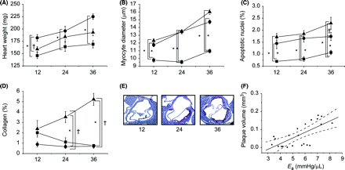
Figure 5 Histology. (A) Heart weight, (B) myocyte diameters, (C) levels of apoptosis, and (D) collagen accumulation in ...
Notes:
Figure 5 Histology. (A) Heart weight, (B) myocyte diameters, (C) levels of apoptosis, and (D) collagen accumulation in 12, 24, and 36 weeks old WT (filled square), ob/ob (filled circle), and DKO (filled triangle) mice. Data are presented as mean ± SEM (n = 5 for each group). *P < 0.05 vs. WT, †P < 0.05 vs. ob/ob. (E) Representative cross-sections of aortic arch from DKO mice at 12, 24, and 36 weeks. (F) Correlation of plaque volume with arterial elastance (Ea), as parameter for afterload.
Unless provided in the caption above, the following copyright applies to the content of this slide: Published on behalf of the European Society of Cardiology. All rights reserved. © The Author 2007. For permissions please email: journals.permissions@oxfordjournals.org

