Slide 1
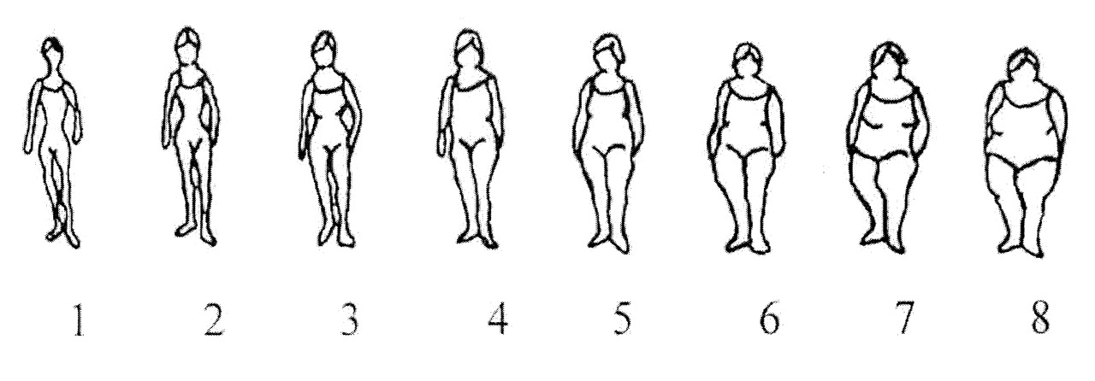
FIGURE 1. Body silhouettes used on the baseline questionnaire to assess body mass at various ages (as first ...
Notes:
FIGURE 1. Body silhouettes used on the baseline questionnaire to assess body mass at various ages (as first proposed by Sörensen et al. (22)), E3N Cohort Study, France, 1990–1993. The sihouettes are represented by figure drawings ranked from 1 to 8, corresponding to increasing body size (from the leanest to the largest). Women reported the drawing that reflected their perceived body size at a specific age (at approximately age 8 years, at menarche, at age 20–25 years, at age 35–40 years, and at the time of completion of the questionnaire). Because few women reported having a silhouette larger than 5, the eight silhouettes were further ranked from 1 to ≥5, with the four largest silhouettes being grouped together.
Unless provided in the caption above, the following copyright applies to the content of this slide:

Slide 2
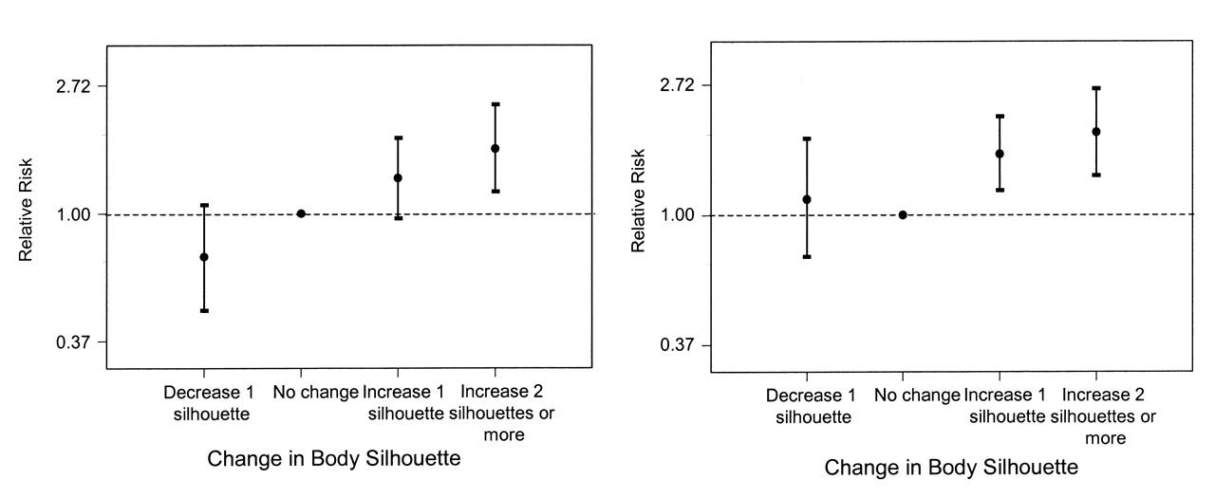
FIGURE 2. Relative risk of asthma incidence among adult women according to change in body silhouette between ...
Notes:
FIGURE 2. Relative risk of asthma incidence among adult women according to change in body silhouette between menarche and baseline (left) and between age 20 years and baseline (right), E3N Cohort Study, France, 1990–1993. Point estimates (circles) and 95% confidence intervals (bars) are presented on a loge scale. Relative risks were adjusted for age, total caloric intake, physical activity, smoking status, menopausal status, use of vitamin supplements, and body silhouettes at menarche and age 20 years, respectively.
Unless provided in the caption above, the following copyright applies to the content of this slide:

